Slide 1
Environmental Sound Classification
Team Members :
V Noothan [CB.SC.U4AIE24156]
M THEJESWARA REDDY [CB.SC.U4AIE24129]

Slide 2
Introduction :
Environmental Sound Classification identifies and categorizes sounds like traffic noise, alarms, and
footsteps.
Deep Neural Networks (DNNs) enhance Environmental Sound Classification by learning complex patterns from
audio data, improving classification accuracy.
Using features like Mel-Frequency Cepstral Coefficients (MFCCs), DNNs effectively distinguish different sound
categories for applications in surveillance, healthcare.

Slide 3
Objectives :
To develop a Deep Neural Network (DNN)-based model for accurately classifying environmental sounds.
To extract and utilize Mel-Frequency Cepstral Coefficients (MFCCs) as key audio features for improved
classification.
To train and evaluate a neural network for accurate sound classification.
To enhance real-world applications like smart surveillance, healthcare monitoring.

Slide 4
Methodology :
Dataset Selection:
We are using UrbanSound8K dataset to get audio data for our project which contains labelled environmental sound clips .
Data Preprocessing:
We are loading audio files using Librosa library to read the “.wav” form files.
We are using MFCC (Mel-Frequency Cepstral Coefficients) as extracted features to differentiate between 2 different audio clips.
Encoded class labels and split data into training (80%) and testing (20%) sets.
Model Development:
We are implementing a Deep Neural Network (DNN) using TensorFlow and Keras.
We are using “ReLU” for activation of hidden layers and Softmax for classification .
Applied Dropout layers to prevent overfitting.

Slide 5
Model Training & Evaluation :
Trained with “cross-entropy loss” means it acts as a loss function which measures how well the predicted class matches the actual labels.
We are using “ReLu Optimizers” during model training for faster and better accuracy.
Prediction & Testing :
Tested the model with unseen audio samples because we already divided the data into training and testing so that the model’s accuracy can be tested with the data which it never seen.
The model analyses the audio and predicts the sound class with the highest probability as final prediction.

Slide 6
Comparison with previous models
1st one:
Unlike in some papers where they are using “zero padding” method i.e. adding zeroes at the extracted mfcc feature vectors to create a same length vectors we are using “Librosa” library to get the average of the extracted mfcc feature over time to
create a fixed length vector. The advantage of doing this with Librosa library is we can prevent the data loss of mfcc features.
2nd one:
In some other models in the papers they are using CRNN (Convolutional Recurrent Neural Networks) where there are hyper parametres such as number of layers , filter count, batch size etc. which improves model’s performance but these are limited only to the dataset which we provide and not mostly usable in real-time situation because it takes more time to process the data which we provide so it decreases the model’s ability to perform in real-time so we are using simple but effective way of training a model by DNN which takes less time to process the data.

Slide 7
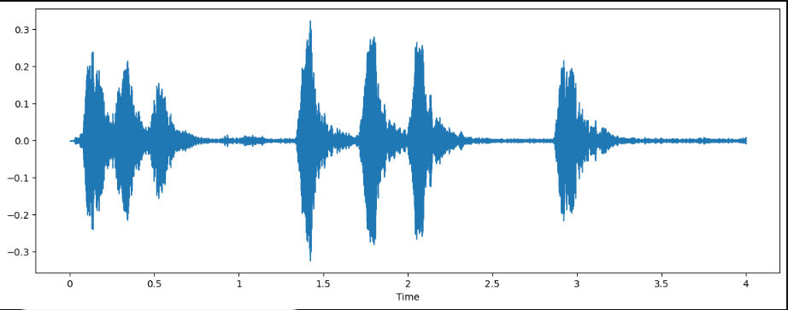
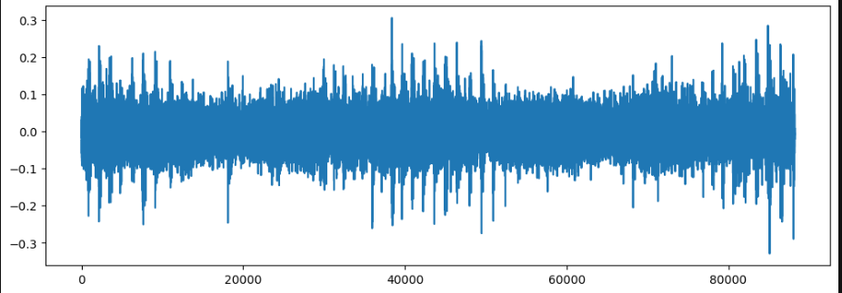
Results:
We are able to represent audio data into two different forms.
First one by using “Librosa” library time vs amplitude.
Second one by using “Matplotlib” library sample index vs amplitude.

Slide 8
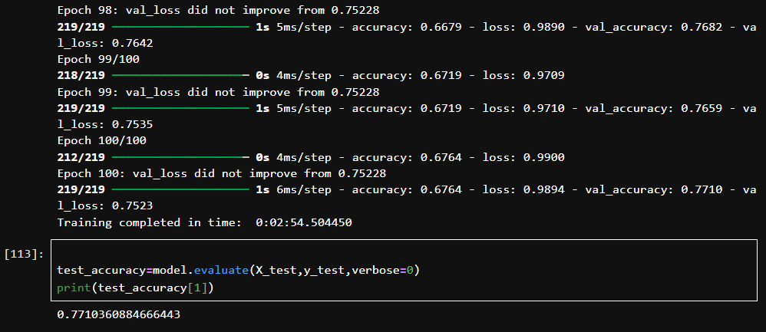
We have runned the code upto 100 epochs and we got the training accuracy as 67.64 % and we got testing accuracy as
77.103 %.

Slide 9
Limitations:
Like every model have some draw backs our model has also some major draw backs.
Although it process the data relatively faster than some other models but it lacks precision.
Extraction of audio features are very tough because they contains so many noises from the surrounding while removing
those noises some of the data might be lose.

Slide 10
Future scope:
We are trying to develop or improve the model to increase the accuracy of the model
We are also trying to change the activation layers, and number of dense layers to effectively train the model for better
Performance.

Slide 11
Concepts of MFC involved in this project:
Audio data is visualized in terms of vectors and the extracted MFCC features are visualized in terms of matrices
We are using transpose of the matrices to get the mean or average values of the columns across time values

Slide 12
THANK YOU

