Slide 1





THEJESWINI V
NM id: au711721243116
Final Project
1

Slide 2

PROJECT TITLE
Building a Chatbot Using Keras
2

Slide 3



AGENDA
PROBLEM STATEMENT
PROJECT OVERVIEW
WHO ARE THE END USERS?
YOUR SOLUTION AND ITS VALUE PROPOSITION
THE WOW IN YOUR SOLUTION
MODELLING
RESULTS
3

Slide 4

PROBLEM STATEMENT
Develop an intelligent conversational agent system using natural language processing (NLP) techniques and deep learning to accurately interpret user intents and generate contextually relevant responses. The primary objective is to create a chatbot capable of effectively categorizing user input into distinct intents and providing appropriate replies, thereby enhancing the user experience across various interactive platforms.
4

Slide 5

PROJECT OVERVIEW
This project aims to develop a chatbot utilizing the Keras deep learning framework.
The chatbot will undergo training to comprehend user intents from text inputs and generate appropriate responses.
The process involves preprocessing a dataset, crafting a neural network architecture using Keras layers such as Embedding and Dense, training the model to discern intents, and finally deploying the chatbot for interactive applications.
The objective is to create a functional and agile conversational agent employing Keras for natural language understanding and response generation.
5

Slide 6
WHO ARE THE END USERS?
Customers: Within customer service applications, end users seek information, assistance, or support. The chatbot handles common queries, provides product information, troubleshoots issues, and offers basic services.
Website Visitors: When integrated into websites, end users are the visitors who use the chatbot to ask questions, navigate the site, request help, or engage in interactive experiences.
Mobile App Users: For chatbots deployed within mobile applications, end users are the app users accessing functionalities like asking questions, receiving recommendations, or accessing personalized services through the app interface.
Employees: In internal business applications, employees utilize chatbots for HR inquiries, IT support, knowledge base access, scheduling, or workflow automation within the organization.
Students or Learners: Within educational contexts, students or learners utilize chatbots for learning support, accessing course materials, receiving study tips, or engaging in interactive learning experiences.
General Public: In public-facing applications like information portals, news platforms, or entertainment services, the general public uses chatbots to seek information, updates, recommendations, or entertainment through the chatbot interface.
6

Slide 7
YOUR SOLUTION AND ITS VALUE PROPOSITION
Solution:
Objective Definition: Clearly define the chatbot's purpose and target audience to align its functionalities and features effectively, ensuring it meets the specific needs of end users across different contexts.
Technology Stack Selection: Choose appropriate tools and frameworks such as Keras to efficiently develop and integrate natural language processing capabilities, enabling the chatbot to understand user inputs and generate relevant responses.
Data Preprocessing: Ensure data quality through normalization and tokenization techniques, optimizing inputs for training and improving the accuracy of the chatbot model. This ensures that the chatbot can effectively comprehend user queries and provide accurate responses.
Model Training: Utilize deep learning techniques to train the chatbot model, adjusting parameters to enhance language understanding and response generation. This empowers the chatbot to continuously improve its performance and adapt to evolving user needs.
Integration and Testing: Integrate the trained model into the deployment platform and conduct rigorous testing to validate its functionality and performance. By refining the chatbot based on user feedback, it ensures optimal performance and enhances the overall user experience.
7

Slide 8
YOUR SOLUTION AND ITS VALUE PROPOSITION
Value Proposition:
Cost Efficiency: By leveraging Keras and deep learning technologies to build a chatbot, organizations can realize cost savings by automating tasks such as customer support, data entry, and information retrieval, reducing the need for human intervention and associated labor costs.
Improved Operational Efficiency: The chatbot enhances operational efficiency by handling routine interactions, allowing human resources to focus on more strategic tasks. This streamlining of processes leads to smoother workflows and increased productivity within the organization.
Data Insights and Analytics: The chatbot generates valuable insights from user interactions, including frequently asked questions, user preferences, and sentiment analysis. These insights enable data-driven decision-making, inform product/service improvements, and guide marketing strategies for better results.
Enhanced Customer Service: With 24/7 support, consistent responses, and personalized recommendations, a well-designed chatbot improves customer satisfaction and loyalty. This strengthens the brand's reputation and fosters positive customer relationships, ultimately driving business growth.
Competitive Advantage: Embracing AI-driven solutions like chatbots demonstrates technological innovation and responsiveness to customer needs. It sets organizations apart in the market, attracting new customers and retaining existing ones by delivering superior user experiences and staying ahead of competitors.
7

Slide 9
THE WOW IN YOUR SOLUTION
Advanced NLP Techniques: Harness cutting-edge natural language processing techniques powered by Keras for precise language comprehension and context-aware responses, ensuring the chatbot delivers accurate and meaningful interactions.
Seamless Integration: Seamlessly integrate the chatbot into existing platforms and systems, elevating user experience and optimizing workflow efficiency. This frictionless integration enhances user engagement and satisfaction across various touchpoints.
Personalized Interactions: Implement machine learning algorithms to craft personalized interactions tailored to each user's preferences and needs. This personalized touch enhances user engagement, fosters brand loyalty, and drives conversion rates.
Continuous Learning: Empower the chatbot to learn and evolve continuously through feedback loops and adaptive algorithms. By incorporating user feedback and adapting to changing contexts, the chatbot continuously improves its performance and relevance.
Scalability and Performance: Architect a scalable infrastructure that ensures high performance even under increased user loads, guaranteeing a seamless and responsive chatbot experience at any scale. This scalability ensures the chatbot can grow with your business and accommodate expanding user bases without compromising performance.
8

Slide 10
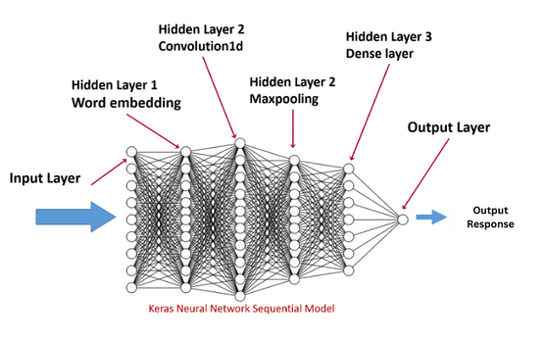
MODELLING
The Keras-based model begins by tokenizing and encoding input text data into numerical sequences. These sequences undergo transformation in an embedding layer, converting words into dense vectors that capture semantic relationships. Following this, subsequent layers such as LSTM or Dense layers analyze these embeddings to extract patterns and understand the underlying structure of the text data. During training, the model adjusts its parameters via backpropagation to minimize the loss function, thereby improving its ability to accurately classify intents or generate responses. To prevent overfitting and enhance generalization, regularization techniques like dropout are utilized. Once trained, the model can classify new input text by predicting the most likely intent or generating contextually relevant responses based on learned patterns, delivering a smooth and intelligent conversational experience within the chatbot system.
9

Slide 11
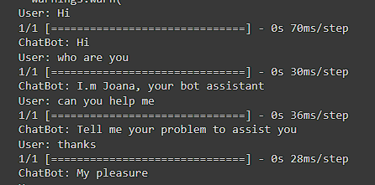
RESULTS
10

