Slide 1
FitPulse
Health Anomaly Detection from Fitness Devices
Thejomayie K
Batch 13

Slide 2
Project Overview – Fitpulse
The Problem
Our Solution — FitPulse
Wearables generate massive health data — but nobody watches it.
• Millions of Fitbit users track their heart rate, steps and sleep daily — yet most anomalies go unnoticed.
• Irregular heartbeats, sleep disturbances and abnormal activity are early warning signs of serious health conditions.
• No tool exists to automatically flag these subtle patterns from raw CSV device exports.
• Healthcare providers lack a simple, visual way to review a patient’s wearable data history.
An AI-powered pipeline that detects health anomalies automatically.
• Upload raw Fitbit CSV files — FitPulse cleans, merges and analyses them automatically.
• 3 detection methods — threshold rules, residual ±σ, and DBSCAN — flag anomalies with reasons.
• Prophet forecasts next 30 days of HR, steps and sleep with confidence intervals.
• Interactive dashboard with date/user filters + one-click PDF and CSV export.

Slide 3
Project Objectives — What Each Milestone Delivers
M1
Data Preprocessing
M2
Feature Extraction
M3
Anomaly Detection
M4
Insights Dashboard
Objective
Turn raw Fitbit CSVs into a clean, analysis-ready dataset.
What We Do
Upload any fitness CSV file
Auto-fix dates, interpolate gaps, fill missing text
Inspect raw data and detect outliers via IQR Box Plot
Export cleaned CSV with zero missing values
Output: Clean dataset ready for M2
Objective
Extract patterns and model fitness behaviour from merged sensor data.
What We Do
Merge 5 Fitbit sensor files into one master dataset
TSFresh: extract 10 features from 196K+ HR readings
Prophet: 30-day forecast for HR, Steps and Sleep
KMeans + DBSCAN user clustering with PCA and t-SNE maps
Output: Features, forecasts and user clusters
Objective
Flag unusual health patterns in HR, steps and sleep automatically.
What We Do
Threshold rules: HR > 100 or < 50 bpm, Steps < 500/day
Residual ±2σ from 3-day rolling median baseline
DBSCAN structural outliers — user-level clustering
90%+ detection accuracy on simulated injected anomalies
Output: Flagged anomaly records with reasons
Objective
Deliver a live, filterable dashboard with one-click reports.
What We Do
6 live KPI cards: flags, HR, Steps, Sleep, users, peak day
Date range and per-user filters in the sidebar
Combined anomaly timeline and per-metric deep-dive tabs
Export: PDF report (9 sections) + full CSV anomaly log
Output: PDF and CSV reports for doctors and coaches

Slide 4
01
Upload CSV
User uploads a fitness tracking CSV file
01
02
Inspect
Preview raw data, check missing values & types
Milestone 1
03
Clean
Fix dates, interpolate numbers, fill categories
Data Collection &
Preprocessing
04
Visualise
Detect outliers with Box Plot & Histogram

Slide 5
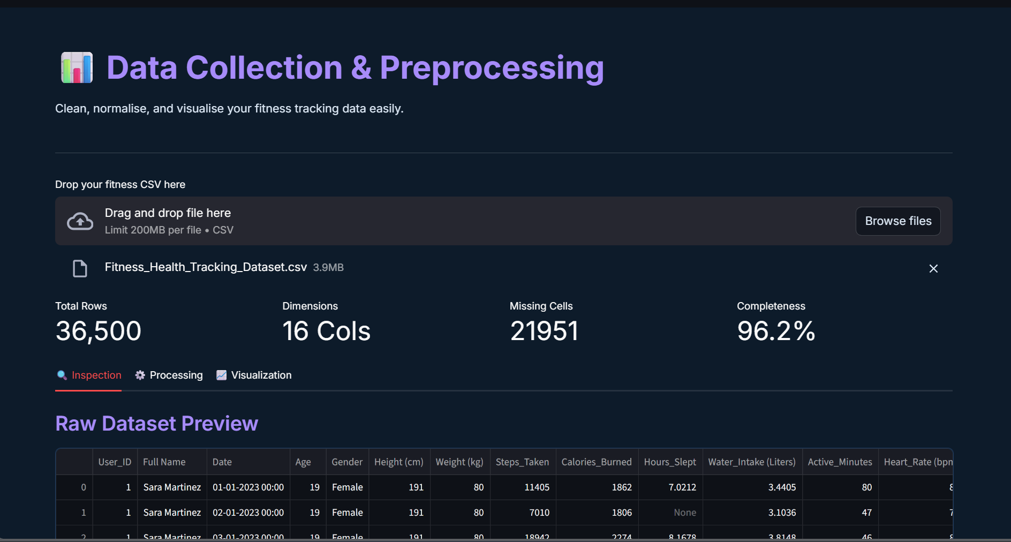
Milestone 1 — Key Features
🔍 Data Inspection
Raw dataset preview — first 10 rows
Missing values bar chart per column
Data types table for all columns
4 summary metrics — rows, columns, missing, completeness

Slide 6
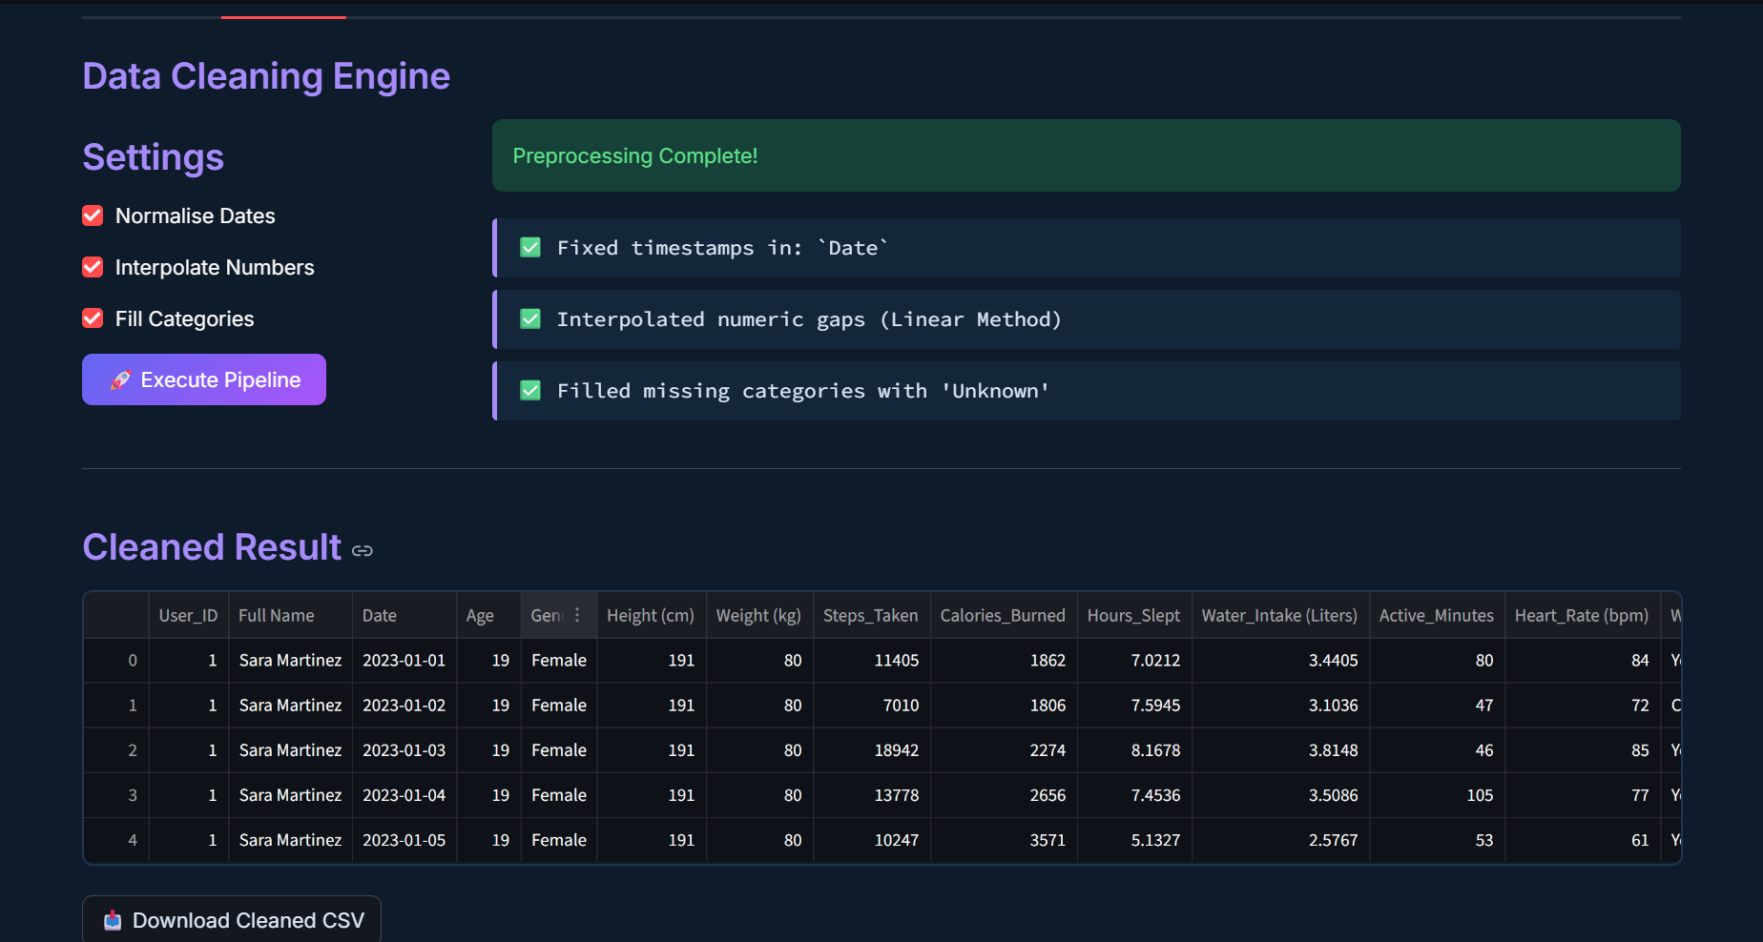
Milestone 1 — Key Features
🧹 Data Cleaning Engine
Normalise date columns to proper format
Interpolate missing numeric values (linear method)
Fill empty text columns with 'Unknown'
Download cleaned CSV after processing

Slide 7
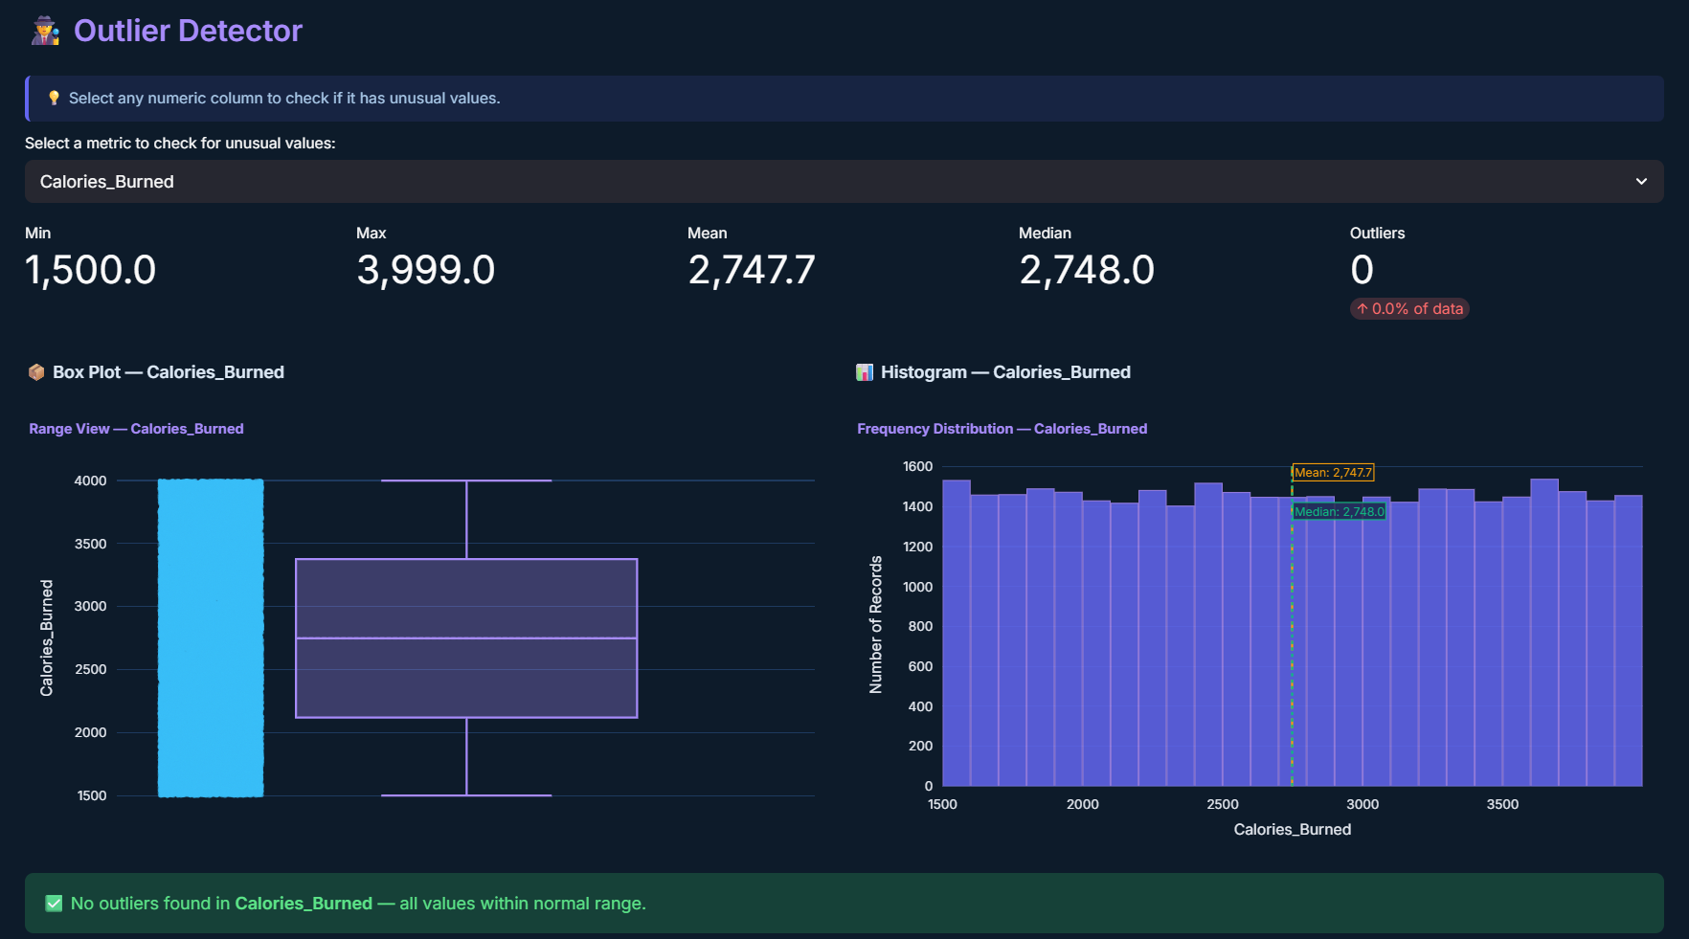
Milestone 1 — Key Features
📈 Outlier Detection
IQR method — Q1, Q3, and 1.5×IQR rule
Box plot — shows normal range and outlier dots
Histogram — frequency distribution with outlier zones
Mean and Median reference lines on histogram

Slide 8
01
5 Files Merged
Daily activity, heart rate, sleep, steps, hourly intensity
02
02
TSFresh
Extract 10 features from 196K+ heart rate readings
Milestone 2
03
Prophet Forecast
Predict next 30 days — heart rate, steps, sleep
Feature Extraction
& Modelling
04
Clustering
KMeans + DBSCAN + PCA + t-SNE group visualisation

Slide 9
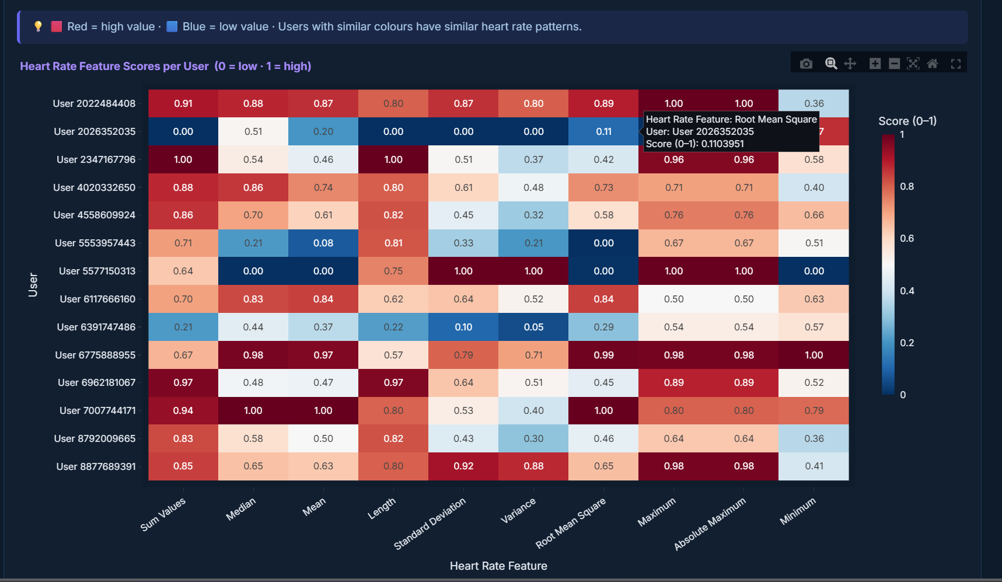
Milestone 2 — Data Pipeline & Feature Extraction
🔬 TSFresh Feature Extraction
196,537 heart rate readings → 10 features per user
Features: Mean, Median, Variance, Max, Min, Standard Deviation, Root Mean Square, Sum, Absolute Max, Length
MinimalFCParameters used for speed
Results shown as normalised heatmap (0 = lowest, 1 = highest among all users)
Why heart rate only? Steps & sleep are already 1 number per day. Heart rate has 50,000+ raw readings that need summarising.

Slide 10
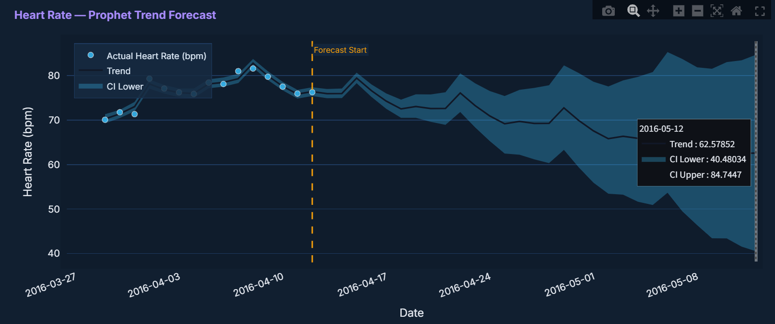
Prophet Forecasting
What is Prophet?
Prophet is a Facebook-developed time series forecasting tool. It looks at historical data and predicts future values while accounting for weekly seasonality and uncertainty.
💓 Heart Rate
Daily average heart rate
Teal dots = actual values
Teal shaded band = 80% CI
30-day forecast · 80% Confidence Interval shown · CI Upper & Lower visible on hover · Orange dashed line = forecast start

Slide 11
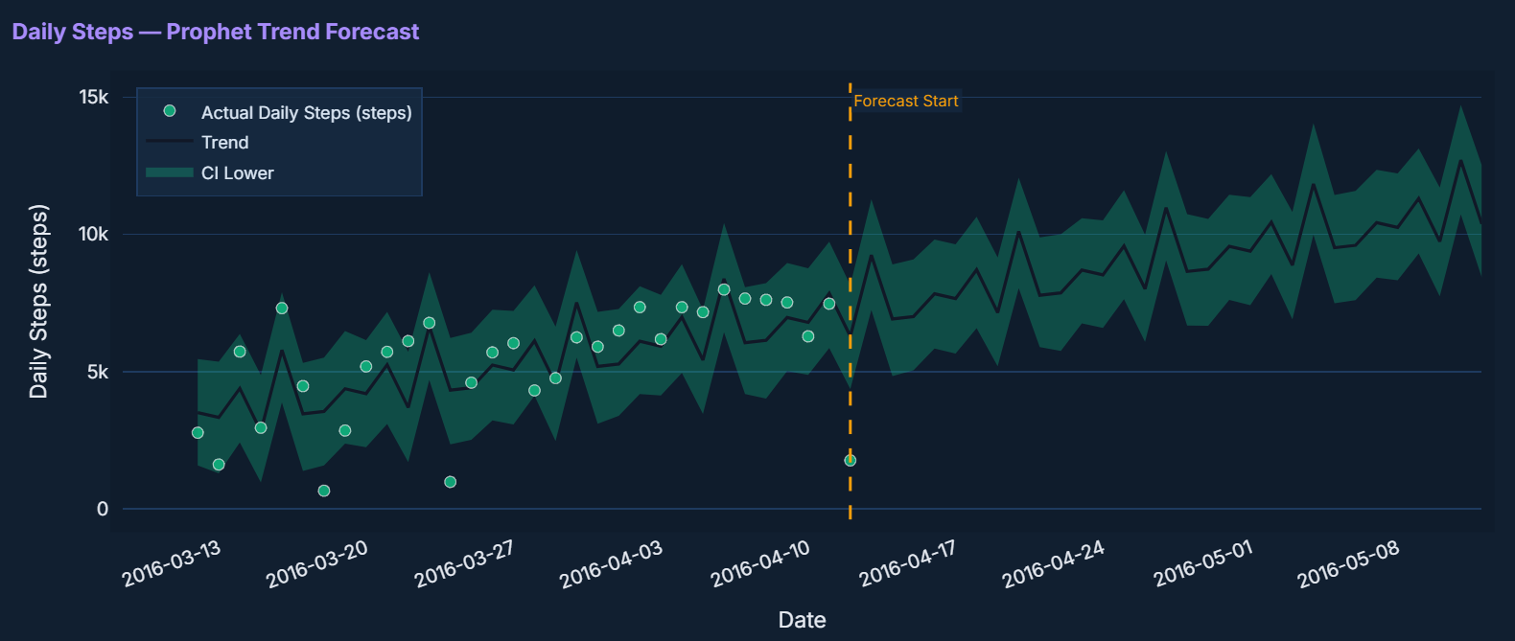
Prophet Forecasting
👟 Daily Steps
Average steps per day
Green dots = actual values
Green shaded band = 80% CI
30-day forecast · 80% Confidence Interval shown · CI Upper & Lower visible on hover · Orange dashed line = forecast start

Slide 12
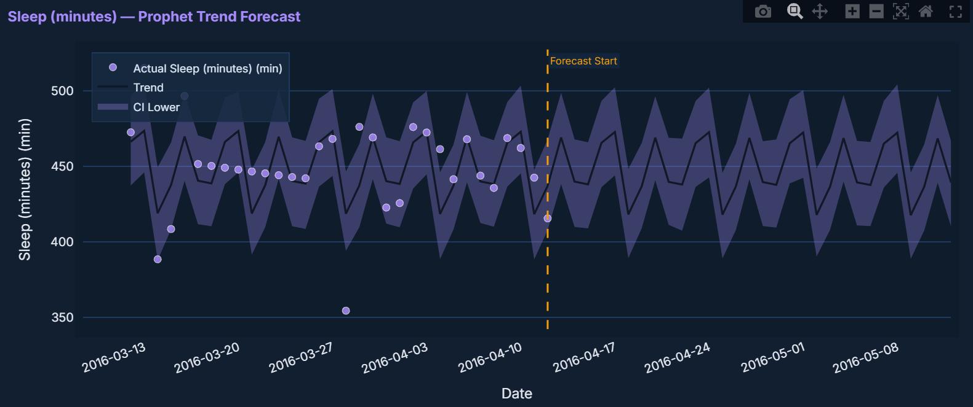
Prophet Forecasting
😴 Sleep
Total sleep in minutes/day
Purple dots = actual values
Purple shaded band = 80% CI
30-day forecast · 80% Confidence Interval shown · CI Upper & Lower visible on hover · Orange dashed line = forecast start

Slide 13
User Clustering & Visualisation
KMeans
Visualisation Methods
You choose number of groups (k)
PCA
Use Elbow Chart to find best k
Squashes 20+ columns into 2 dimensions so we can plot users on a chart. Dimension 1 = 50% info.
Every user forced into exactly one group
Groups: Highly Active / Moderate / Sedentary
t-SNE
Better than PCA at separating close groups visually. Takes ~20 seconds to compute.
DBSCAN
Auto-detects number of groups
eps = friendship radius between users
Group Profiles
Outliers = users who don't fit any group
Bar chart showing average steps, sleep, calories, heart rate per group side by side.
Grey dots = outliers on the chart

Slide 14
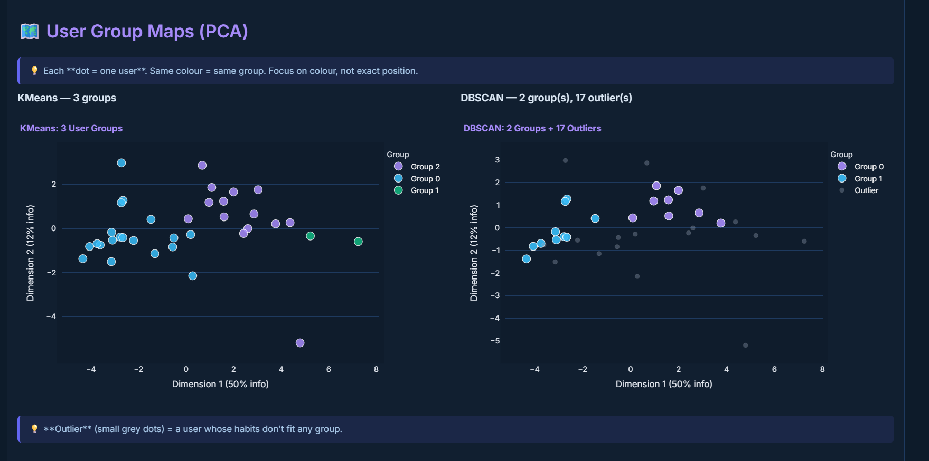
Output Screenshots:
Clustering – K-means and DBSCAN

Slide 15
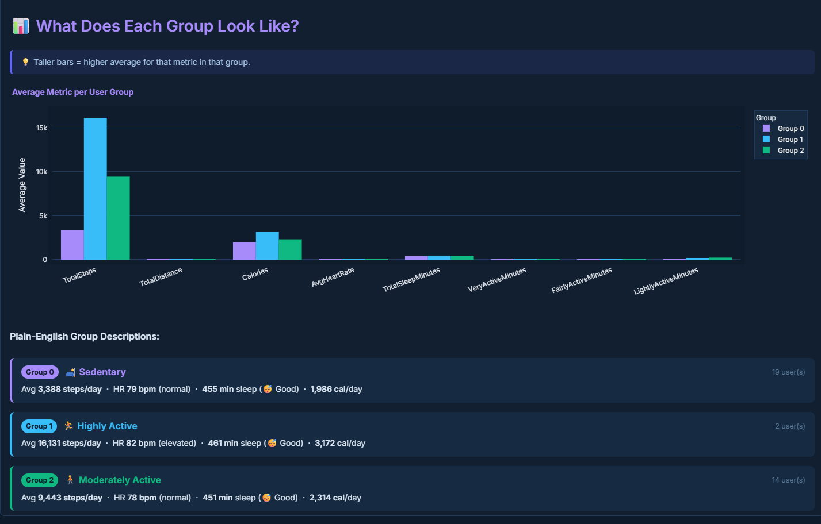
Output Screenshots:
Average values of groups – Bar Graph

Slide 16
Summary
✅
Loaded and cleaned 5 Fitbit sensor files
✅
Built a merged master dataset (one row per user per day)
✅
TSFresh extracted 10 features from 196K+ heart rate readings
✅
Prophet forecasted Heart Rate, Steps & Sleep for 30 days
✅
KMeans and DBSCAN clustered users by fitness behaviour
✅
PCA and t-SNE visualised groups in 2D plots

Slide 17
01
Upload the 5 CSV files
Upload to M3 pipeline
03
02
Threshold Violations
Hard-coded limits on HR, Steps & Sleep
Milestone 3
03
Residual-Based Detection
Rolling median ±2σ baseline anomalies
Anomaly Detection
& Visualization
04
DBSCAN Structural Outliers
Users with abnormal profiles across all metrics

Slide 18
Milestone 3 — Three Anomaly Detection Methods
📏 Threshold Violations
📊 Residual-Based Detection
🔵 DBSCAN Outlier Detection
01
02
03
Hard-coded upper and lower limits on Heart Rate, Steps, and Sleep. Simple, fast, and interpretable. Flags absolute out-of-range values immediately.
A 7-day rolling median is computed as the expected baseline. Any day where the actual value deviates by more than ±2 standard deviations is flagged as a statistical anomaly.
Machine learning clustering on aggregated user profiles. Users labelled -1 (do not fit any cluster) are structural outliers across all health dimensions.
Key Parameters:
Key Parameters:
Key Parameters:
Heart Rate: 40 – 120 bpm
Window: 7-day rolling median
eps = 2.5, min_samples = 2
Daily Steps: 1,000 – 25,000
Threshold: ±2 standard deviations
Per-user average profile
Sleep: 180 – 720 minutes
Detects sudden spikes / drops
Label -1 = structural outlier

Slide 19
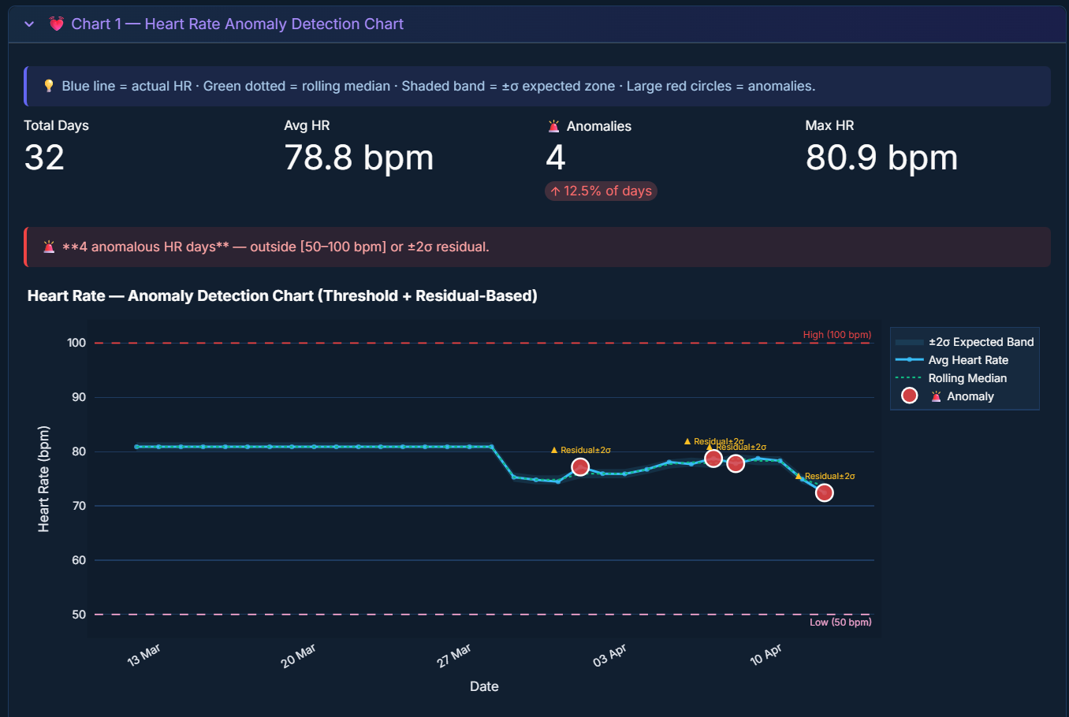
Output Screenshots:
Anomalies in Heart Rate

Slide 20
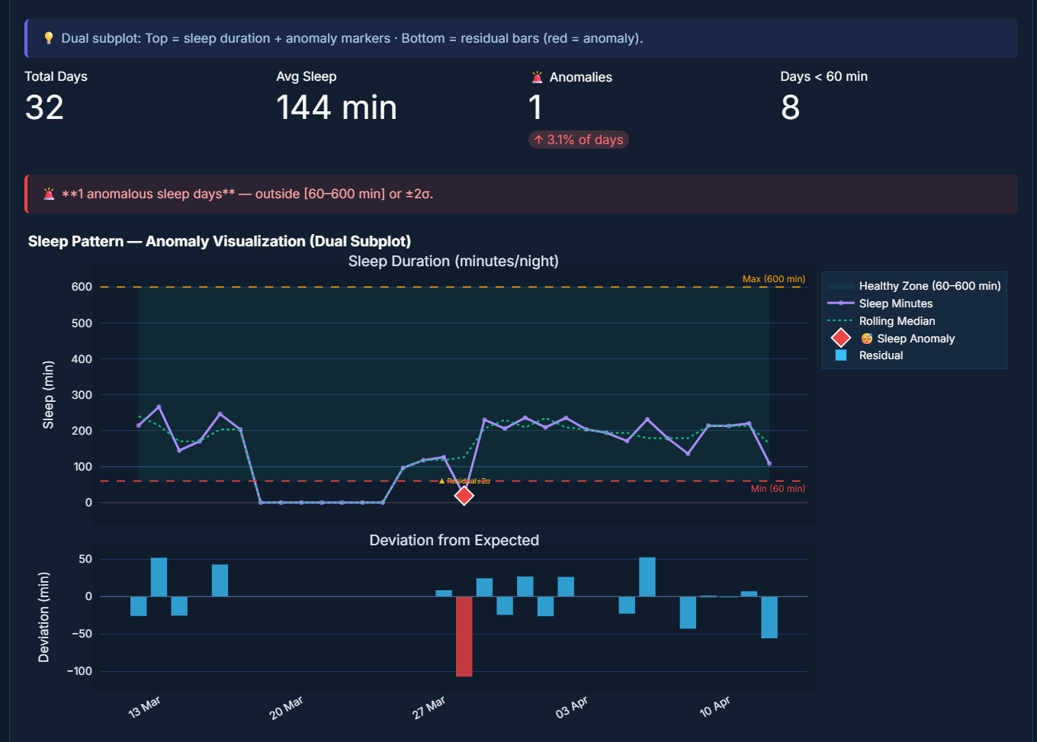
Output Screenshots:
Anomalies in Sleep Rate

Slide 21
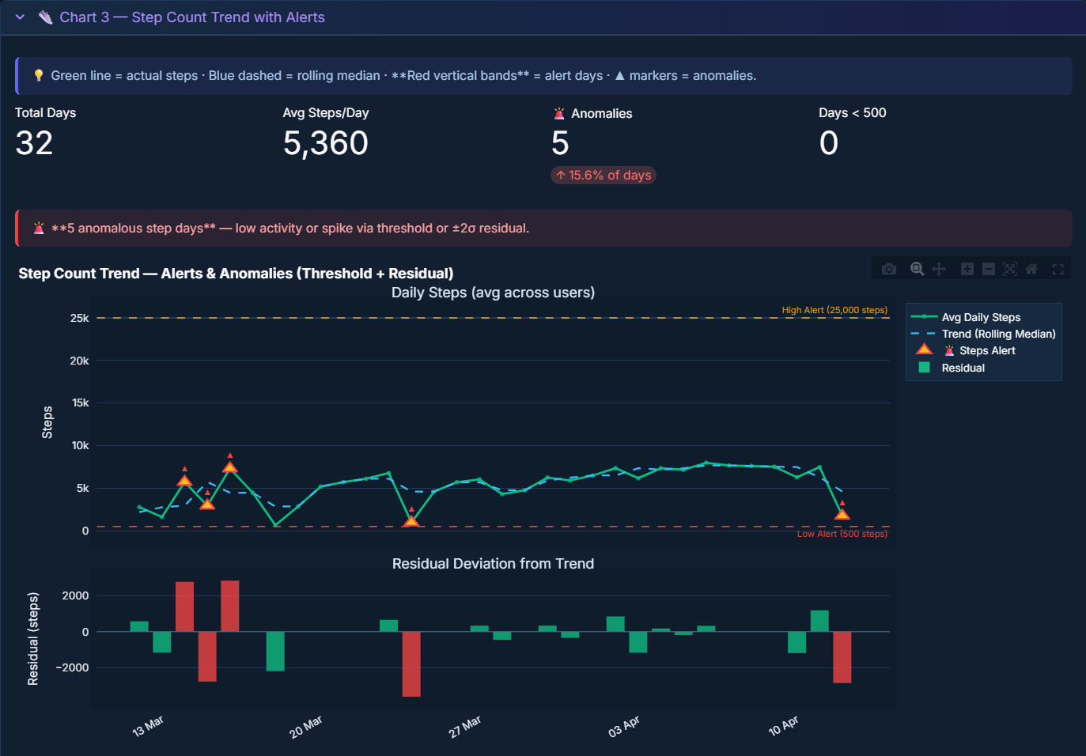
Output Screenshots:
Anomalies in Steps

Slide 22
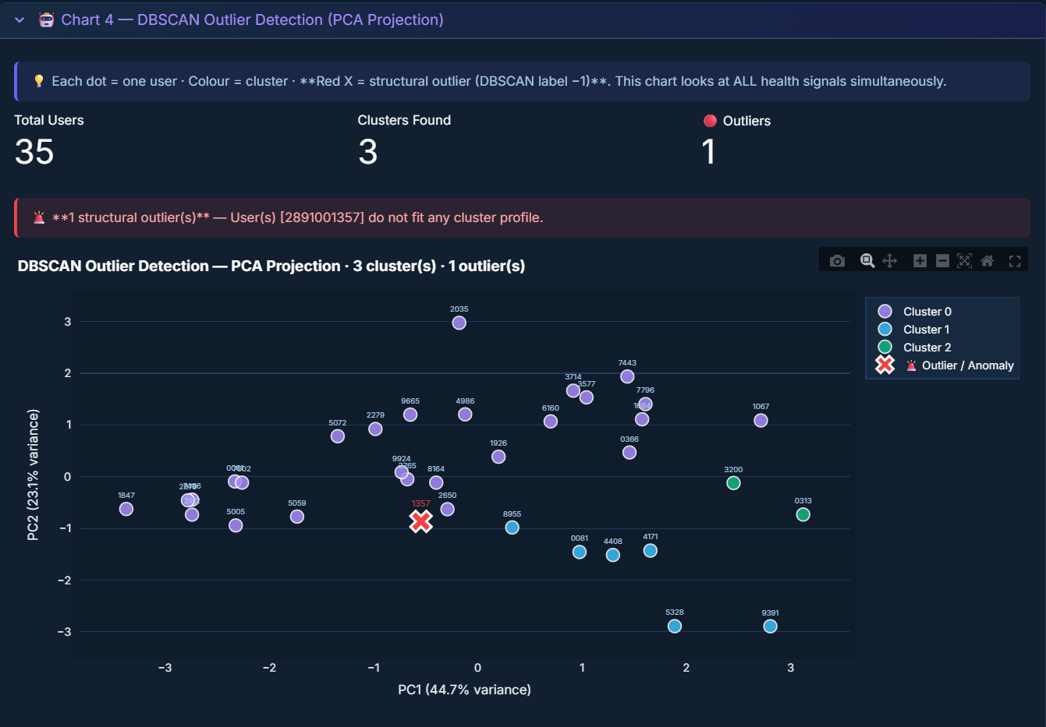
Output Screenshots:
DBSCAN Outliers

Slide 23
Milestone 3 — Summary
✅
Threshold violations: HR, Steps, Sleep vs hard-coded clinical limits
✅
Residual detection: 7-day rolling median ±2σ for all 3 metrics
✅
DBSCAN outliers: per-user profile clustering, label -1 = anomalous user
✅
Combined anomaly heatmap — days with multiple simultaneous alerts
✅
Downloadable anomaly report CSV with date, metric, value, method, and note
✅
PCA visualisation of structural outliers vs normal user clusters

Slide 24
01
Upload CSV
User uploads a fitness tracking CSV file
04
02
Overview
All anomaly timeline and log
Milestone 4
03
Anomaly Detection Dashboard
Statistics and anomaly record
Insights Dashboard
04
File Export
All anomaly record from three signals

Slide 25
Milestone 4 — Interactive Dashboard
✅
Auto-Detect File Upload
All 5 CSV files auto-detected by column structure. One-click pipeline trigger builds master dataset.
✅
Live KPI Dashboard
6 KPI cards: total flags, HR / Steps / Sleep anomalies, users, peak HR day.
✅
Date & User Filters
Sidebar date-range picker and per-user selector. All charts and tables update instantly.
✅
Combined Anomaly Timeline
Interactive scatter timeline showing all HR, Steps, Sleep anomaly events in one chart.
✅
PDF Report Export (ReportLab)
9-section PDF with anomaly tables, user profiles, methodology, and conclusions.
✅
CSV Anomaly Export
All anomaly records (signal, date, value, expected, deviation, reason) in one CSV.

Slide 26
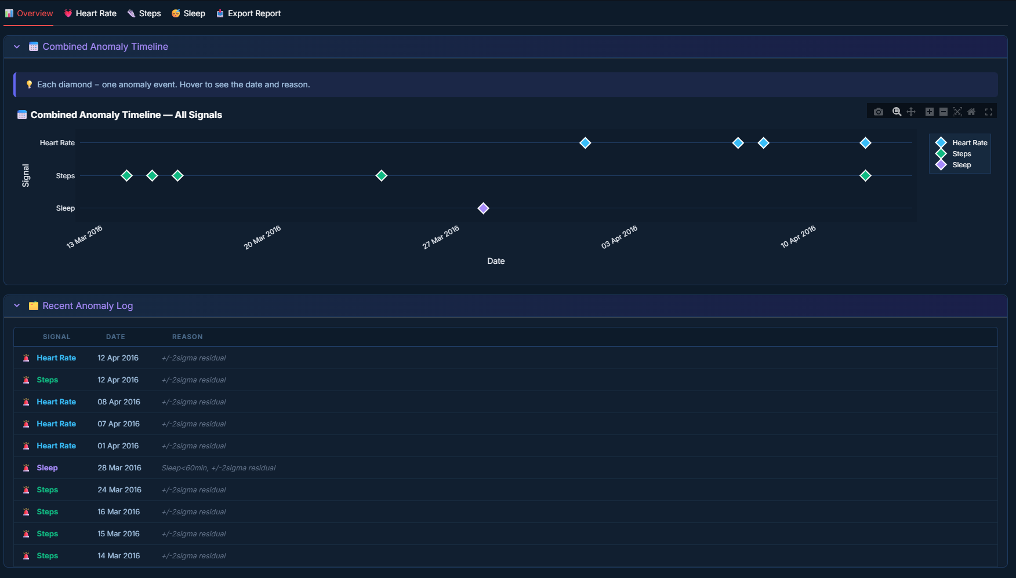
Milestone 4 — Dashboard Deep Dive
📊 Overview Tab
Combined Anomaly Timeline
Scatter plot (KPI Strips) showing HR (blue), Steps (green), Sleep (purple) anomaly events side by side on a shared timeline. Hover for date and reason.
Recent Anomaly Log
Last 15 anomaly events (newest first) in a live feed-style log with signal, date, and reason.
Deep-Dive Tabs
Separate tabs for Heart Rate, Steps, and Sleep with statistics panel + full anomaly records table.

Slide 27
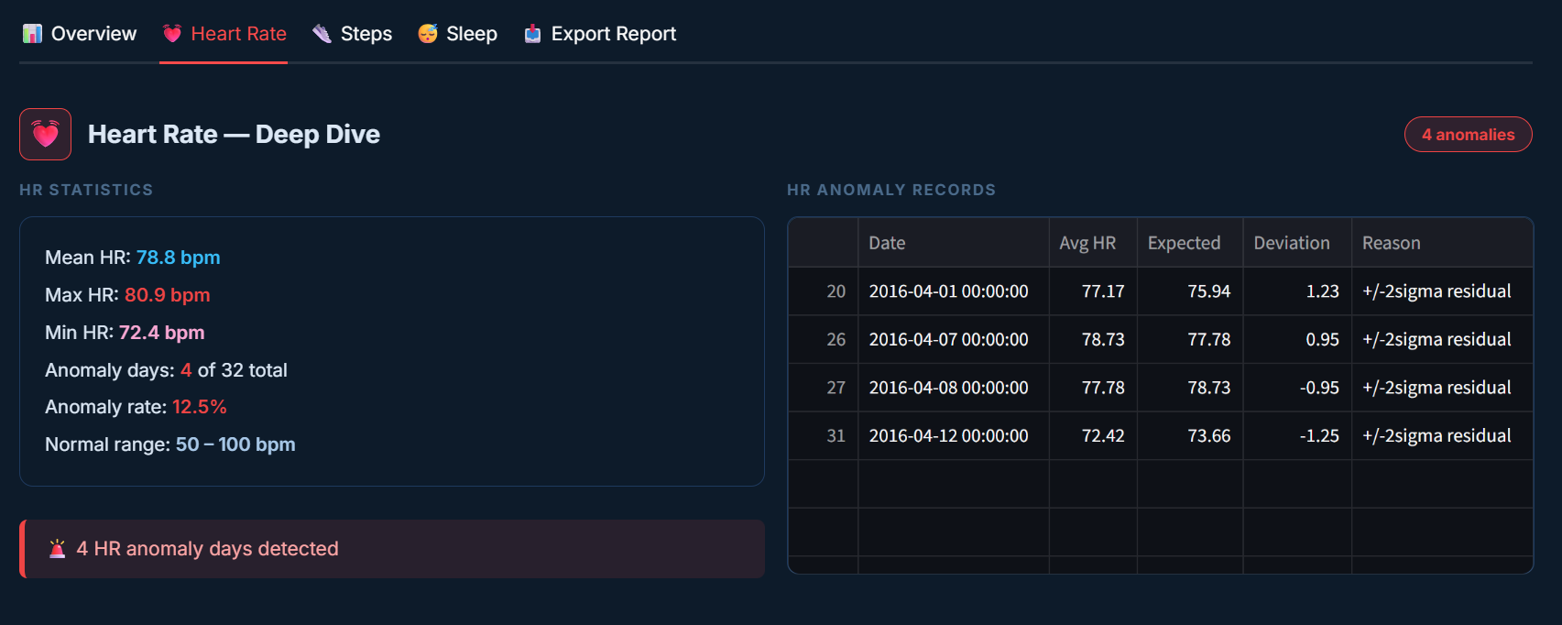
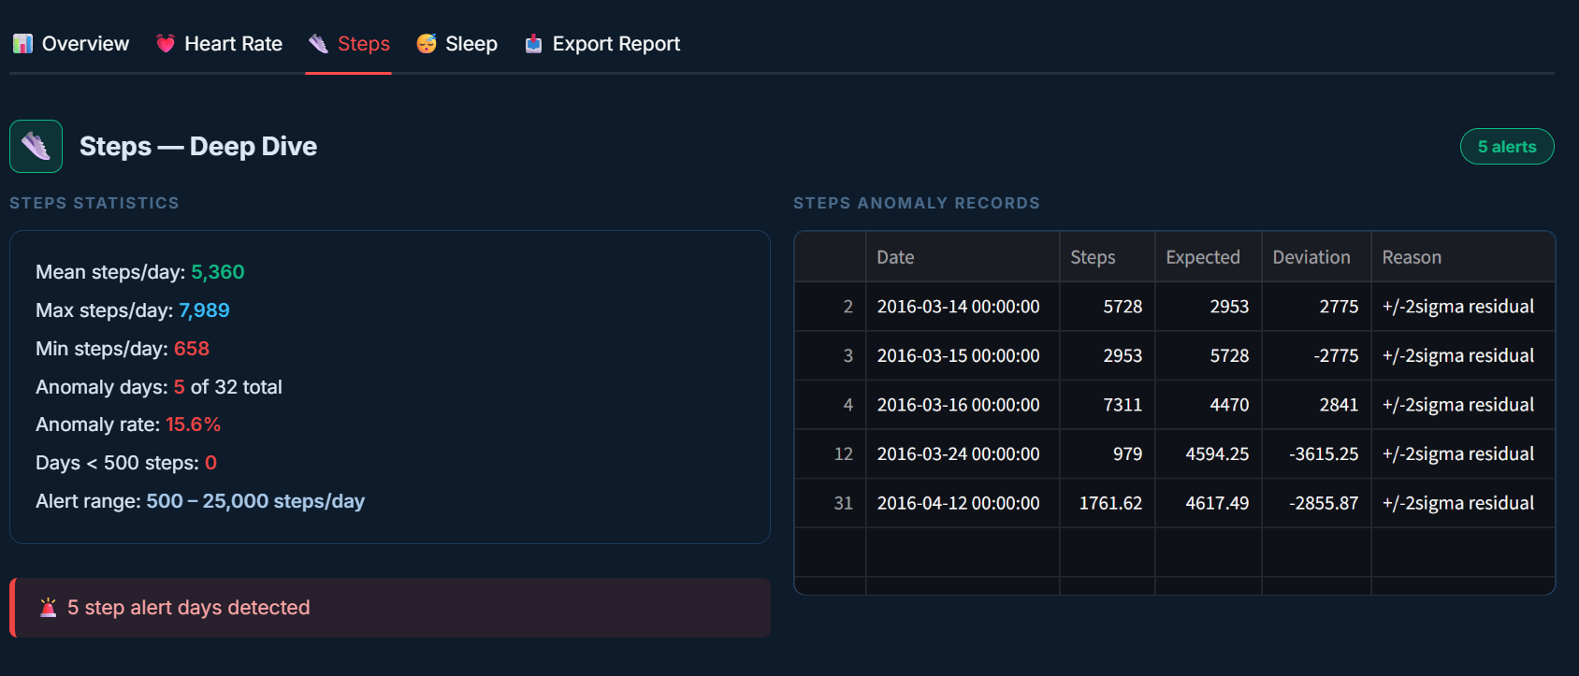
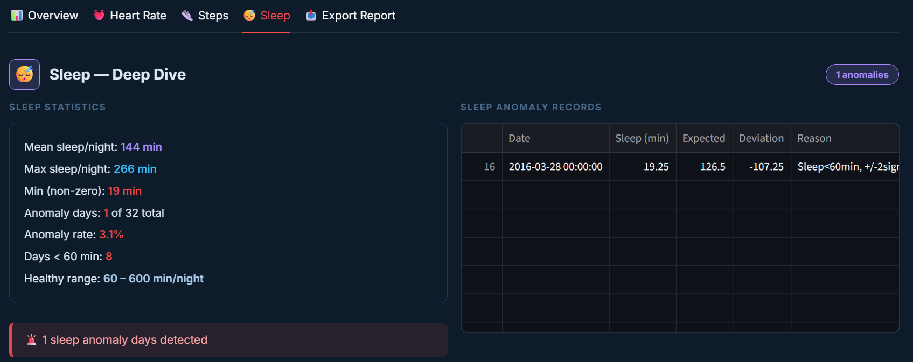
Milestone 4 — Dashboard Deep Dive
📊 Anomaly Detection Tab
Individual Statistics and Anomaly Records – For Heart Rate, Steps Count, Sleep Rate

Slide 28
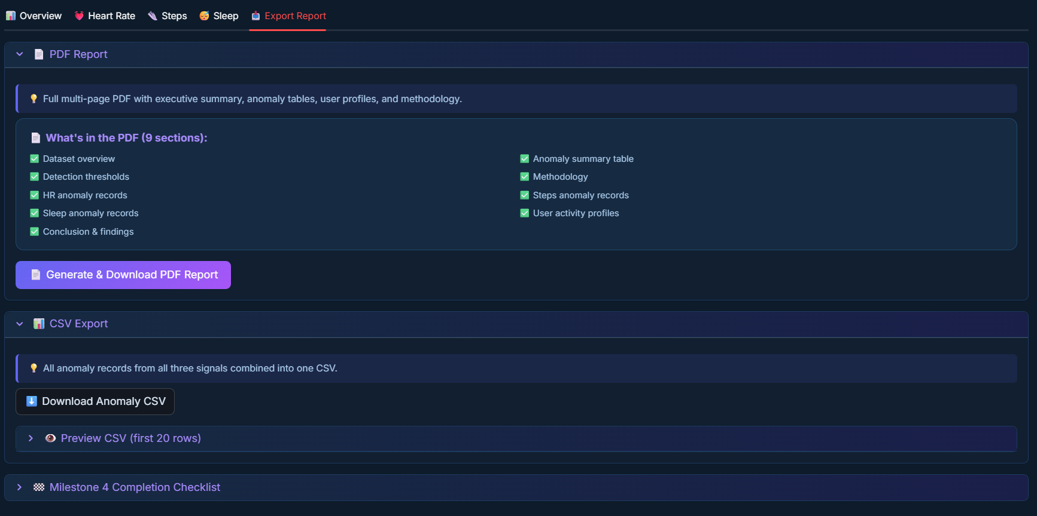
Milestone 4 — Dashboard Deep Dive
📥 Export Tab
PDF Report (9 Sections)
Dataset overview · Anomaly summary · Thresholds · Methodology · HR / Steps / Sleep tables · User profiles · Conclusion
Built with ReportLab
No kaleido or chart image rendering required. Works on any server. Dark-themed pages, styled tables, page headers, and footer.
CSV Anomaly Export
Combined file: signal, date, actual value, expected baseline, residual deviation, anomaly reason. Filtered by sidebar selection.
Completion Checklist
13-item verified checklist confirming all Milestone 4 deliverables completed.

Slide 29
Milestone 4 — Summary
✅
5 Fitbit CSV files loaded, merged, and cleaned automatically
✅
6-KPI summary strip (flags, HR, Steps, Sleep, users, peak day)
✅
Combined anomaly timeline, log, and per-metric deep-dive tabs
✅
Date range + per-user filter; all views update dynamically
✅
PDF report (9 sections, ReportLab) — one-click download
✅
CSV export of all anomaly records with full metadata

Slide 30
What We Did? Why To Use?
📌 What We Did
✨ Why You Should Use This App
M1 — Data Preprocessing
Loaded, cleaned and normalised real Fitbit CSV data from 30 users. Fixed timestamps, interpolated gaps, exported clean dataset.
M2 — Feature Extraction & Modelling
Extracted 10 TSFresh features from 196K+ HR readings, ran Prophet forecasts for 30 days, clustered users with KMeans + DBSCAN, visualised with PCA + t-SNE.
M3 — Anomaly Detection
Applied threshold rules, rolling-median residuals, and DBSCAN structural outliers to flag abnormal HR, step, and sleep patterns across 30 days.
M4 — Insights Dashboard & Export
Built an interactive Streamlit dashboard with KPI strip, anomaly timeline, per-metric deep-dive tabs, date/user filters, PDF report export and CSV download.
💪 Catch Health Problems Early
Flags subtle anomalies in HR, sleep, and activity before they escalate into serious conditions.
🧠 No Data Science Degree Needed
Upload CSVs, click one button. Results explained in plain English with visual indicators and anomaly reasons.
📄 Shareable Reports
One-click PDF and CSV exports ready to hand to doctors, coaches, or health teams.
📊 Real Data, Real Insights
Trained and tested on real consented Fitbit data from 30 users. Not synthetic — not simulated.

Slide 31
Full Technology Stack — All 4 Milestones
Streamlit
Web app framework
Pandas / NumPy
Data loading, cleaning, merging
Plotly
Interactive charts & subplots
Scikit-learn
KMeans, DBSCAN, PCA, t-SNE
TSFresh
Automated feature extraction
Prophet
Time series forecasting
ReportLab
PDF report generation
Preprocessing.py
Custom shared pipeline module
End-to-End Pipeline Architecture
Raw CSVs (5 files) → Load & Clean (preprocessing.py) → Merge Master DataFrame → Feature Extraction (TSFresh) → Forecasting (Prophet) → Clustering (KMeans + DBSCAN) → Anomaly Detection (Threshold + Residual) → Dashboard (Streamlit) → Export (PDF + CSV)
All 4 milestones are integrated into a single multi-page Streamlit application. One unified app.py file with milestone selector in the sidebar. preprocessing.py is the shared data pipeline used by all milestones.

Slide 32
FitPulse · Health Anomaly Detection Platform
Thank You
for your time, attention, and evaluation
Thejomayie K · Batch 13
Infosys Springboard Virtual Internship
M1 Preprocessing
M2 Modelling
M3 Anomaly Detection
M4 Dashboard

