Slide 1
FitPulse
Health Anomaly Detection from Fitness Devices
Thejomayie K
Batch 13

Slide 2
FitPulse
Health Anomaly Detection from Fitness Devices
Milestone 1 · Milestone 2
Streamlit
Python
Machine Learning

Slide 3
Project Overview
What is FitPulse?
FitPulse is a complete data science platform that takes raw Fitbit sensor data from 30 users, cleans it, extracts patterns, forecasts health trends, and groups users by their fitness behaviour — all in an interactive web application.
30
5
30
2
Users
Sensor Files
Days of Data
Milestones
Dataset
FitBit Fitness Tracker Dataset — real data from 30 Fitbit users who consented to share their personal tracker data covering steps, heart rate, sleep, calories, and activity intensity over 30 days (March–May 2016). Publicly available dataset used for academic research.

Slide 4
01
Upload CSV
User uploads a fitness tracking CSV file
01
02
Inspect
Preview raw data, check missing values & types
Milestone 1
03
Clean
Fix dates, interpolate numbers, fill categories
Data Collection &
Preprocessing
04
Visualise
Detect outliers with Box Plot & Histogram

Slide 5
Milestone 1 — Key Features
🧹 Data Cleaning Engine
🔍 Data Inspection
📈 Outlier Detection
Normalise date columns to proper format
Raw dataset preview — first 10 rows
IQR method — Q1, Q3, and 1.5×IQR rule
Interpolate missing numeric values (linear method)
Missing values bar chart per column
Box plot — shows normal range and outlier dots
Fill empty text columns with 'Unknown'
Data types table for all columns
Histogram — frequency distribution with outlier zones
Download cleaned CSV after processing
4 summary metrics — rows, columns, missing, completeness
Mean and Median reference lines on histogram

Slide 6
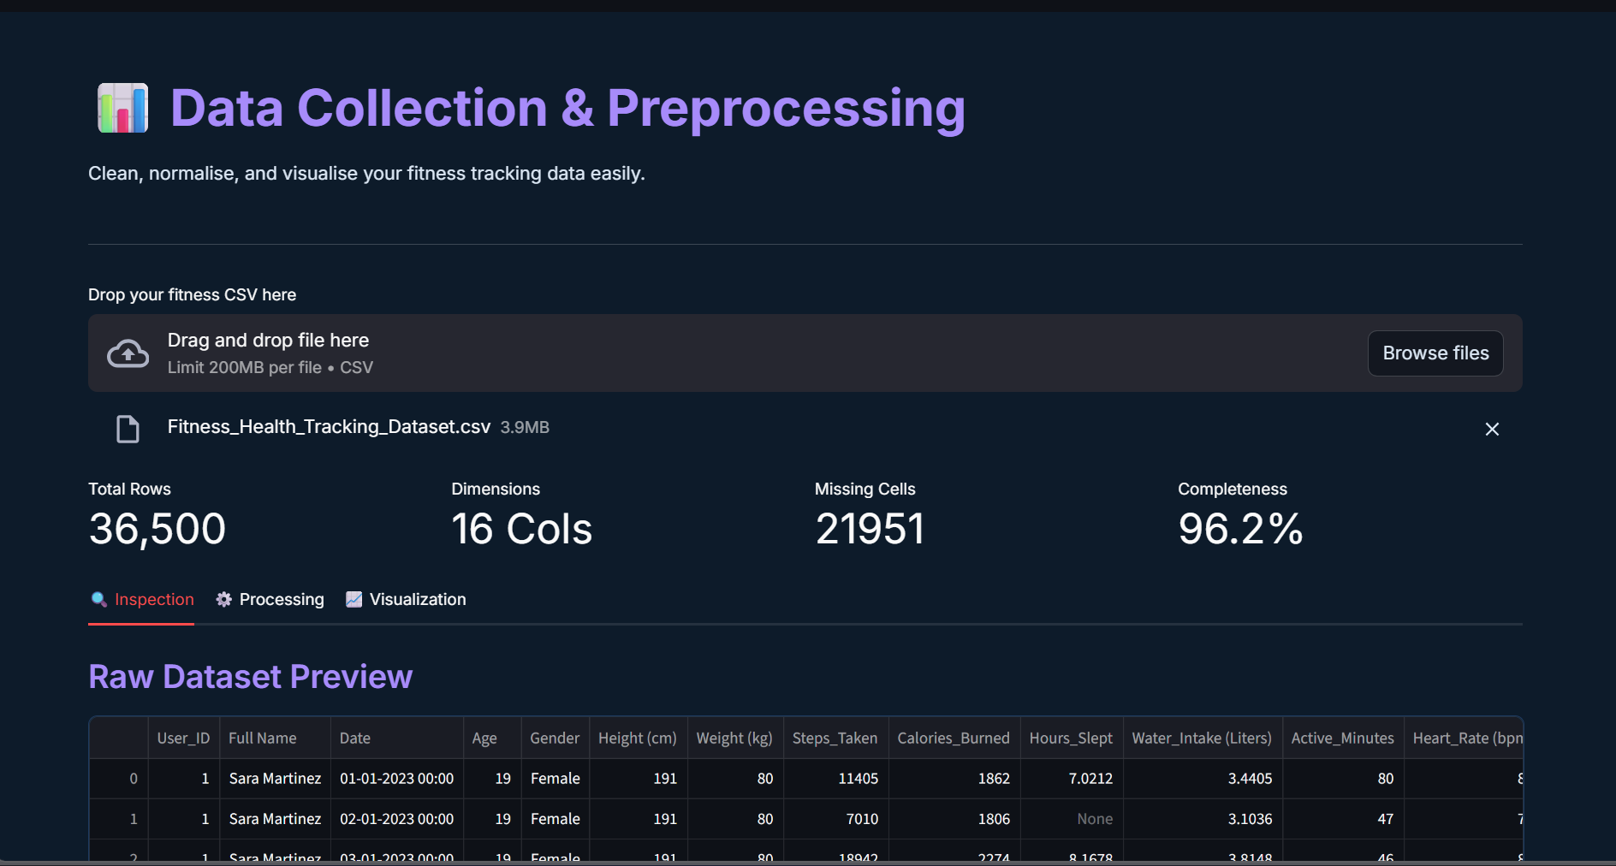
Output Screenshots:
File Upload:

Slide 7
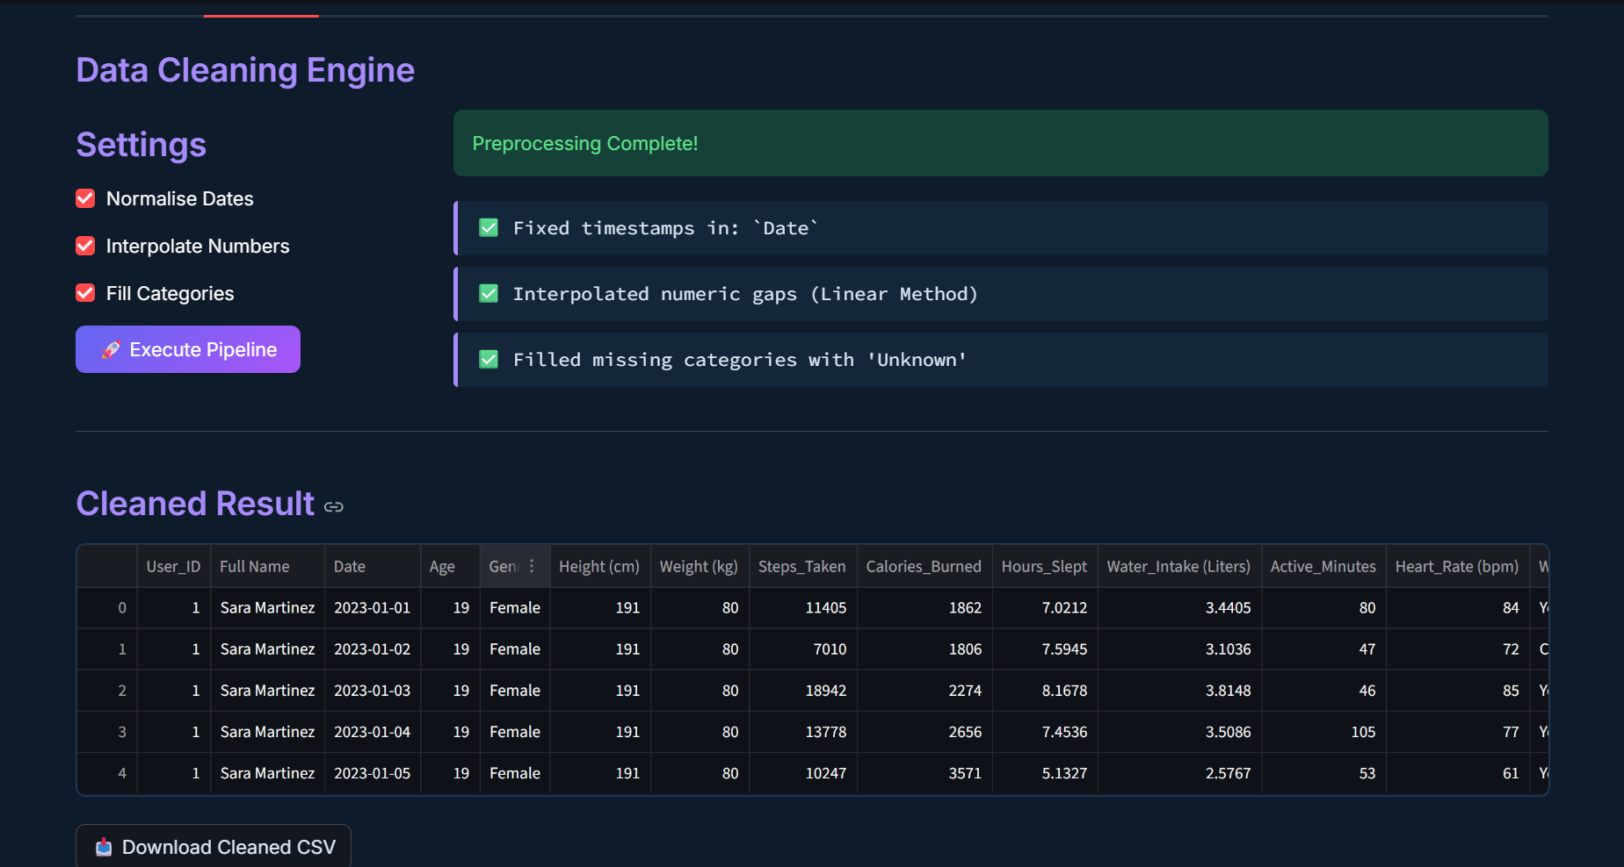
Output Screenshots:
Cleaned Dataset Preview:

Slide 8
01
5 Files Merged
Daily activity, heart rate, sleep, steps, intensity
02
02
TSFresh
Extract 10 features from 196K+ heart rate readings
Milestone 2
03
Prophet Forecast
Predict next 30 days — heart rate, steps, sleep
Feature Extraction
& Modelling
04
Clustering
KMeans + DBSCAN + PCA + t-SNE group visualisation

Slide 9
Milestone 2 — Data Pipeline & Feature Extraction
5 Input Files
🔬 TSFresh Feature Extraction
Daily Activity
196,537 heart rate readings → 10 features per user
Steps, calories, distance per day
Heart Rate
Features: Mean, Median, Variance, Max, Min, Standard Deviation, Root Mean Square, Sum, Absolute Max, Length
Readings every few seconds
Hourly Intensities
MinimalFCParameters used for speed
Activity intensity each hour
Results shown as normalised heatmap (0 = lowest, 1 = highest among all users)
Hourly Steps
Step count each hour
Why heart rate only? Steps & sleep are already 1 number per day. Heart rate has 50,000+ raw readings that need summarising.
Minute Sleep
Sleep state every minute

Slide 10
Prophet Forecasting
What is Prophet?
Prophet is a Facebook-developed time series forecasting tool. It looks at historical data and predicts future values while accounting for weekly seasonality and uncertainty.
💓 Heart Rate
👟 Daily Steps
😴 Sleep
Daily average heart rate
Average steps per day
Total sleep in minutes/day
Teal dots = actual values
Green dots = actual values
Purple dots = actual values
Teal shaded band = 80% CI
Green shaded band = 80% CI
Purple shaded band = 80% CI
30-day forecast · 80% Confidence Interval shown · CI Upper & Lower visible on hover · Orange dashed line = forecast start

Slide 11
User Clustering & Visualisation
KMeans
Visualisation Methods
You choose number of groups (k)
PCA
Use Elbow Chart to find best k
Squashes 20+ columns into 2 dimensions so we can plot users on a chart. Dimension 1 = 50% info.
Every user forced into exactly one group
Groups: Highly Active / Moderate / Sedentary
t-SNE
Better than PCA at separating close groups visually. Takes ~20 seconds to compute.
DBSCAN
Auto-detects number of groups
eps = friendship radius between users
Group Profiles
Outliers = users who don't fit any group
Bar chart showing average steps, sleep, calories, heart rate per group side by side.
Grey dots = outliers on the chart

Slide 12
Technology Stack
Streamlit
Pandas
NumPy
Plotly
Web application framework
Data loading, cleaning & merging
Numerical computing
Interactive charts & visualisations
Scikit-learn
TSFresh
Prophet
Matplotlib
KMeans, DBSCAN, PCA, t-SNE
Automated time series feature extraction
Time series forecasting
Static chart rendering

Slide 13
Summary
✅
Loaded and cleaned 5 Fitbit sensor files
✅
Built a merged master dataset (one row per user per day)
✅
TSFresh extracted 10 features from 196K+ heart rate readings
✅
Prophet forecasted Heart Rate, Steps & Sleep for 30 days
✅
KMeans and DBSCAN clustered users by fitness behaviour
✅
PCA and t-SNE visualised groups in 2D plots

Slide 14
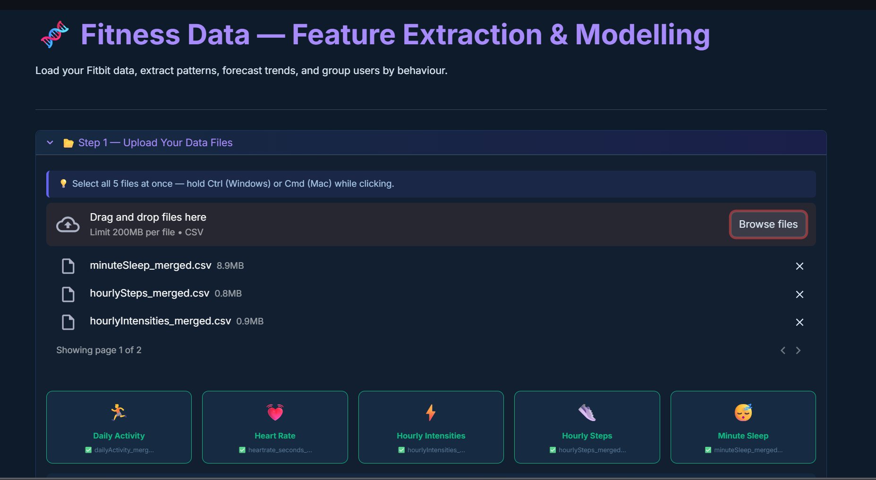
Output Screenshots:
File Upload

Slide 15
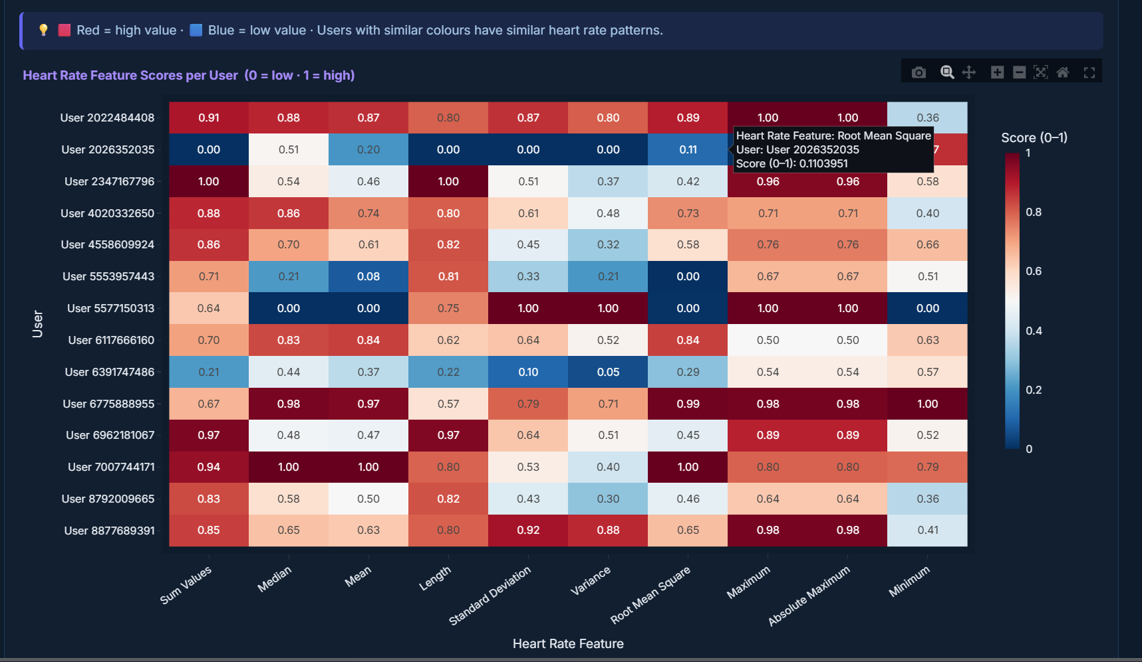
Output Screenshots:
TSFresh – Heatmap

Slide 16
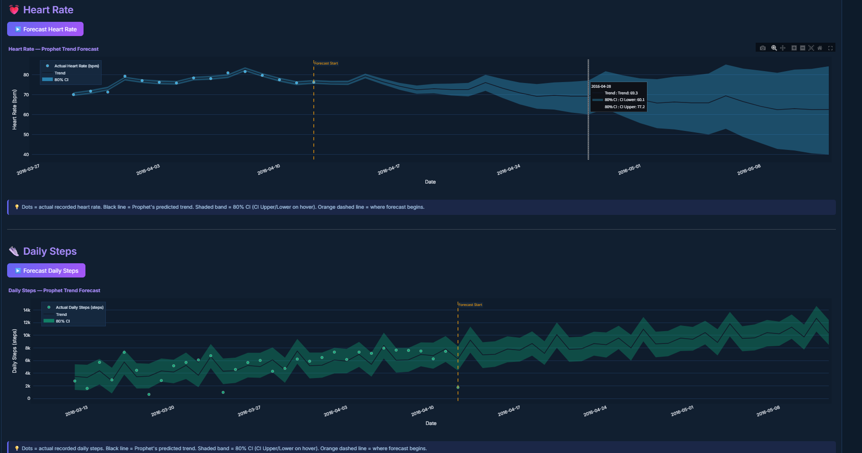
Output Screenshots:
Prophet Analysis : Trend forecasting

Slide 17
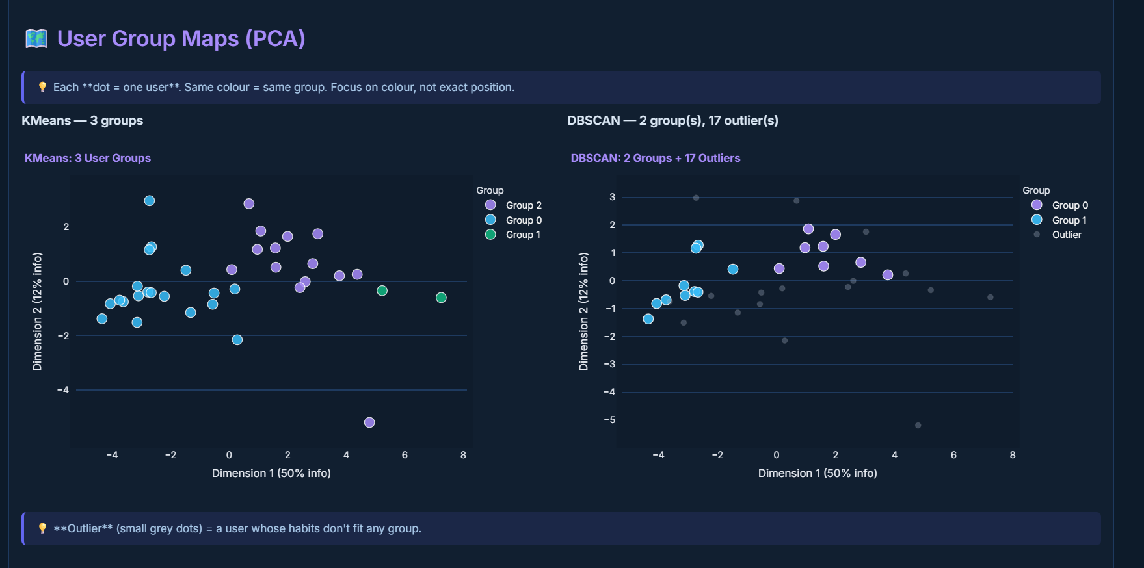
Output Screenshots:
Clustering – K-means and DBSCAN

Slide 18
01
Upload the 5 CSV files
Upload to M3 pipeline
03
02
Threshold Violations
Hard-coded limits on HR, Steps & Sleep
Milestone 3
03
Residual-Based Detection
Rolling median ±2σ baseline anomalies
Anomaly Detection
& Visualization
04
DBSCAN Structural Outliers
Users with abnormal profiles across all metrics

Slide 19
Milestone 3 — Three Anomaly Detection Methods
📏 Threshold Violations
📊 Residual-Based Detection
🔵 DBSCAN Outlier Detection
01
02
03
Hard-coded upper and lower limits on Heart Rate, Steps, and Sleep. Simple, fast, and interpretable. Flags absolute out-of-range values immediately.
A 7-day rolling median is computed as the expected baseline. Any day where the actual value deviates by more than ±2 standard deviations is flagged as a statistical anomaly.
Machine learning clustering on aggregated user profiles. Users labelled -1 (do not fit any cluster) are structural outliers across all health dimensions.
Key Parameters:
Key Parameters:
Key Parameters:
Heart Rate: 40 – 120 bpm
Window: 7-day rolling median
eps = 2.5, min_samples = 2
Daily Steps: 1,000 – 25,000
Threshold: ±2 standard deviations
Per-user average profile
Sleep: 180 – 720 minutes
Detects sudden spikes / drops
Label -1 = structural outlier

Slide 20
Method 1 — Threshold Violations
How it works:
Hard-coded clinical upper and lower bounds are applied to each health metric. Any daily average that exceeds these limits is immediately flagged as a threshold violation. This method is the most interpretable — a doctor or analyst can instantly understand why a day was flagged.
💓 Heart Rate
👟 Daily Steps
😴 Sleep Duration
Min (Lower Bound)
Min (Lower Bound)
Min (Lower Bound)
40 bpm
1,000 steps
180 min (3h)
Max (Upper Bound)
Max (Upper Bound)
Max (Upper Bound)
120 bpm
25,000 steps
720 min (12h)
Below 40 = bradycardia risk. Above 120 = tachycardia concern.
Below 1,000 = inactivity/sensor error. Above 25,000 = unrealistic.
Below 3h = insufficient rest. Above 12h = hypersomnia flag.

Slide 21
Method 2 — Residual-Based Detection (Rolling Median ± 2σ)
How it works:
Why use this method?
A rolling 7-day median is computed as the expected baseline for each metric. Any day where the actual value deviates by more than ±2 standard deviations from this baseline is flagged as a statistical anomaly.
This method detects sudden, unexpected changes relative to the user's recent pattern — even if the absolute value is technically within normal range.
Personalised Baseline
Uses each user's own recent history, not population averages
Detects Relative Change
Flags sudden drops/spikes even if absolute value looks normal
Robust to Noise
Rolling median is less affected by single extreme days vs rolling mean
Algorithm Steps:
Interpretable Z-Score
Z-score > 2 means the day was more than 2 std deviations unusual
1
Compute 7-day rolling median for each metric
Applied to 3 Metrics
2
Compute 7-day rolling standard deviation
Heart rate, daily steps, and sleep duration — independently
3
Calculate daily residual: | actual − median |
4
Divide residual by standard deviation → Z-score
5
Flag days where Z-score > 2.0 as anomalous

Slide 22
Method 3 — DBSCAN Structural Outlier Detection
How it works:
Machine learning clustering (DBSCAN) is applied to aggregated user profiles — one row per user, averaging all their daily metrics. Users who do not fit into any cluster are labelled -1 by DBSCAN and identified as structural outliers. These users have an unusual combination of health metrics that doesn't match any other user group.
DBSCAN Parameters
System Architecture — Data Flow:
Raw Fitbit CSVs (5 files)
eps = 2.5
▼
Neighbourhood radius for clustering
Merge → Master DataFrame (one row per user per day)
min_samples = 2
▼
Min users to form a group
Group by User ID → Average all daily metrics
Label = -1
User is a structural outlier
▼
StandardScaler
StandardScaler → Normalise feature values
Normalises features before clustering
▼
PCA (2D)
DBSCAN (eps=2.5, min_samples=2) → Cluster labels
Visualises outliers vs groups
▼
Red × marker
Users with label -1 → Structural Outliers flagged
Outlier shown on PCA plot

Slide 23
Milestone 3 — Summary
✅
Threshold violations: HR, Steps, Sleep vs hard-coded clinical limits
✅
Residual detection: 7-day rolling median ±2σ for all 3 metrics
✅
DBSCAN outliers: per-user profile clustering, label -1 = anomalous user
✅
Combined anomaly heatmap — days with multiple simultaneous alerts
✅
Downloadable anomaly report CSV with date, metric, value, method, and note
✅
PCA visualisation of structural outliers vs normal user clusters

Slide 24
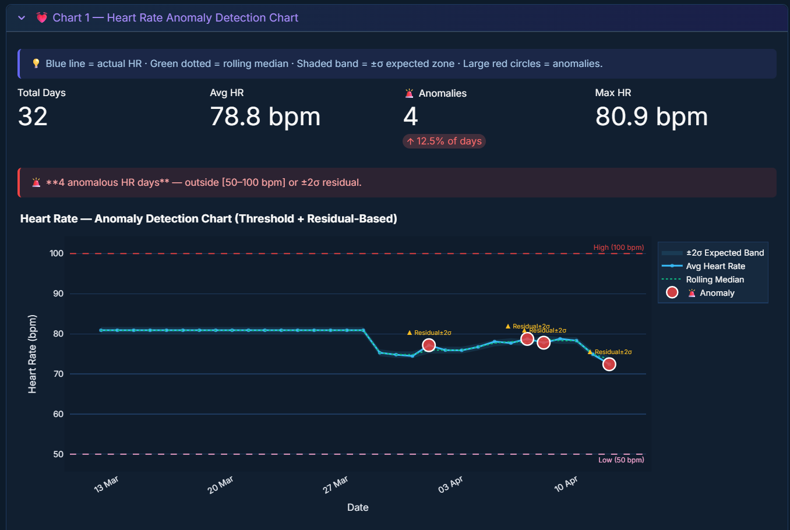
Output Screenshots:
Anomalies in Heart Rate

Slide 25
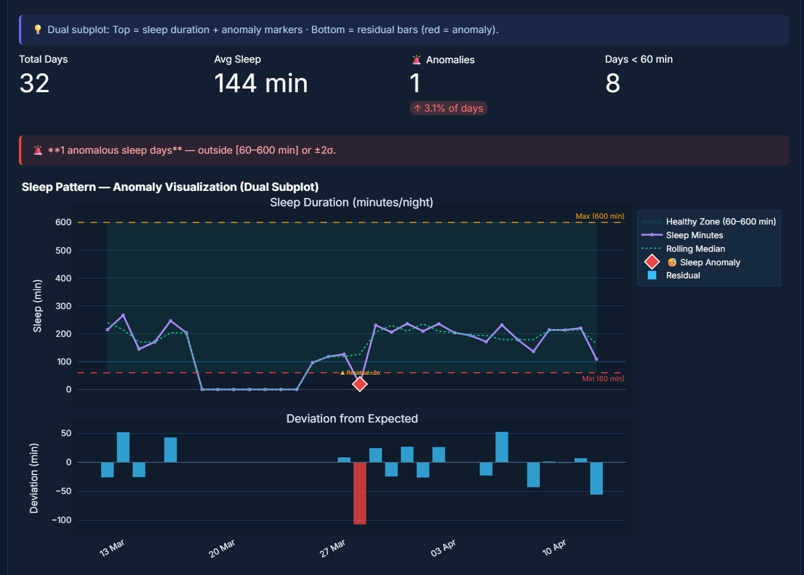
Output Screenshots:
Anomalies in Sleep Rate

Slide 26
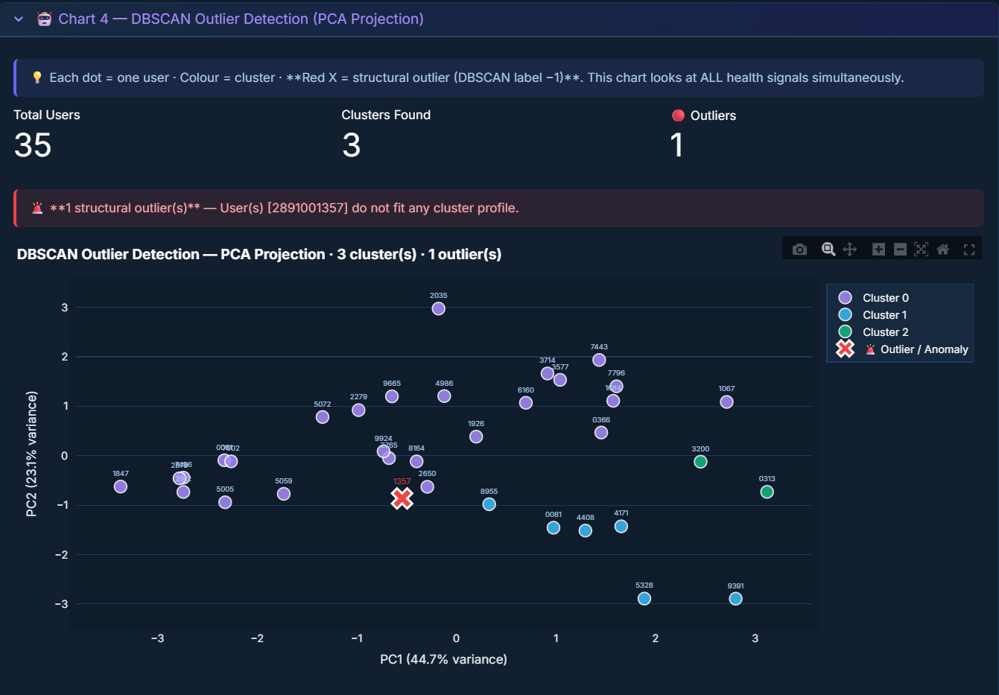
Output Screenshots:
DBSCAN Outliers

Slide 27
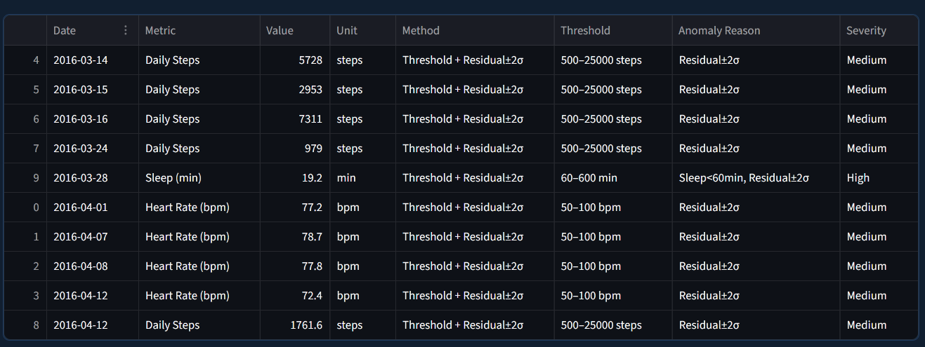
Output Screenshots:
Anomaly Report Summary

