Slide 1
Fight or Flight Instinct in Virtual Reality versus Non-Immersive Simulation
Poruthikode Unnivelan Thejus

Slide 2
Outline
Introduction
Purpose
Background
Methods/Materials
Results
Conclusion

Slide 3
Introduction
Virtual Reality has been rising in the entertainment industry
Virtual Reality gives two extra levels of immersion
Gyroscopic movement
3D spatial movement
VR has been used to treat medical conditions

Slide 4
Purpose
To study how effectively the brain perceives the extra level of immersion
This study would lead to how effective Virtual Reality in immersive the user
We hypothesize that the Virtual Reality simulation will produce a stronger signal spike than the non-immersive simulation

Slide 5
Background
The Fight or Flight instinct is a natural defense system.
Increase blood pressure, release hormones
Triggered by negative emotions; enhanced by self-awareness
Fear disorders such as PTSD, phobia, and depression sees an increased response from the amygdala
Virtual Reality presents benefits in the medical industry

Slide 6
Materials
BioSemi MkI/MKII
32+2 Electrode Set
EEG 32+2 Electrode Cap
Computer with OpenViBE and Excel
Gear VR/Other VR Device

Slide 7
Methods
Raw EEG Data
Channel Selector
[F Series, P Series, FP Series]
Temporal Filter Beta 1, 2, 3 Waves
[13-15.5; 17-19.5; 21-27]
Time Based Epoching
[1 second duration]
Spectral Analysis
Spectral Analysis →
Spectrum Average

Slide 8
Results Virtual Reality
 |  | Frontal Lobe | Motor Cortex | Parietal Lobe
Beta 1 13 – 15.5 Hz
Beta 2 17 – 19.5 Hz
Beta 3 21 – 27 Hz
Signal Strength (μV)

Slide 9
Discussion
Data from Non-immersive Simulation was corrupted
Three spikes observable
Doll drop stimulus
Jump scare stimulus
Lightening stimulus
Beta 1 data may not be the right type of wave to study.
Beta 1 and Beta 3 stronger than Beta 2
Butterworth vs.

Slide 10
Graph 1

Slide 11
Graph 2
Parietal Lobe

Slide 12
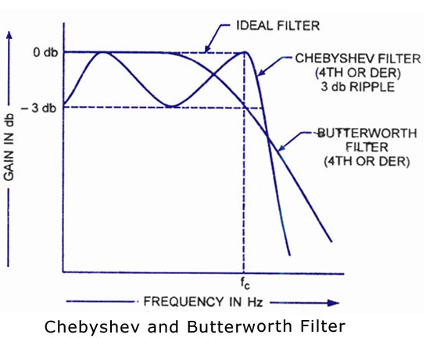
Butterworth vs. Chebyshev

Slide 13
References
Adolphs, R., Russell, J., & Tranel, D. (1999). A Role for the Human Amygdala in Recognizing Emotional Arousal from Unpleasant Stimuli. Psychological Science, 10(2), 167-171. Retrieved from http://www.jstor.org/stable/40063399
Debiec, J., & LeDoux, J. (2004). Fear and the Brain. Social Research, 71(4), 807-818. Retrieved from http://www.jstor.org/stable/40971979
Goslin, M., & Morie, J. (1996). "Virtopia": Emotional Experiences in Virtual Environments. Leonardo, 29(2), 95-100. doi:1. Retrieved from http://www.jstor.org/stable/1576338 doi:
Virtual Reality. (1992). The Journal of Epsilon Pi Tau, 18(2), 2-7. Retrieved from http://www.jstor.org/stable/43603590
Weger, U.W., Loughnan, S., Sharma, D. et al. Psychon Bull Rev (2015) 22: 1111. doi:10.3758/s13423-014-0778-z
Andreae, M. (1996). Virtual Reality In Rehabilitation: Potential Benefits For People With Disability Or Phobias. BMJ: British Medical Journal, 312(7022), 4-5. Retrieved from http://www.jstor.org/stable/29730203

