Slide 1
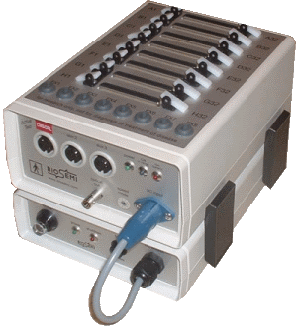
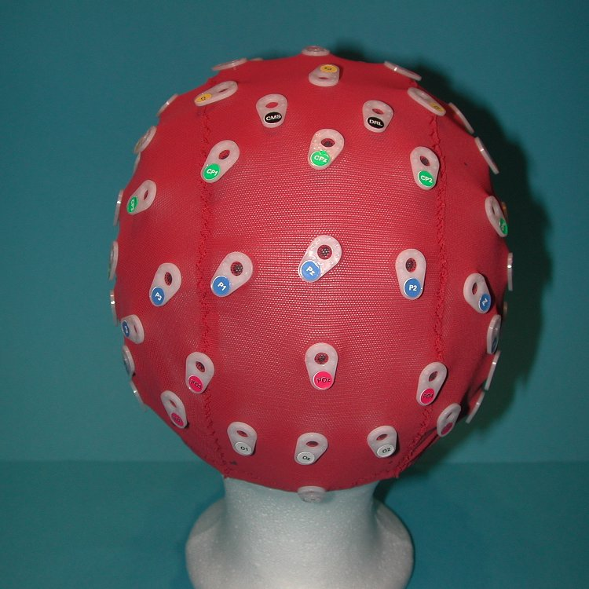
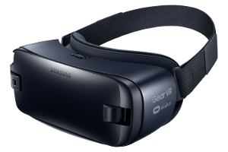
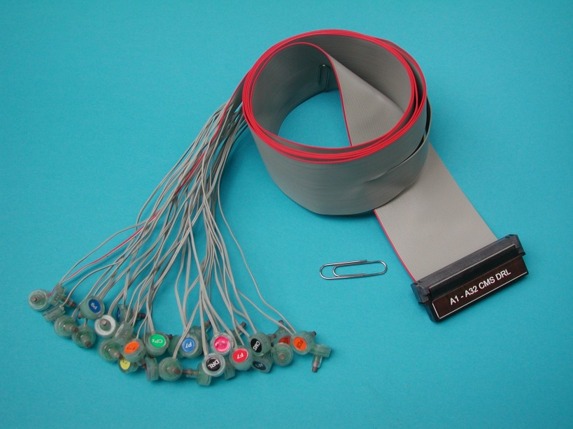
Fight or Flight Instinct in Virtual Reality Simulation versus Non-Immersed Simulation
Thejus Poruthikode Unnivelan
Introduction
MATERIALS
Methods
Discussion/ Analysis
Currently, because more immersive simulation technologies, Virtual reality (VR), exist such as the Google Cardboard, Oculus Rift, PlayStation VR, HoloLens, the level of immersion of entertainment systems, and especially videogames, have drastically increased from the previous generation of non-immersive technology. Virtual and Augmented reality have an upper hand in spurring emotions because they have the ability to take data of the player’s involuntary movement and give another dimension of immersion to the simulation developers.
The Gear VR virtual reality device was also used as the virtual reality medium for this experiment. The opportunity was also open to use the Oculus Rift DK2, which is able to sense the not only gyroscopic movements of the head, but also location of the head in 3D space. However, without the expertise or hardware to use the DK2, along with the time restraint, the Oculus Rift was abandoned for the Gear VR. The Gear VR poses several pros and cons for this experiment. Much like the Oculus Rift, the Gear VR came with the standard gyroscopic readings of the movement of the head, but it did not read positional movement in neither 3D nor 2D space using the accelerometer. However, the Gear VR is relevant to the experiment because it is the most consumer friendly VR device for its price on the market and allows the study of Virtual Reality capabilities with what is available to current consumers.
We hypothesize that the EEG data from the Virtual Reality test will produce a significantly larger signal than the EEG data from the non-immersive simulation. The extra level of immersion will create stronger signals from the Parietal Lobe, which is responsible for processing information from the senses like touch or taste. It will also create larger signals from the Motor Cortex, which is responsible for controlling bodily movements. The immersive aspect of Virtual Reality will also spur the analytical side of the human brain, the Frontal Lobe.
Materials
BioSemi MkI/MKII
32+2 Electrode Set
EEG 32+2 Electrode Cap
Computer with OpenViBE and Excel
Gear VR/Other VR Device
Raw EEG Data
Channel Selector
[F Series, P Series, FP Series]
Temporal Filter Beta 1, 2, 3 Waves
[13-15.5; 17-19.5; 21-27]
Time Based Epoching
[1 second duration]
Spectral Analysis
Spectral Analysis →
Spectrum Average
Beta waves can be separated into Beta 1, 2 and 3. Beta 1 is associated with fast idle wakefulness; Beta 2 is associated with high engagement; and Beta 3 is associated with complex thoughts, new experiences, high anxiety or excitement.
The data collected at all three regions studied—Motor Cortex, Frontal Lobe, and Occipital Lobe—followed the same pattern between Beta 1, 2 and 3. The average voltage values for Beta 2 values were significantly lower than that of Beta 1 and 3. This suggests that Alpha waves and Gamma waves may respond to the stimuli stronger than Beta waves. This theory is further reinforced by the method used to filter the data, Butterworth, which causes a bleed effect from surrounding frequencies. Furthermore, Beta 2 voltage data is surprisingly low considering the bleed from Beta 1 and 3 was also factored into the average value for the Beta 2 voltage. This possibly indicates that while the brain will be in a greater alerted state, other brain activities will take precedence.
The spike before the main voltage spike can be found in the Beta 1 and 3 graphs from the Motor Cortex, all three Beta graphs from the Parietal Lobe, and the Beta 3 graph of the Frontal Lobe. This time also coincides with a doll on a shelf falling and creating a large sound.
The second smaller spike occurred at 94 seconds, but it did not correlate with any specific stimuli in the simulation. There were, however, several smaller stimuli throughout the simulation, specifically, the thunder and lightning. The lightning was blindingly bright and that may have been the cause of the sudden spike in the Parietal Lobe.
It would be expected for the data from the Motor Cortex to create larger, stronger voltage readings, but in relation to other regions of the brain it does not. A possible answer to this problem is the fact that the movements made during these stimuli are more reactionary than intentional.
Unfortunately, there were problems throughout this research. For future projects, it is suggested that more time be taken for data collection with a larger group of individuals. A control sample should also be taken to gauge the data more accurately. During the testing, the subject should be in an isolated environment: no exterior sounds, sight of other individuals, etc. Different subjects will respond differently to the same experience. Another source of interference is the Gear VR plus phone itself. Due to its close proximity to the electrodes they may influence the voltage readings from the electrodes.
TRIFOLD AREA – THIS GUIDE WILL BE REMOVED BEFORE PRINTING – TRIFOLD AREA – THIS GUIDE WILL BE REMOVED BEFORE PRINTING – TRIFOLD AREA – THIS GUIDE WILL BE REMOVED BEFORE PRINTING – TRIFOLD AREA – THIS GUIDE WILL BE REMOVED BEFORE PRINTING – TRIFOLD
TRIFOLD AREA – THIS GUIDE WILL BE REMOVED BEFORE PRINTING – TRIFOLD AREA – THIS GUIDE WILL BE REMOVED BEFORE PRINTING – TRIFOLD AREA – THIS GUIDE WILL BE REMOVED BEFORE PRINTING – TRIFOLD AREA – THIS GUIDE WILL BE REMOVED BEFORE PRINTING – TRIFOLD
Results
Background
The fight or flight instinct is a response that transcends time, is still imbedded into the core of our brain, and determines the actions one take when faced by danger. It is a naturally occurring defense system that increases blood pressure, releases hormones, and takes control of the body. This instinct is often triggered by emotions such as fear or sadness, and is enhanced by self-awareness. Many fear disorders see an increase in activity in the amygdala such as post-traumatic stress disorder (PTSD), phobia, depression, and schizophrenia. By studying fear conditioning we can shed light on these disorders.
Virtual Reality presents certain benefits for the future of the medical industry, not just in the entertainment industry. This technology has the capability to help improve the lives of paraplegics, disabled, and people with phobias, through different simulations and human-computer interface that immerses the player. This study of the difference between Virtual Reality and Non-Immersive Simulation is a study into how effective this technology is, and provides an idea on how effective it will be as a contribution to the health industry.
Figure 1: (Top): Spectral Analysis Data from F3, F2, F4, and F8 Nodes, corresponding to the Motor Cortex, responsible for motor movements of the body. Snapshot between T=60 s and T=106 s and depicts the main beta wave spike at the time of stimuli.
Figure 2 (Right): Spectral Analysis Data from the P2, P7, P3, P4, and P8 Nodes. These nodes correlate with the Parietal lobe, responsible for processing information through the senses.
The first noticeable characteristic that all the Beta wave graphs possess is the large spike at 83 seconds. The time of the spike correlates with the time of the major jump scare within the simulation. In the Parietal lobe graphs for Beta waves, there is also a second smaller spike before the jump scare spike, at 77 seconds. During this time in the simulation a doll on the shelf fell down, creating a large noise, which could have led to this bump.
A pattern arises between the different Beta graphs which could lead to different results coming from the different Beta wave graphs. The Beta 1 graph, which has a frequency closer to that of Mu rhythms, has the strongest spike. Beta 2 waves have a much weaker voltage spike than Beta 1 and 3. And Beta 3’s waves are closest in strength to that of Beta 1 graph. This suggests that the Beta waves do not respond as strongly to these simulation compared to wave types around the Beta wave such as Alpha or Gamma waves.
References
Adolphs, R., Russell, J., & Tranel, D. (1999). A Role for the Human Amygdala in Recognizing Emotional Arousal from Unpleasant Stimuli. Psychological Science, 10(2), 167-171. Retrieved from http://www.jstor.org/stable/40063399
Debiec, J., & LeDoux, J. (2004). Fear and the Brain. Social Research, 71(4), 807-818. Retrieved from http://www.jstor.org/stable/40971979
Goslin, M., & Morie, J. (1996). "Virtopia": Emotional Experiences in Virtual Environments. Leonardo, 29(2), 95-100. doi:1. Retrieved from http://www.jstor.org/stable/1576338 doi:
Virtual Reality. (1992). The Journal of Epsilon Pi Tau, 18(2), 2-7. Retrieved from http://www.jstor.org/stable/43603590
Weger, U.W., Loughnan, S., Sharma, D. et al. Psychon Bull Rev (2015) 22: 1111. doi:10.3758/s13423-014-0778-z
Andreae, M. (1996). Virtual Reality In Rehabilitation: Potential Benefits For People With Disability Or Phobias. BMJ: British Medical Journal, 312(7022), 4-5. Retrieved from http://www.jstor.org/stable/29730203

