Slide 1
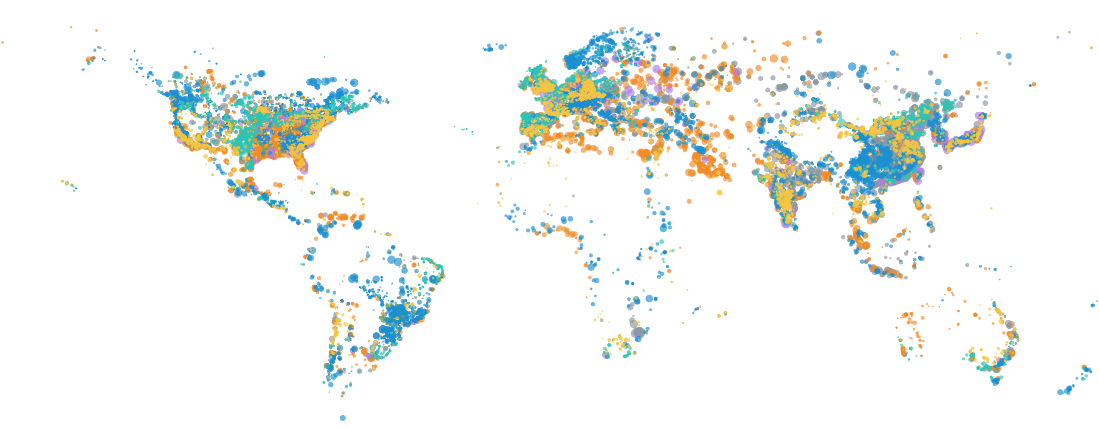
POWER BI DASHBOARD ANALYSIS
Global Power Plant Dashboard
Capacity, generation and efficiency across 31,118 plants in 162 countries
Notes:
Welcome. This deck walks through the Power BI dashboard on the Global Power Plant Database: the headline KPIs, how each visual reads, and what the data says about the world's electricity system. The map is a preview of the dashboard's location visual: each dot is a plant, sized by capacity and coloured by fuel.

Slide 2




Executive Summary
The dashboard's four headline KPIs, and three stories behind them
31,118
5.41M
7.33M
19.3%
Total plants
Total capacity (MW)
Total generation (GWh)
Avg capacity utilization
across 162 countries
5,405,310 MW installed
7,331,096 GWh recorded
target on gauge: 40%
45%
60%
31%
of all generation comes from hydropower
of generation is in North America
of plants report no generation (0 GWh)
Notes:
The four KPI cards at the top of the dashboard: 31,118 plants, 5.41 million MW of installed capacity, 7.33 million GWh of recorded generation, and average capacity utilization of 19.3%. Below them, three headline findings that the rest of the deck unpacks.

Slide 3
Energy Mix by Source
Hydropower produces almost half of all recorded electricity
45.0%
Hydro is the largest source: 3.30M GWh generated
45.4%
from gas, coal and nuclear combined
9.3%
from wind and solar, despite 51% of all plants
Notes:
This is the donut chart from the dashboard: generation share by fuel type. Hydro alone is 45% (3.30 million GWh). Gas, coal and nuclear together add up to 45.4%. Wind and solar are just 9.3% of generation even though they are 51% of all plants by count, because individual wind and solar plants are small.

Slide 4
Capacity vs. Generation
Coal holds the most capacity but delivers a fraction of the output
Coal
36.4% → 12.8%
share of capacity → share of generation
Hydro
19.5% → 45.0%
share of capacity → share of generation
Generation recorded as 0 GWh for 31% of plants (see Data Quality).
Notes:
Comparing each fuel's share of installed capacity to its share of generation shows who over- and under-delivers. Coal is 36.4% of capacity but only 12.8% of generation; hydro is 19.5% of capacity and 45.0% of generation. Part of coal's gap reflects plants with no generation data, covered in the data quality slide.

Slide 5
Performance Across Regions
North America generates three-fifths of the world's recorded electricity
59.9%
of generation is in North America (4.39M GWh)
38% vs 15%
Asia: share of capacity vs share of generation
22% vs 3.5%
Europe: share of plants vs share of generation
Notes:
This is the bar chart from the dashboard, generation by region. North America leads with 4.39 million GWh (59.9%). Asia has the largest installed capacity, 38% of the world total, but only 15.3% of recorded generation. Europe has 22% of all plants but 3.5% of generation. 'Other' is a catch-all region of 5,188 plants that is not mapped to a continent.

Slide 6
Top Countries by Generation
The United States alone accounts for over half of global recorded generation
54.6%
of global generation comes from the USA
China: 26% of capacity, 10% of generation
Notes:
Top ten countries by recorded generation. The USA produces 4.0 million GWh, 54.6% of the global total. China is the world's largest by installed capacity, 1.41 million MW or 26% of capacity, but its recorded generation is 745 thousand GWh, only 10%. That gap points to reporting coverage in the source data rather than purely to operations.

Slide 7
Generation Trends Over Time
Each decade's build-out has been led by a different fuel
1970s–80s
Nuclear and coal build-out peaks
2000s
Gas boom: 820K GWh from new plants
2010s
Wind and solar scale up; hydro grows again
Based on the 14,874 plants (48%) with a start year.
Notes:
This reworks the dashboard's line chart (generation by start year and fuel) into decades for readability. Coal and nuclear led the 1970s and 1980s. Gas boomed in the 2000s with 820 thousand GWh from new plants. In the 2010s, wind and solar scaled up and hydro grew again. Only 48% of plants have a start year, so this is a partial view, and the 2020s are excluded as a partial decade.

Slide 8
Plant Efficiency
Average utilization is 19.3%, less than half of the 40% target
Target 40%
19.3%
Avg plant efficiency
0
100
28.1%
9,658
avg of 21,386 plants that report generation
plants (31%) with 0 GWh recorded
Notes:
This is the dashboard gauge: average capacity utilization of 19.3% against a target of 40 on a 0 to 100 scale. Hydro comes closest at 38.4%, and no fuel reaches the target. The average is pulled down by plants that report 0 GWh. Among the 21,386 plants that do report generation, the average is 28.1%.

Slide 9
Power Plants by Location
Plants cluster in North America, Europe, India and eastern China
Hydro
Gas
Coal
Nuclear
Wind
Solar
Biomass
Notes:
The dashboard map plots every plant by latitude and longitude, coloured by fuel type and sized by capacity. Hydro dominates the Amazon basin, Scandinavia and western China, solar is dense across Europe and India, and large gas plants stand out across the Middle East and North Africa.

Slide 10
Data Quality Check
Three data gaps shape how far the dashboard's numbers can be trusted
31%
52%
42%
9,658 plants report 0 GWh generation
16,244 plants have no start year
13,057 plants have no owner listed
What it means
Recommended fix
Efficiency KPI reads 19.3%; reporting plants average 28.1%
Trend line covers only 48% of plants
5,188 plants sit in region “Other”
Keep missing generation blank instead of replacing it with 0
Source output for large plants (Three Gorges shows 0 GWh)
Map “Other” plants to real regions
Notes:
Three gaps in the source data. 31% of plants, 9,658, have zero generation recorded; even the Three Gorges Dam at 22,500 MW shows 0. 52% have no start year, so the time trend covers less than half the plants. 42% have no owner. Also, 5,188 plants sit in a region called Other. Fixing these makes the KPIs more defensible.

Slide 11
Key Takeaways & Next Steps
What the dashboard tells us, and how to sharpen it
Key takeaways
Recommended next steps
1
Hydro makes 45% of generation; coal holds 36% of capacity but makes 13%
Fix missing generation data before benchmarking regions or fuels
A
2
North America (60%) and the USA (55%) dominate recorded output
Add drill-downs by country and fuel with a data-quality flag
B
3
Gas led the 2000s; wind and solar are scaling in the 2010s
Track wind + solar share over time as a headline KPI
C
4
Utilization averages 19.3%, under half of the 40% target
Notes:
Close with the four takeaways on the left: hydro leads generation, North America and the USA dominate recorded output, gas drove the 2000s while wind and solar scale up now, and utilization is half the target. On the right are three next steps, starting with the data fixes. Invite questions.

