Slide 1
Software engineering
Introduction to Classes and UML design

Slide 2
Procedural versus Object-Oriented Programming
Procedural programming focuses on the process/actions that occur in a program. The program starts at the beginning, does something, and ends.
Object-Oriented programming is based on the data and the functions that operate on it. Objects are instances of abstract data types that represent the data and its functions

Slide 3
Key Point
An object or class contains the data and the functions that operate on that data. Objects are similar to structs but contain functions, as well.

Slide 4
Limitations of Procedural Programming
If the data structures change, many functions must also be changed
Programs that are based on complex function hierarchies are:
difficult to understand and maintain
difficult to modify and extend
easy to break

Slide 5
Object-Oriented Programming Terminology
class: like a struct (allows bundling of related variables), but variables and functions in the class can have different properties than in a struct
object: an instance of a class, in the same way that a variable can be an instance of a struct

Slide 6
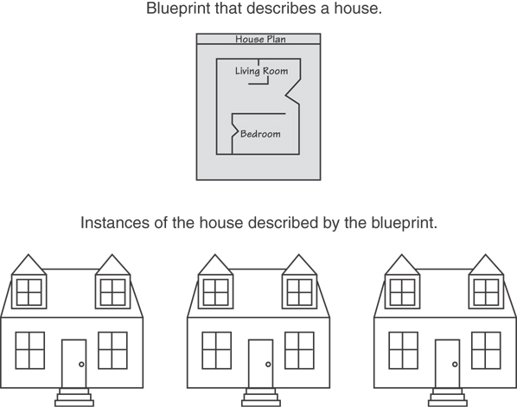
Classes and Objects
A Class is like a blueprint and objects are like houses built from the blueprint

Slide 7
Object-Oriented Programming Terminology
attributes: members of a class
methods or behaviors: member functions of a class

Slide 8
More Object Terms
data hiding: restricting access to certain members of an object
public interface: members of an object that are available outside of the object. This allows the object to provide access to some data and functions without sharing its internal details and design, and provides some protection from data corruption

Slide 9
Creating a Class
Objects are created from a class
Format:
class ClassName
{
declaration;
declaration;
};

Slide 10
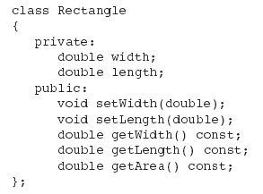
Classic Class Example

Slide 11
Access Specifiers
Used to control access to members of the class
public: can be accessed by functions outside of the class
private: can only be called by or accessed by functions that are members of the class
In the example on the next slide, note that the functions are prototypes only (so far)

Slide 12
Class Example

Slide 13
Access Specifiers
Private Members
Public Members

Slide 14
Access Specifiers (continued)
Can be listed in any order in a class
Can appear multiple times in a class
If not specified, the default is private

Slide 15

Using const With Member Functions
const appearing after the parentheses in a member function declaration specifies that the function will not change any data in the calling object.

Slide 16
Defining a Member Function
When defining a member function:
Put prototype in class declaration
Define function using class name and scope resolution operator (::)
int Rectangle::setWidth(double w)
{
width = w;
}

Slide 17
Global Functions
Functions that are not part of a class, that is, do not have the Class::name notation, are global. This is what we have done up to this point.

Slide 18
Accessors and Mutators
Mutator: a member function that stores a value in a private member variable, or changes its value in some way
Accessor: function that retrieves a value from a private member variable. Accessors do not change an object's data, so they should be marked const.

Slide 19
Defining an Instance of a Class
An object is an instance of a class
Defined like structure variables:
Rectangle r;
Access members using dot operator:
r.setWidth(5.2);
cout << r.getWidth();
Compiler error if you attempt to access a private member using dot operator
Notes:
Show “Rectangle” class program.

Slide 20
Derived Attributes
Some data must be stored as an attribute.
Other data should be computed. If we stored “area” as a field, its value would have to change whenever we changed length or width.
In a class about a “person,” store birth date and compute age

Slide 21
Pointers to Objects
Can define a pointer to an object:
Rectangle *rPtr;
Can access public members via pointer:
rPtr = &otherRectangle;
rPtr->setLength(12.5);
cout << rPtr->getLength() << endl;

Slide 22
Dynamically Allocating Objects
Rectangle *r1;
r1 = new Rectangle();
This allocates a rectangle and returns a pointer to it. Then:
r1->setWidth(12.4);

Slide 23
Private Members
Making data members private provides data protection
Data can be accessed only through public functions
Public functions define the class’s public interface

Slide 24
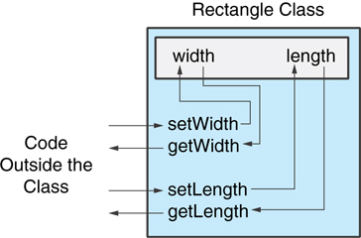
Private Members
Code outside the class must use the class's public member functions to interact with the object.

Slide 25
Separating Specification from Implementation
Place class declaration in a header file that serves as the class specification file. Name the file ClassName.h, for example, Rectangle.h
Place member function definitions in ClassName.cpp, for example, Rectangle.cpp File should #include the class specification file
Programs that use the class must #include the class specification file, and be compiled and linked with the member function definitions

Slide 26
Inline Member Functions
Member functions can be defined
inline: in class declaration
after the class declaration
Inline appropriate for short function bodies:
int getWidth() const { return width; }

Slide 27
Tradeoffs – Inline vs. Regular Member Functions
Regular functions – when called, compiler stores return address of call, allocates memory for local variables, etc.
Code for an inline function is copied into program in place of call – larger executable program, but no function call overhead, hence faster execution

Slide 28
Constructors
Member function that is automatically called when an object is created
Purpose is to construct an object and do initialization if necessary
Constructor function name is class name
Has no return type specified
(What is the real return type?)

Slide 29
Default Constructors
A default constructor is a constructor that takes no arguments.
If you write a class with no constructor at all, C++ will write a default constructor for you, one that does nothing.
A simple instantiation of a class (with no arguments) calls the default constructor:
Rectangle r;

Slide 30
Passing Arguments to Constructors
To create a constructor that takes arguments:
indicate parameters in prototype: Rectangle(double, double);
Use parameters in the definition: Rectangle::Rectangle(double w, double len) { width = w; length = len; }

Slide 31
Passing Arguments to Constructors
You can pass arguments to the constructor when you create an object:
Rectangle r(10, 5);

Slide 32
More About Default Constructors
If all of a constructor's parameters have default arguments, then it is a default constructor. For example:
Rectangle(double = 0, double = 0);
Creating an object and passing no arguments will cause this constructor to execute: Rectangle r;

Slide 33
Classes with No Default Constructor
When all of a class's constructors require arguments, then the class has NO default constructor
When this is the case, you must pass the required arguments to the constructor when creating an object

Slide 34
Destructors
Member function automatically called when an object is destroyed
Destructor name is ~classname, e.g., ~Rectangle
Has no return type; takes no arguments
Only one destructor per class, i.e., it cannot be overloaded
If constructor allocates dynamic memory, destructor should release it

Slide 35
Constructors, Destructors, and Dynamically Allocated Objects
When an object is dynamically allocated with the new operator, its constructor executes: Rectangle *r = new Rectangle(10, 20);
When the object is destroyed, its destructor executes: delete r;

Slide 36
Overloading Constructors
A class can have more than one constructor Overloaded constructors in a class must have different parameter lists:
Rectangle(); Rectangle(double);
Rectangle(double, double);

Slide 37
Only One Default Constructor and One Destructor
Do not provide more than one default constructor for a class: one that takes no arguments and one that has default arguments for all parameters
Square();
Square(int = 0); // will not compile
Since a destructor takes no arguments, there can only be one destructor for a class

Slide 38
Member Function Overloading
Non-constructor member functions can also be overloaded:
void setCost(double);
void setCost(char *);
Must have unique parameter lists as for constructors

Slide 39
Using Private Member Functions
A private member function can only be called by another member function
It is used for internal processing by the class, not for use outside of the class
If you wrote a class that had a public sort function and needed a function to swap two elements, you’d make that private

Slide 40
Arrays of Objects
Objects can be the elements of an array:
Rectangle rooms[8];
Default constructor for object is used when array is defined

Slide 41
Arrays of Objects
Must use initializer list to invoke constructor that takes arguments:
Rectangle rArray[3]={Rectangle(2.1,3.2), Rectangle(4.1, 9.9),
Rectangle(11.2, 31.4)};

Slide 42
Arrays of Objects
It isn't necessary to call the same constructor for each object in an array:
Rectangle rArray[3]={Rectangle(2.1,3.2), Rectangle(),
Rectangle(11.2, 31.4)};

Slide 43
Accessing Objects in an Array
Objects in an array are referenced using subscripts
Member functions are referenced using dot notation:
rArray[1].setWidth(11.3);
cout << rArray[1].getArea();

Slide 44
The Unified Modeling Language
UML stands for Unified Modeling Language.
The UML provides a set of standard diagrams for graphically depicting object-oriented systems

Slide 45
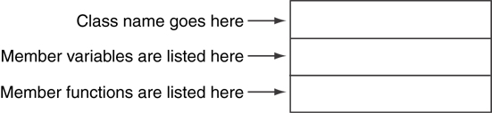
UML Class Diagram
A UML diagram for a class has three main sections.

Slide 46
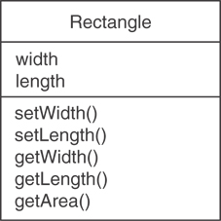
Example: A Rectangle Class
class Rectangle
{
private:
double width;
double length;
public:
bool setWidth(double);
bool setLength(double);
double getWidth() const;
double getLength() const;
double getArea() const;
};

Slide 47
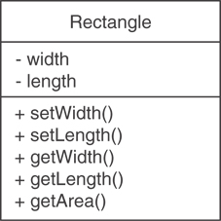
UML Access Specification Notation
In UML you indicate a private member with a minus (-) and a public member with a plus(+).
These member variables are private.
These member functions are public.

Slide 48
UML Data Type Notation
To indicate the data type of a member variable, place a colon followed by the name of the data type after the name of the variable.
- width : double
- length : double

Slide 49
UML Parameter Type Notation
To indicate the data type of a function’s parameter variable, place a colon followed by the name of the data type after the name of the variable.
+setWidth(w : double)

Slide 50
UML Function Return Type Notation
To indicate the data type of a function’s return value, place a colon followed by the name of the data type after the function’s parameter list.
+ setWidth(w : double) : void

Slide 51
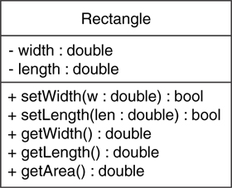
The Rectangle Class

Slide 52
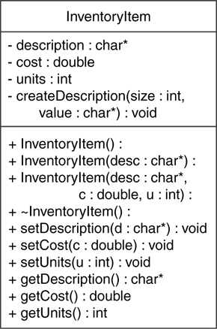
Showing Constructors and Destructors
No return type listed for constructors or destructors
Constructors
Destructor

