Slide 1
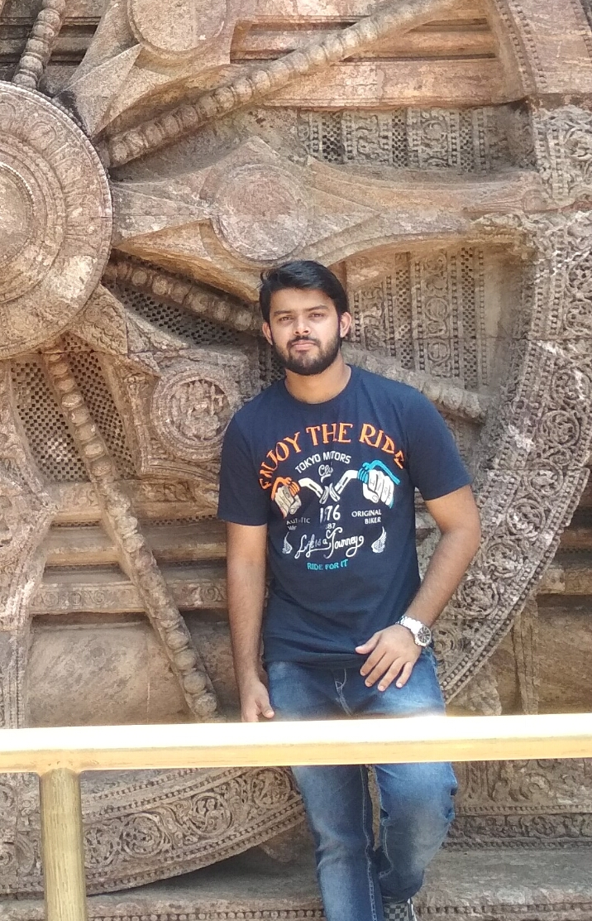
Portfolio
Thejus K V

Slide 2
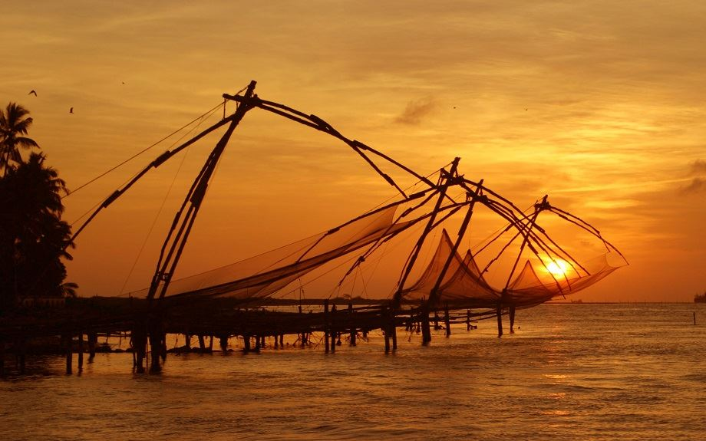
Born on 26th October
Hailing from Gods own country Kerala

Slide 3


Slide 4
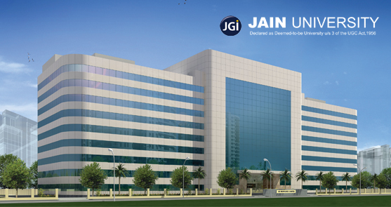
Education
Graduated from Jain University Bangalore
Did my degree From St Aloysius College Mangalore
10+2 from Kendriya Vidyalaya Keltron Nagar , Kerala

Slide 5

Career summary

Slide 6
Professional career
Started journey in Mindtree Kalinga as a Trainee Engineer.
Undergone training as a Java Full Stack Engineer

Slide 7




Technical skills
Java
Angular 5
Spring MVC
Hibernate
HTML5 , CSS , Bootstrap
Javascript
MySQL

Slide 8

Project @ Orchard
VIBGYOR PAINTS
PROJECT AT ORCHARD
Link: https://vibgyorpaints2018.azurewebsites.net/

Slide 9
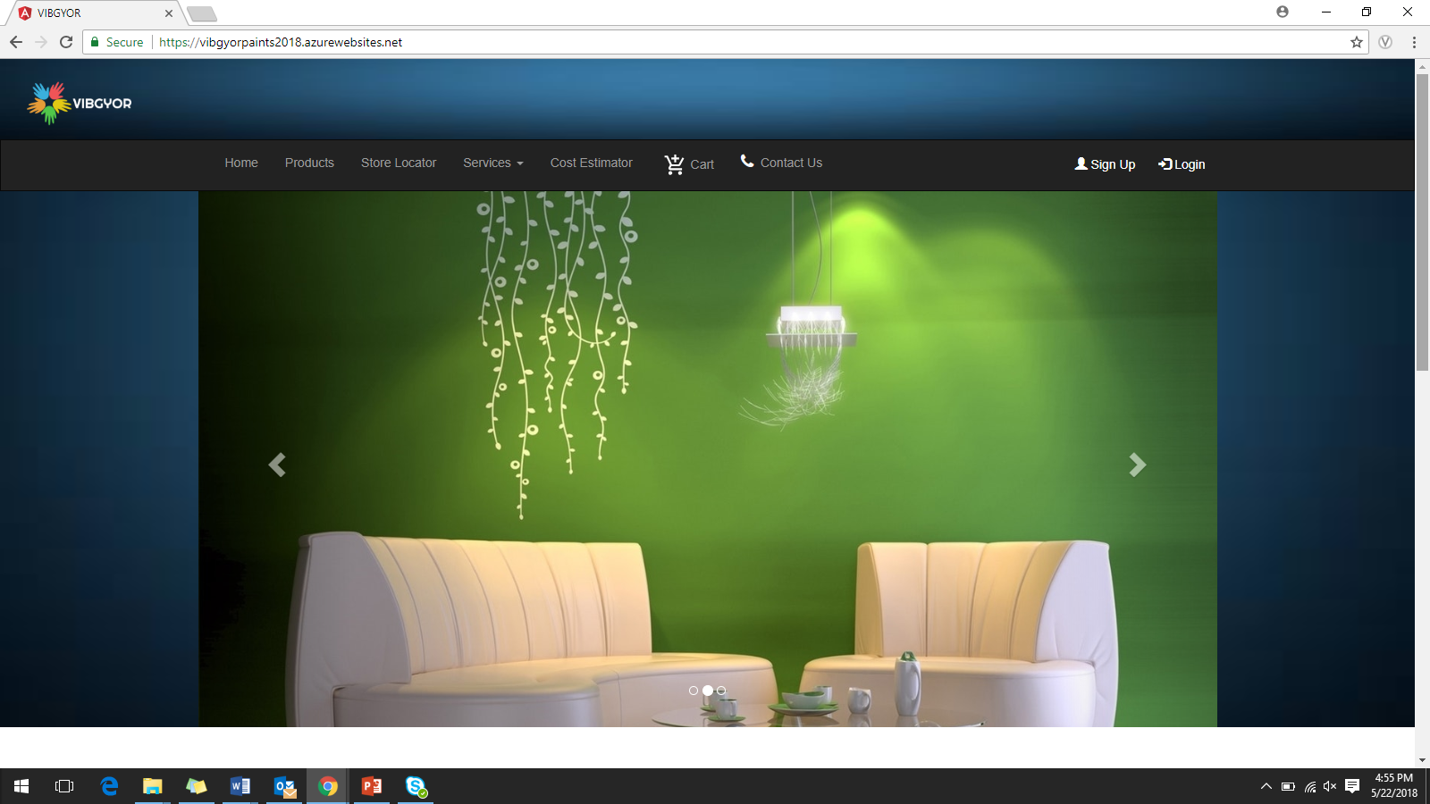
Home Page

Slide 10
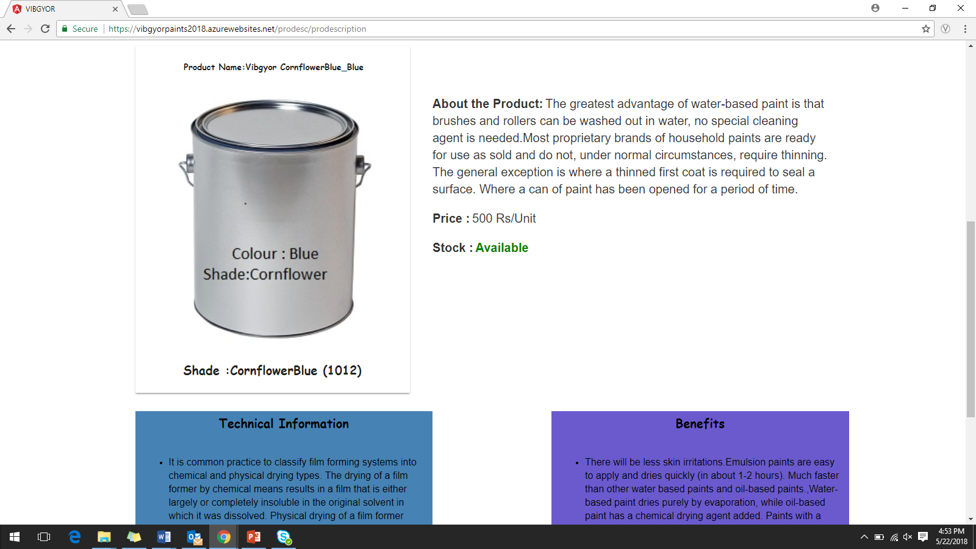
Product Description Page:

Slide 11
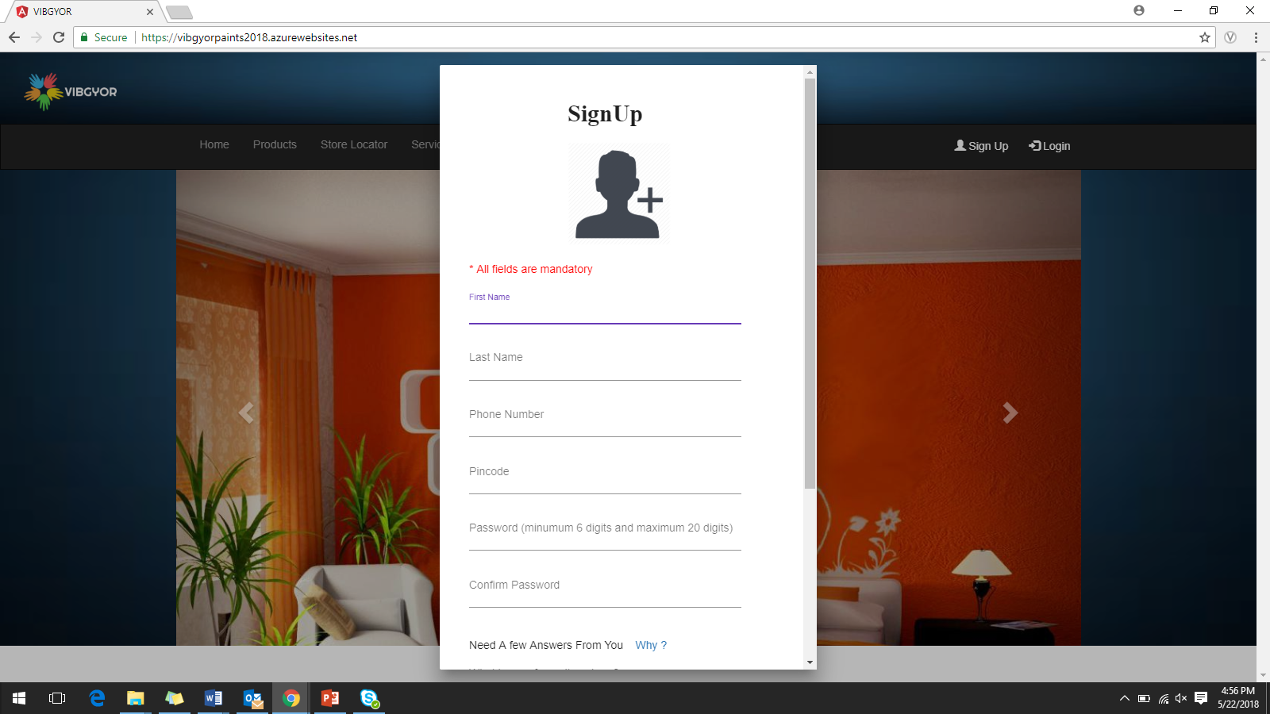

Slide 12
Life At Orchard
Started my Professional journey at Mindtree Kalinga as a trainee and I became a campus mind .
I was very fortunate to be in the Orchard program with lots of new faces and know culture inherited to each person.
Orchard program taught us technology as well as values that a professional should possess.
Even though we were under lot of pressure , It was worth being in Mindtree Kalinga .
And now I am proud to say that I am a Mindtree Mind.

Slide 13
Thank You
Contact:
Thejus.Kallyadanveettil@mindtree.com
thejuskv93@gmail.com

