Slide 1


Skin Care Database
DB Administration and Security ISEC-325
Supervised by:
Dr. Nadiah Fiad Alnomasy
Submission Date: 30 Nov, 2024
Group number : 7
Section: 351
Thekra Yousef Alslhani 202200150
Raneem Bander Alhathal 202206908
Bayan Ibrahim Altamimi 202204698

Slide 2

Table of Contents:
Introduction:
Code:
Code Explanation:
Output:
References:

Slide 3
Introduction:
The current generation of people is more conscious about their health, including having a regular skincare routine.
A skincare routine keeps your skin clear, fresh, and healthy by removing dirt and oil, preventing acne, and reducing sunspots.
It's a simple way to maintain a youthful and radiant complexion.

Slide 4
Introduction:
This project is dedicated to securing and managing a database for a medium-sized skin care company, focusing on protecting sensitive employee information. The database will store critical data such as employee numbers, salaries, emails, and birth dates. Through the implementation of access control mechanisms, encryption techniques, and role-based permissions, the project ensures the confidentiality and integrity of this sensitive information. The documentation details the process of database creation, role assignment, data encryption, and security testing to meet best practices in database administration and security..

Slide 5
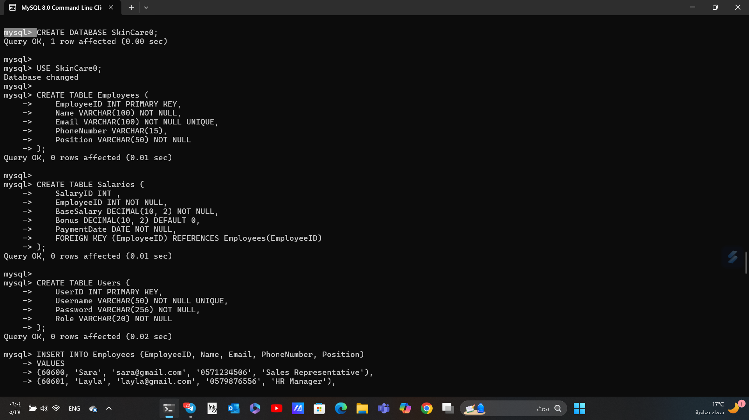
Command :

Slide 6
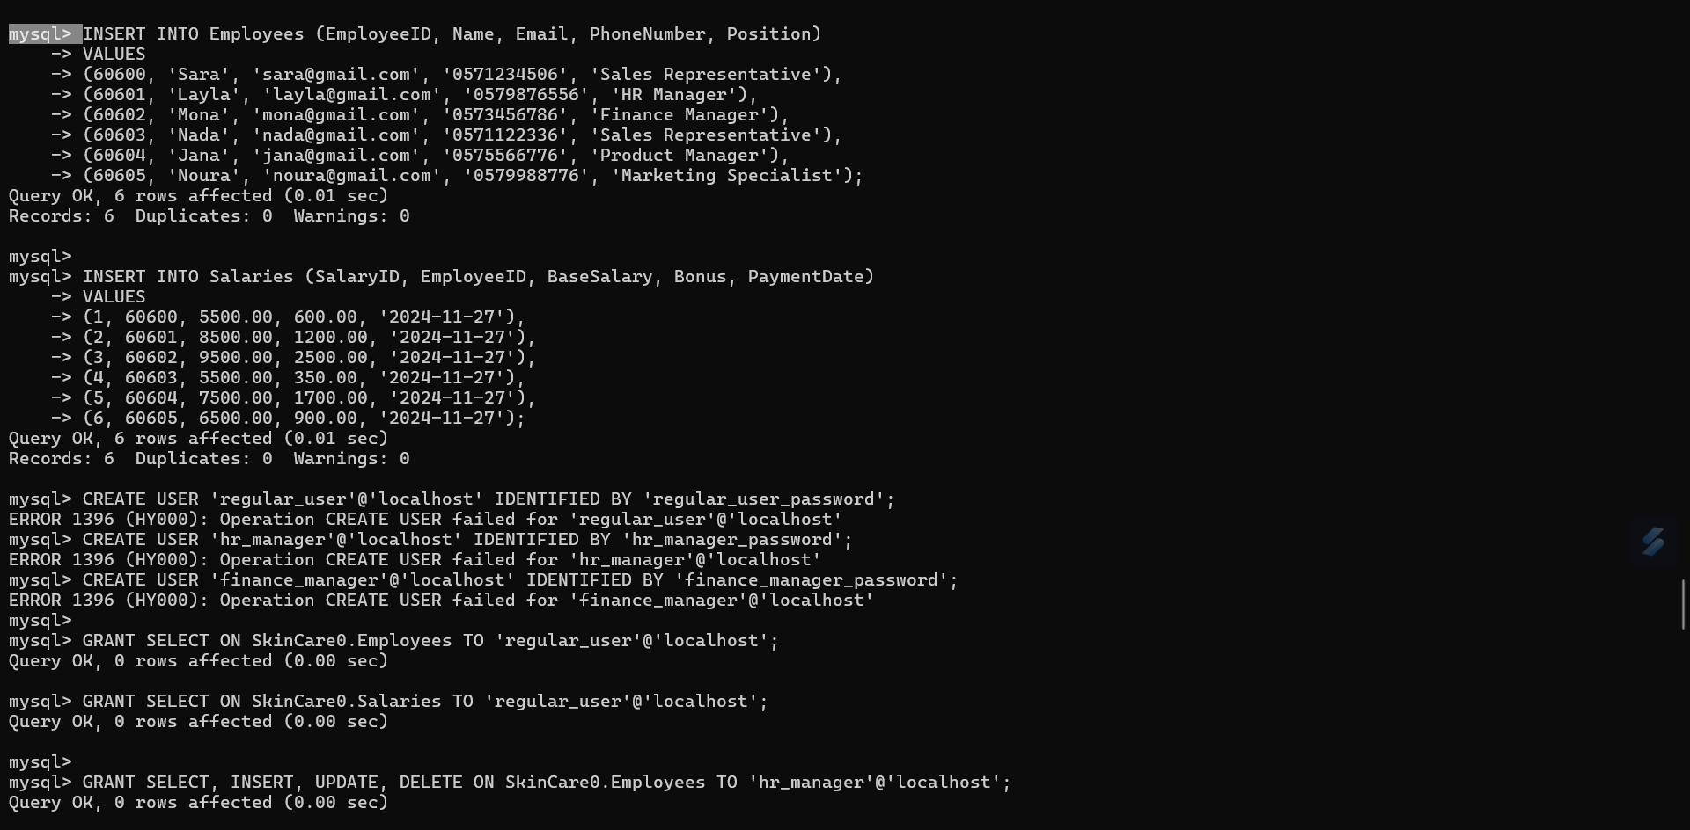
Command :

Slide 7
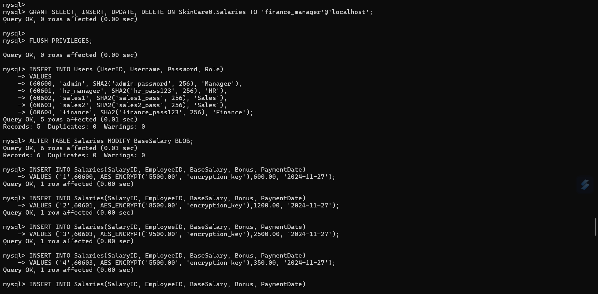
Command :

Slide 8
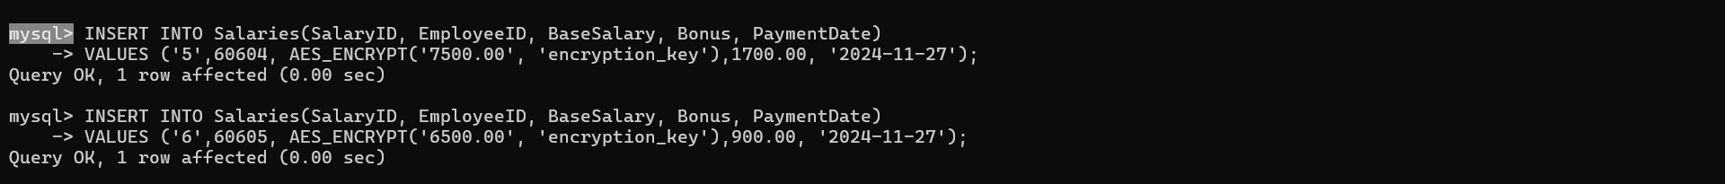
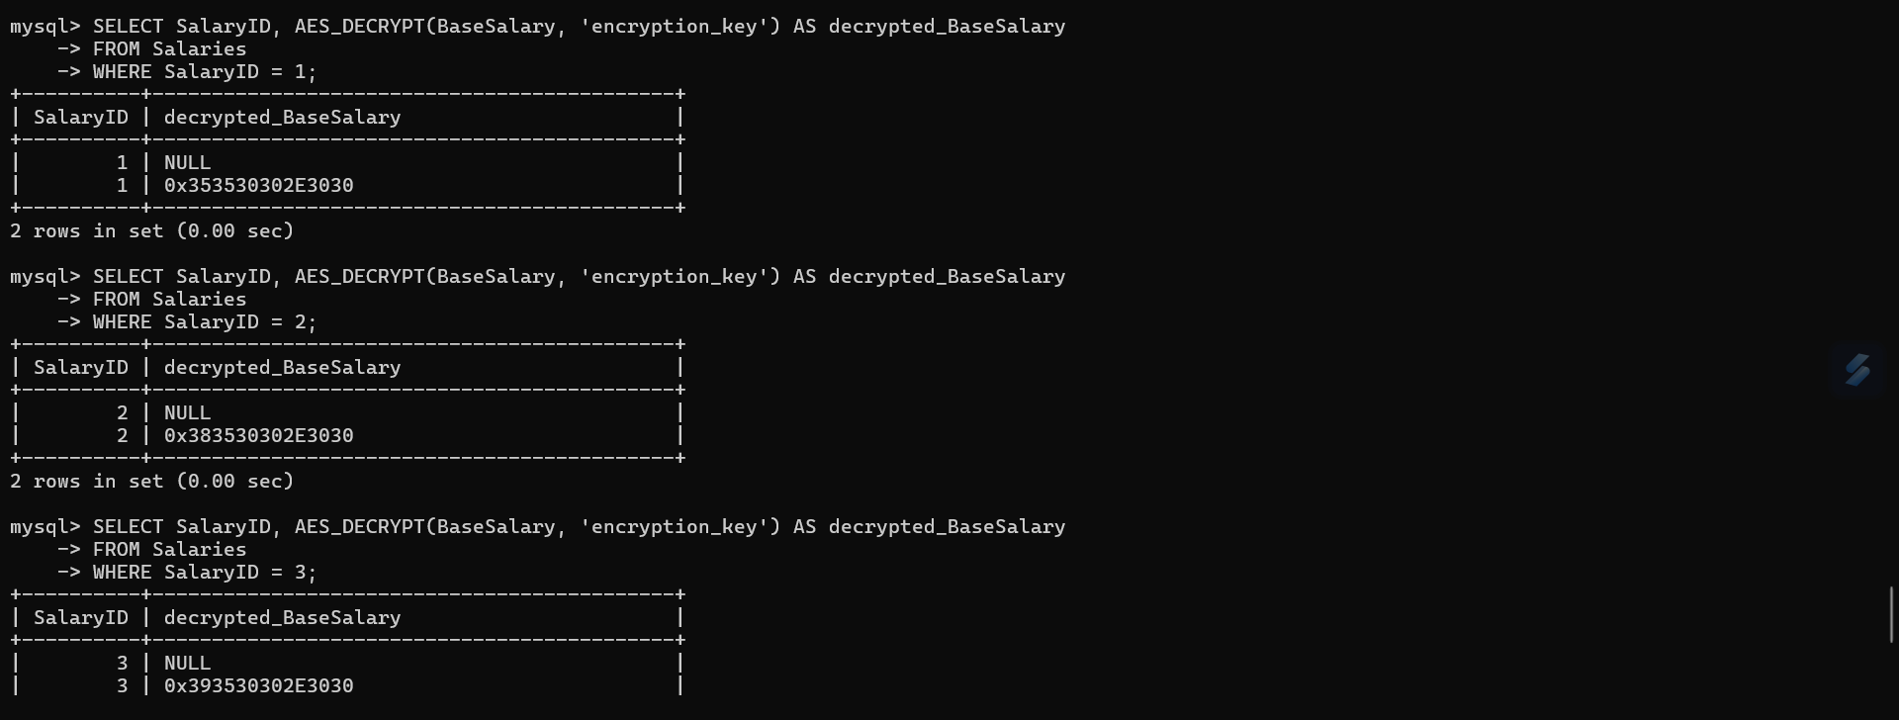
Command :

Slide 9
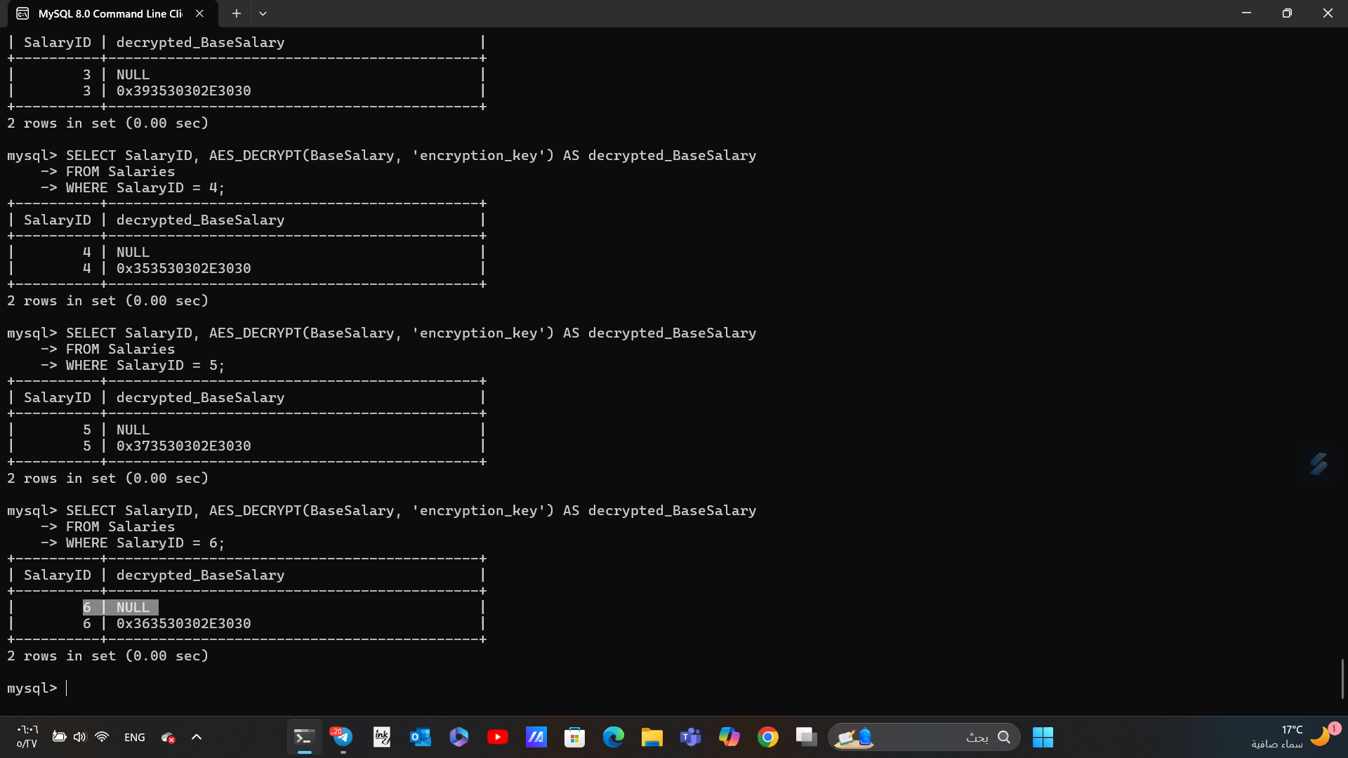
Command :

Slide 10
Code Explanation :
The provided SQL script demonstrates a systematic approach to designing, securing, and managing a database for a skincare company. Here's a detailed breakdown:
Database and Table Creation:
CREATE DATABASE SkinCare0; creates the main database.
Tables:
Employees: Stores employee information with fields like EmployeeID, Name, Email, PhoneNumber, and Position. The Email field is unique to prevent duplicates.

Slide 11
Code Explanation :
Salaries: Links salary details to employees using EmployeeID as a foreign key. It includes BaseSalary, Bonus, and PaymentDate.
Users: Stores system users' login credentials and roles, hashed for security using SHA2.
2. Data Insertion:
The INSERT INTO statements populate the tables with sample employee details, salaries, and user accounts.

Slide 12
Code Explanation :
3. User Accounts and Permissions:
SQL users are created (regular_user, hr_manager, finance_manager) with specific roles and secure passwords.
Permissions are granted:
regular_user can only view (SELECT) data.
hr_manager can view and modify employee data.
finance_manager has similar permissions for the salaries table.

Slide 13
Code Explanation :
4. Data Encryption:
Sensitive data in the Salaries table is encrypted using AES_ENCRYPT with a key (encryption_key).
Decryption is done using AES_DECRYPT, allowing secure retrieval of sensitive information.
5. Testing and Validation:
Queries validate encryption and decryption by retrieving and decrypting specific salary records.

Slide 14
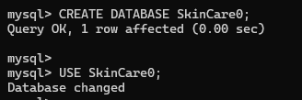
Output:
Running the code would yield the following results:
Successful creation of the SkinCare0 database and its tables.

Slide 15
Output:
Employees Table
This table represents basic employee information, including the following columns:
EmployeeID: The employee's unique identifier.
Name: The employee's name.
Email: The employee's email.
PhoneNumber: The employee's phone number.
The data in this table is clear and not encrypted since it doesn't contain sensitive information directly.

Slide 16
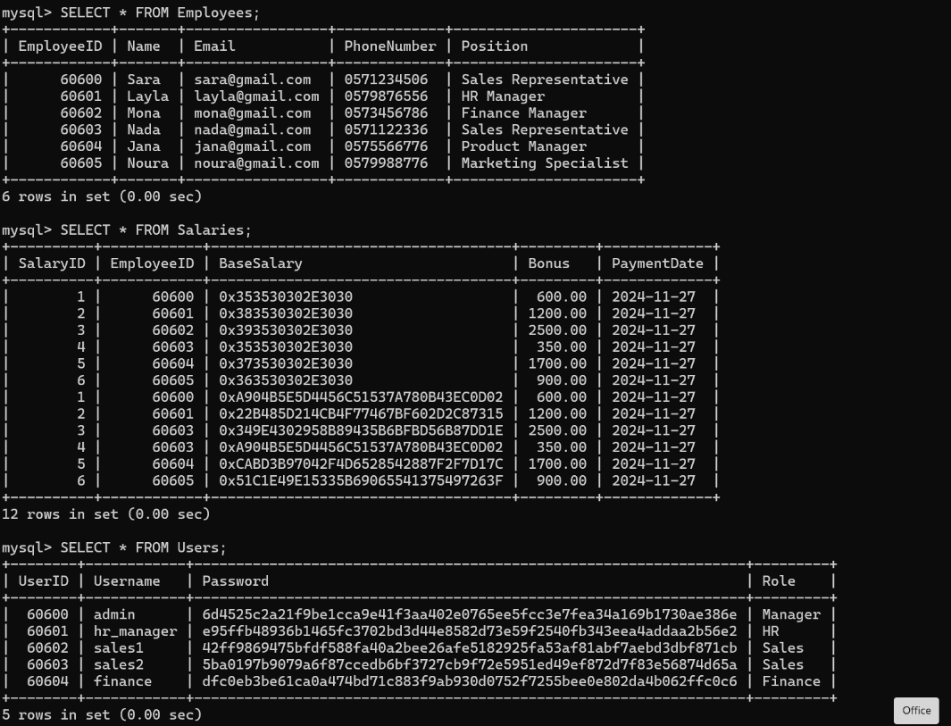
Output:

Slide 17
Output:
Salaries Table
This table contains information about employee salaries, with some columns encrypted for privacy protection:
SalaryID: The salary record's unique identifier.
EmployeeID: The employee's unique identifier linked to the salary.
BaseSalary: Encrypted using AES algorithm.
Bonus: Additional bonuses.
PaymentDate: The date the salary is paid.

Slide 18
Output:

Slide 19
Output:
Salary Encryption
The AES algorithm was used to encrypt the BaseSalary column.
To reveal the original salary (after decryption), the following query was executed:

Slide 20
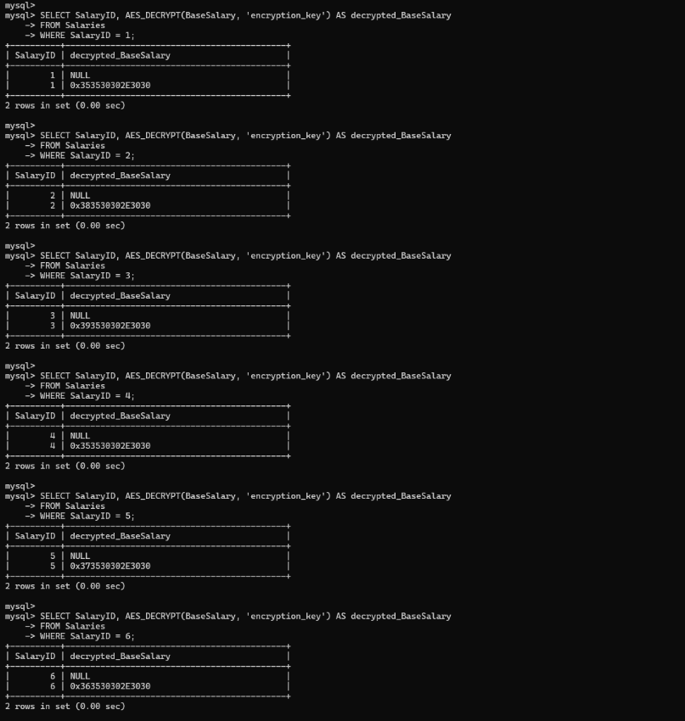
Output:

Slide 21
Output:
Users Table
This table contains login information for users, with the following columns:
UserID: The user's unique identifier.
Username: The username.
Password: Hashed using the SHA algorithm.
Role: The user's role (e.g., Manager, HR, Sales).

Slide 22
Output:

Slide 23

References:
MySQL AES Functions Documentation
MySQL SHA2 Function Documentation
SQL Server HASHBYTES Documentation

Slide 24
Thank you
Do you have any question?

