Slide 1

Good To Go
System

Slide 2
Descrption
The system is an online platform designed to reduce food waste by connecting restaurants ,bakeries and stores with customers
Users can discover restaurants, bakeries, and stores that
have extra food available at discounted prices
They can choose an offer ,reserve it and pick it up at the specified time.
The system allows users to manage their reservations and orders
,save their favorite places and rate the food they receive
On the business side , restaurants and stores can add their available surplus food to the system ,set the price and quantity
and manage their offers and reservations
Objectives
Reduce food waste .
Help restaurants and stores benefit from their surplus food.
Provide customers with affordable food options.
Support a more sustainable future

Slide 3
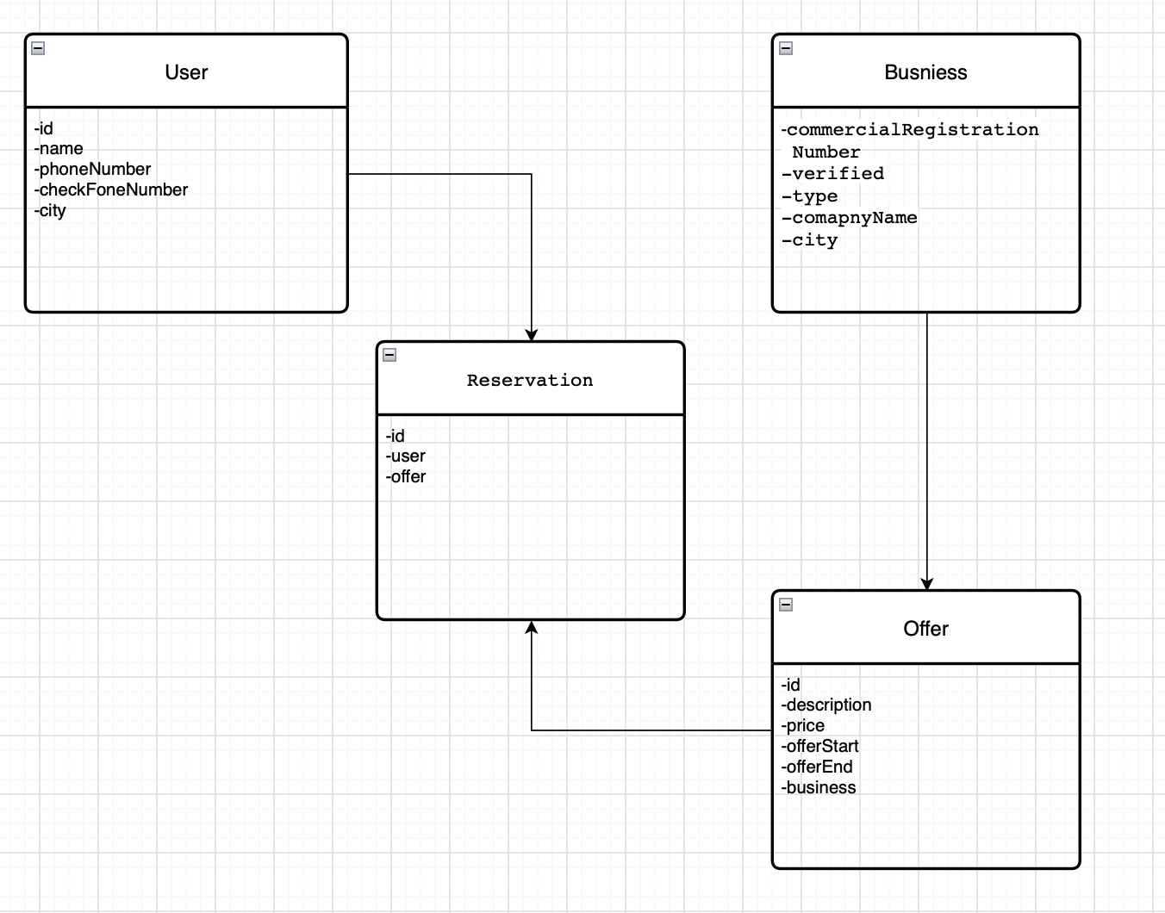
Class Relationship
Reservation is associated with a User because every reservation must be made by a user.
Reservation is associated with an Offer because every reservation must be for a specific offer.
Offer is associated with a Business because each offer belongs to a specific business.
This creates the relationship: User → Reservation Offer Business.

Slide 4
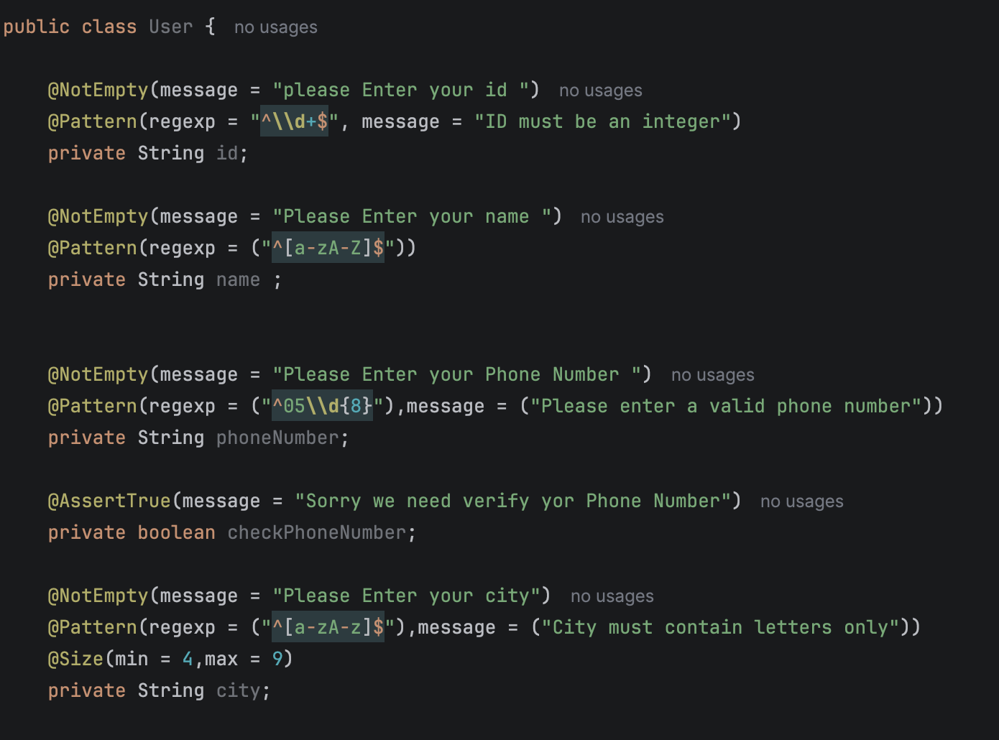
Validation Checklist
User
Field | Validation Criteria | Potential Consequence of Failure
ID | Not Empty + exactly 10 digits | Invalid user identification
Name | Not Empty + letters only | Invalid user name
Phone Number | Not Empty + starts with 05 + exactly 10 digits | Invalid contact information
Phone Verification | Must be true | User cannot be verified
City | Not Empty + letters only + size 4–9 characters | Invalid location information

Slide 5
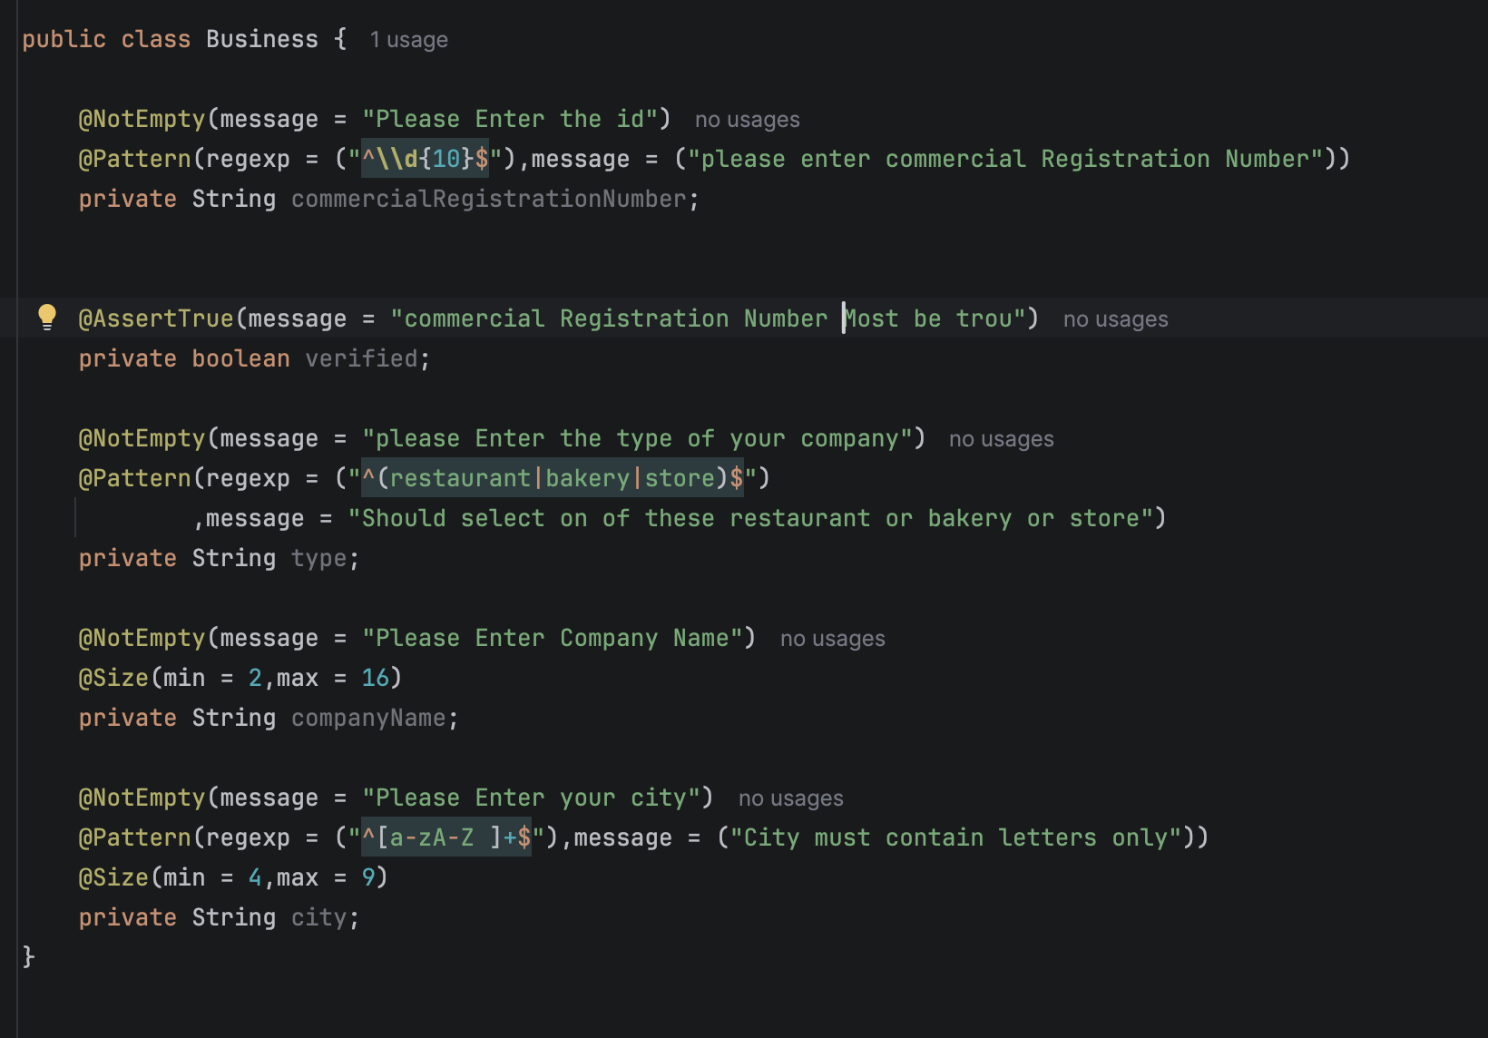
Validation Checklist
Business
Field | Validation Criteria | Potential Consequence of Failure
Commercial Registration Number | Not Empty + exactly 10 digits | Invalid business identification
Verification | Must be true | Business cannot be verified
Type | Not Empty + must be restaurant, bakery, or store | Invalid business type
Company Name | Not Empty + size 2–16 characters | Invalid company name
City | Not Empty + letters only + size 4–9 characters | Invalid business location

Slide 6
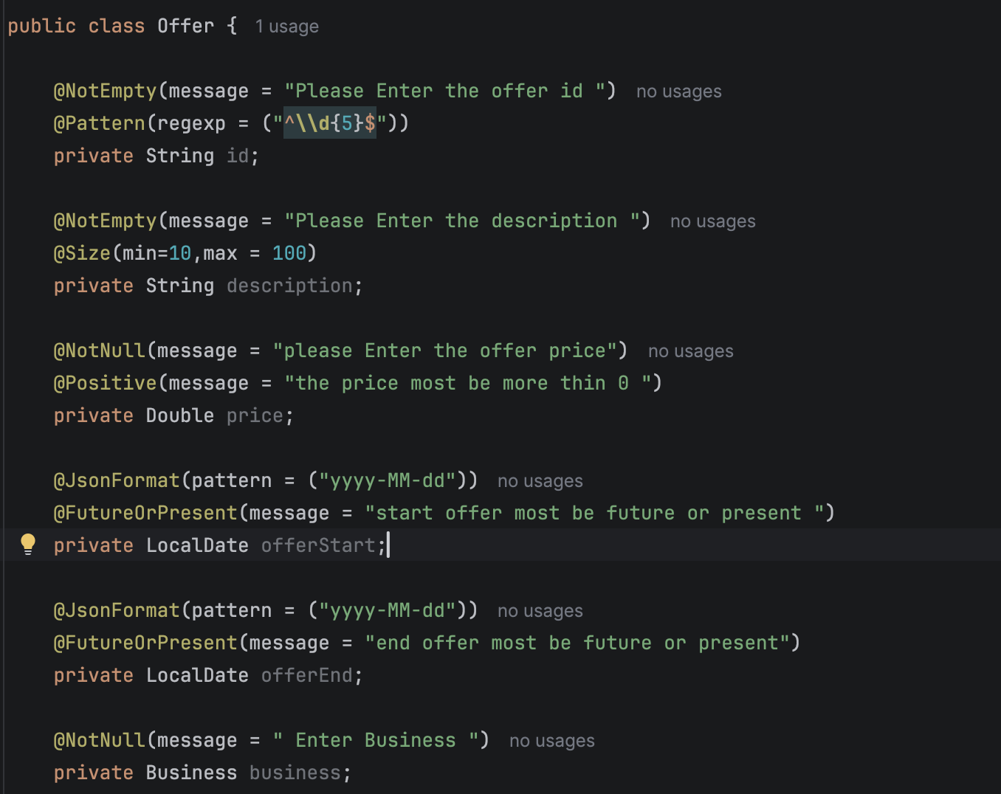
Validation Checklist
Offer
Field | Validation Criteria | Potential Consequence of Failure
ID | Not Empty + exactly 5 digits | Invalid offer identification
Description | Not Empty + size 10–100 characters | Invalid offer description
Price | Not Null + greater than 0 | Invalid offer price
Offer Start | Must be today or in the future | Offer cannot be started
Offer End | Must be today or in the future | Offer cannot be ended
Business | Not Null | Offer cannot be associated with a business

Slide 7
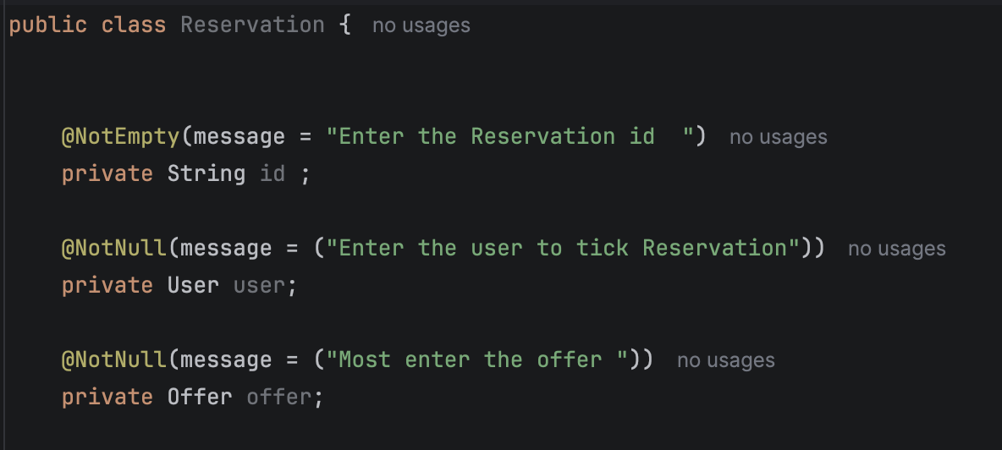
Validation Checklist
Reservation
Field | Validation Criteria | Potential Consequence of Failure
ID | Not Empty | Invalid reservation identification
User | Not Null | Reservation cannot be associated with a user
Offer | Not Null | Reservation cannot be associated with an offer

Slide 8
Future Development
Market Inspiration
Existing applications in the Saudi market, such as KNZ and Barakah offer a similar concept by allowing users to benefit from surplus food at discounted prices. The idea of Good To Go was inspired by these applications with the goal of developing a more comprehensive user experience.
Proposed Features
Recommendations — Suggest offers based on user preferences.
SmartNotifications & Promotions — Notify users about new offers and promotions.
Ratings & Reviews — Allow users to rate their experience.
Restaurant Reservations — Enable users to reserve restaurants through the system
Location-Based Offers — Show offers available near the user.
Summary
Good To Go is a simple system for managing users, businesses, offers, and reservations. It ensures accurate data through validation and can be enhanced with more features in the future.
Thank You

