Slide 1
Lecture 11
Stored Procedure

Slide 2
PostgreSQL Procedure
A stored procedure is a set of SQL statements that can be stored and executed in a database management system (DBMS).
It is a way to encapsulate a sequence of database operations, allowing for code reuse, better performance, and improved security.
Stored procedures are typically written in SQL, but they can also contain procedural logic (such as loops, conditionals, and error handling), depending on the DBMS.

Slide 3
Advantage 1
Reduce the number of round trips between application and database servers.
All SQL statements are wrapped inside a function stored in the PostgreSQL database server so the application only has to issue a function call to get the result back instead of sending multiple SQL statements and wait for the result between each call.

Slide 4
Advantage 2
Increase application performance because the user- defined functions are pre-compiled and stored in the PostgreSQL database server.

Slide 5
Advantage 2
Be able to reuse in many applications. Once you develop a function, you can reuse it in any applications.

Slide 6
Disadvantages
Slow in software development because it requires specialized skills that many developers do not possess.
Make it difficult to manage versions and hard to debug.
May not be portable to other database management systems e.g., MySQL or Microsoft SQL Server.

Slide 7
Stored Procedures
By default, PostgreSQL supports three procedural languages: SQL, PL/pgSQL, and C.
You can also load other procedural languages e.g., Perl, Python, JS, Ruby, Java and TCL into PostgreSQL using extensions.

Slide 8
Key Characteristics
Key Characteristics
Precompiled:
Once a stored procedure is created, it is precompiled and stored in the database. The DBMS doesn't need to parse and compile the SQL each time it's executed.
Encapsulation:
Stored procedures allow you to group related SQL statements into a single logical unit.

Slide 9
Key Characteristics
Parameterization:
Stored procedures often accept input parameters, and they may also return output parameters or result sets.
Security:
You can control access to sensitive data by providing users with permissions
Error Handling

Slide 10
PL/pgSQL Overview
PL/pgSQL (Procedural Language/PostgreSQL) is a procedural extension for PostgreSQL that allows users to write functions, procedures, and triggers with control-flow constructs like loops, conditionals, and error handling. It enhances standard SQL by adding procedural logic for more complex database operations.
Key Features of PL/pgSQL
Control Structures: Supports IF, CASE, LOOP, WHILE, and FOR.
Error Handling: Provides EXCEPTION blocks to manage runtime errors.
Dynamic SQL: Allows execution of dynamically constructed queries.
Variables and Parameters: Enables declaration and manipulation of variables.
Integration: Works seamlessly with PostgreSQL's SQL capabilities.

Slide 11
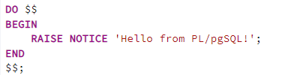
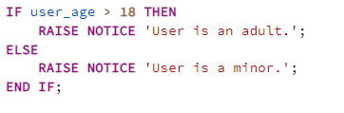
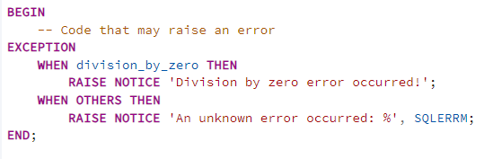

PL/pgSQL Basics
Control Structures
Declaring PL/pgSQL Code Blocks
Error Handling with EXCEPTION Blocks
Declaring Variables

Slide 12
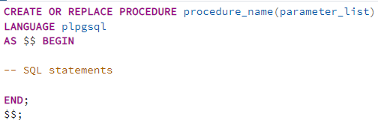
Basic Syntax
LANGUAGE plpgsql: Specifies the procedural language for the procedure.
$$: Delimiters for the procedure body.

Slide 13
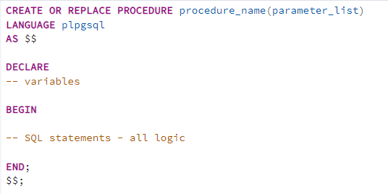
Basic Syntax
In declare you will describe all variables

Slide 14
Parameters
Parameters in stored procedures allow passing data in and out of the procedure, enabling dynamic behavior. PostgreSQL supports three types of parameters:
IN: Used to pass values into the procedure.
OUT: Used to return values from the procedure.
INOUT: Used to pass a value in and return a value out.

Slide 15
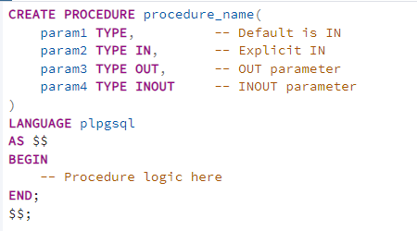
Parameters

Slide 16
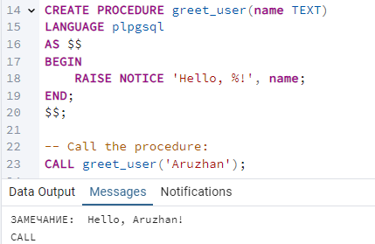
IN Parameters Example

Slide 17
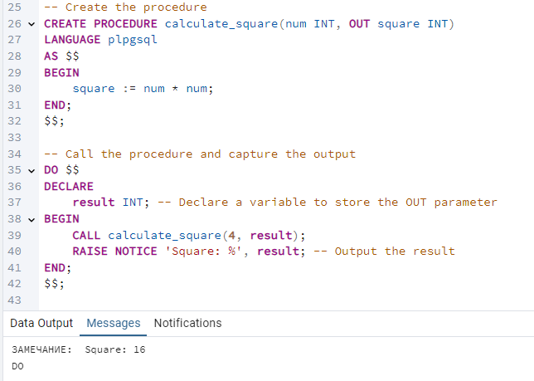
OUT Parameters Example

Slide 18
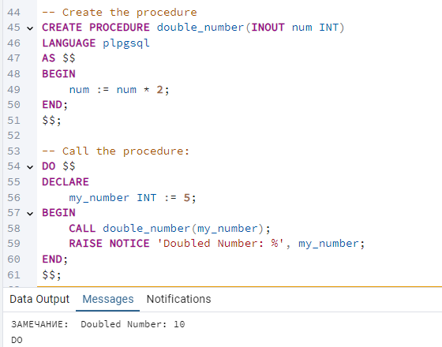
INOUT Parameters Example

Slide 19
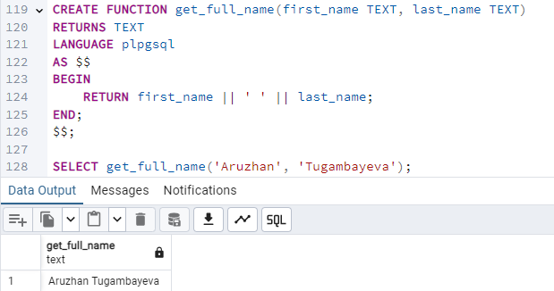
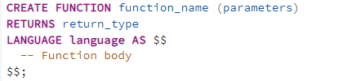
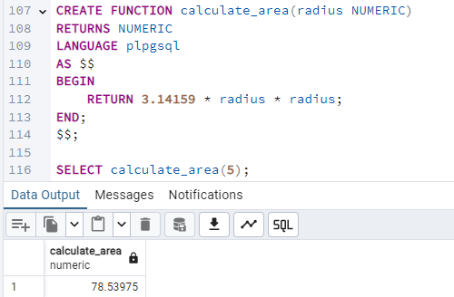
Functions
Functions allow you to encapsulate logic, perform calculations, and return results. They can accept parameters, return values or tables, and handle errors using PL/pgSQL or SQL.
Syntax
Function with Multiple Parameters
Basic Example

Slide 20
Stored Procedures vs. Functions
Feature | Stored Procedures | Functions
Introduction | Introduced in PostgreSQL 11 | Available since early PostgreSQL versions
Return Value | Do not return values by default | Must return a value (scalar, record, or table)
Transaction Control | Supports COMMIT, ROLLBACK, and savepoints | Cannot manage transactions
Syntax | CREATE PROCEDURE | CREATE FUNCTION
Call Statement | Invoked with CALL | Used within SQL queries or expressions
Purpose | Encapsulates workflows, automation, and complex logic | Handles reusable calculations or data processing
Dynamic SQL | Fully supports execution with EXECUTE | Limited, no transaction control
Typical Use Cases | ETL processes, data migrations, and transaction workflows | Data retrieval, calculations, and reporting

Slide 21
Stored Procedures vs. Functions
Key differences:
Can return no value
Support transaction control
Scenario | Use Stored Procedures | Use Functions
Need transaction control | Yes (supports COMMIT, ROLLBACK, savepoints) | No
Returning values | Not directly; uses OUT parameters | Yes
SQL Expression Integration | Cannot be embedded in SQL queries | Fully embeddable in SQL

Slide 22
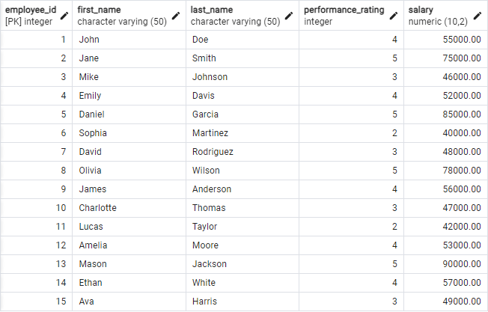
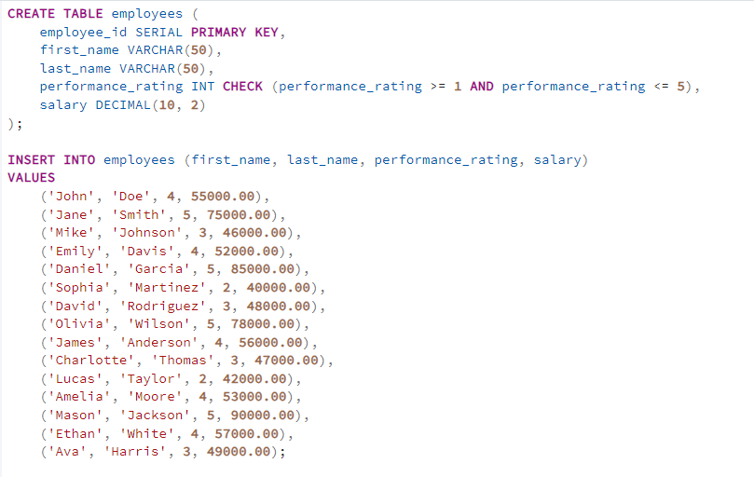
Simple Example

Slide 23
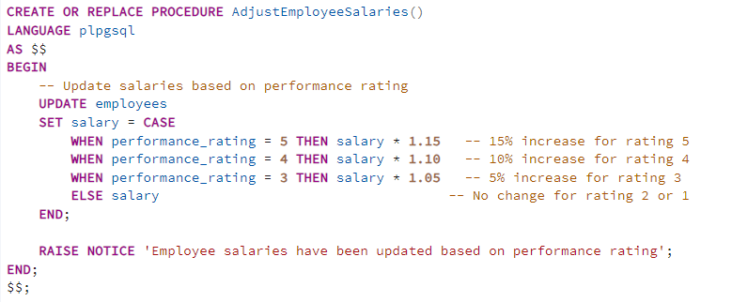


Simple Example

Slide 24
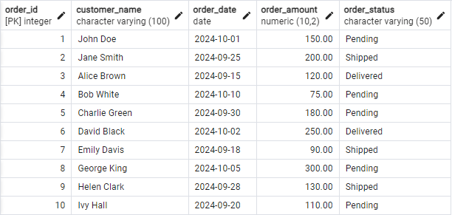
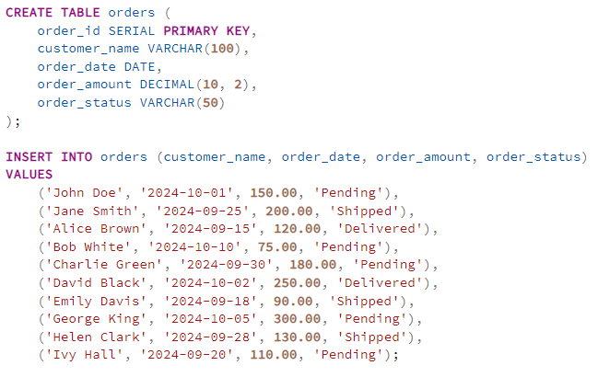
Stored Procedure with Multiple SQL Statements

Slide 25
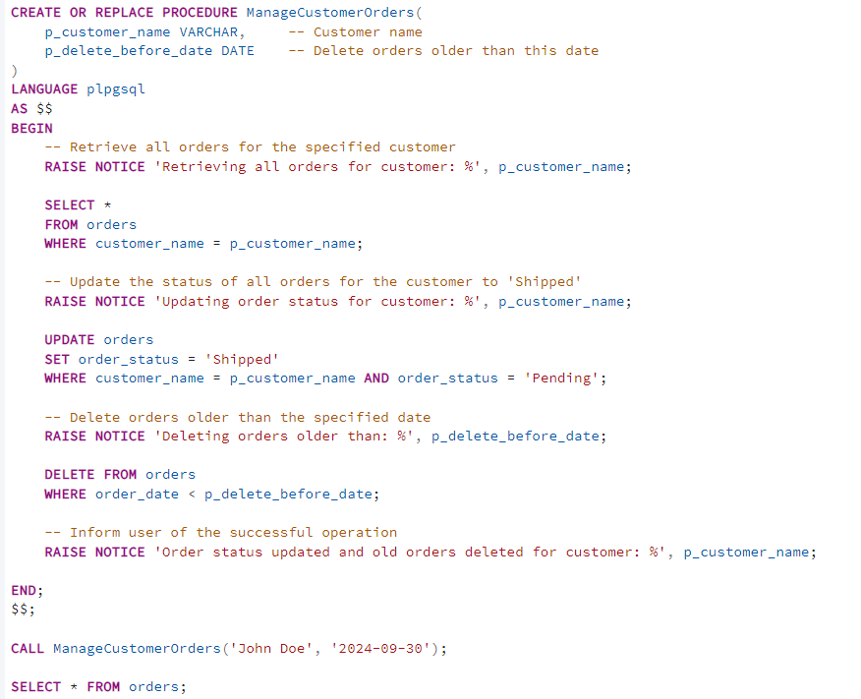
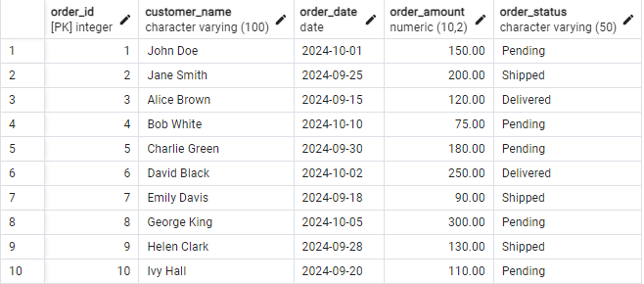
Stored Procedure with Multiple SQL Statements

Slide 26
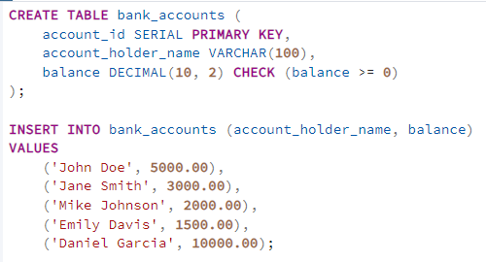
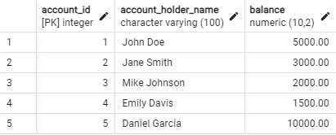
Example with transaction

Slide 27
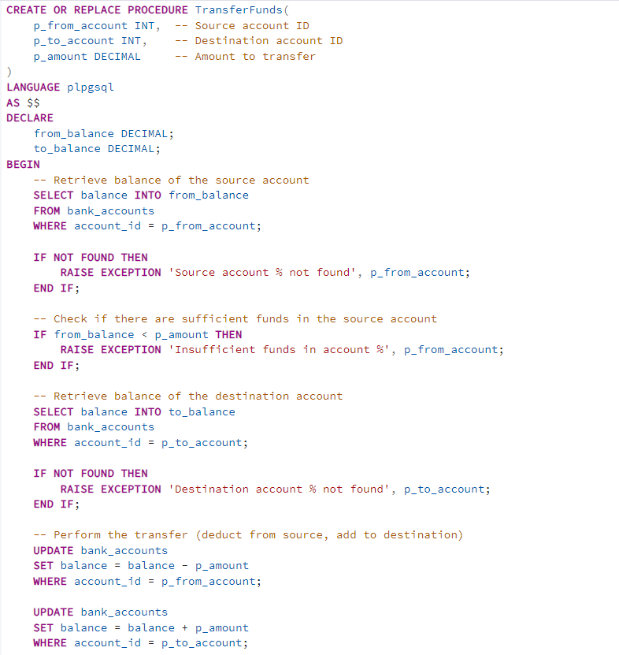
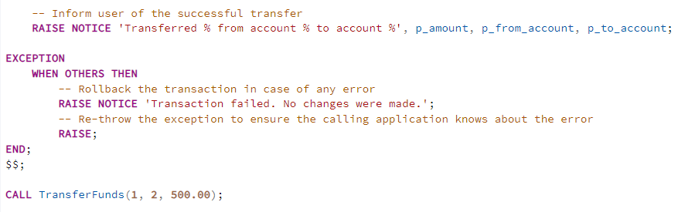
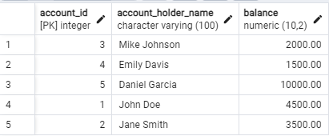
Example with transaction

Slide 28
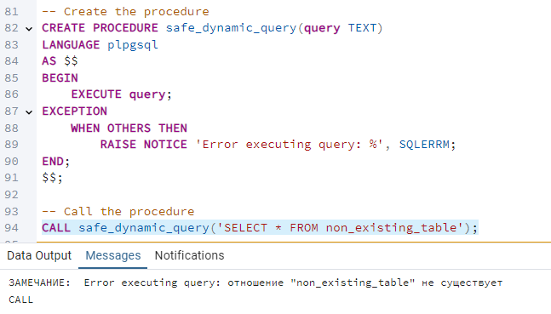
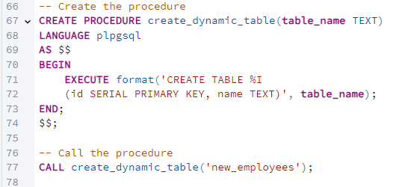
Dynamic SQL in Stored Procedures
Dynamic SQL allows you to construct and execute SQL statements at runtime.

Slide 29
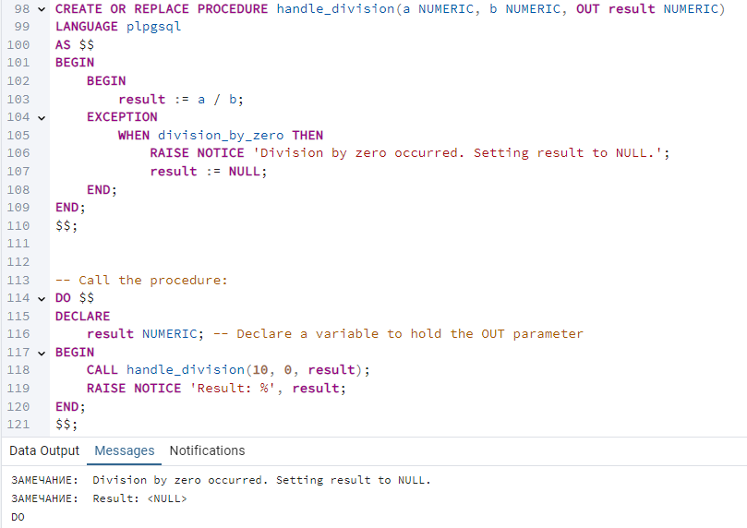
Error Handling in Stored Procedures
Error handling in PostgreSQL stored procedures ensures that errors during execution are managed gracefully

Slide 30
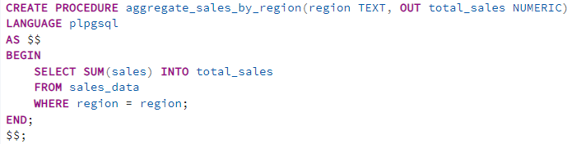
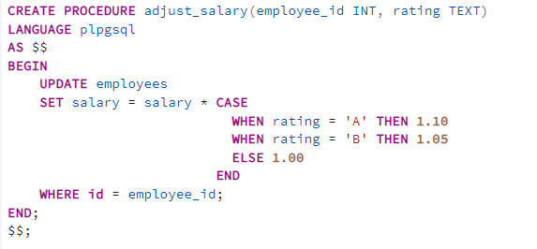
Real-World Use Cases for Stored Procedures
1. Data Transformation
Transform and preprocess data for analytics or reporting.
Example: Aggregating sales data by region and time period.
2. Business Logic Encapsulation
Encapsulate business rules within the database to enforce consistency.
Example: Automating salary adjustments based on performance ratings.

