Slide 1

Pre-University College
Masterclass Big Data
Prof.dr.ir. Arjen P. de Vries
arjen@acm.org
Nijmegen, February 20th, 2017

Slide 2

Overview
Big Data
  Defining properties?
  The data center as the computer!
Very brief: map-reduce
Streaming data!
Whatever pops up meanwhile

Slide 3
“Big Data”
If your organization stores multiple petabytes of data, if the information most critical to your business resides in forms other than rows and columns of numbers, or if answering your biggest question would involve a “mashup” of several analytical efforts, you’ve got a big data opportunity
http://hbr.org/2012/10/data-scientist-the-sexiest-job-of-the-21st-century

Slide 4
Process
Challenges in Big Data Analytics include
  capturing data,
  aligning data from different sources (e.g., resolving when two objects are the same),
  transforming the data into a form suitable for analysis,
  modeling it, whether mathematically, or through some form of simulation,
  understanding the output — visualizing and sharing the results
Attributed to IBM Research’s Laura Haas in
http://www.odbms.org/download/Zicari.pdf

Slide 5
The “Data Scientist”
Suggested reading:
  Harvard Business Review:
  http://hbr.org/2012/10/data-scientist-the-sexiest-job-of-the-21st-century/
  A 2001 (!) Bell Labs technical report
  Data Science: An Action Plan for Expanding the Technical Areas of the Field of Statistics
  http://www.stat.purdue.edu/~wsc/papers/datascience.pdf
  Quora
  http://www.quora.com/What-is-it-like-to-be-a-data-scientist

Slide 6
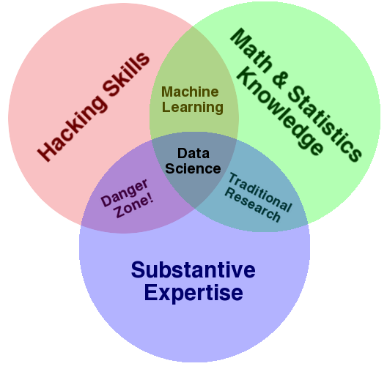

Slide 7
Big Data?
Big Data refers to datasets whose size is beyond the ability of typical database software tools to capture, store, manage and analyze
  McKinsey Global Institute, “Big data: The next frontier for innovation, competition and productivity.” May 2011.

Slide 8
Big Data?
Big data is the data that you aren’t able to process and use quickly enough with the technology you have now
  Buck Woody
  http://www.simple-talk.com/sql/database-administration/big-data-is-just-a-fad/
We need to think about data comprehensively – all types of data.

Slide 9
Big Data
The 3 Vs (sometimes others are added):
  Volume
  We measure more and more; the resulting data is very large already, and it grows faster and faster
  Velocity
  The analysis may take too long for appropriate reaction to measurement
  Variety
  The data comes in many variants, structured and unstructured

Slide 10
Why Big Data?
We can analyse (and differentiate) to the level of the individual
We are less likely to miss rare events, e.g., those that occur one out of ten million times
We can better account for the real-time nature of the data

Slide 11
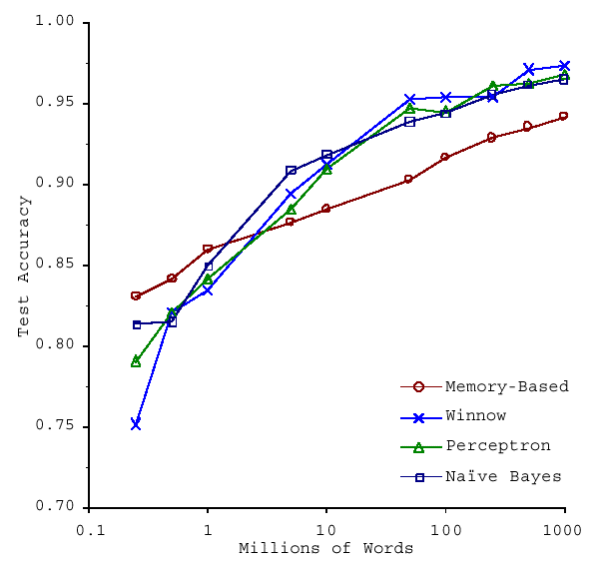
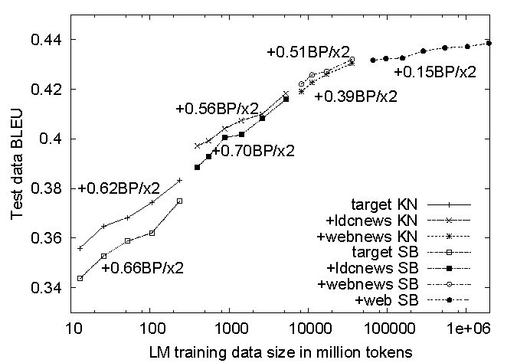
s/knowledge/data/g;
No data like more data!
How do we get here if we’re not Google?
(Banko and Brill, ACL 2001)
(Brants et al., EMNLP 2007)

Slide 12
Exercise
What examples of big data to analyze can we imagine?
How much data could that be?

Slide 13
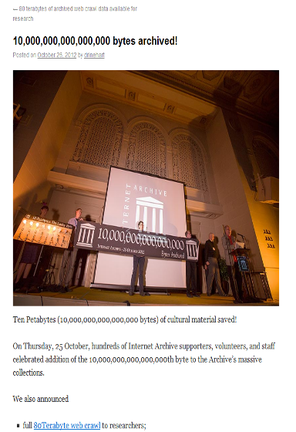
Big?
20 Terabyte?
  Clueweb 2009
80 – 120 – 150 Terabyte?
  Recent “web” crawls (IA, CommonCrawl 2009-2016, Clueweb 2012)
10 Petabyte?
  Complete Internet Archive

Slide 14







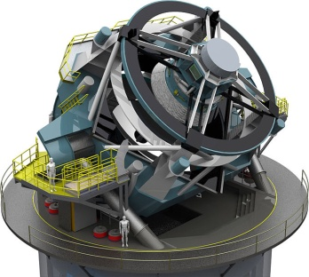
processes 20 PB a day (2008)
150 PB on 50k+ servers
running 15k apps
9 PB of user data +
>50 TB/day (11/2011)
Wayback Machine: 3 PB +
100 TB/month (3/2009)
36 PB of user data +
80-90 TB/day (6/2010)
LHC: ~15 PB a year
(at full capacity)
S3: 449B objects, peak 290k request/second (7/2011)
How much data?
LSST: 6-10 PB a year (~2015)

Slide 15
How big is big?
Facebook (Aug 2012):
  2.5 billion content items shared per day (status updates + wall posts + photos + videos + comments)
  2.7 billion Likes per day
  300 million photos uploaded per day

Slide 16
Big is very big!
100+ petabytes of disk space in one of FB’s largest Hadoop (HDFS) clusters
105 terabytes of data scanned via Hive, Facebook’s Hadoop query language, every 30 minutes
70,000 queries executed on these databases per day
500+ terabytes of new data ingested into the databases every day
http://gigaom.com/data/facebook-is-collecting-your-data-500-terabytes-a-day/

Slide 17
Back of the Envelope
Note:
“105 terabytes of data scanned every 30 minutes”
A very very fast disk can do 300 MB/s – so, on one disk, this would take
  (105 TB = 110100480 MB) / 300 (MB/s) =
  367Ks =~ 6000m
So at least 200 disks are used in parallel!
PS: the June 2010 estimate was that facebook ran on 60K servers

Slide 18
Shared-nothing
A collection of independent, possibly virtual, machines, each with local disk and local main memory, connected together on a high-speed network
  Possible trade-off: large number of low-end servers instead of small number of high-end ones

Slide 19
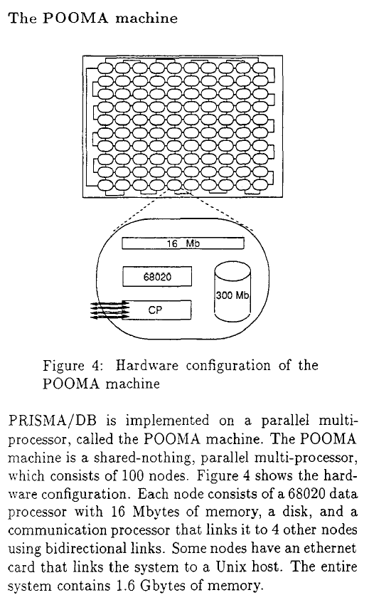
@UT ~1990

Slide 20
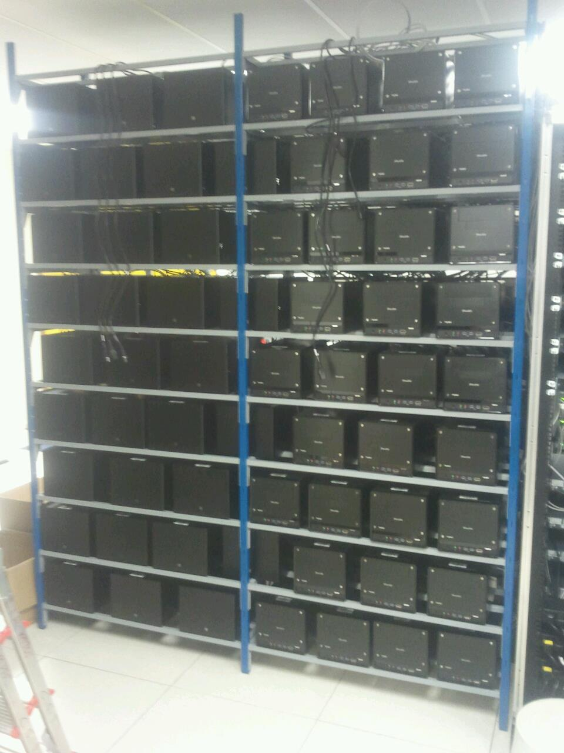
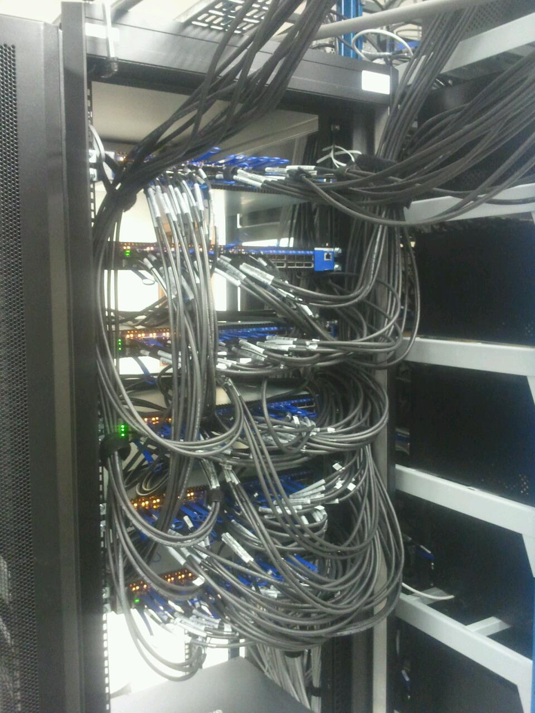
@CWI – 2011

Slide 21
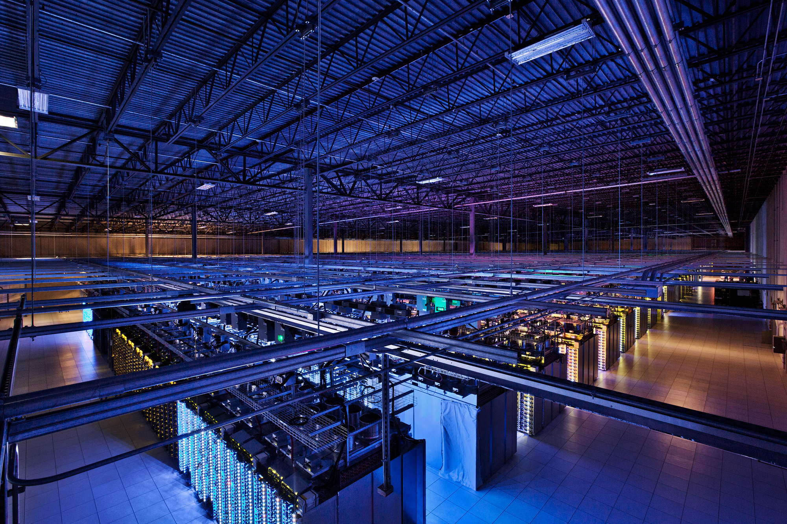
Data Center (is the Computer)
Source: Google

Slide 22
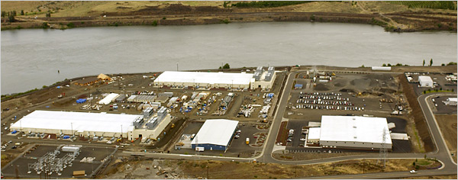
Source: NY Times (6/14/2006), http://www.nytimes.com/2006/06/14/technology/14search.html

Slide 23
FB’s Data Centers
Suggested further reading:
  http://www.datacenterknowledge.com/the-facebook-data-center-faq/
  http://opencompute.org/
    “Open hardware”: server, storage, and data center
    Claim 38% more efficient and 24% less expensive to build and run than other state-of-the-art data centers

Slide 24
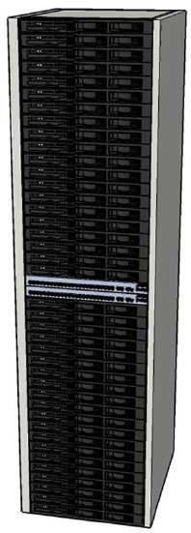
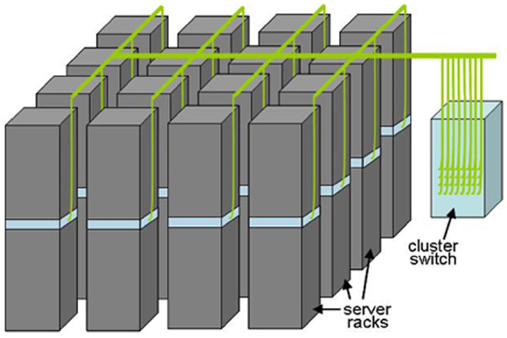
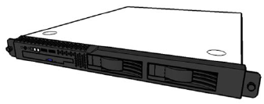
Building Blocks
Source: Barroso, Clidaras and Hölzle (2013): DOI 10.2200/S00516ED2V01Y201306CAC024

Slide 25
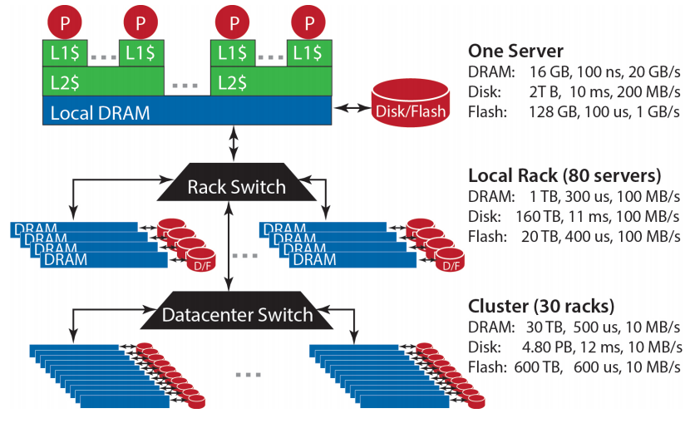
Storage Hierarchy
Source: Barroso, Clidaras and Hölzle (2013): DOI 10.2200/S00516ED2V01Y201306CAC024

Slide 26
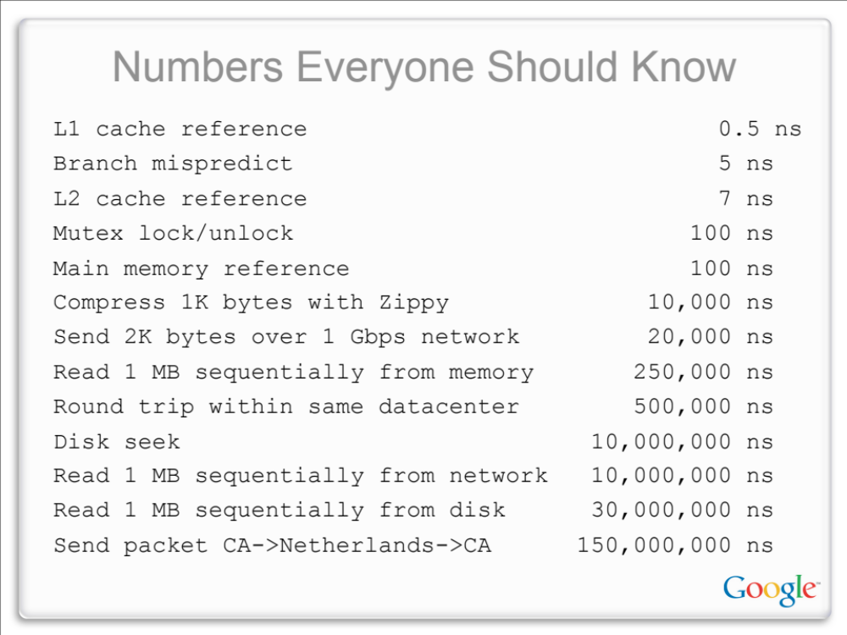
According to Jeff Dean

Slide 27
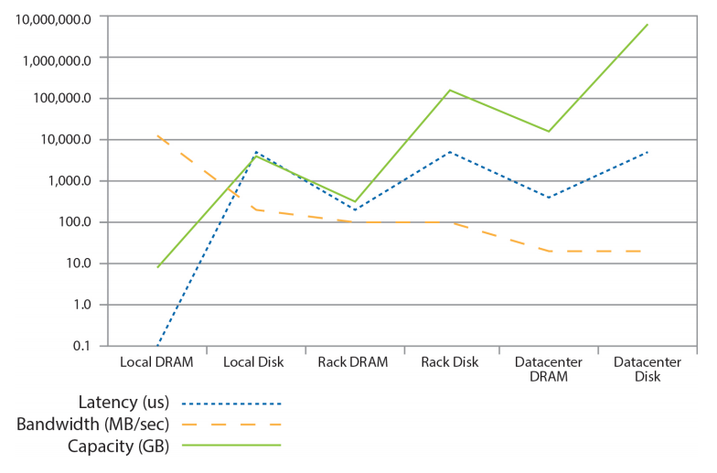
Storage Hierarchy
Source: Barroso, Clidaras and Hölzle (2013): DOI 10.2200/S00516ED2V01Y201306CAC024

Slide 28
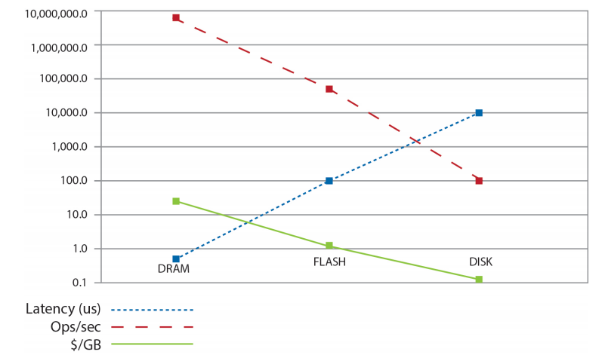
Storage Hierarchy
Source: Barroso, Clidaras and Hölzle (2013): DOI 10.2200/S00516ED2V01Y201306CAC024

Slide 29
Quiz Time!!
Consider a 1 TB database with 100 byte records
  We want to update 1 percent of the records
  Plan A:
  Seek to the records and make the updates
  Plan B:
  Write out a new database that includes the updates
Source: Ted Dunning, on Hadoop mailing list

Slide 30
Seeks vs. Scans
Consider a 1 TB database with 100 byte records
  We want to update 1 percent of the records
Scenario 1: random access
  Each update takes ~30 ms (seek, read, write)
  10⁸ updates = ~35 days
Scenario 2: rewrite all records
  Assume 100 MB/s throughput
  Time = 5.6 hours(!)
Lesson: avoid random seeks!
In words of Prof. Peter Boncz (CWI & VU):
“Latency is the enemy”
Source: Ted Dunning, on Hadoop mailing list

Slide 31
Parallel Programming is Difficult
Concurrency is difficult to reason about
  At the scale of datacenter(s)
  In the presence of failures
  In terms of multiple interacting services
In the dark ages of data center computing…
  Lots of one-off solutions, custom code
  Programmers using their own dedicated libraries
  Burden on the programmer to explicitly manage everything

Slide 32
Observation
Remember:
  0.5ns (L1) vs.
  500,000ns (round trip in datacenter)
  Δ is 6 orders in magnitude!
With huge amounts of data (and resources necessary to process it), we simply cannot expect to ship the data to the application – the application logic needs to ship to the data!

Slide 33
Gray’s Laws
How to approach data engineering challenges for large-scale scientific datasets:
  Scientific computing is becoming increasingly data intensive
  The solution is in a “scale-out” architecture
  Bring computations to the data, rather than data to the computations
  Start the design with the “20 queries”
  Go from “working to working”
  See:
  http://research.microsoft.com/en-us/collaboration/fourthparadigm/4th_paradigm_book_part1_szalay.pdf

Slide 34
Emerging (Emerged ☺) Big Data Systems
Distributed
Shared-nothing
  None of the resources are logically shared between processes
Data parallel
  Exactly the same task is performed on different pieces of the data

Slide 35
A Prototype “Big Data Analysis” Task
Iterate over a large number of records
Extract something of interest from each
Aggregate intermediate results
  Usually, aggregation requires to shuffle and sort the intermediate results
Generate final output
Map
Reduce
Key idea: provide a functional abstraction for these two operations
(Dean and Ghemawat, OSDI 2004)

Slide 36
Streaming Big Data
What if you cannot store all the data coming in?
  E.g., small devices in Internet of Things
Can you carry out the analysis without making a copy?
Hands-on session!
  Tutorial: https://rubigdata.github.io/course/puc/
  Code: https://github.com/rubigdata/puc/
But first things first: Big Food ☺

