Slide 1
Partner+ 2nd Version

Slide 2
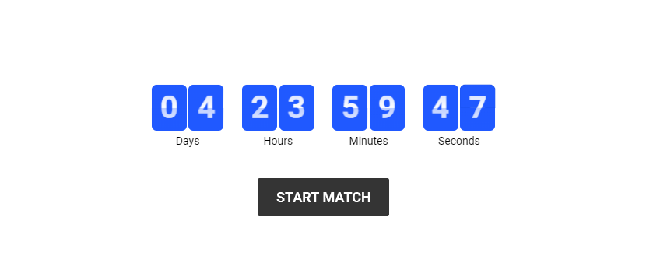
Partner+ 2nd version Notification and Alerts
COUNTDOWN: This is an alert will show notification will show on home page of manager and player 48 hours before starting.

Slide 3
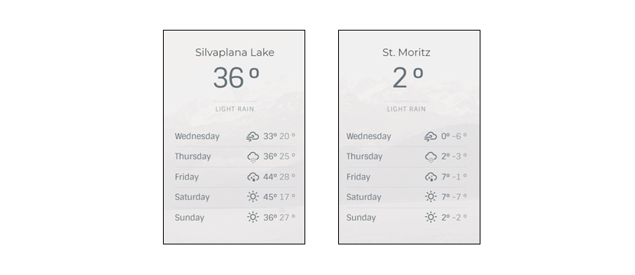
Partner+ 2nd version Notification and Alerts
WEATHER ALERT: Connect on our system if somebody adds a game on a date specific and our system detect that they are a critical change 50 hours before start the game. partner will send a notification on the manager and showing him an icon. when he will click on it, he will see a simple page showing the weather of the next 5 days and our system will be connected to a web weather info. (When manager create a game he will see the weather of same day that he chose to play).

Slide 4
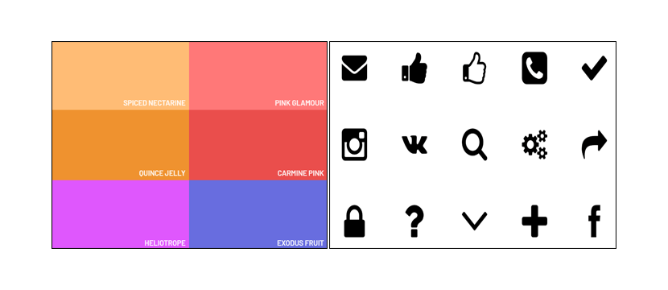
Partner+ 2nd version Notification and Alerts
ALERT NOTIFICATION, ALERT CHANGE, CRITICAL CHANGE, REMAINDER: Some information and alert will show by the different icon with different colors.

Slide 5
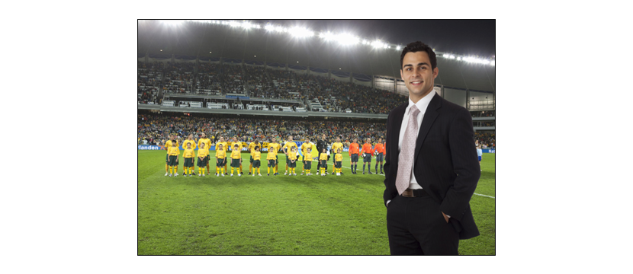
Partner+ 2nd version Manager Close Team
MANAGER CLOSE TEAM: This is an option that will be created by a manager. The icon showing on the menu to add and to see the list of player on the Manager team.
By clicking on Add new player to the list of close team, the manager will send an invitation to his personal contact from mms-message and WhatsApp, this contact will receive a link with information of this game (a flayer invitation with the manager visit card) by clicking on it shows 2 option.
1. Download the app: one-time player download, the player will be adding automatic to the manager invitation.
2. By clicking on add button player will be added to the manager invitation close team

Slide 6
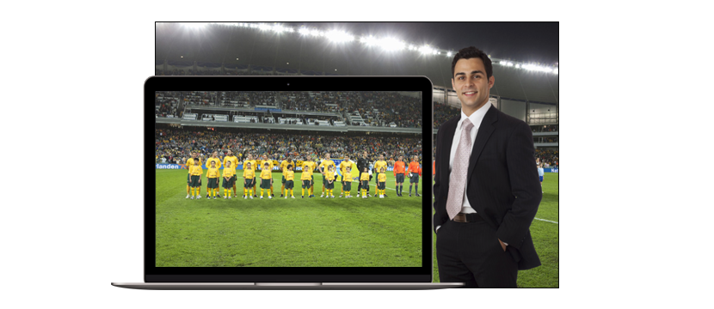
Partner+ 2nd version Manager New Close Team
MANAGER NEW CLOSE TEAM: When a manager creates a new game he can add a player only by from his close team or from his close team and the application listing.
Example: If he creates a game with 20 player and 15 player from his close team was confirm to play so the other 5 missing players can be added from the partner list.
The open team option is the player available on the app list and the manager can use it from adding a new match or from the status screen on the icon at any time before start the game.

Slide 7

Partner+ 2nd Version Invitation For Player
INVITE PLAYER: This an option showing with icon or button on menu and status screen. On the status player screen this invitation it for adding a new player from the list of favorite player and from his personal contact by sending MMS/WhatsApp an invitation link.
By clicking on the invite button from the menu a list appears of his favorite player one time the choice one or more of his player the player will choice for which active match from his list he wants to send a request to the manager.
One time the manager accept one time the manager accept this player this player will remove from other request and will be added for a favorite player for the manager that accept them.

Slide 8

Partner+ 2nd Version Social Media Share
SHARE BUTTON: Application share icon or button will show on the app and sharing button will show different social media to share your information that what you want.

Slide 9

Partner+ 2nd Version Missing Player
MISSING PLAYER: When the player will not be able to come to play so he needs to make a cancel by report problem.
So the manager and the player from this team will get a notification on the home page, it shows by icon 48 hours before in (orange color) and 24 hours in (red color).

Slide 10
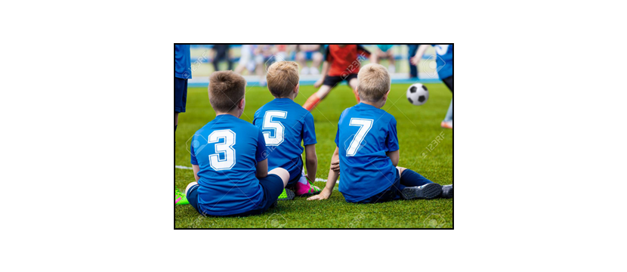
Partner+ 2nd Version Reserve Player
RESERVE PLAYER : Partner Player user can be added to a reserve list that if some player wants to cancel.
The players from the reserve list with similar basic information will receive a notification of confirmation and the first a player that confirm will be able to enjoy to play.

Slide 11

Partner+ 2nd Version Bonus Coin
BONUS AND PARTNER PLUS: The bonus is to give to the user some motivation to help Partner to be partner+. The bonus will show by notification by adding information to the partner, by the complete mission and more. The bonus will be collected on the wallet of this user. the wallet of manager/player/team and the Value of this bonus will show on partner plus page.

Slide 12
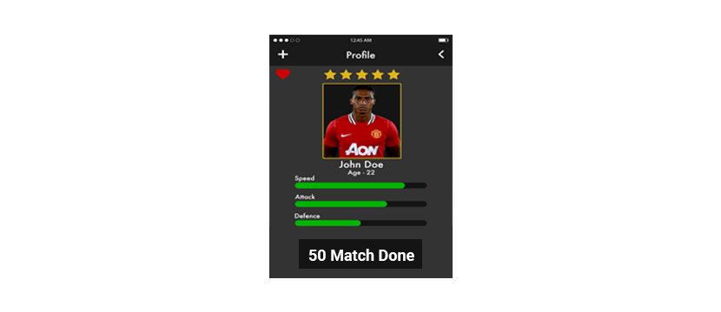
Partner+ 2nd Version Player Visit Card
VISIT CARD: A visit card is a player that shows information of the user The visit card can be shared by social media contact the personal user and by a different way on the App.

Slide 13
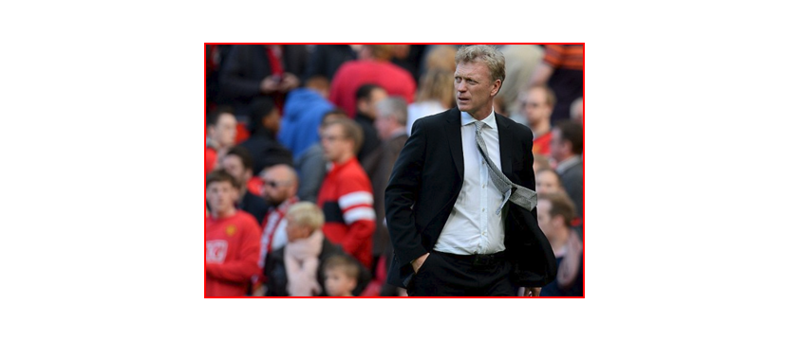
Partner+ 2nd Version Manager
MANAGER NEW FEATURES ADD: The manager adds: (when manager adds new game he can send a request to a specific type of user judge/ Goal kicker /attack/ Defiance) he can add special request and change the information of request on the status screen for a specific player that he needs.
for example, he has an 8/10 player and 8 of them from the attack so he can change the request for 2 Defiance player. this request will send notification for the Defiance player notification.

Slide 14
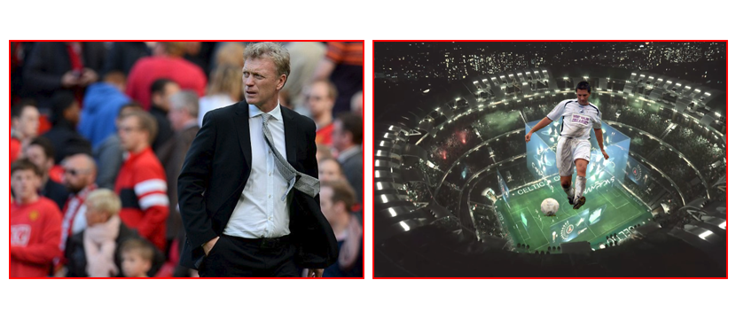
Partner+ 2nd Version Manager & Player New Future & Favorite
FUTURE AND FAVORITE GAME FORM PLAYER AND MANAGER: When the player searching a game and they are no result he will get the option to add a request for future game one time a manager will create a similar game he will get a notification confirmation to play with this manager teams.
This option is able on the player menu also. the manager can create a similar long term game for 3 next month.

Slide 15
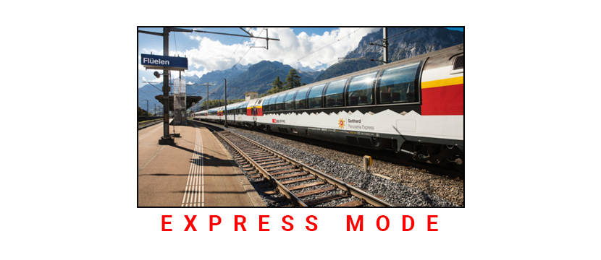
Partner+ 2nd Version Smart Express Mode
MANAGER AUTOMATIC SMART EXPRESS MODE: When the manager clicks on this option it will show him a group list request of a player. the top of this screen will show the group with more player and to down. the manager can reduce per location of this option.

Slide 16

Partner+ 2nd Version Organization
PARTNAR ORGANIZATION PAGE: Showing by Partner button or from the icon. this page its an organization page that can help the team to manage the organization of the game like:
- Uniform manage the uniform of the teams to show on status screen the color of the uniform that needs to take for the game.
- Ball the manager and the players can manage who will take a ball to the stadium
- Feed make a description notification for the team.
- Travel user can make a trip for the player to get point to the stadium.

Slide 17

Partner+ 2nd Version Report & Behavior
REPORT & BEHAVIOR: User and manager can report about any issue to the partner if a player gets a report from another 2 players in the same match or from a manager so he can get a yellow card or red card. yellow and the red card can limit the player to use Partner plus.

