Slide 1
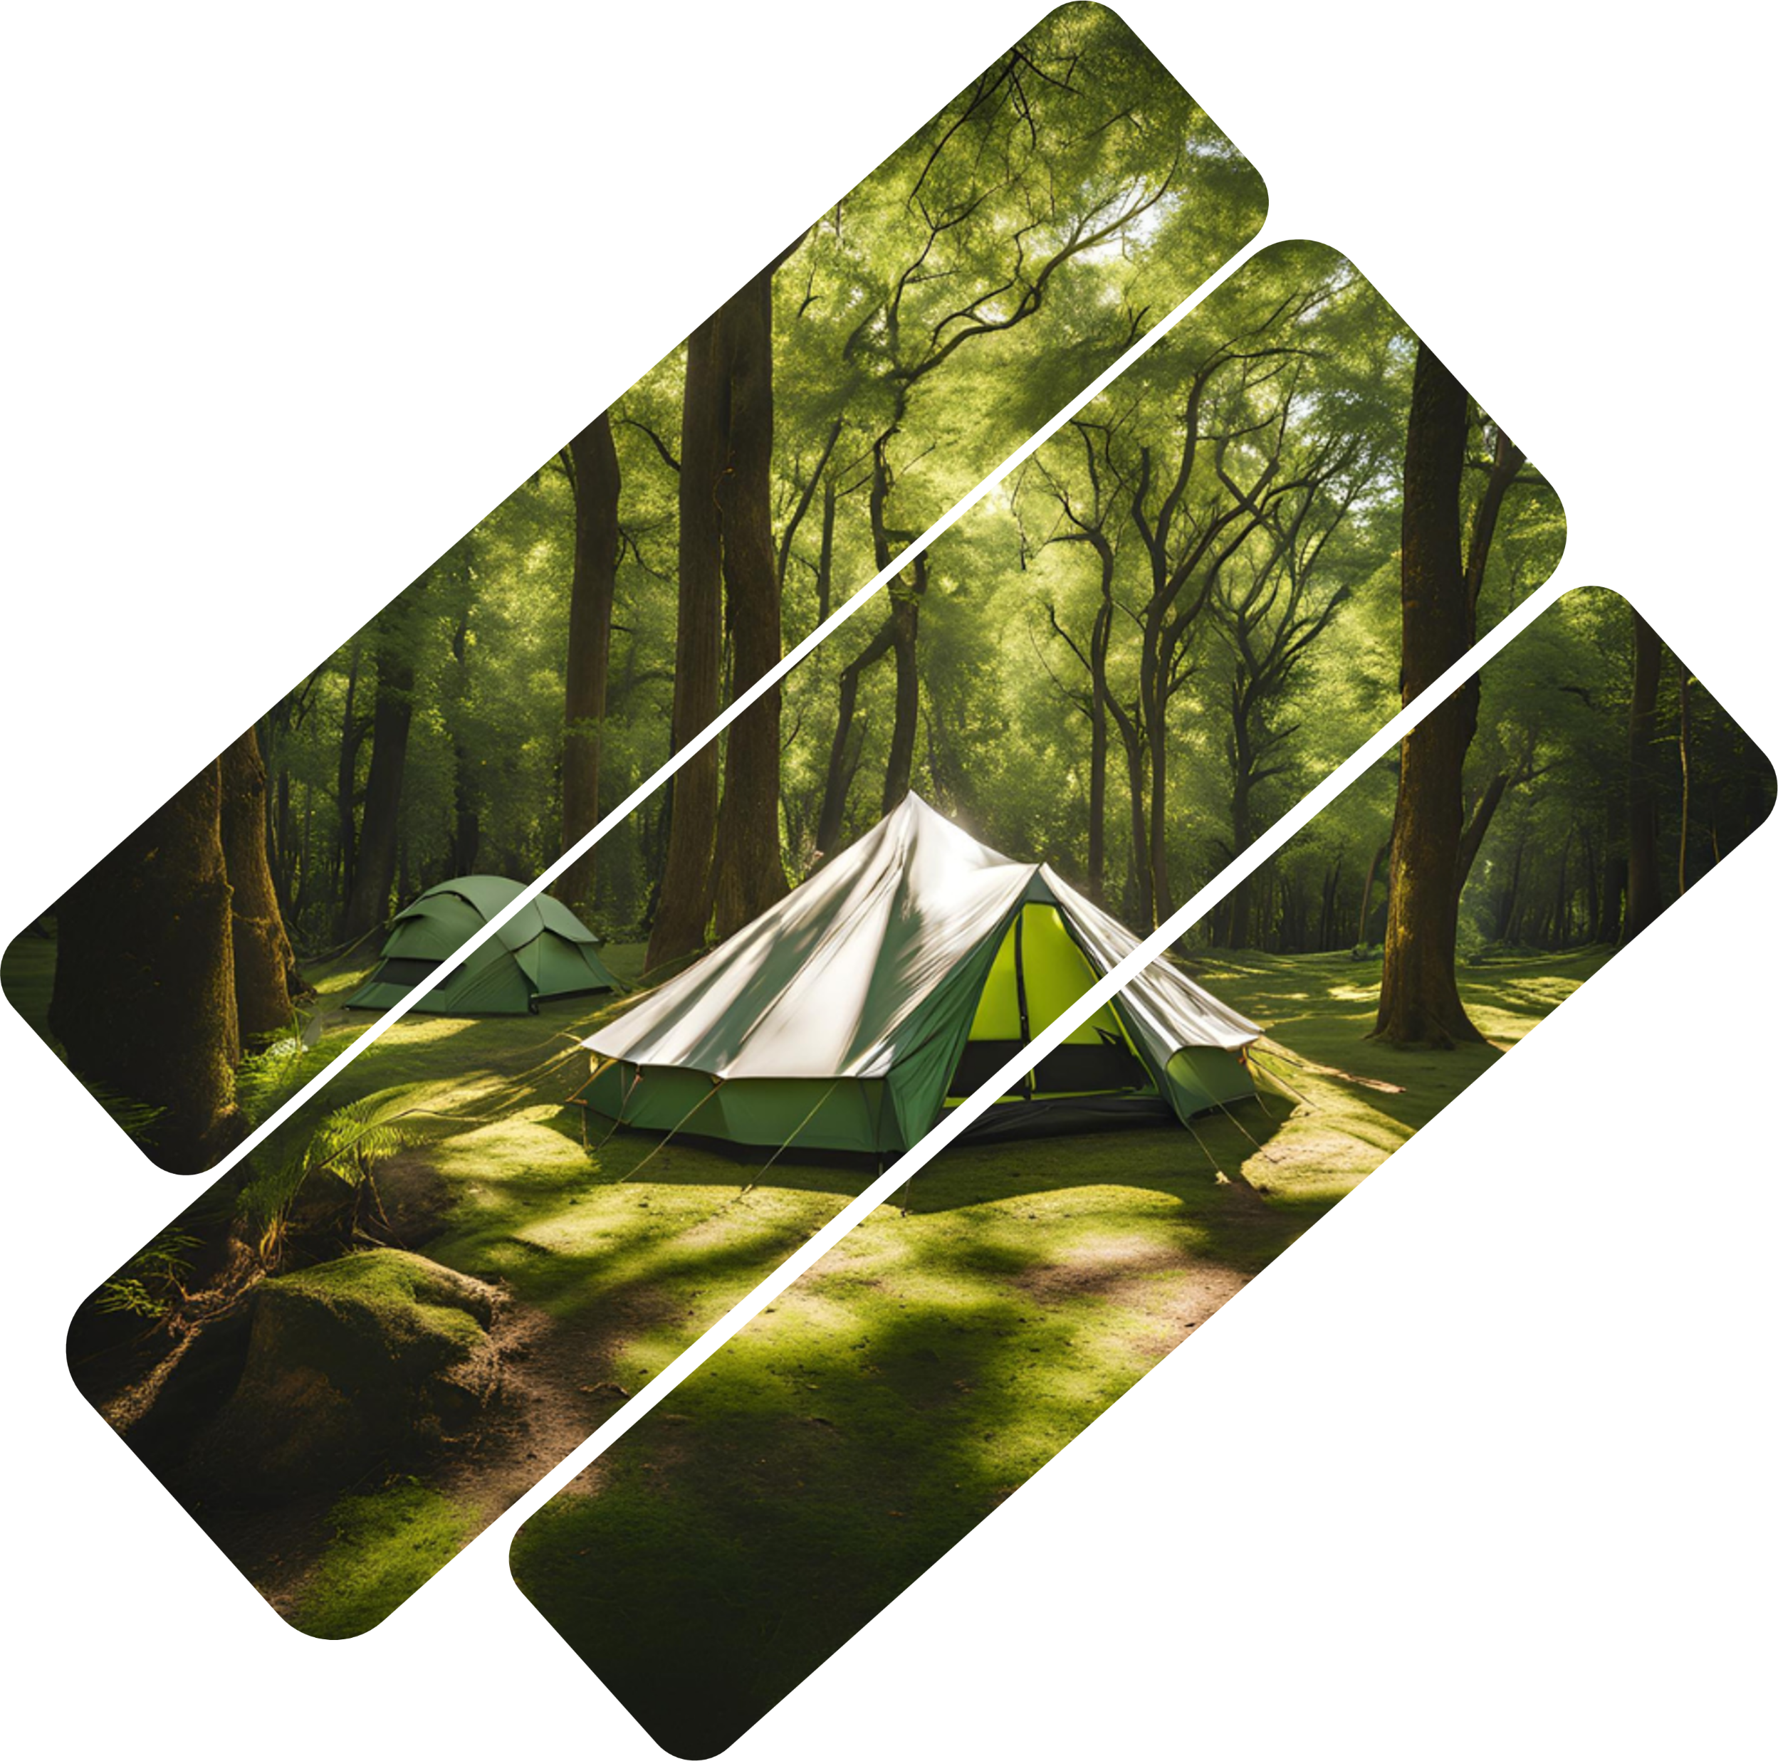
CampwME
make camping easy for everyone
Created by:
Efthimios Goneos P20049,
Ioannis Tasioulis
P21162

Slide 2
CampwME
make camping easy for everyone
In this presentation we will discuss:
Created by:
Efthimios Goneos P20049,
Ioannis Tasioulis
P21162
What is “CampwME”?
How to use it
And How we ended up with this design

Slide 3
What is “CampwME”?
CampwME is an application capable for making anyone be a camping Expert in no time. Even if it’s your first time camping or you go camping as a hobby, “CampwME” will be a handy tool in your disposal.
Lets look at the Hierarchical Task Analysis to get a better understanding:

Slide 4
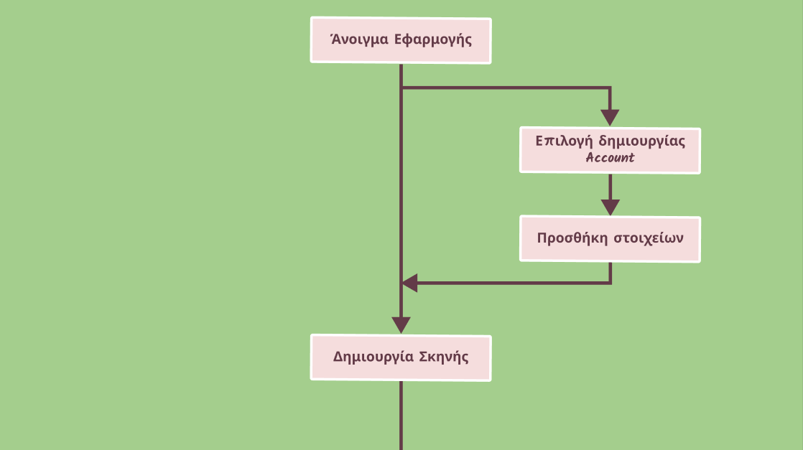
Hierarchical Task Analysis-HTA
Start Application

Slide 5
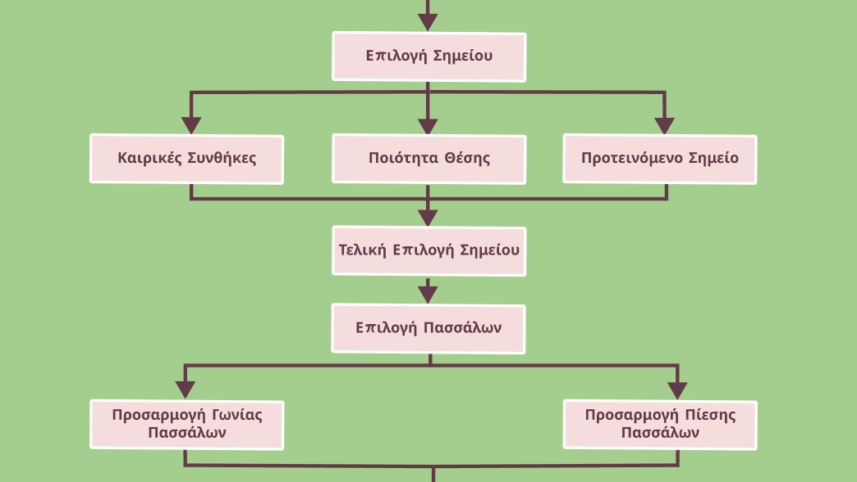
Hierarchical Task Analysis-HTA
Choose a place in the map

Slide 6
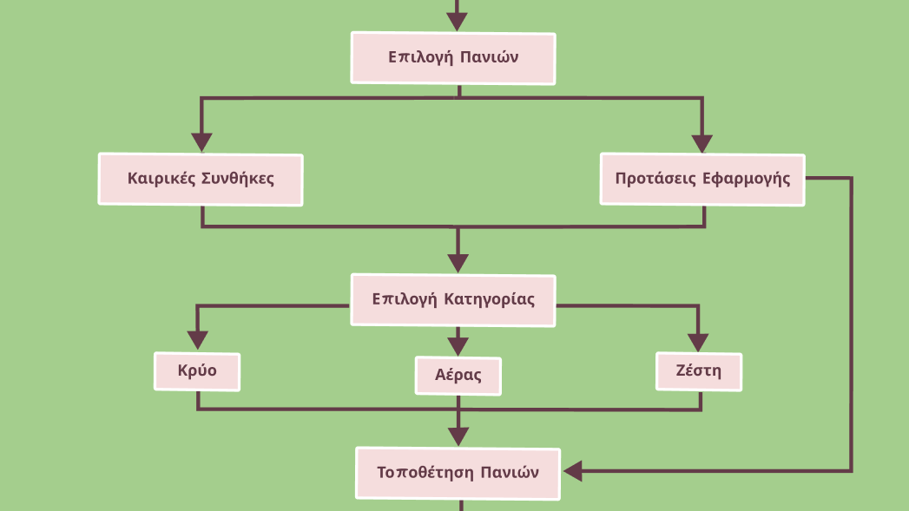
Hierarchical Task Analysis-HTA
Cloths placement

Slide 7
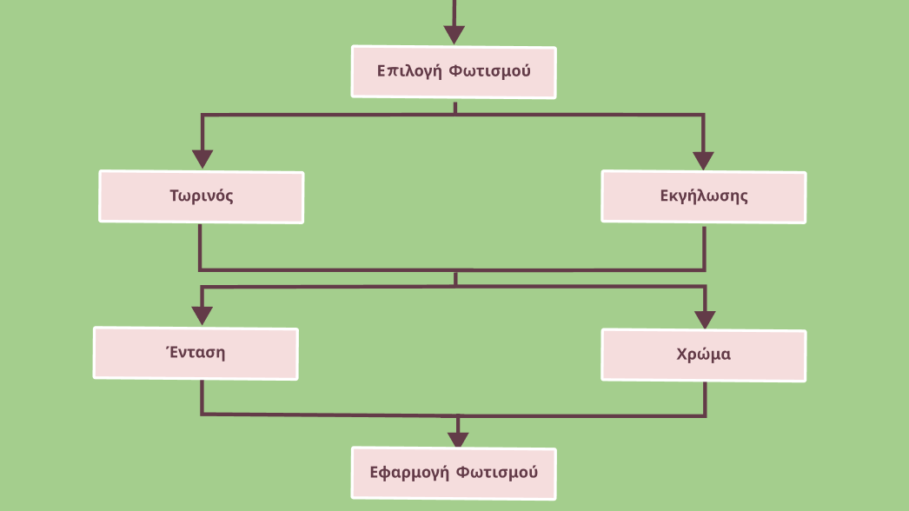
Hierarchical Task Analysis-HTA
Lighting

Slide 8
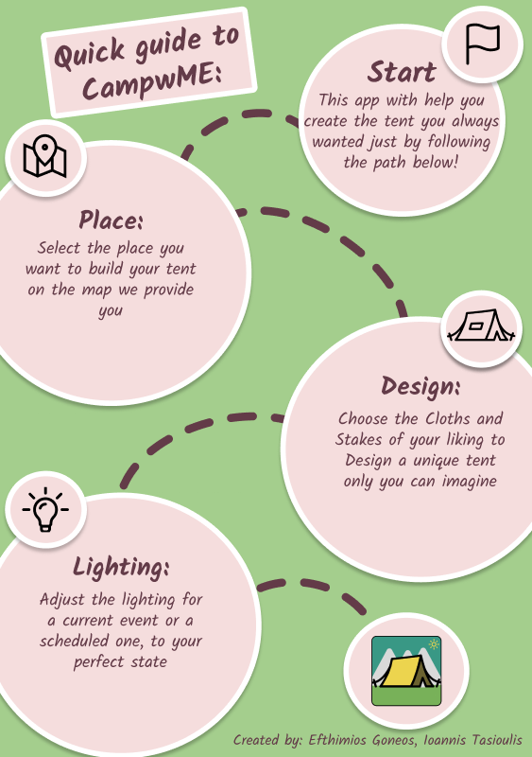
How you use it ?
To answer this question we will present you with the 3 manuals you need to get started:
Getting-started guide
Quick reference manual
Detailed reference manual

Slide 9
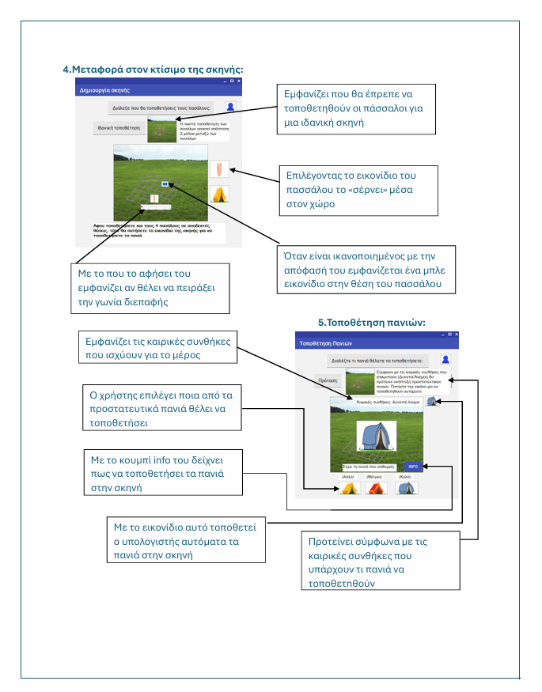
How you use it ?
To answer this question we will present you with the 3 manuals you need to get started:
Getting-started guide
Quick reference manual
Detailed reference manual

Slide 10
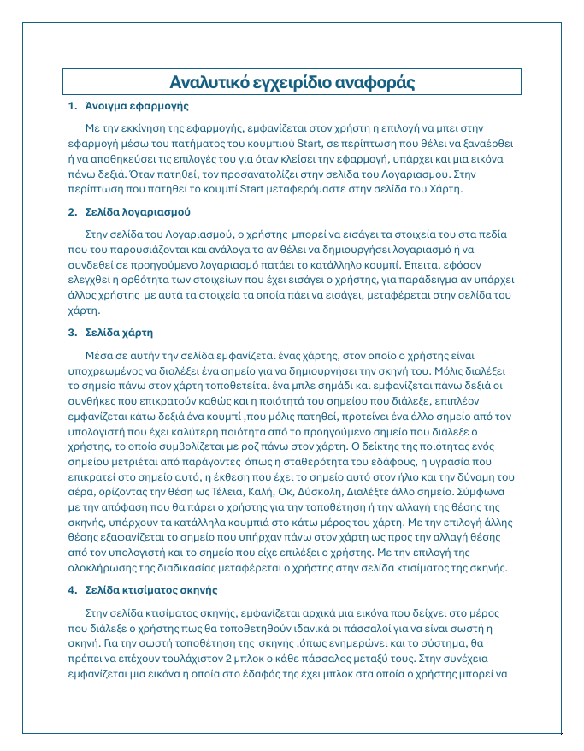
How you use it ?
To answer this question we will present you with the 3 manuals you need to get started:
Getting-started guide
Quick reference manual
Detailed reference manual

Slide 11
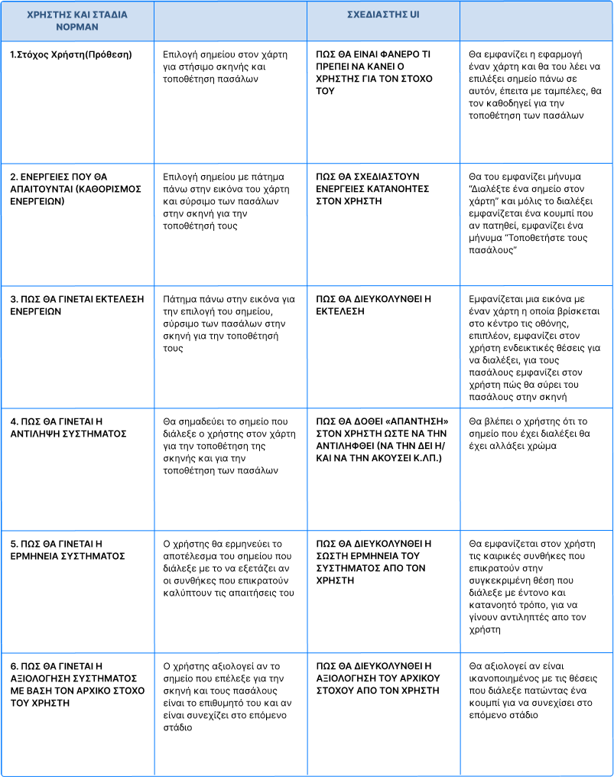
How we ended up with this design?
The final design, came up by using the Model of Norman in our tasks. We divided those tasks into 3 groups:
Interface for Semi-Automatic Scene Setup
Interactive Placement of Protective Cloths
Setting the lighting according to the conditions

Slide 12
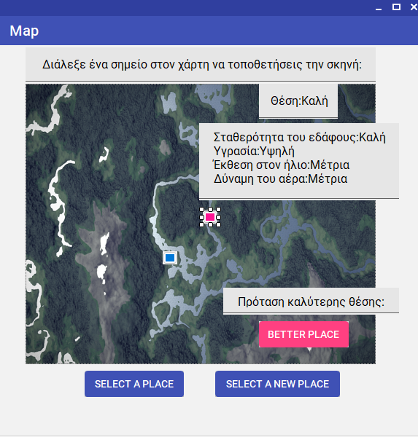
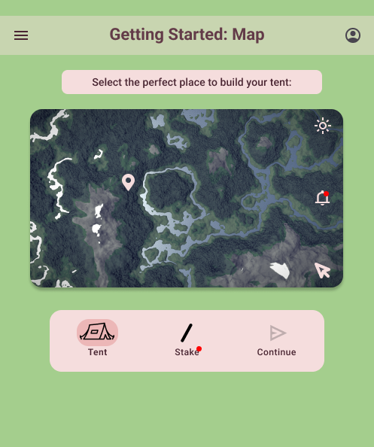
Interface for Semi-Automatic Scene Setup
Prototype 1
Prototype 2

Slide 13
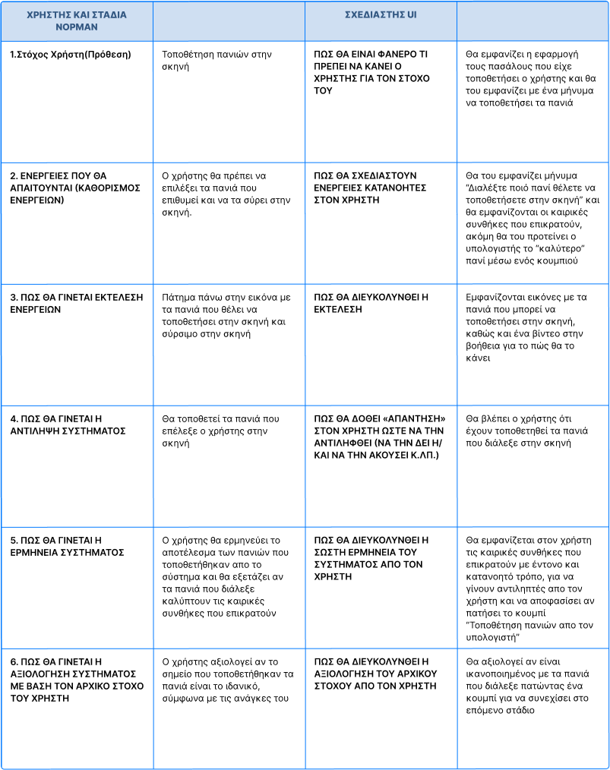
How we ended up with this design?
The final design, came up by using the Model of Norman in our tasks. We divided those tasks into 3 groups:
Interface for Semi-Automatic Scene Setup
Interactive Placement of Protective Cloths
Setting the lighting according to the conditions

Slide 14
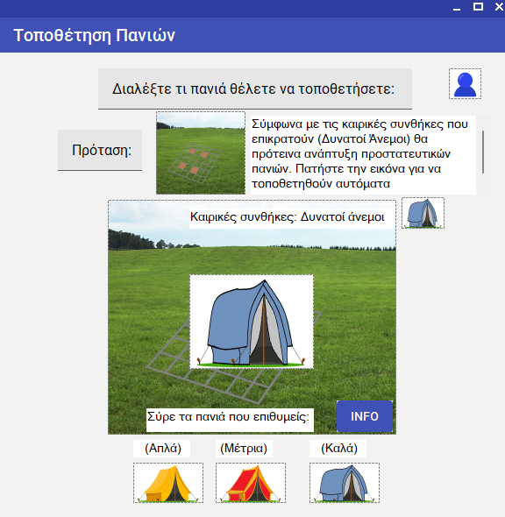
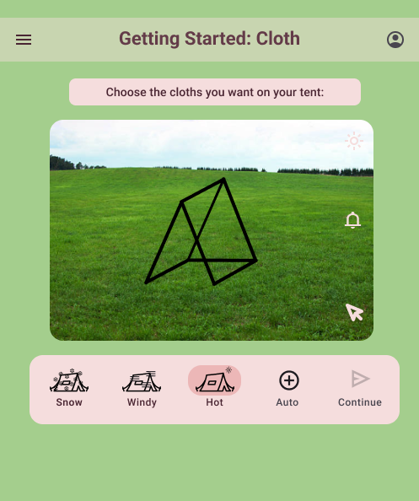
Interactive Placement of Protective Cloths
Prototype 1
Prototype 2

Slide 15
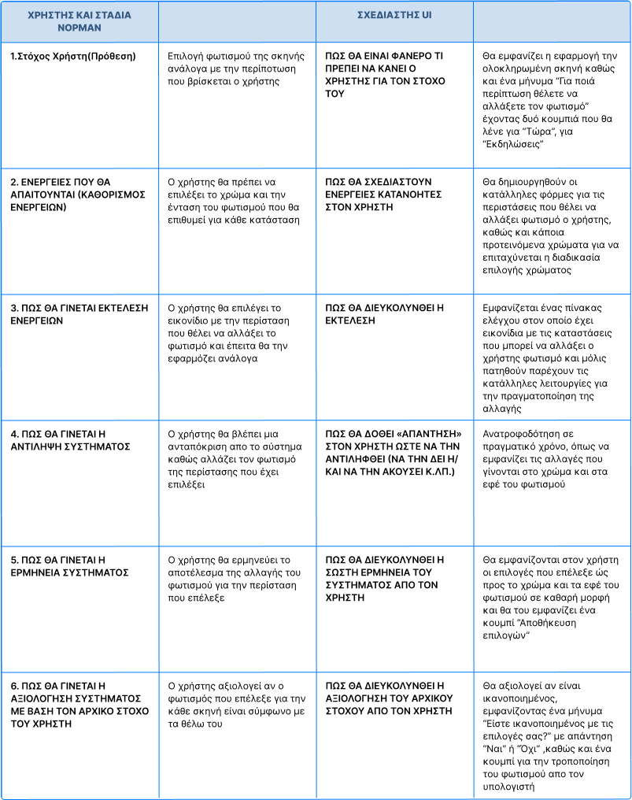
How we ended up with this design?
The final design, came up by using the Model of Norman in our tasks. We divided those tasks into 3 groups:
Interface for Semi-Automatic Scene Setup
Interactive Placement of Protective Cloths
Setting the lighting according to the conditions

Slide 16
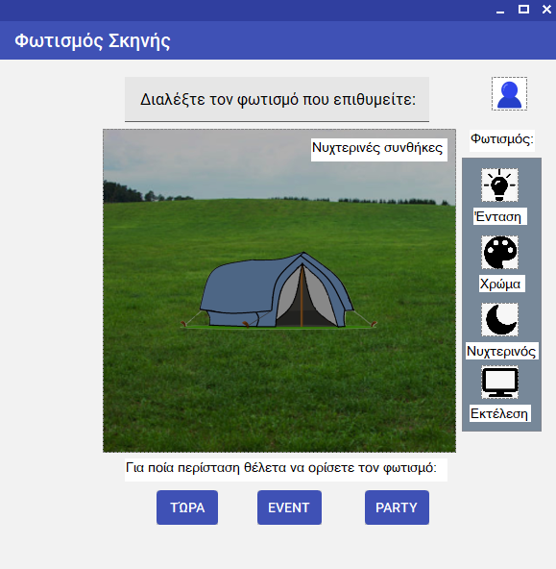
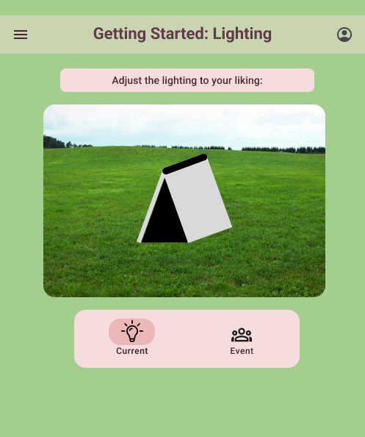
Setting the lighting according to the conditions
Prototype 1
Prototype 2

Slide 17
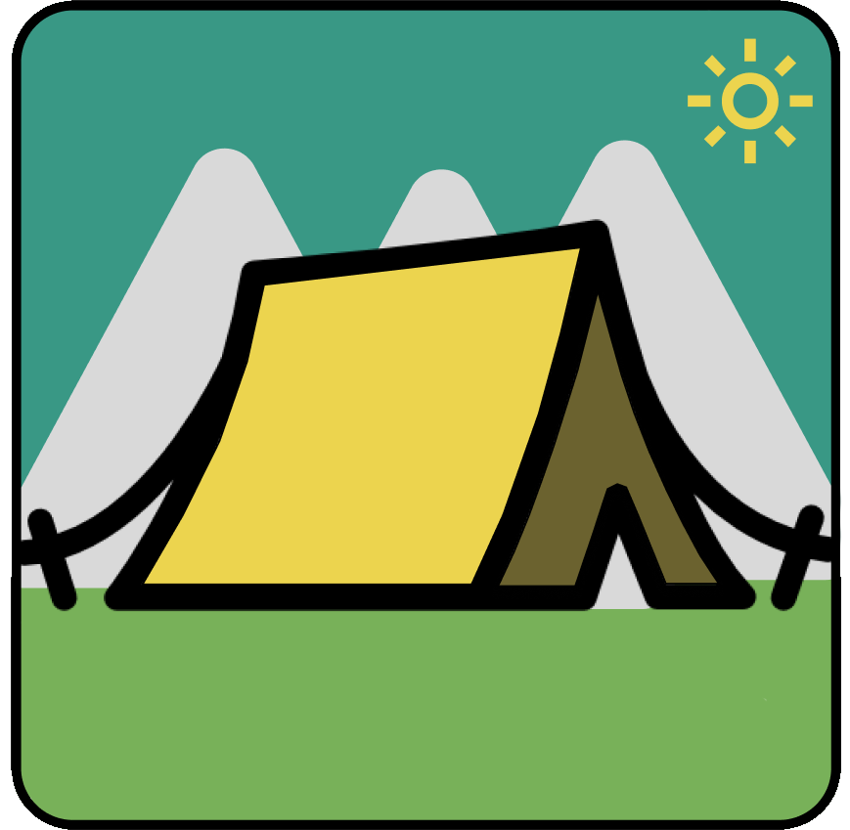
Thank you!
CampwME

