Slide 1

Major Project Presentation
Image Encryption and Decryption using a Hybrid Chaotic
Approach with AI-Based Parameter Selection
and Selective Region Protection
Yash Kumar Raut · Rishu Mehta · Suman Kumar
Guide: Dr. Sampa Sahoo
Dept. of Computer Science & Engineering, C. V. Raman Global University, Bhubaneswar
Major Project · Session 2025 – 26

Slide 2
Outline
CONTENTS
01 Introduction — Image Encryption & Decryption
02 Types of Image Encryption
03 Literature Study (12 papers)
04 Research Gap
05 Objectives of the Project
06 Methodology
07 Technology Platform
08 Project Feature Overview
09 Implementation — The Four Steps
10 The Four Steps in Detail
11 Project Flow Chart
12 The Whole Pipeline on a Real Image
13 Selective Region Encryption
14 Results
15 Live Application
16 References
Image Encryption and Decryption using a Hybrid Chaotic Approach · C. V. Raman Global University, Bhubaneswar
2 / 26

Slide 3
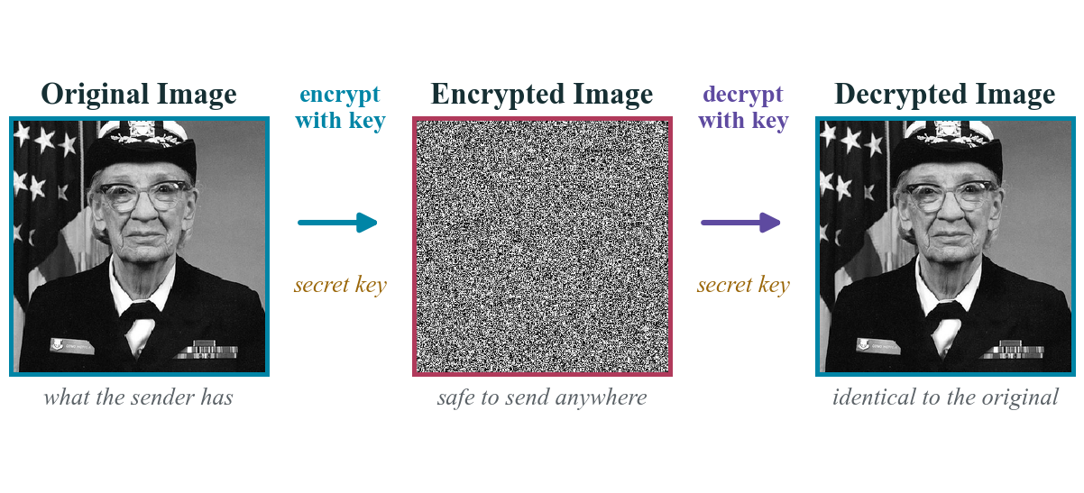

Introduction — Image Encryption and Decryption
What is it?
▪ A normal image is turned into a scrambled, noise-like image using a secret key
Decryption is the exact reverse — with the correct key the original image must come back with no loss of quality.
Why do images need special treatment?
▪ Images are large
One 512×512 photo is about 262 KB against a few bytes of text, so ordinary ciphers become slow.
▪ Neighbouring pixels are almost identical
A pixel and the one next to it usually hold nearly the same value, so patterns leak straight through a weak cipher.
Where it is used
▪ Medical scans · Aadhaar and ID photos · military and satellite imagery · cloud photo storage · CCTV and IoT cameras
Anywhere a picture travels over the internet and has to stay private.
The whole project in one line: the middle image is what an attacker sees, and only the key brings the third image back.
Image Encryption and Decryption using a Hybrid Chaotic Approach · C. V. Raman Global University, Bhubaneswar
3 / 26

Slide 4

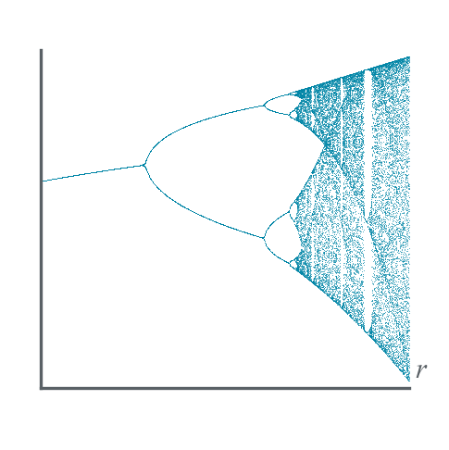
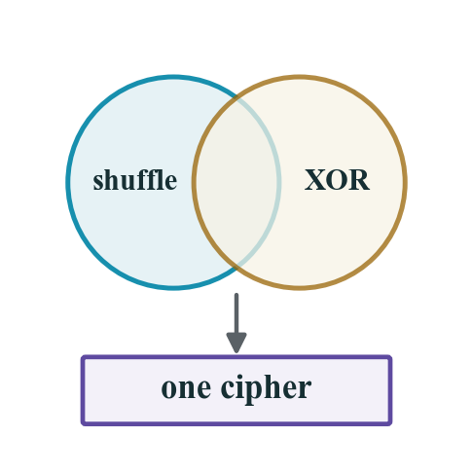
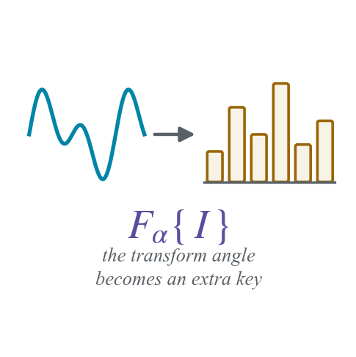
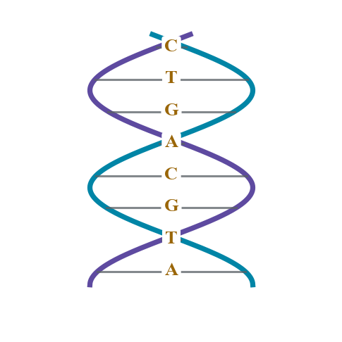
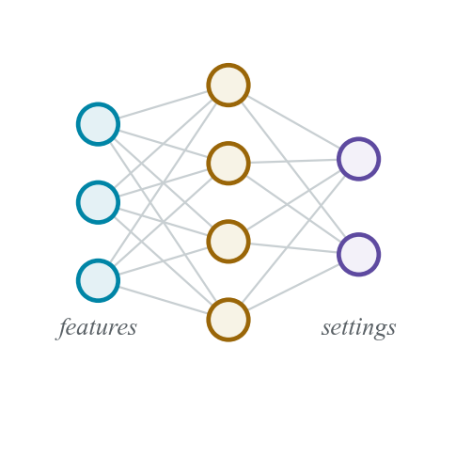
Types of Image Encryption
1
Traditional Block Ciphers
2
Chaos-Based
3
Hybrid Chaotic
AES, DES, RSA and Blowfish. Standard, well studied and very strong — but slow once the image gets large.
Arnold Cat Map, Logistic Map, Baker Map. Fast, an enormous key space, and wildly sensitive to the key.
Two chaotic maps together — one shuffles the pixel positions, the other changes the pixel values.
◆ OUR MAIN METHOD
4
Transform Domain
5
DNA-Based
6
AI / Learning-Based
DCT, DWT and the Fractional Fourier Transform. The transform setting itself becomes an extra key.
Pixel values are rewritten as DNA letters — A, T, G, C — and then mixed using DNA addition rules.
A trained model generates the keys, or picks the encryption settings for the image in front of it.
We use type 3 as the main method, type 1 (AES-256) as an optional extra layer, and a small type 6 model to choose the settings.
Image Encryption and Decryption using a Hybrid Chaotic Approach · C. V. Raman Global University, Bhubaneswar
4 / 26

Slide 5
Literature Study (1–4 of 12)
Sl. No. | Journal, Publisher & Year | Title & Author | Methodology | Findings | Limitation
1 | IEEE Access, IEEE, 2025 | Comprehensive Review and Analysis of Image Encryption Techniques — K. Mahalakshmi, S. Nagarajan | Reviews six families of methods — traditional, quantum, chaos, DNA, neural network and compressive sensing — and compares their speed, key sensitivity and attack resistance. | Chaos-based and hybrid methods give the best balance of security and speed. No single method is best for everything. | Only a review, nothing is implemented. Says key management and real-time speed are still open problems.
2 | Journal of Imaging, MDPI, 2022 | Secure Image Encryption Using Chaotic, Hybrid Chaotic and Block Cipher Approach — N. Chaudhary, T. B. Shahi, A. Neupane | Actually builds three systems — Arnold Cat Map alone, Arnold + Logistic (hybrid) and AES — and compares them on the same benchmark images. | The hybrid chaotic method gives the best differential-attack scores (NPCR 95–99, UACI 28–34). AES is the slowest of the three. | Uses one fixed parameter setting for every image. Only 2D maps tested and no cryptanalysis is done.
3 | IEEE Access, IEEE, 2020 | Investigation of Chaotic Image Encryption in Spatial and FrFT Domains for Cybersecurity Applications — O. S. Faragallah et al. | Applies Cat, Baker and Logistic maps in the normal (spatial) domain and in the Fractional Fourier Transform domain, using the transform angle as an extra key. | Working in the FrFT domain improves scrambling and adds key space. Baker-FrFT and Logistic-FrFT survive channel noise well. | Cat-FrFT is weak against noise. The extra transform costs computation time. Tested only on grayscale images.
4 | Mathematics, MDPI, 2023 | Chaos-Based Image Encryption: Review, Application and Challenges — B. Zhang, L. Liu | Reviews how chaos has been combined with neural networks, DNA, genetic algorithms, blockchain and elliptic curves, plus the standard security tests. | Chaos is still the most effective base for image encryption because it is extremely sensitive to its starting values. | Two problems remain unsolved: resisting cryptanalysis, and working on images while they are still encrypted.
Image Encryption and Decryption using a Hybrid Chaotic Approach · C. V. Raman Global University, Bhubaneswar
5 / 26

Slide 6
Literature Study (5–8 of 12)
Sl. No. | Journal, Publisher & Year | Title & Author | Methodology | Findings | Limitation
5 | ICDICI (Conference), IEEE, 2024 | A Comprehensive Review of Image Encryption Algorithms: Techniques and Applications — C. Sheeba Joice, S. Hitha Shanthini, K. V. Harsha, S. Gopika | Survey of symmetric, asymmetric, chaos-based, quantum and hybrid algorithms with a strengths-and-weaknesses comparison for each application area. | Hybrid methods are the most used today. Chaos-based methods are preferred wherever speed matters. | Comparison is descriptive only — no common test images and no measured numbers.
6 | ICIT (Conference), IEEE, 2021 | A Survey of Image Encryption Algorithms — Q. H. Makki, A. M. Abdalla, A. A. Tamimi | Picks several algorithms with different characteristics and compares them on usage, quality, security and other metrics, mainly for document images. | Gives a selection table; concludes that no single algorithm suits every type of image or situation. | Small number of algorithms compared and no experiments repeated by the authors.
7 | ICICACS (Conference), IEEE, 2024 | A Comprehensive Study on Various Encryption Techniques for Digital Images in Multimedia Networks — S. Benaka Santhosha, K. V. Sudheesh, K. Puttegowda, B. D. Parameshachari | Studies symmetric, asymmetric and hybrid techniques for multimedia networks using MSE, PSNR, NC and BER, across banking, healthcare and military use. | Key management and computation cost are the two problems that keep coming back in every method. | No implementation. Reports image-quality numbers instead of attack-resistance numbers.
8 | IJCC (Conference), IEEE, 2024 | Image Encryption Techniques: A Survey — H. A. Abughali, U. Köse | Studies 25 years of literature — AES, RSA, Blowfish, quantum and DNA-based schemes — comparing encryption speed, complexity and attack resistance. | The method must match the environment. Classical block ciphers stay expensive for large images. | No common experimental setup; the conclusions are taken from the reviewed papers.
Image Encryption and Decryption using a Hybrid Chaotic Approach · C. V. Raman Global University, Bhubaneswar
6 / 26

Slide 7
Literature Study (9–12 of 12)
Sl. No. | Journal, Publisher & Year | Title & Author | Methodology | Findings | Limitation
9 | SUMMA (Conference), IEEE, 2021 | Design of Digital Image Encryption Scheme With Cryptographic Analysis — K. Kordov, S. Zhelezov, A. Nachev, N. Gueorguiev, D. Pavlova | Builds a cipher where two chaotic maps together form a random number generator that drives pixel shuffling and value substitution. | Proves that a two-map hybrid passes the full set of statistical tests — a direct precedent for our Arnold + Logistic design. | One fixed parameter set for all images, no per-image adjustment and no user-facing application.
10 | IEEE Access, IEEE, 2022 | Systematic Survey on Visually Meaningful Image Encryption Techniques — V. Himthani, V. S. Dhaka, M. Kaur, D. Singh, H.-N. Lee | Surveys methods that first encrypt an image and then hide it inside a normal-looking cover image, so the output is not obvious noise. | A noise-like encrypted image attracts an attacker's attention; hiding it inside a cover image avoids that. | Hiding the data reduces image quality and capacity. The survey does not test the schemes on one common dataset.
11 | IEEE Trans. on Circuits and Systems I, IEEE, 2023 | An Efficient Image Encryption Algorithm Based on Innovative DES Structure and Hyperchaotic Keys — S.-Y. Li, Y. Gai, K.-C. Shih, C.-S. Chen | Shuffles rows and columns, then runs the image through a DES-style structure for four rounds using hyperchaotic sub-keys and a new S-box. | Gives a large key space and low pixel correlation, and is much faster than the original DES — usable in real time. | The round count is fixed and the new S-box still needs independent security analysis.
12 | IEEE Access, IEEE, 2018 | Digital Image Encryption Algorithm Based on Elliptic Curve Public Cryptosystem — X. Zhang, X. Wang | A public-key method: sender and receiver agree on an elliptic curve point, pixels are grouped into big integers and encrypted with ECC plus chaos. | Removes the problem of safely sending the secret key, while keeping reasonable speed. | Public-key operations are heavy for large images and no differential-attack results are reported.
Image Encryption and Decryption using a Hybrid Chaotic Approach · C. V. Raman Global University, Bhubaneswar
7 / 26

Slide 8
Research Gap
What all 12 papers already agree on
▪ Hybrid chaotic encryption works best
Shuffle the pixels first (confusion), then change their values (diffusion). Papers 2, 9 and 11 all follow this order.
The gap we found — and it is a simple one
▪ Every paper uses ONE fixed setting for EVERY image
The same number of shuffling rounds and the same starting value are used for a dark X-ray, a bright selfie and a plain white document — even though these images are completely different.
▪ No easy tool for a normal user
All the work stays in research code. A student, doctor or ordinary user has no simple app to encrypt a picture.
How we fill it
▪ A small AI model reads the image first and then chooses the settings
It measures how detailed the image is, picks the number of shuffling rounds and decides whether the extra AES layer is needed — then we wrap the whole thing in a full web application, and add selective encryption so only the sensitive regions of a document get locked.
Image Encryption and Decryption using a Hybrid Chaotic Approach · C. V. Raman Global University, Bhubaneswar
8 / 26

Slide 9
Objectives of the Project — What We Picked and Why
What we picked
▪ Arnold Cat Map for confusion + Logistic Map for diffusion, with AES-256 as an optional extra layer
Chosen because Paper 2 measured this hybrid combination as the strongest against differential attacks, and Paper 9 proved a two-map design passes all the standard statistical tests.
O1
Build a working hybrid chaotic encryption and decryption program
Decryption must return exactly the original image, with no quality loss anywhere.
O2
Add a small AI module that chooses the settings for each image
This is our contribution — the gap that none of the 12 papers fills.
O3
Put it inside a web application anyone can use
Upload an image, click encrypt, download the result and the key file — with accounts and a per-user history archive.
O4
Keep the encrypted image safe to verify
Attach a SHA-256 tag so the receiver knows the file was not tampered with.
O5
Encrypt only the sensitive parts of a document
Detect PII regions — Aadhaar, PAN, phone, signature, QR — and lock just those with AES-256-GCM, leaving the rest readable.
Image Encryption and Decryption using a Hybrid Chaotic Approach · C. V. Raman Global University, Bhubaneswar
9 / 26

Slide 10
Methodology
Step 1
Study the literature
Read 12 papers from IEEE and MDPI and note the method, findings and limitation of each one.
Step 2
Find the gap
Compare the limitation columns and look for something small that nobody has done — per-image settings.
Step 3
Design the system
Choose Arnold Cat Map + Logistic Map because Paper 2 measured them as the best hybrid combination.
Step 4
Build the encryption core first
Write and test the encrypt and decrypt functions on their own, before any user interface.
Step 5
Add the AI module
Encode the readable decision rules over entropy, edge density and size that choose the settings per image.
Step 6
Add selective encryption
Detect the PII regions and lock each one with AES-256-GCM under a PBKDF2-derived key.
Step 7
Build the web app and test
Wrap everything in React and Express, then test with different image types and confirm the decrypted image matches the original byte for byte.
Image Encryption and Decryption using a Hybrid Chaotic Approach · C. V. Raman Global University, Bhubaneswar
10 / 26

Slide 11
Technology Platform
Platform
Web application — React SPA served by one Express server on a single port
Front end
React 19 + TypeScript 5.9 · Vite 7 · React Router 7
User interface
shadcn/ui + Radix primitives · Tailwind CSS · Motion animations · Three.js accents
Back end
Node.js + Express 5 · Multer uploads · SSE streams the pipeline reasoning live
Image handling
Jimp — lossless PNG decode / encode at native resolution, in colour
Chaotic core
Arnold Cat Map + Logistic Map in pure JavaScript typed arrays
AI / detection
Readable decision tree for the parameters · Gemini Vision or in-browser Tesseract.js OCR for PII regions
Cryptography
node:crypto — AES-256-GCM, PBKDF2-SHA-512 (100k iterations), SHA-256, scrypt password hashing
Database
node:sqlite — accounts, sessions and the History archive (cipher / key / recovered)
Code editor / tools
VS Code, Git and GitHub · ESLint
Testing
node:test round-trip suite + a per-run self-test that decrypted bytes == original bytes
Image Encryption and Decryption using a Hybrid Chaotic Approach · C. V. Raman Global University, Bhubaneswar
11 / 26

Slide 12
Project Feature Overview
For the sender
For the receiver
Upload any PNG or JPG up to 2048 px per side
Upload the cipher image plus the key file
AI suggests the best settings automatically
SHA-256 tag checked before any key is used
Manual mode — rounds, seed and r yourself
A wrong key gives only noise — never the image
Optional AES-256-GCM layer with one click
The correct key returns the exact original
Selective mode locks only the PII regions
One page decrypts both cipher schemes
Download the cipher image and the key file
Every run is archived in the History folders
Image Encryption and Decryption using a Hybrid Chaotic Approach · C. V. Raman Global University, Bhubaneswar
12 / 26

Slide 13
Implementation — The Four Steps
Step 1
Step 2
Optional
Step 3
Step 3b
Step 4
Confusion
Diffusion
Optional AES-256
The AI Module
Selective Mode
Decryption
›
›
›
›
›
Arnold Cat Map moves every pixel to a new position. Colour values are untouched.
The Logistic Map makes a keystream and we XOR it with every pixel, so the values change too.
A second lock applied to the already encrypted bytes, only when the AI asks for it.
Reads three numbers from the image and picks the rounds, the seed and the AES flag.
PII regions are detected and each one is locked on its own with AES-256-GCM.
Every step undone in reverse order, verified against the original image.
The two equations the whole project rests on
▪ [x', y'] = [[1, 1], [1, 2]] · [x, y] mod N
Arnold Cat Map — confusion. Repeated a secret number of times.
▪ x(n+1) = r · x(n) · (1 − x(n)), r ≈ 3.99
Logistic Map — diffusion. Produces the keystream we XOR with the pixels.
What makes ours different
▪ The settings are not fixed in the code
A decision tree reads the entropy, the edge density and the size of the image, then chooses the rounds and the seed for that one image.
▪ Everything is verified and archived
A SHA-256 tag travels with the cipher, the decrypted image is asserted equal to the original byte for byte, and every run lands in History.
Image Encryption and Decryption using a Hybrid Chaotic Approach · C. V. Raman Global University, Bhubaneswar
13 / 26

Slide 14
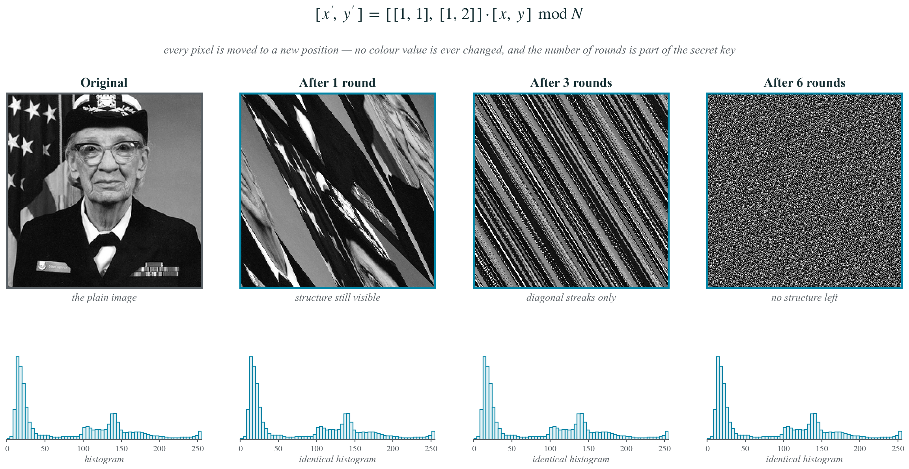
Step 1 — Confusion with the Arnold Cat Map
Shuffling alone is not enough — the histogram never changes, so the colour information is still all there
Image Encryption and Decryption using a Hybrid Chaotic Approach · C. V. Raman Global University, Bhubaneswar
14 / 26

Slide 15
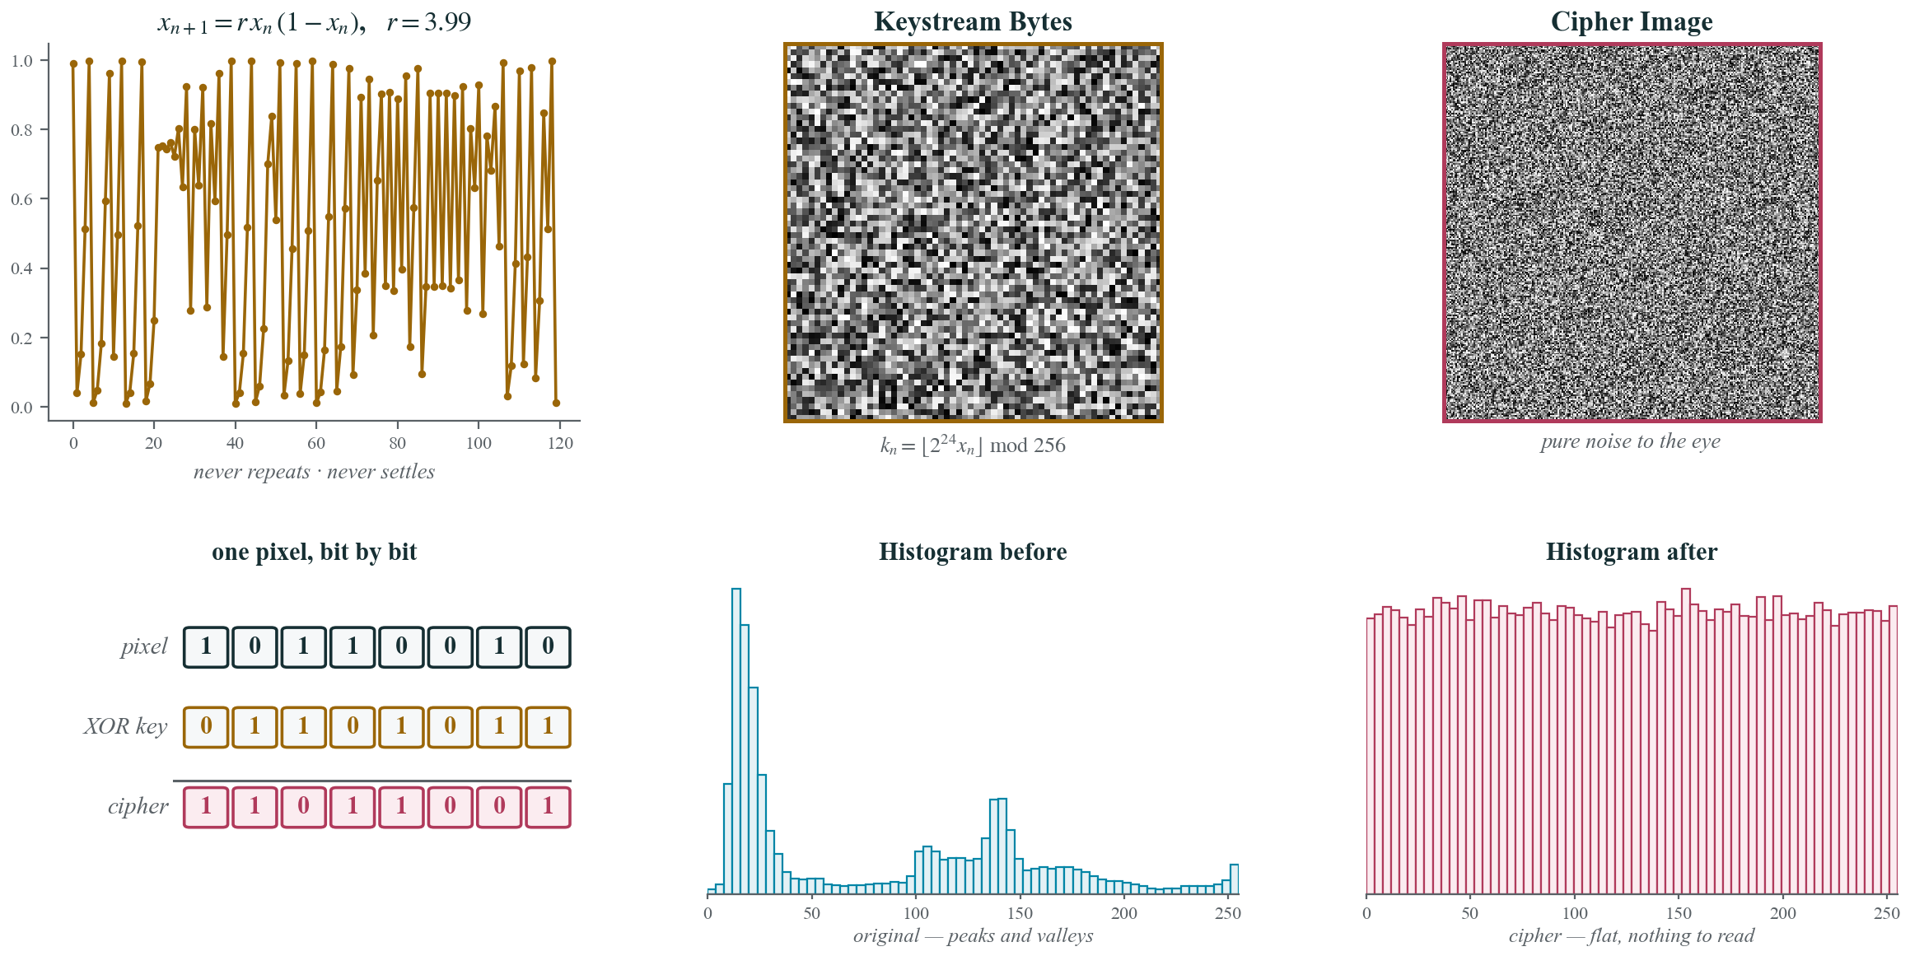
Step 2 — Diffusion with the Logistic Map and XOR
Diffusion is what flattens the histogram — this is the step that actually hides the content
Image Encryption and Decryption using a Hybrid Chaotic Approach · C. V. Raman Global University, Bhubaneswar
15 / 26

Slide 16
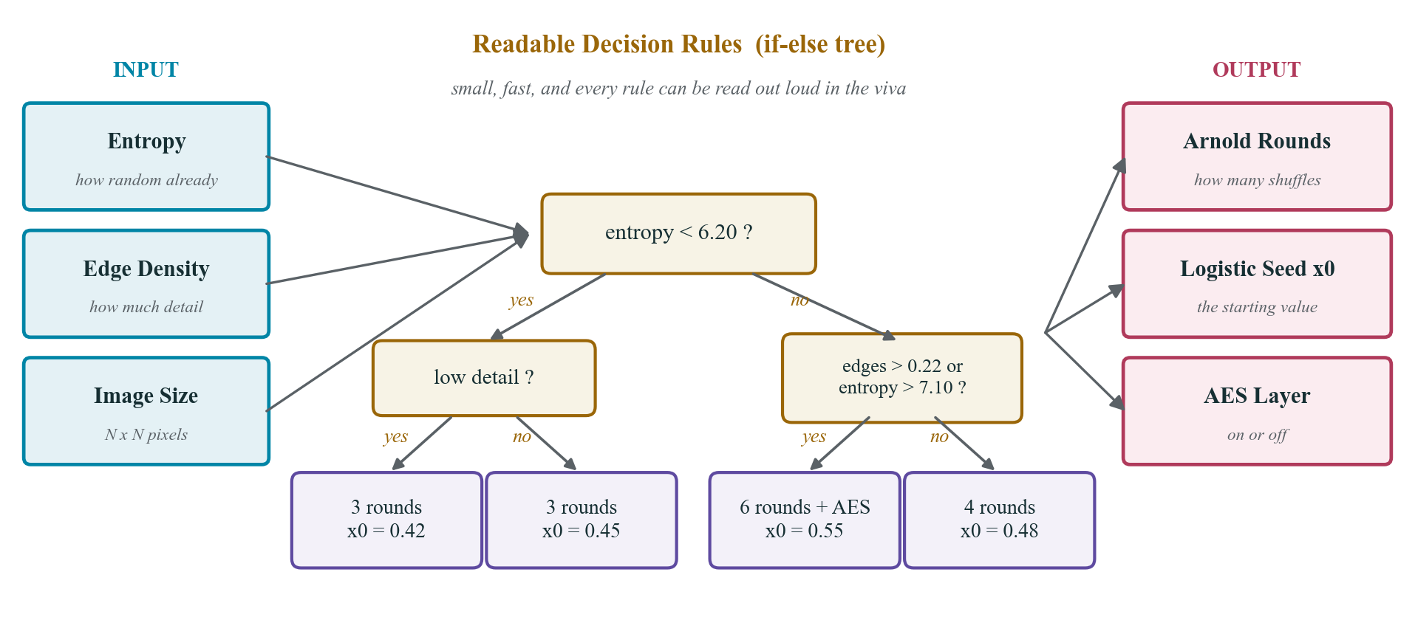
Step 3 — The AI Module Picks the Settings
Three numbers in, three settings out — this is the contribution that fills the research gap
Image Encryption and Decryption using a Hybrid Chaotic Approach · C. V. Raman Global University, Bhubaneswar
16 / 26

Slide 17
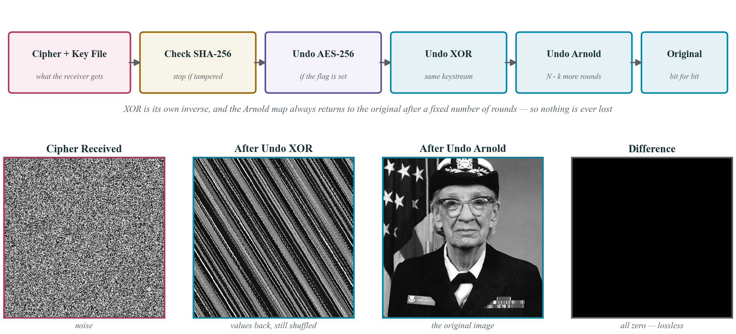
Step 4 — Decryption is Every Step in Reverse
The difference image is completely black, which is how we prove the scheme is lossless
Image Encryption and Decryption using a Hybrid Chaotic Approach · C. V. Raman Global University, Bhubaneswar
17 / 26

Slide 18
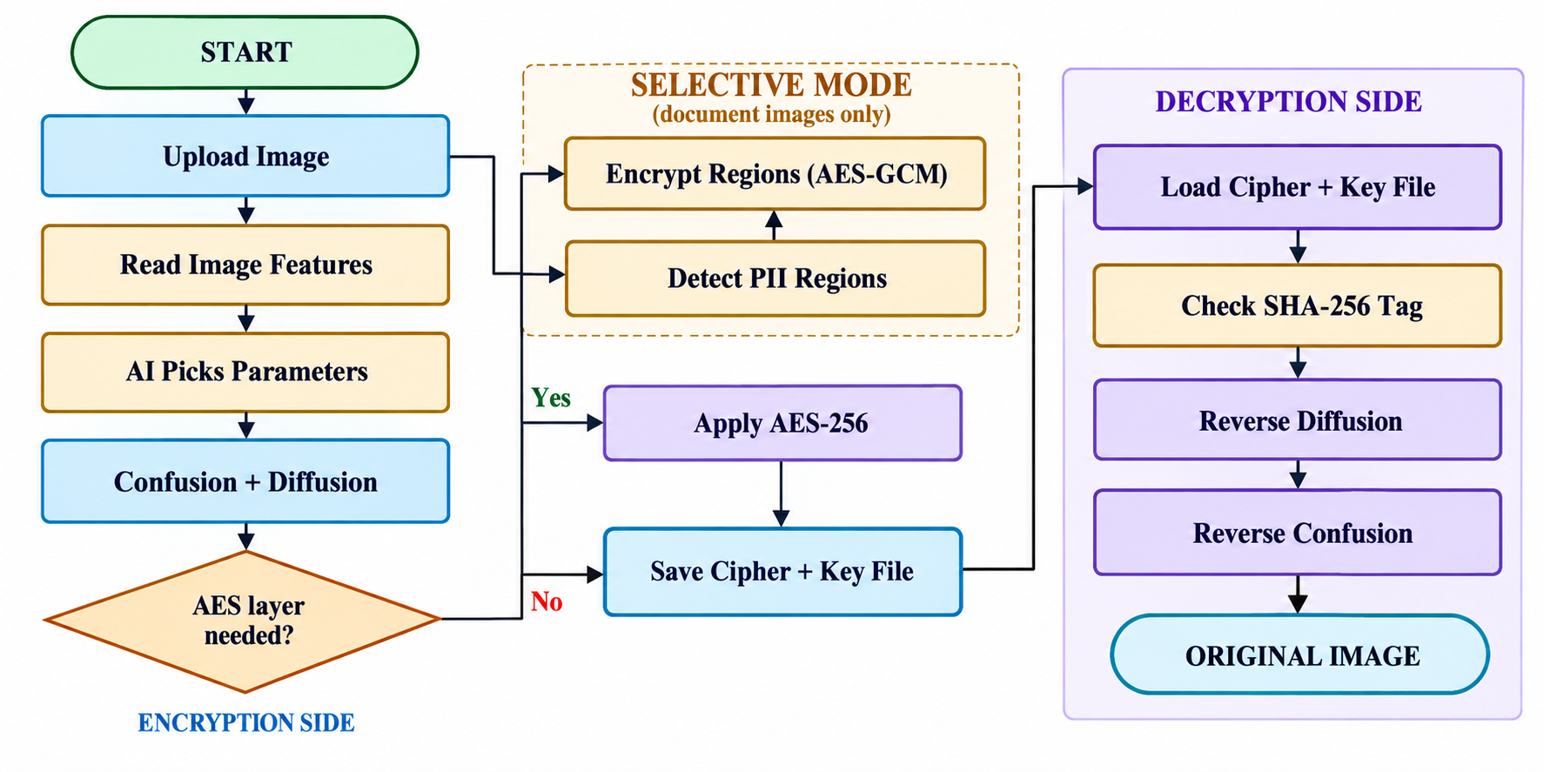
Project Flow Chart
The left side is encryption and the right side is decryption; the diamond is the only decision point
Image Encryption and Decryption using a Hybrid Chaotic Approach · C. V. Raman Global University, Bhubaneswar
18 / 26

Slide 19
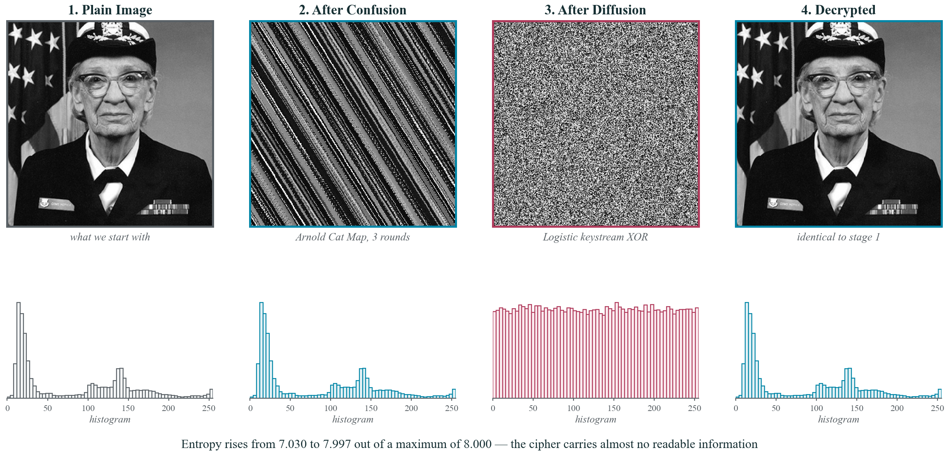

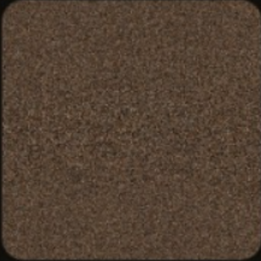

The Whole Pipeline Running on a Real Image
Confusion leaves the histogram alone, diffusion flattens it, and decryption brings back the exact original
Image Encryption and Decryption using a Hybrid Chaotic Approach · C. V. Raman Global University, Bhubaneswar
19 / 26

Slide 20
New Feature — Selective Region Encryption
Why selective?
▪ A document is mostly public — only a few rectangles are sensitive
An Aadhaar card, a payslip or a prescription hides its risk in the number, the signature and the QR code, not in the letterhead.
▪ Lock only those rectangles, leave the rest readable
The receiver still sees the document; the sensitive fields stay noise until the password and the key file arrive.
How each region is locked
▪ One AES-256-GCM call per region, with its own random IV
The key comes from the password through PBKDF2-SHA-512 with 100,000 iterations and a random salt stored in the key file.
▪ The region pixels become visual noise
The real ciphertext lives in the key file metadata; the noise on the image is only a marker of what is protected.
▪ GCM authenticates every region separately
Flip one ciphertext byte or guess the password wrong and decryption refuses outright — tampering is detected, never silently accepted.
▪ The rest of the image is untouched
Outside the boxes the pixels are byte-identical to the original, so the document stays perfectly legible.
The detection pipeline
▪ Gemini Vision on the server, or Tesseract.js OCR in the browser
Either way the regions come back as bounding boxes with a confidence score; the local path never sends the image anywhere.
▪ Regex plus checksums confirm each hit
Verhoeff for Aadhaar, Luhn for cards, context keywords for phone, email, PAN and bank accounts — eleven PII types in all.
▪ The user always gets the final say
Every box can be toggled, deleted or drawn by hand on the canvas before a single byte is encrypted.
Image Encryption and Decryption using a Hybrid Chaotic Approach · C. V. Raman Global University, Bhubaneswar
20 / 26

Slide 21
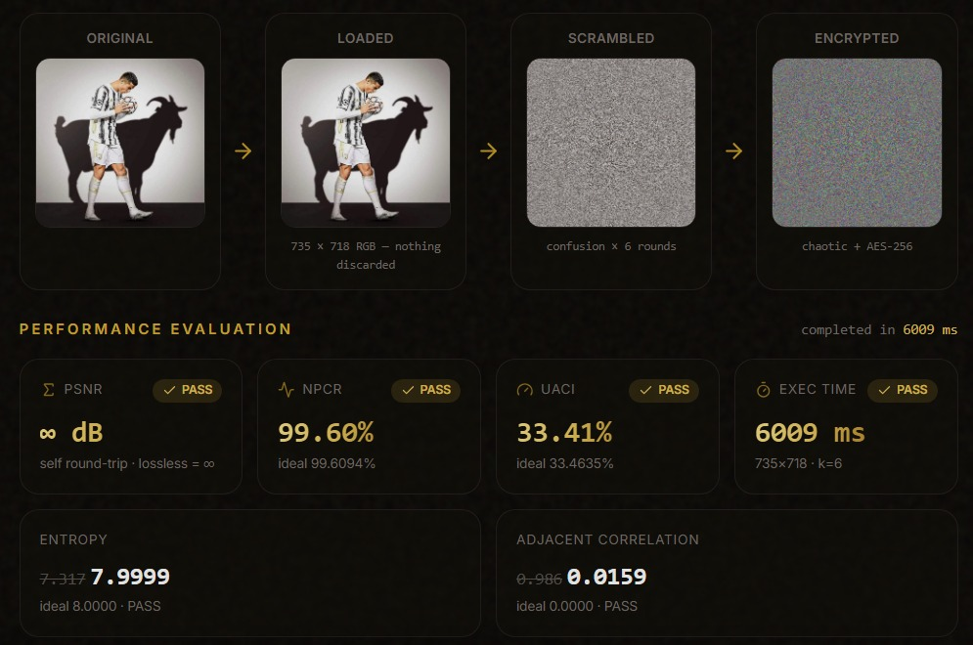
Results
What the numbers mean
▪ The cipher is indistinguishable from random noise
Entropy near 8, zero neighbour correlation and ideal NPCR / UACI mean statistical and differential attacks find nothing to hold on to.
▪ And nothing is ever lost
Every run re-decrypts itself in memory and compares bytes — PSNR ∞ dB is asserted, not assumed.
Image Encryption and Decryption using a Hybrid Chaotic Approach · C. V. Raman Global University, Bhubaneswar
21 / 26

Slide 22
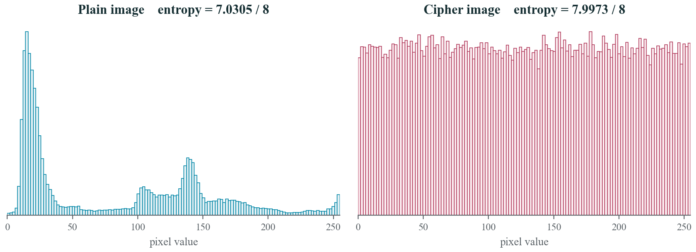
Results — Histogram Flattening
The plain histogram carries the image's fingerprint; the cipher histogram is flat — indistinguishable from noise
Image Encryption and Decryption using a Hybrid Chaotic Approach · C. V. Raman Global University, Bhubaneswar
22 / 26

Slide 23
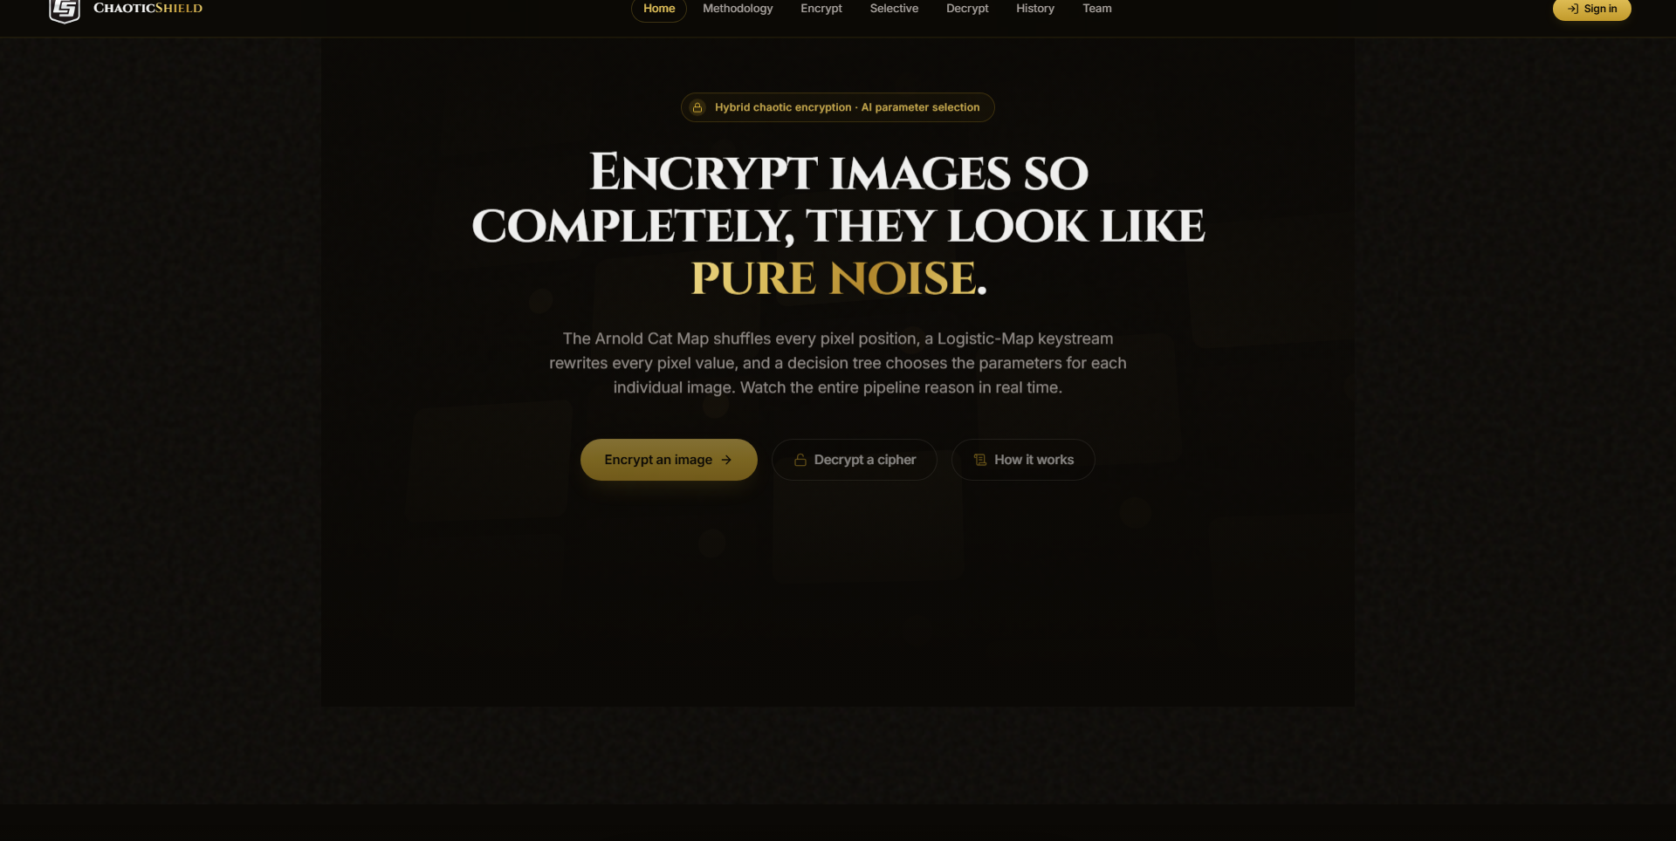
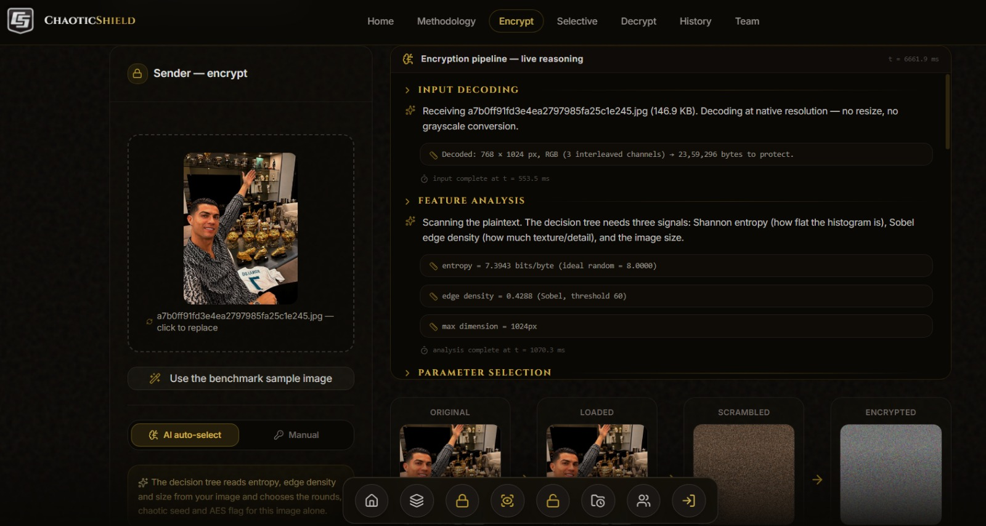
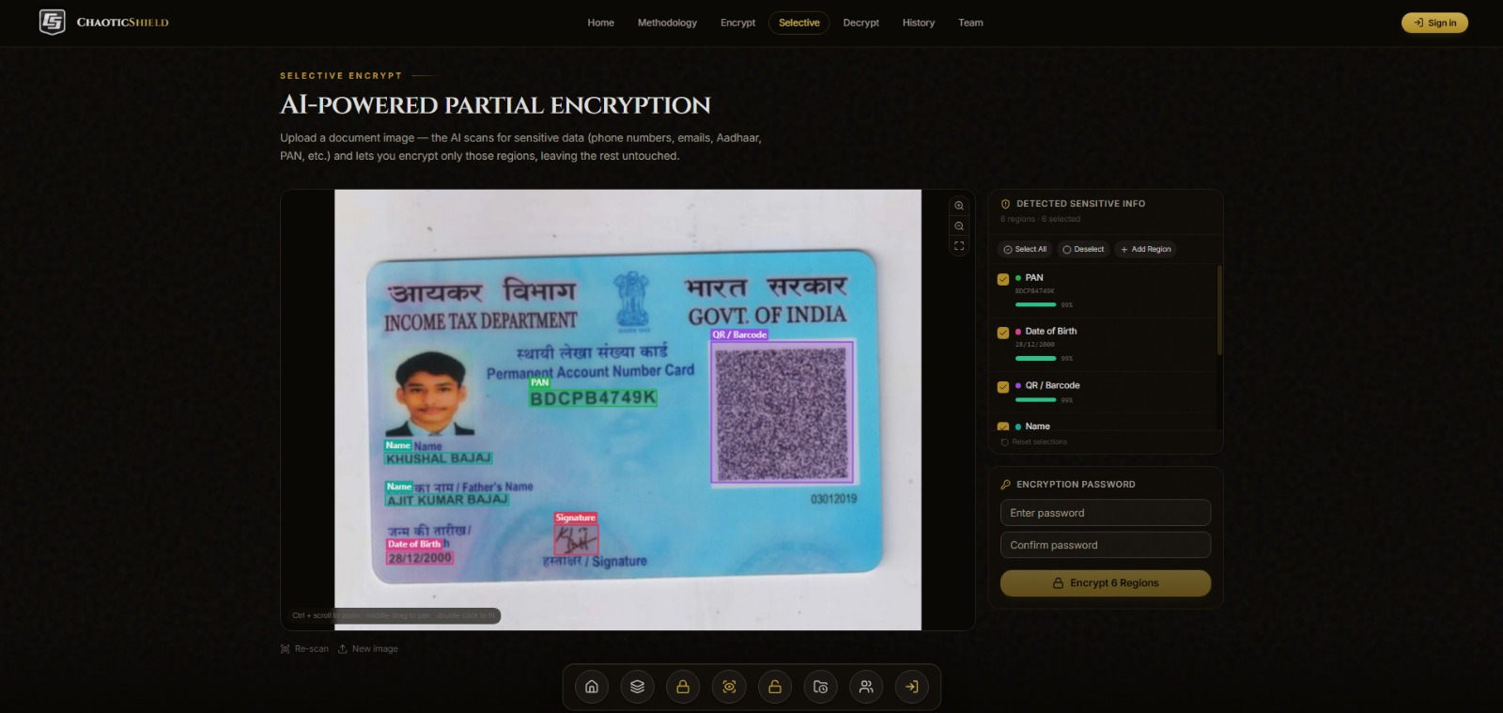
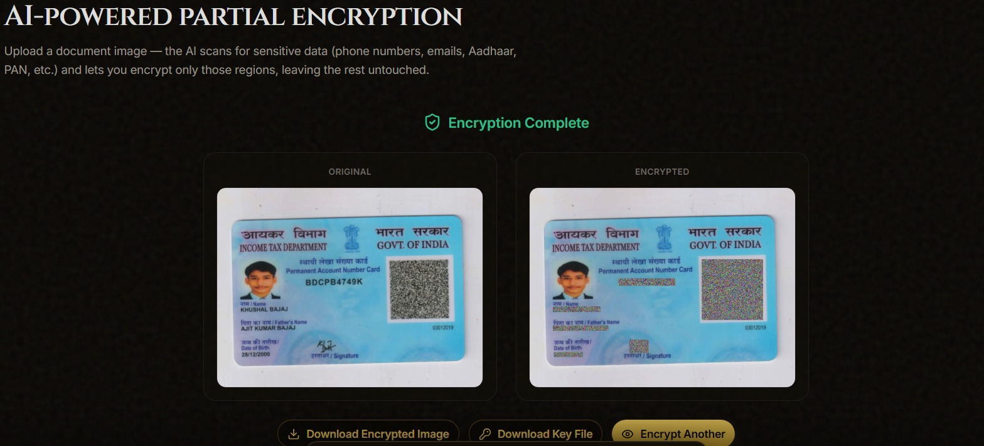
Live Application — Screenshots
Home page — hybrid chaotic encryption at a glance
Encryption workspace — live pipeline console
Selective mode — detected PII regions
History — cipher · key · recovered folders
Image Encryption and Decryption using a Hybrid Chaotic Approach · C. V. Raman Global University, Bhubaneswar
23 / 26

Slide 24
References (1 / 2)
[1]
K. Mahalakshmi and S. Nagarajan, “Comprehensive Review and Analysis of Image Encryption Techniques,” IEEE Access, vol. 13, pp. 109783–109813, 2025. doi: 10.1109/ACCESS.2025.3578158
[2]
N. Chaudhary, T. B. Shahi and A. Neupane, “Secure Image Encryption Using Chaotic, Hybrid Chaotic and Block Cipher Approach,” Journal of Imaging, vol. 8, no. 6, art. 167, 2022. doi: 10.3390/jimaging8060167
[3]
O. S. Faragallah et al., “Investigation of Chaotic Image Encryption in Spatial and FrFT Domains for Cybersecurity Applications,” IEEE Access, vol. 8, pp. 42491–42503, 2020. doi: 10.1109/ACCESS.2020.2974226
[4]
B. Zhang and L. Liu, “Chaos-Based Image Encryption: Review, Application, and Challenges,” Mathematics, vol. 11, no. 11, art. 2585, 2023. doi: 10.3390/math11112585
[5]
C. Sheeba Joice, S. Hitha Shanthini, K. V. Harsha and S. Gopika, “A Comprehensive Review of Image Encryption Algorithms: Techniques and Applications,” Proc. ICDICI, IEEE, 2024. doi: 10.1109/ICDICI62993.2024.10810878
[6]
Q. H. Makki, A. M. Abdalla and A. A. Tamimi, “A Survey of Image Encryption Algorithms,” Proc. ICIT, IEEE, 2021. doi: 10.1109/ICIT52682.2021.9491727
Image Encryption and Decryption using a Hybrid Chaotic Approach · C. V. Raman Global University, Bhubaneswar
24 / 26

Slide 25
References (2 / 2)
[7]
S. Benaka Santhosha, K. V. Sudheesh, K. Puttegowda and B. D. Parameshachari, “A Comprehensive Study on Various Encryption Techniques for Digital Images in Multimedia Networks,” Proc. ICICACS, IEEE, 2024. doi: 10.1109/ICICACS60521.2024.10498590
[8]
H. A. Abughali and U. Köse, “Image Encryption Techniques: A Survey,” Proc. IJCC, IEEE, 2024. doi: 10.1109/IJCC64742.2024.10847281
[9]
K. Kordov, S. Zhelezov, A. Nachev, N. Gueorguiev and D. Pavlova, “Design of Digital Image Encryption Scheme With Cryptographic Analysis,” Proc. SUMMA, IEEE, 2021. doi: 10.1109/SUMMA53307.2021.9632137
[10]
V. Himthani, V. S. Dhaka, M. Kaur, D. Singh and H.-N. Lee, “Systematic Survey on Visually Meaningful Image Encryption Techniques,” IEEE Access, vol. 10, pp. 98360–98373, 2022. doi: 10.1109/ACCESS.2022.3203173
[11]
S.-Y. Li, Y. Gai, K.-C. Shih and C.-S. Chen, “An Efficient Image Encryption Algorithm Based on Innovative DES Structure and Hyperchaotic Keys,” IEEE Trans. Circuits and Systems I, pp. 4103–4111, 2023. doi: 10.1109/TCSI.2023.3296693
[12]
X. Zhang and X. Wang, “Digital Image Encryption Algorithm Based on Elliptic Curve Public Cryptosystem,” IEEE Access, vol. 6, pp. 70025–70034, 2018. doi: 10.1109/ACCESS.2018.2879844
Image Encryption and Decryption using a Hybrid Chaotic Approach · C. V. Raman Global University, Bhubaneswar
25 / 26

Slide 26
Thank You
Questions?
Yash Kumar Raut · Rishu Mehta · Suman Kumar
Guide: Dr. Sampa Sahoo · Dept. of CSE, C. V. Raman Global University
Image Encryption and Decryption using a Hybrid Chaotic Approach · C. V. Raman Global University, Bhubaneswar
26 / 26

