Slide 1
Employee Data Analysis using Excel
STUDENT NAME: D.THENMOZHI
REGISTER NO: 312203937 (C4A7B4FADB4A9ED82C341CCBEC4EF388 )
DEPARTMENT: COMMERCE
COLLEGE : ANNAI THERASA ARTS AND SCIENCE COLLEGE, THIRUKAZHUKUNDRAM

Slide 2
PROJECT TITLE
Employee Performance Analysis using Excel

Slide 3


AGENDA
Problem Statement
Project Overview
End Users
Our Solution and Proposition
Dataset Description
Modelling Approach
Results and Discussion
Conclusion
3/21/2024 Annual Review

Slide 4

PROBLEM STATEMENT
The HR department wants to create a comprehensive performance dashboard to track and analyze employee performance metrics such as sales numbers, customer satisfaction ratings, and project completion rates. They also need to analyze sales data to identify top-performing employees, sales trends, and areas for improvement. Additionally, they want to develop a dynamic ranking system to compare employee performance and identify top performance and calculations of using excel formula and function of data analysis.

Slide 5
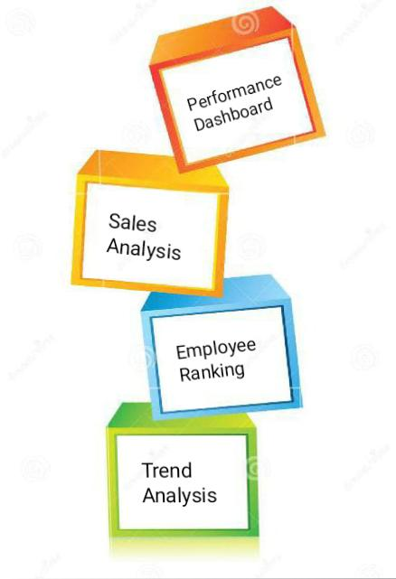
Performance Dashboard: Create a comprehensive dashboard to track and analyze employee performance metrics such as sales numbers, customer satisfaction ratings, and project completion rates.
Sales Analysis: Analyze sales data to identify top-performing employees, sales trends, and areas for improvement, including sales by region, product, and time period.
Employee Ranking: Develop a dynamic ranking system to compare employee performance and identify top performers, including metrics such as sales performance, customer satisfaction, and project completion.

Slide 6
Performance Report: Create a detailed report to provide individual employee performance feedback and recommendations for improvement, including strengths, weaknesses, and areas for development.
Employee Retention: Analyze employee retention rates and identify factors contributing to turnover, including metrics such as tenure, job satisfaction, and exit interviews.
Trend Analysis: Analyze performance trends over time to identify areas for improvement and optimize employee development strategies, including metrics such as sales growth and customer satisfaction.

Slide 7

TYPES OF PROBLEM STATEMENT
Specific Problem: A clear and well-defined problem, e.g., "How can I automate the calculation of sales performance metrics for 100+ employees using Excel?
General Problem: A broader problem that needs to be narrowed down, e.g., "How can I improve employee performance analysis using Excel?”.
Optimization Problem: A problem that seeks to optimize a process or outcome, e.g., "How can I optimize data visualization and reporting to present employee performance insights to management and HR?“.
Comparison Problem: A problem that involves comparing different options or scenarios, e.g., "Which Excel formula is best for calculating employee performance metrics: VLOOKUP or INDEX-MATCH?"

Slide 8

PROJECT OVERVIEW
Collect and preprocess employee performance data.
Develop Excel formulas and functions to automate calculations.
Identify trends, correlations, and areas for improvement.
Improved accuracy and efficiency in employee performance analysis.
Enhanced data-driven decision-making.

Slide 9


WHO ARE THE END USERS?
HR Professionals: Responsible for managing employee data, tracking performance, and identifying areas for improvement.
Managers: Need to evaluate employee performance, provide feedback, and make informed decisions about promotions, training, and development.
Team Leads: Require insights into team performance, strengths, and weaknesses to optimize team dynamics and productivity.
Department Heads: Need to monitor departmental performance, identify trends, and make data-driven decisions about resource allocation.

Slide 10

OUR SOLUTION AND ITS VALUE PROPOSITION
Condition Formatting = Missing
Filter = Remove
Formulae = Performance
Pivot = Summary
Graph = Data Visualization

Slide 11
Dataset Description
This dataset contains employee performance data for a period of 12 months, including metrics such as:-
Employee ID
Name
Department
Job Title
Performance Metrics (e.g., sales numbers, customer satisfaction ratings, project completion rates)
Time Period (monthly)
Quantitative (numerical) data for performance metrics
Categorical data for department, job title, and time period
HR software, performance management systems, or manual data Collection.

Slide 12

THE "WOW" IN OUR SOLUTION
PERFORMANCE LEVEL :
IFS(T7>=5, “VERY HIGH”T7>=4, “HIGH”,T7>=3,
“MED”, TRUE , “LOW”)
3/21/2024 Annual Review
12

Slide 13
MODELLING
DATA COLLECTION
1. Department
2. Division
3. Job Function
4. Employee Classification
DATA CLEANING
1. Start Date
2. End Date
PERFORMANCE LEVEL
1. Very High
2. High
3. Medium
4. Low
13

Slide 14
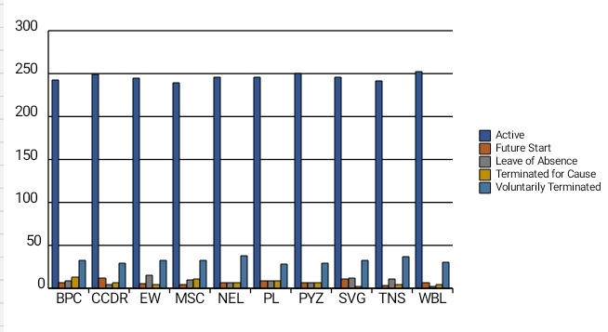
RESULTS
14

Slide 15
conclusion
The Employee Performance Analysis using Excel project aimed to analyze and evaluate employee performance metrics, identify areas for improvement, and provide data-driven insights for informed decision-making. The analysis revealed key findings and trends in employee performance, including:
Top-performing departments and teams.
Strong correlations between performance metrics and employee tenure.
Significant increases in project completion rates.
Inform talent development and training programs.
Optimize team dynamics and resource allocation.
Enhance performance management and evaluation processes.
Drive business outcomes and growth

