Slide 1


Employee Data Analysis using Excel ✅
J.THENMOZHI
312200137
COMMERCE
R.V.GOVT ARTS COLLEGE CHENGALPATTU
STUDENT NAME:
REGISTER NO:
DEPARTMENT:
COLLEGE
:

Slide 2
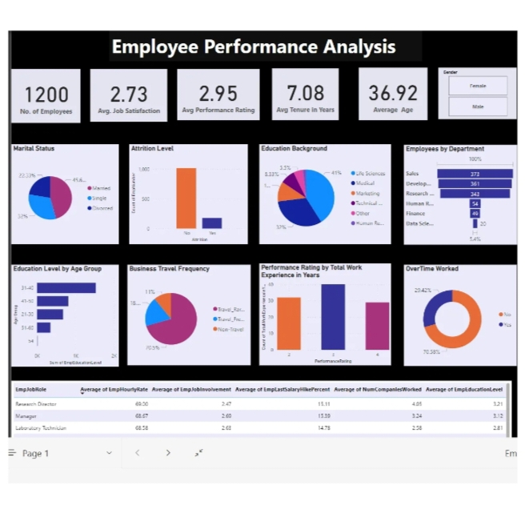

PROJECT TITLE :
Employee Performance Analysis using Excel ✨☑️

Slide 3



💚AGENDA:
Problem Statement
Project Overview
End Users
Our Solution and Proposition
Dataset Description
Modelling Approach
Results and Discussion
Conclusion
3/21/2024 Annual Review

Slide 4

PROBLEM STATEMENT
🍁
🍁
Employee Performance Analysis is a condition and an assumption for the performance and success of a company on the market. In order to ensure competitive ability, the quality of human resources, their management, and related measurement and performance assessment are at the forefront of company interest. Many companies have the problem of setting up evaluation system so that it carried itself elements of responsibility and objectivity. The result of conceptual work in this area is the ultimate use of tools whose deployment, if possible, motivate employees to perform better. The aim of the paper is to refer to problems that arise in companies in evaluating the performance of employees.

Slide 5


✅PROJECT OVERVIEW :
Employee performance analysis involves evaluating various metrics such as productivity, efficiency, and output quality to assess individual and team performance.

Slide 6
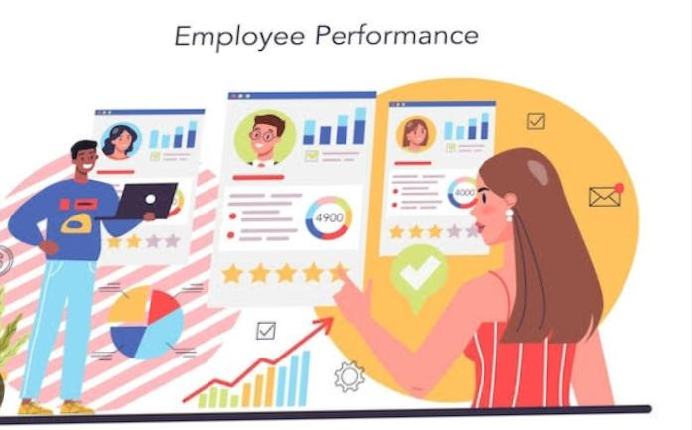

🍁Time Management – using time effectively and productively 🍁 Delegation– knowing how to prioritize tasks and how to distribute work appropriately 🍁 Organization– the ability to keep things on track without missing or forgetting anything 🍁Communication– being able to define goals, express concerns, and give instructions clearly 🍁 Engagement– enthusiasm and involvement in work projects

Slide 7


🌐WHO ARE THE END USERS?
The end user is the term used for those people who actually use a product, often on a constant or regular basis, as part of their own job. End users are hands-on customers who work directly with various products and tools in order to deliver on the business goals of their own organization.

Slide 8
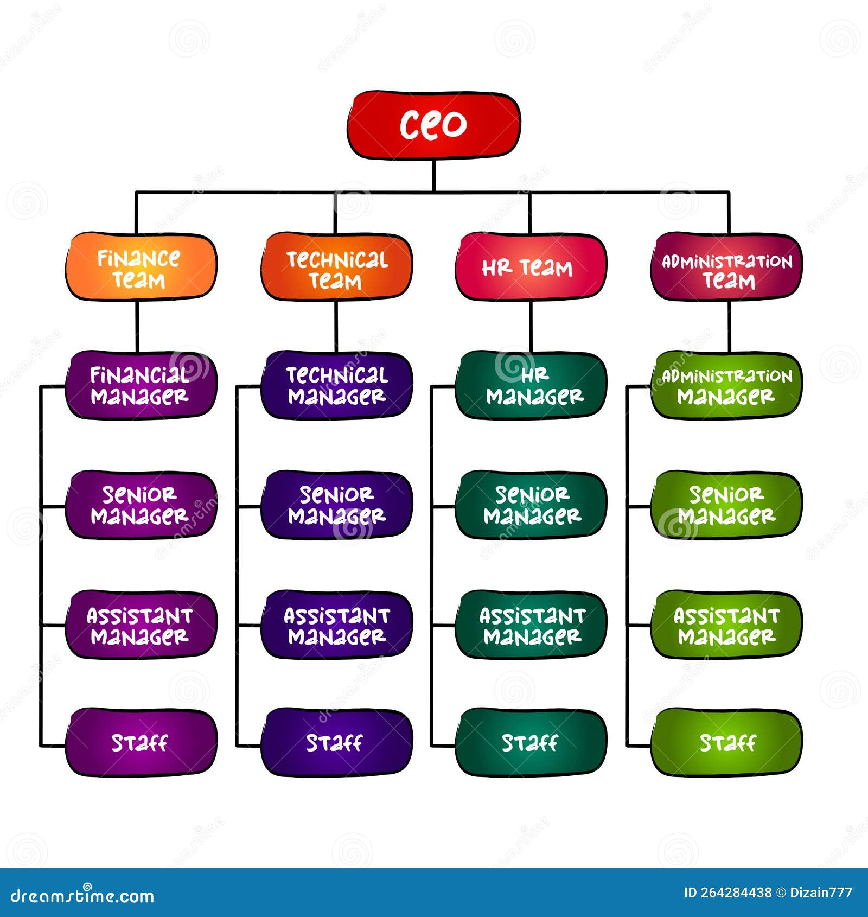

END USER CHART :

Slide 9
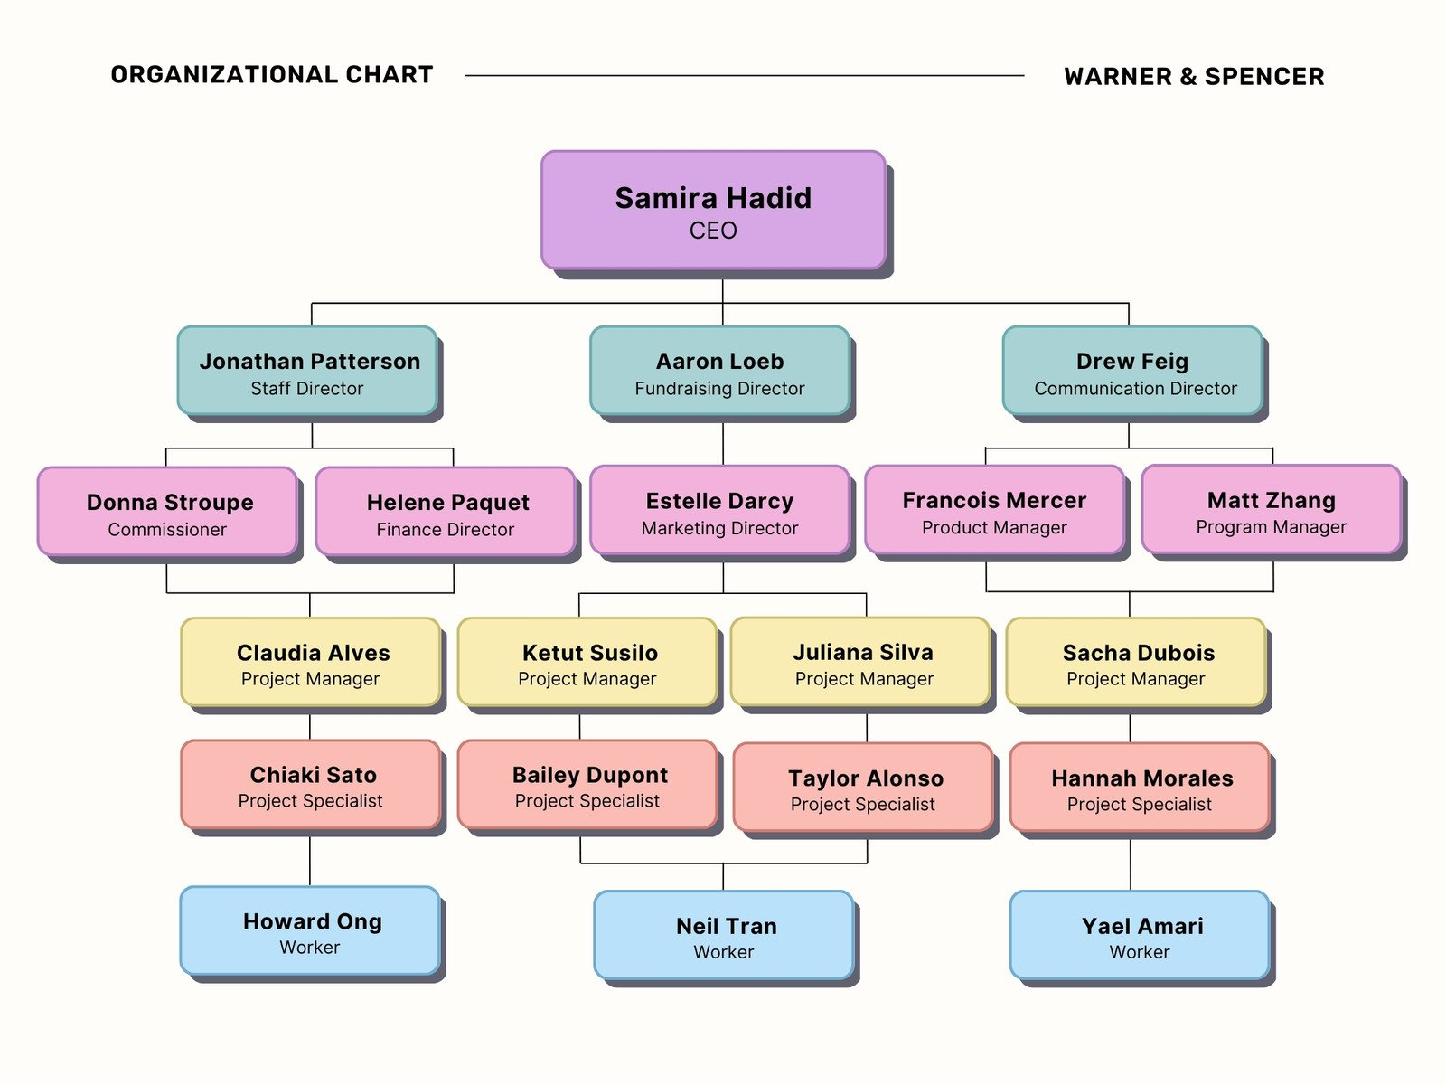

EXAMPLE OF END USERS :

Slide 10


EMPLOYEE LOGOS :✔️

Slide 11
OUR SOLUTION AND IT’S VALUE PROPOSITION ☑️
📌Conditional Formatting – Missing
📌Filter- Remove
📌Formula- Performance
📌Pivot- Summary
📌Graph- Data Visualization

Slide 12
🍁Dataset Description :
📌 Employee Dataset - Kaggle App
📌26 - Features
📌 9 - Features
📌 Employee ID - Numerical Values
📌Name - Text
📌 Employee Type
📌 Performance Level
📌Gender - [Male, Female]
📌 Employee Rating – Numerical Values

Slide 13

🖤THE "WOW" IN OUR SOLUTION :
⭐ Performance Level
🌟 Innovative Level
⭐ New Techniques
🌟 Feasibility
⭐ Potential Impact
🎇
3/21/2024 Annual Review
13

Slide 14
📝MODELLING:✨
1️⃣Data Collection
2️⃣Data Cleaning
3️⃣Performance Level
4️⃣Summary
5️⃣Visualization

Slide 15
Analyzing employee performance using Excel: ✅1. Data Collection - **Employee Information**: Name, ID, Department, Role - **Performance Metrics**: KPIs, Targets, Achievements - **Time Period**: Monthly, Quarterly, Yearly ✅2. Setting Up the Excel Sheet - **Data Input Sheet**: Create a sheet for raw data where you input all the necessary information. - **Metrics Calculation**: Add formulas to calculate performance metrics such as: - **Achievement Rate**: `=Actual/Target * 100` - **Efficiency**: `=Output/Input` - **Attendance**: `=Days Worked / Total Workdays * 100` - **Conditional Formatting**: Highlight cells to quickly visualize high and low performers. ✅3. Analysis - **Comparative Analysis**: Use PivotTables to compare performance across different employees, departments, or periods. - **Trend Analysis**: Create charts (line graphs, bar charts) to identify trends over time.
15

Slide 16
✅4. Visualizations - **Dashboards**: Develop a dashboard with key charts and graphs summarizing the performance. - **Heat Maps**: Use conditional formatting to create heat maps that visually represent performance levels. ✅ 5. Results Interpretation - **Identify Top Performers**: Note the top 10% of employees who exceed targets consistently. - **Highlight Improvement Areas**: Employees who consistently perform below expectations. - **Trend Observations**: Document any noticeable trends (e.g., performance dips during certain months). ✅ 6. Notes and Documentation - **General Observations**: Document any patterns or anomalies observed. - **Action Points**: List recommended actions for improvement (e.g., training, mentoring). ✅ 7. Reporting - **Summary Sheet**: Create a summary sheet with key findings, including average performance, highest and lowest performers, and recommended actions. - **Detailed Reports**: For individual employee analysis, provide a detailed breakdown of their performance with notes on specific strengths and weaknesses.

Slide 17
⭐1. Define Your Performance Metrics Start by identifying key performance indicators (KPIs) that reflect your business objectives. Common KPIs include sales targets, customer satisfaction scores, and project completion rates. ⭐2. Create a Data Input Sheet Set up a dedicated sheet for inputting raw data. Organize data with columns for: Date Metric Name Values Employee/Team Name

Slide 18
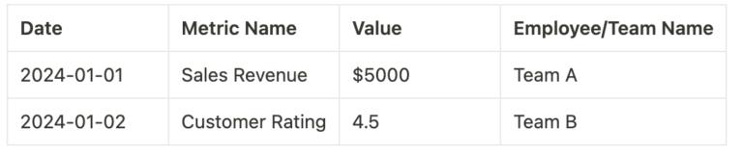
EXAMPLE:
⭐3. Design a Dashboard Sheet: Create a summary dashboard to visualize performance metrics using charts, graphs, and conditional formatting. This sheet should provide a quick overview of key trends and insights.
✅ Basic Formulas:
Use basic Excel formulas such as SUM, AVERAGE, and COUNT to aggregate data and calculate KPIs.

Slide 19
Example:
Total Sales: =SUM(B2:B10) Average Rating: =AVERAGE(C2:C10)
✅Advanced Functions Leverage advanced functions like VLOOKUP, INDEX/MATCH, and IF statements to manage and analyze data more efficiently. Example: Lookup Sales Value: =VLOOKUP(“Sales Revenue”, A2:C10, 2, FALSE)

Slide 20
⭐4. Automating Performance Tracking:
📌 Setting Up Conditional Formatting Use conditional formatting to highlight performance thresholds and variances. For instance, you can color-code cells based on performance levels. 📌 Creating Automated Alerts Set up automated alerts using conditional formatting and rules to flag performance issues automatically.

Slide 21
⭐5. Visualizing Data with Charts and Graphs: ✅1. Creating Bar and Line Charts Use bar and line charts to visualize performance trends over time. Include step-by-step instructions with screenshots. ✅2. Using Pivot Tables Create and use pivot tables for dynamic data analysis, summarizing and filtering performance data.

Slide 22
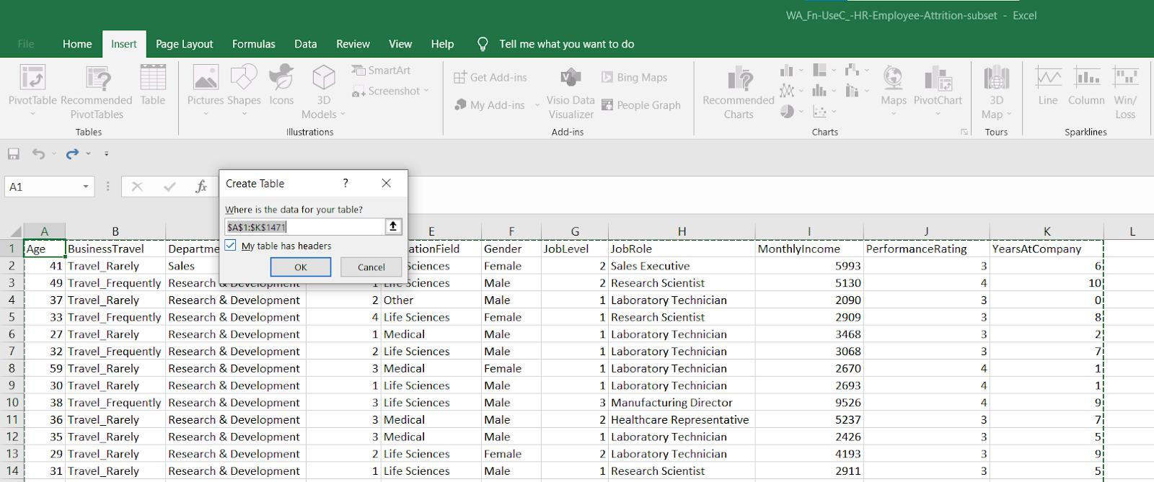

Slide 23

🌠RESULTS:
Employee performance analysis indicates that they consistently meet or exceed targets in key areas such as productivity and teamwork. However, there is room for improvement in time management and deadline adherence.”
The Results Given !!!
23

Slide 24

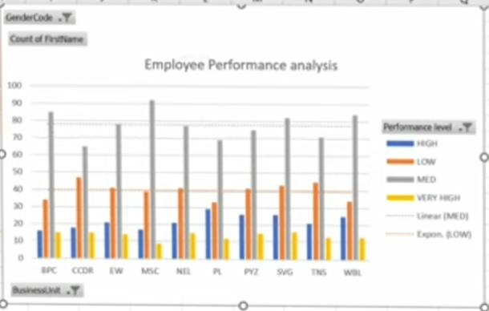
✒️EMPLOYEE PERFORMANCE ANALYSIS :📝📊📊

Slide 25
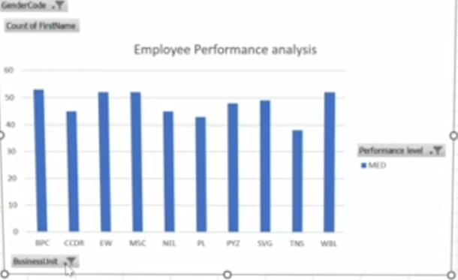
PERFORMANCE LEVEL [PIVOT CHART ]✔️

Slide 26
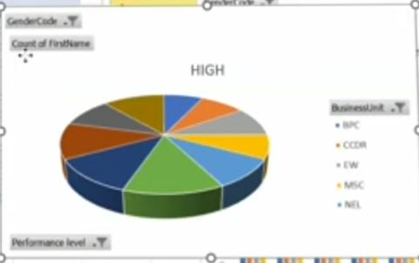
📈PERFORMANCE LEVEL :📉

Slide 27

Conclusion:✅
From the results, we can conclude that the company should provide a better environment as it increases the performance drastically. The company should increase the salary of the employee from time to time and help them maintain a worklife balance. On the other hand, shuffling the manager from time to time will also affect performance.

Slide 28
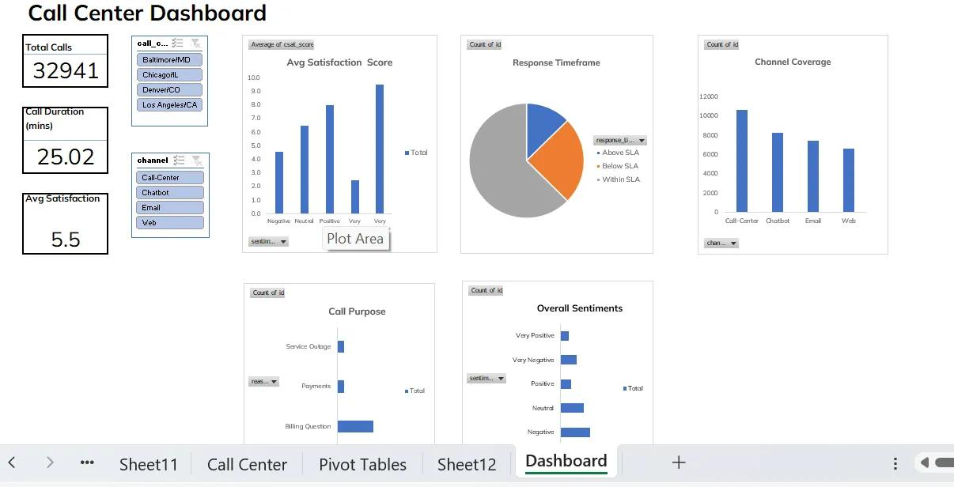

Slide 29
📝✅To analyze an employee’s performance from a moral perspective, you can consider the following points:
✒️Evaluate whether the employee adheres to the company’s ethical standards, such as honesty, integrity, and fairness in their interactions with colleagues, clients, and stakeholders. This includes avoiding conflicts of interest, respecting confidentiality, and demonstrating accountability.
✒️ Assess the employee’s commitment to the company’s core values and principles. This involves their dedication to promoting a positive work environment, supporting diversity and inclusion, and contributing to the overall well-being of the team and organization.

Slide 30


