Slide 1
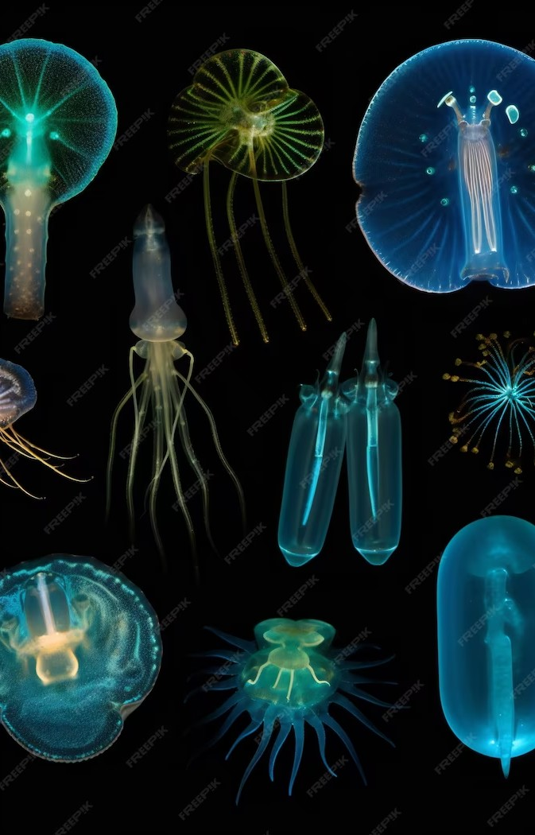
Unleashing the Hidden World of Phytoplankton: A Journey Through the Tiny Marvels of Our Oceans

Slide 2
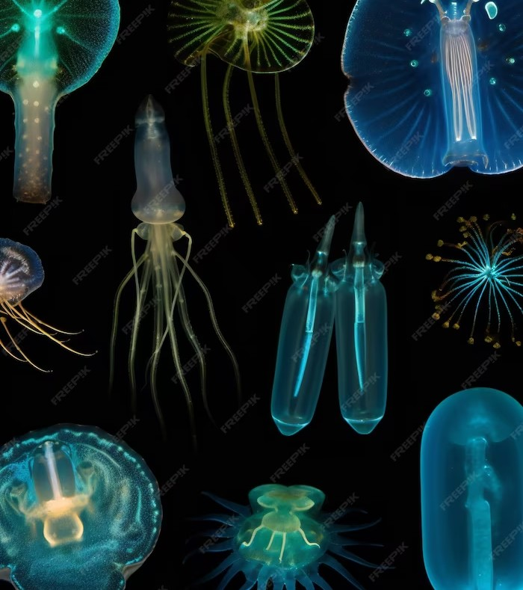
Introduction
Phytoplankton are tiny organisms that play a crucial role in the health of our oceans. They are the base of the marine food web and produce half of the oxygen we breathe. Join us on a journey to explore the hidden world of these marvelous creatures.

Slide 3
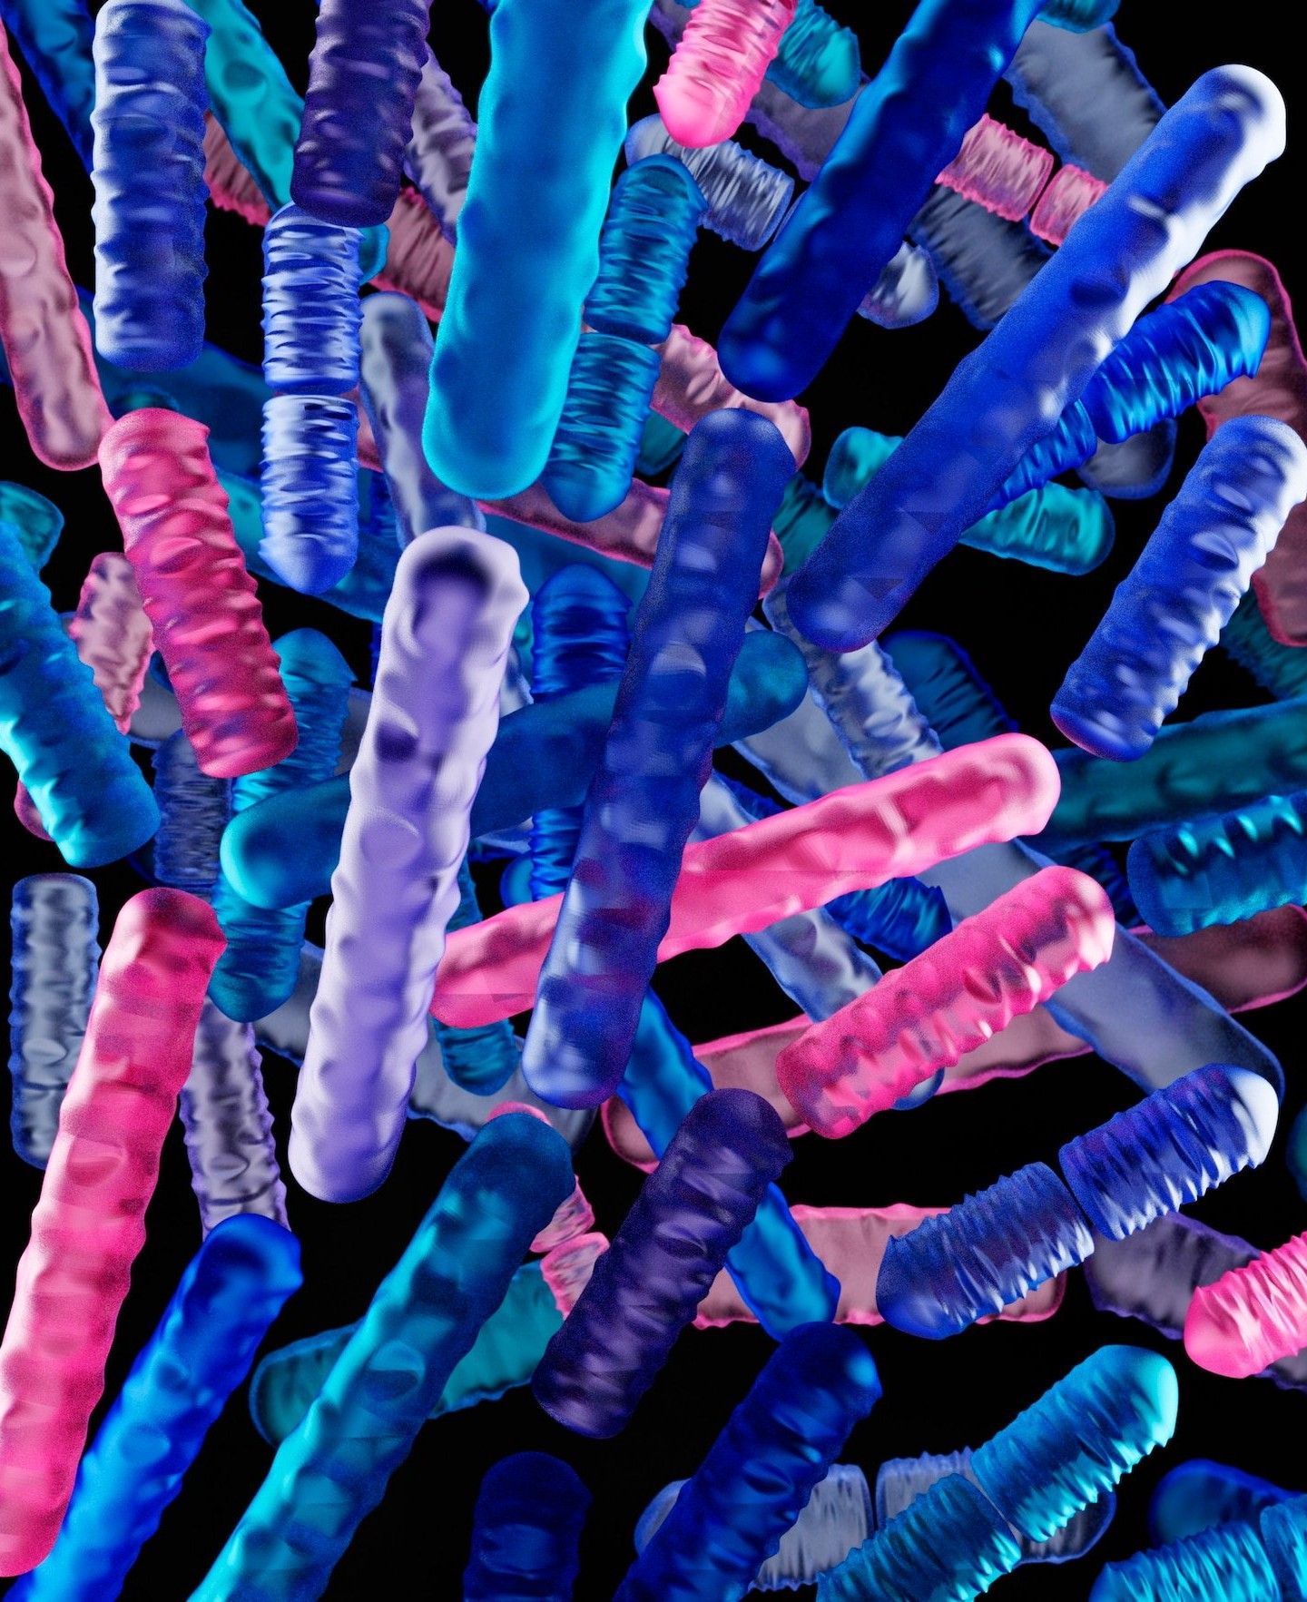
Diversity of Phytoplankton
Phytoplankton come in many shapes and sizes, from diatoms with intricate glass-like shells to dinoﬂagellates with whip-like tails. Some species even have the ability to bioluminesce, creating beautiful displays of light in the ocean at night.

Slide 4
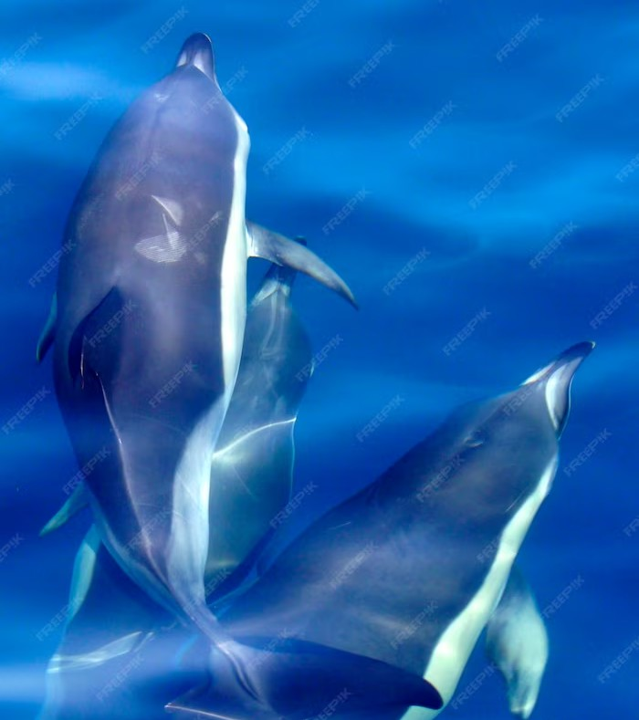
Importance of Phytoplankton
Phytoplankton are the foundation of the marine food chain, providing food for zooplankton, ﬁsh, and even whales. They also play a crucial role in regulating the Earth's climate, absorbing carbon dioxide from the atmosphere through photosynthesis. Without phytoplankton, our oceans and planet would be vastly different.

Slide 5
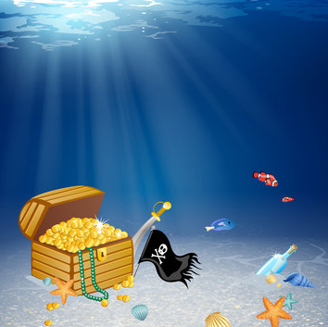

Embark on a Thrilling Underwater Adventure: Treasure Hunt with Your Personalized Avatar!

Slide 6
Conclusion
Phytoplankton may be small, but they are mighty. Their beauty and importance cannot be overstated. We must continue to study and protect these tiny marvels of our oceans to ensure the health of our planet for generations to come.

