Slide 1
PHASAL
AI Plant Disease Recognition System
Presented by:
Thenkarai Maharajan M
MCA Student

Slide 2
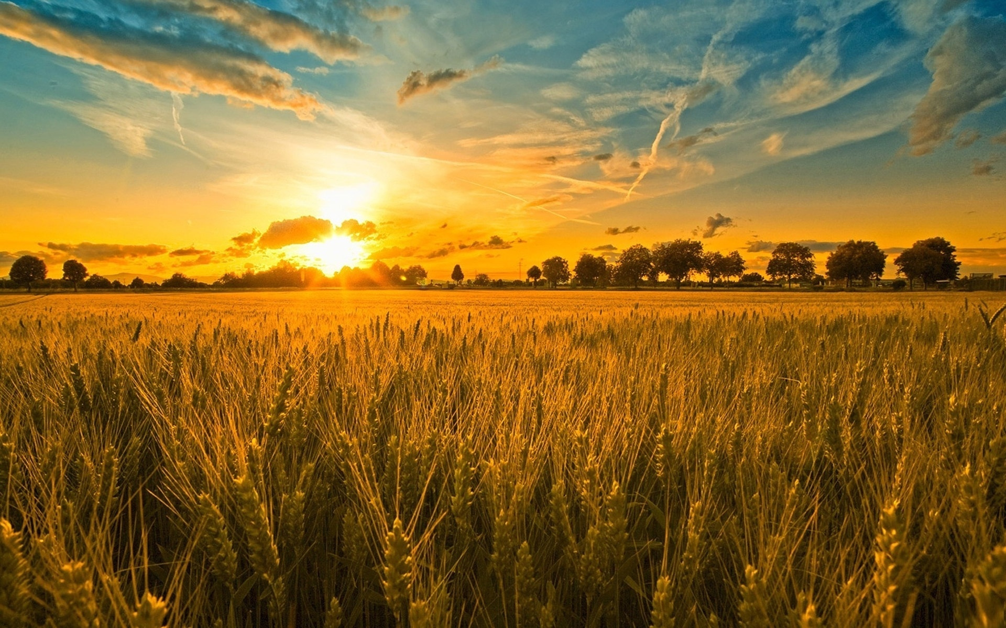
Introduction
• Revolutionizing Agriculture via AI.
• Real-time Identification of plant pathologies.
• Bridging the Gap between technology and farmers.
• Comprehensive health reports in English and Tamil.

Slide 3
Problem Statement
• Global crop yield loss (20-40%) due to diseases.
• Limited access to agriculture experts.
• Slow manual diagnostics leading to crop failure.
• Need for localized linguistic support (Tamil).

Slide 4
Project Objectives
• Develop a lightweight, high-accuracy AI model.
• Provide Instant analysis via Web/Camera.
• Quantify Severity for better decision making.
• Enable Tamil support for regional accessibility.

Slide 5
Technology Stack
• Backend: Python / Flask Web Server.
• AI: Google Gemini-2.5-Flash (LLM Vision).
• Frontend: Modern HTML5 / CSS3 / JavaScript.
• Processing: PIL (Pillow) & Base64 Logic.
• UI Theme: Professional Dark Mode & Glassmorphism.

Slide 6
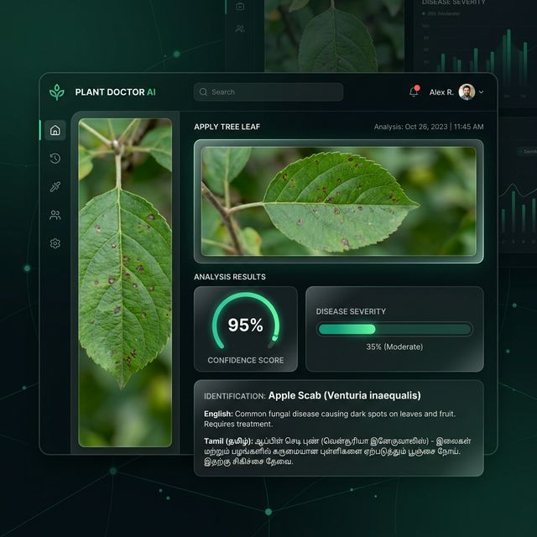
User Interface & Analysis
• Clean, intuitive dashboard for farmers.
• Real-time confidence circular gauges.
• Interactive disease severity indicators.
• Localized result cards for quick reading.

Slide 7
System Workflow
• 1. Image Capture: User uploads or uses camera.
• 2. Analysis: Gemini AI processes visual features.
• 3. Quantification: Severity & Confidence calculated.
• 4. Reporting: Results displayed with Cause & Cure.
• 5. Localization: Dynamic translation to Tamil.

Slide 8
Key Features
• Multi-modal AI: Analyzes images with high precision.
• Tamil Translation: Zero barrier for local farmers.
• Severity Analysis: Precise leaf area impact data.
• Cross-platform: Works on mobile and desktop.

Slide 9
Conclusion & Future Scope
• Integration with IoT Soil Sensors.
• Development of Dedicated Mobile Apps.
• Offline Database for remote rural areas.
• Blockchain for secure crop data tracking.

Slide 10
Thank You!
Questions & Feedback
Thenkarai Maharajan M
MCA Student

