Slide 1

COVID-19 CASES ANALYSIS
Presented by:
Reemasri m
Shiloh j s h
Sudheshna m
Thenmugi t

Slide 2
OBJECTIVE:
1)DATA COLLECTION
2)DATA IMPORTING
3)DATA ANALYZING
4)DATA PREPROCESSING
5)DATA VISUALIZATION

Slide 3
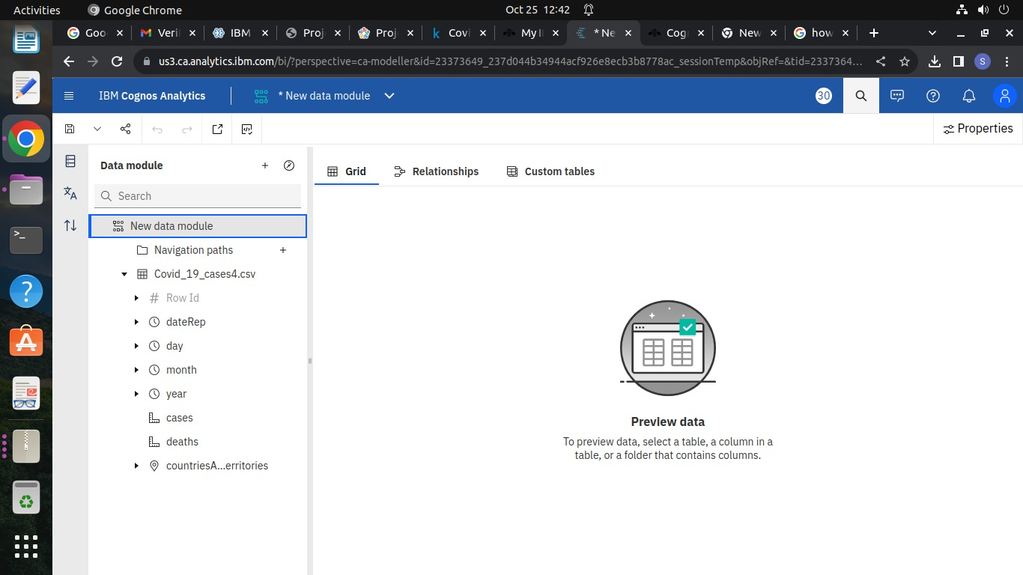
Step-1:Downloading and uploading the dataset
The following dataset is downloaded and it is saved in file manager and it is uploaded

Slide 4
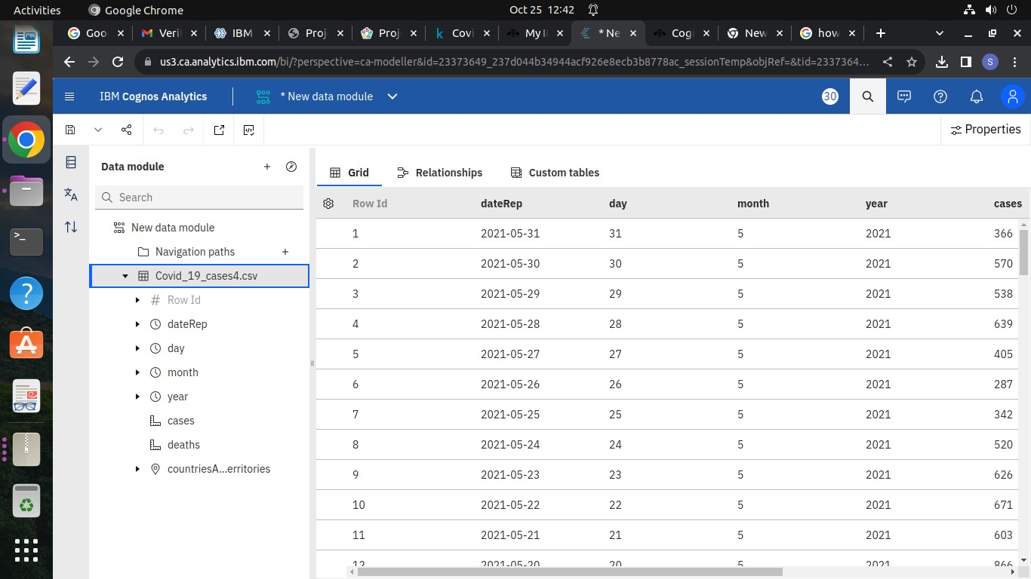
Step-2:Data collection and analysis
In this stage, data is collected and analysed using IBM cognos analytics software

Slide 5
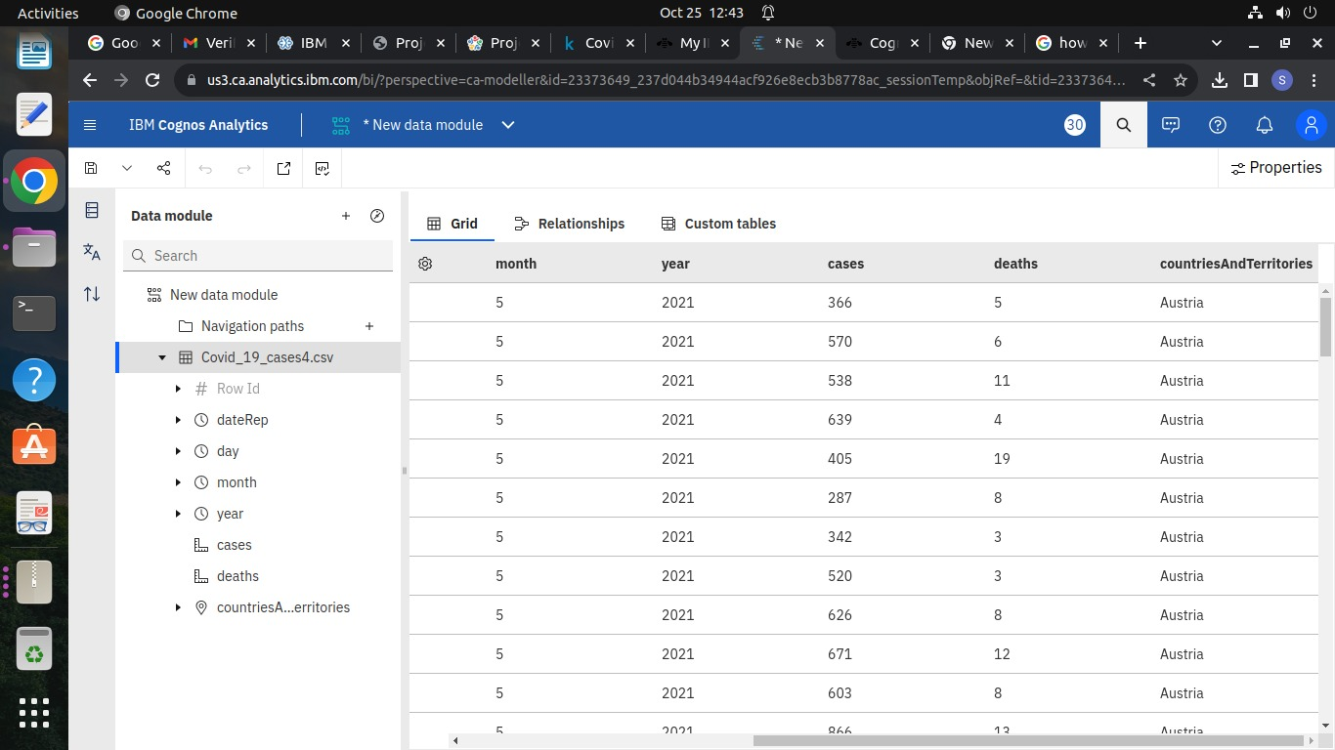

Slide 6
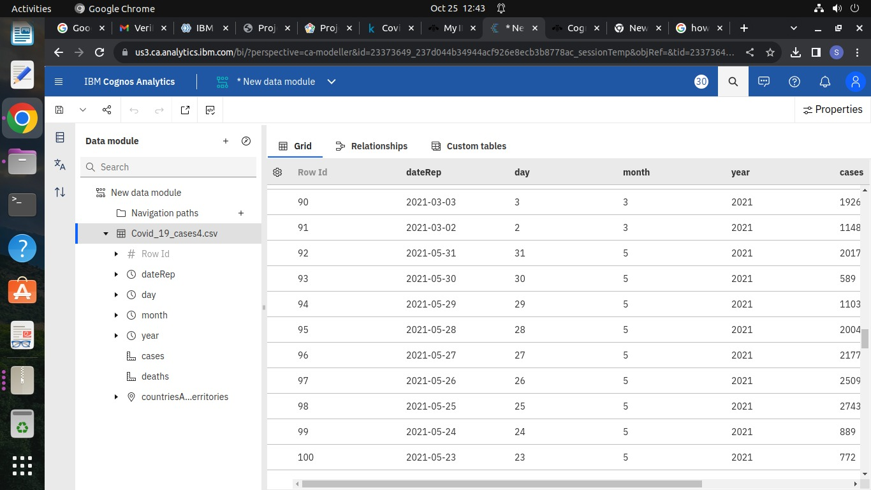

Slide 7
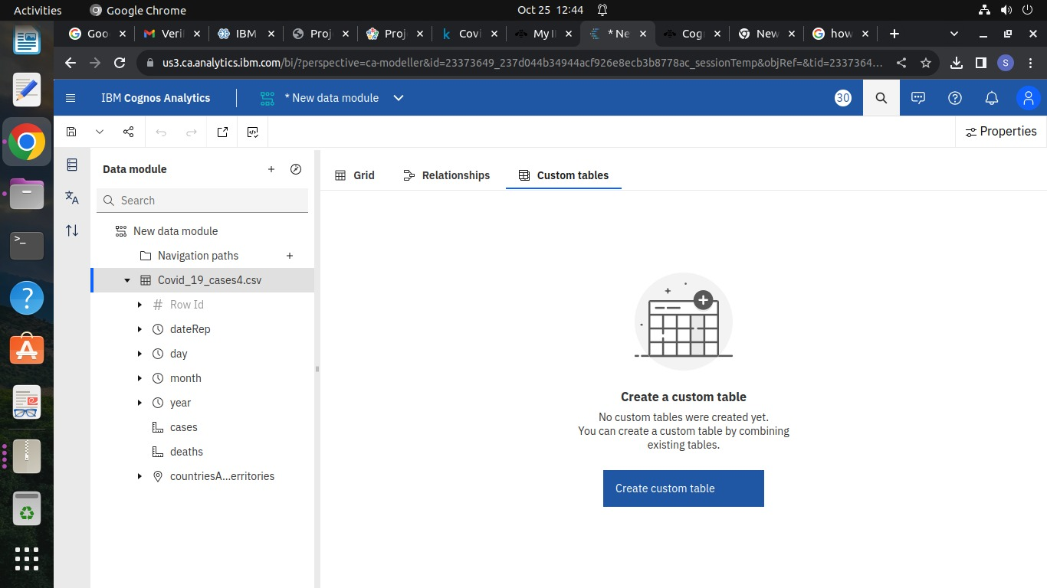
Step-3:Data preprocessing and cleaning

Slide 8
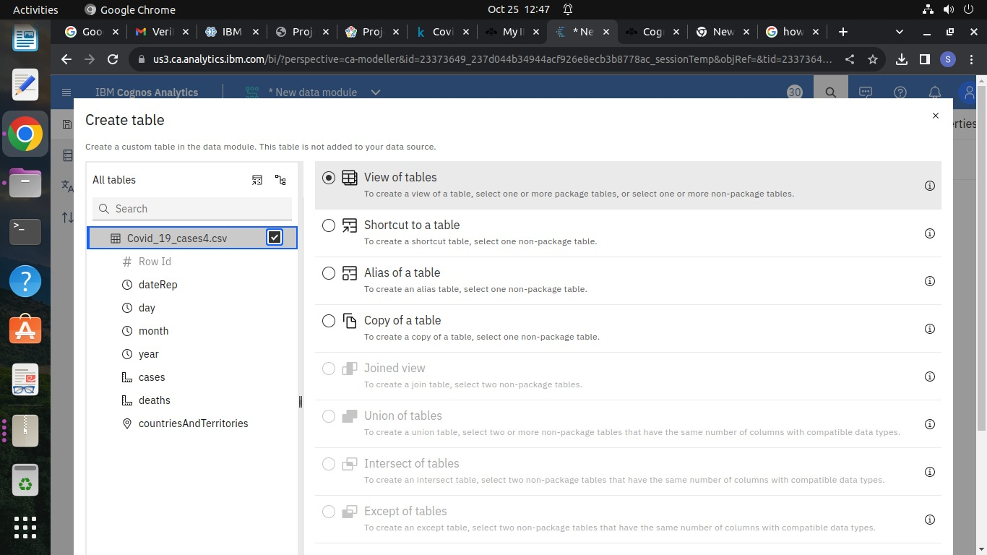

Slide 9
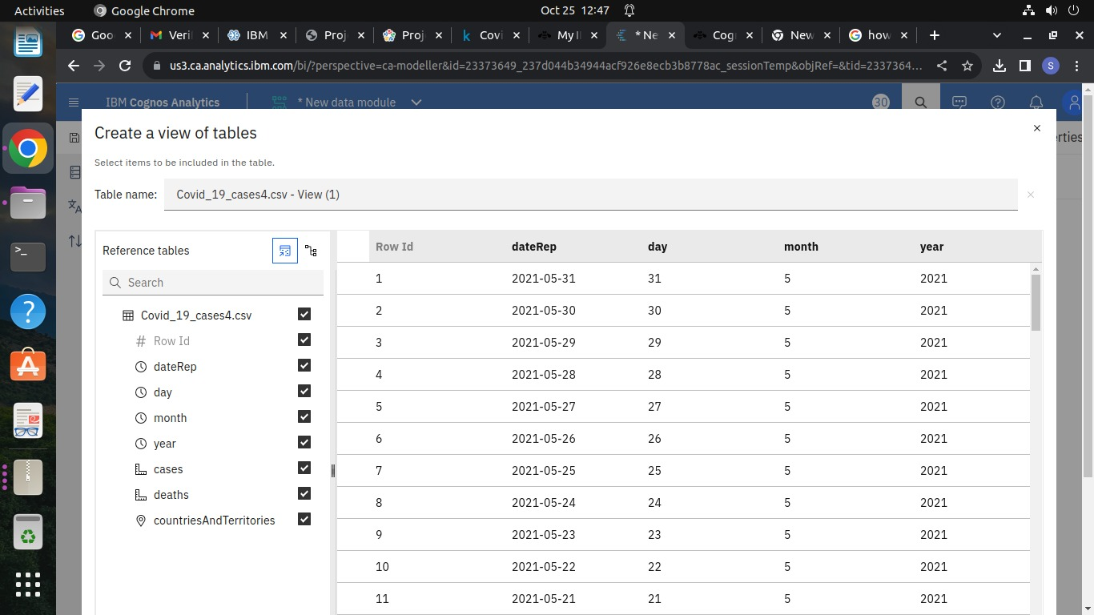

Slide 10


Slide 11
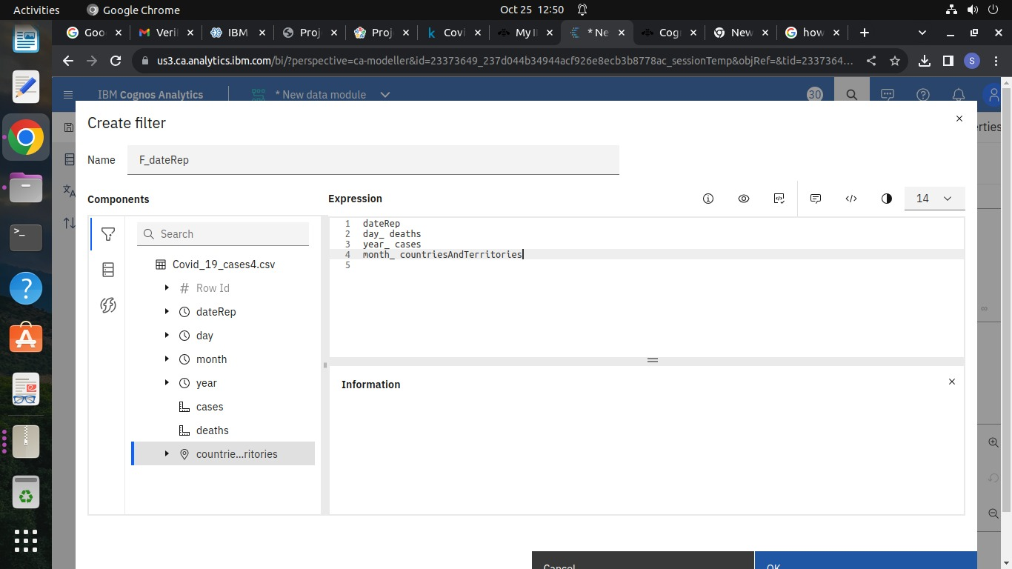

Slide 12


