Slide 1


Virtualization
by Denis Lokaj, LOK0020

Slide 2
What is it?
In computing, virtualisation refers to the act of creating a virtual (rather than actual) version of computer hardware platforms, storage devices, and computer network resources
Hardware virtualisation or platform virtualisation refers to the creation of a virtual machine that acts like a real computer with an operating system

Slide 3
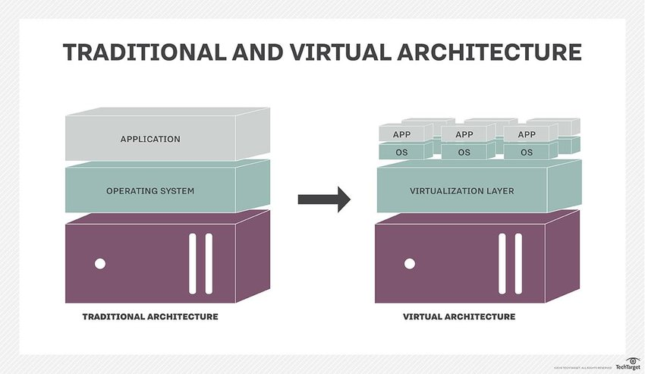
Difference between your home computer for everyday tasks and computer which is suited for virtualization

Slide 4
Business and Industry
Virtualization can be also used in a corporation environment to simulate need of physical computers. With one single server providing computer resources to hundreds of employees
Pros of this approach are: 1) Administrators can easily prepare all virtual computers to every employee within few clicks or commands. 2) Easy backup of data on server. 3) Fast and remote technical support.
Cons: 1) Server must run all the time, even if only one employee needs to work.

Slide 5
Emulation
With virtualization technology we can emulate behavior of different types of CPUs.
This means that in some cases we‘re also able to emulate games from retro game consoles like playstation 1, playstation portable, Nintendo 64 etc. So you can play them on your PC with Windows/Linux distribution.
Nowadays Apple and Microsoft experiment with ARM CPUs for laptops in their products, which are very power efficient and are already widely used in every smartphone, but problem is that, they are not able to run x86 application, so these are emulated.
Emulation comes with its costs, due to being more hardware challenging.

Slide 6
Application hosting
Virtualization provides environment for applications you need to host. For example many websites run on virtual machines with specific hardware resources for that application.
Con of this approach is, that you always must run some kind of Operating system to be able to run that application. Also, most of the time your application doesn‘t use 100% of your provided resources, it‘s mostly idle.
That means resources are not used efficiently, so alternative to virtualization is something called Docker.

Slide 7
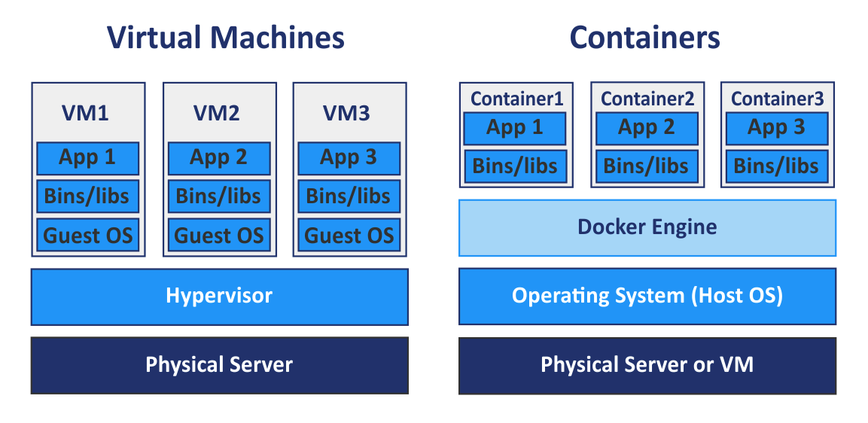
Docker

Slide 8
Docker
Docker uses containers instead of VMs.
Containers are separated and are not dependand on others, just like VMs.
You don‘t need Operating system to be able to host application. You just provide Docker with libraries.
This provides us with an effective use of resources, so application use only resources, that needs at this time.

Slide 9
Thanks for attention

