Slide 1
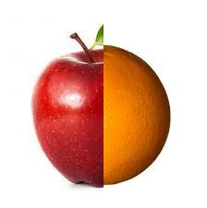
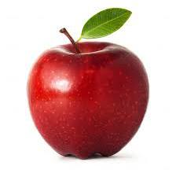
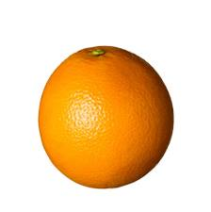
Problem??
After image stitching, how the areal map will look like?
What will happen if they overlap?

Slide 2
Gaussian Smoothing and Laplacian of an image.
Gaussian smoothing is used to `blur' images and remove detail and noise.
The Laplacian is often applied to an image that has first been smoothed by a Gaussian smoothing filter in order to reduce its sensitivity to noise
The Laplacian of an image highlights regions of rapid intensity change.

Slide 3
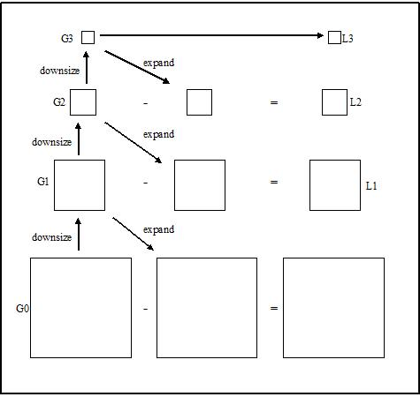
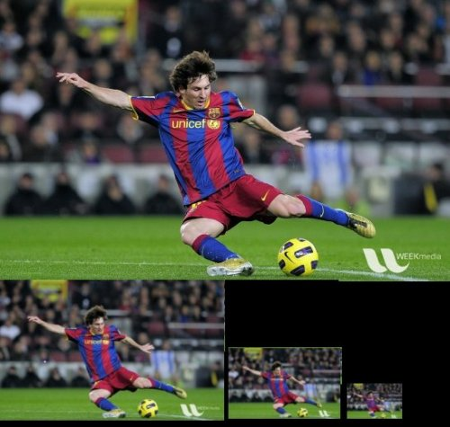
Gaussian Pyramid

Slide 4
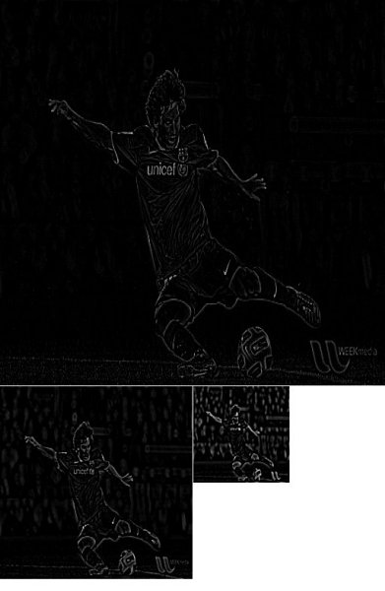
Laplacian Pyramid

Slide 5
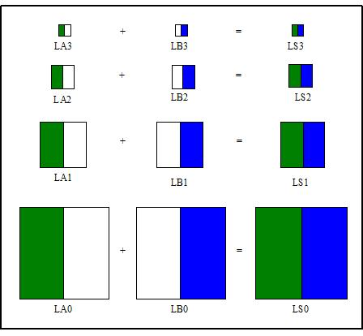
Combining Images.

Slide 6
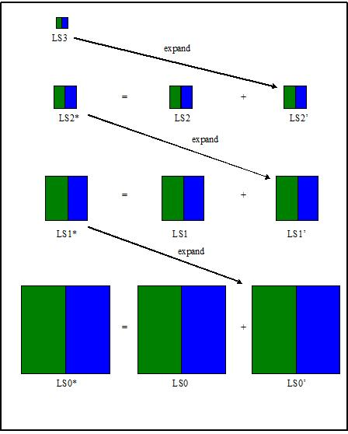
Combining Images cont…

Slide 7
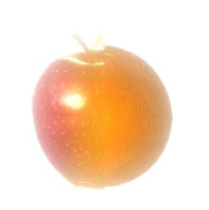
Finally…

