Slide 1
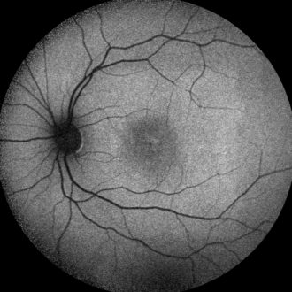
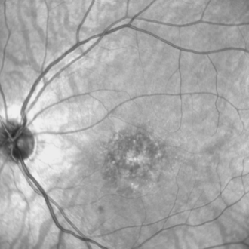
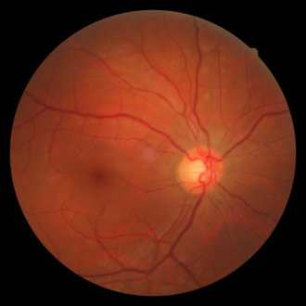
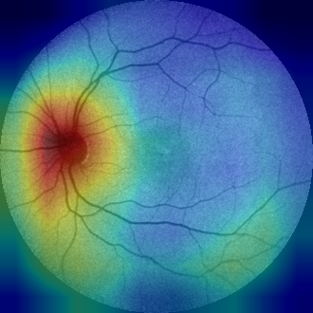
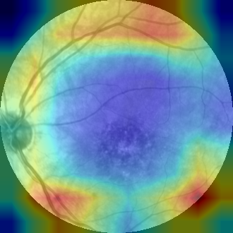
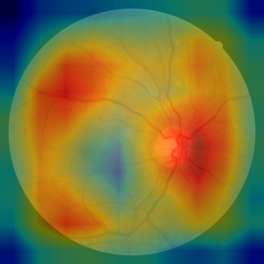
Classifying Retinal Imaging Modality with Deep Learning
FAF
IR
OTHER
Grad-CAM
Grad-CAM
Grad-CAM
Notes:
This project builds a classifier that tells which imaging modality a retinal image is: fundus autofluorescence (FAF), infrared reflectance (IR), or anything else (OTHER). I compared five ImageNet-pretrained CNNs with 5-fold cross-validation, tested the selected model once on a held-out set, and used Grad-CAM to check what the model looks at.

Slide 2
Key results
99.2%
55 / 55
Cross-validated macro-F1
Held-out test images correct
DenseNet-121, 5-fold CV on 253 images (2 errors in total)
Accuracy 100%, macro-F1 1.000 across FAF, IR and OTHER
Grad-CAM: FAF predictions rely on retinal anatomy (optic disc, macula, lesions). IR predictions rely mainly on the outer ring of the image, which may be a shortcut. This needs a follow-up test.
!
Notes:
Four numbers summarise the work. The best cross-validated model, DenseNet-121, reached 99.2% macro-F1. Retrained on all 253 training images, it classified all 55 held-out test images correctly. All five architectures were above 98.4%, so the task is easy for pretrained CNNs. The caveat: 3 test images are byte-identical to training images. Removing them still leaves 52 of 52 correct.

Slide 3
Task: identify the imaging modality
FAF
IR
OTHER
Fundus autofluorescence
Infrared reflectance (SLO)
Colour fundus, fluorescein angiography, montages
87
train
22
test
84
train
13
test
82
train
20
test
253 training images (5-fold cross-validation) · 55 held-out test images, used once
Notes:
Three classes. FAF: fundus autofluorescence, greyscale, with a dark optic disc and macula. IR: infrared reflectance from the scanning laser ophthalmoscope, greyscale, with a bright disc. OTHER: everything else, mainly colour fundus photos plus fluorescein angiography and montages. The training set is balanced (82–87 per class) and is used for cross-validation. The 55-image test set was set aside and used once, at the end.

Slide 4
Method
1
2
3
4
5
Preprocess
Augment
Train
Select
Test
Resize + pad to 330×330
Circular mask: same round field of view for every image
Horizontal flip
Rotation ±7°
Brightness / contrast jitter ±40%
ImageNet weights
AdamW, lr 1e-4, wd 1e-4
Batch 8, class-weighted cross-entropy
Stratified 5-fold CV
Early stop on val macro-F1 (patience 4, max 15 epochs)
Retrain best model on all 253 images (3 epochs)
Evaluate once on 55 test images
Models compared: ResNet-18, ResNet-50, ResNet-101, DenseNet-121, EfficientNet-B0 (all ImageNet-pretrained, identical folds)
Notes:
Preprocessing: each image is resized so its longer side is 330 pixels and padded to a square. A circular mask then blacks out everything outside the central circle, so every image has the same round field of view and the frame shape cannot reveal the class. Augmentation: horizontal flip, rotation up to 7 degrees, brightness and contrast jitter. Training: ImageNet weights, AdamW, learning rate 1e-4, batch 8, cross-entropy weighted by inverse class frequency. Model selection: identical stratified 5-fold splits for every model, early stopping on validation macro-F1. Final model: retrained on all training data for the median best epoch (3 for DenseNet-121), then evaluated once on the test set.

Slide 5
Model comparison: 5-fold cross-validation
Model | Accuracy | Macro-F1 | Errors
DenseNet-121 | 0.992 ± 0.011 | 0.992 ± 0.011 | 2 / 253
ResNet-18 | 0.992 ± 0.011 | 0.992 ± 0.011 | 2 / 253
ResNet-101 | 0.992 ± 0.011 | 0.992 ± 0.011 | 2 / 253
EfficientNet-B0 | 0.984 ± 0.016 | 0.984 ± 0.016 | 4 / 253
ResNet-50 | 0.984 ± 0.009 | 0.984 ± 0.009 | 4 / 253
Top three are tied (2 errors each, ΔF1 < 0.001). DenseNet-121 was selected by the pre-set rule: highest mean CV macro-F1. Values are mean ± SD over 5 folds.
Notes:
Cross-validated results for all five models. Each fold validates on about 50 images, so one error costs about 2 percentage points. DenseNet-121, ResNet-18 and ResNet-101 each made 2 errors out of 253; EfficientNet-B0 and ResNet-50 made 4. The top three are effectively tied (they differ by less than 0.001 in macro-F1). DenseNet-121 was selected by the pre-set rule, highest mean CV macro-F1. Note that the chart's axis starts at 0.95.

Slide 6
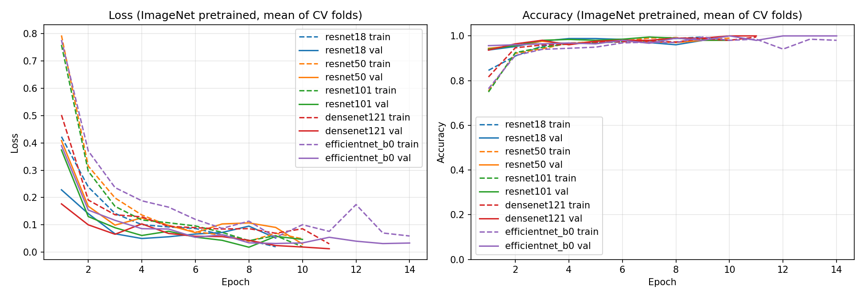
Training converges within a few epochs
Fast convergence
Validation accuracy > 95% from epoch 2 for every model
No strong overfitting
Validation loss stays at or below training loss
Early stopping
Best epochs 1–7 (DenseNet-121 median: 3)
Notes:
Loss and accuracy per epoch, averaged over the five CV folds; dashed lines are training, solid lines validation. Every model converges within about 3 to 5 epochs. Validation loss stays low and does not rise sharply, so there is no strong overfitting. Early stopping ended most folds between epochs 1 and 7. Curves become noisier after epoch 10 because only the few folds that ran that long are averaged.

Slide 7
Held-out test set: 55 / 55 correct
Confusion matrix (rows = true, columns = predicted)
100%
True \ Pred | FAF | IR | OTHER
FAF | 22 | 0 | 0
IR | 0 | 13 | 0
OTHER | 0 | 0 | 20
Test accuracy
1.000
Test macro-F1
Per-class metrics
Class | Precision | Recall | F1 | n
FAF | 1.000 | 1.000 | 1.000 | 22
IR | 1.000 | 1.000 | 1.000 | 13
OTHER | 1.000 | 1.000 | 1.000 | 20
93.5–100%
95% CI for accuracy (n = 55)
Model: DenseNet-121, retrained on all 253 images for 3 epochs
Notes:
Final DenseNet-121, retrained on all 253 training images for 3 epochs, then run once on the 55 held-out images. All 55 are correct: precision, recall and F1 are 1.000 for every class. With only 55 test images, the exact 95% confidence interval for accuracy is 93.5% to 100%. Three test images are exact copies of training images; the remaining 52 are also all correct.

Slide 8
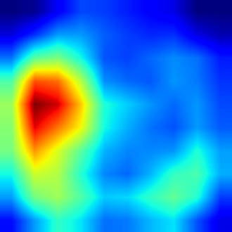
Grad-CAM: where does the model look?
1
Forward pass; take the predicted class score
2
Compute how sensitive the class score is to each region of the final feature maps (10×10).
3
Weight each map by its mean gradient, sum, keep positives (ReLU)
Original
Grad-CAM heatmap
Overlay
4
Upsample to 330×330 and overlay; red = strongest evidence
Example: 0006_AF_B-0_0 · true FAF · Pred FAF · 99.8%
low
high
Coarse by design: it highlights regions, not individual vessels or pixels.
Notes:
Grad-CAM shows which parts of the image pushed the model towards its prediction. We take the last convolutional feature maps of DenseNet-121, about 10 by 10 at this input size, and the gradient of the predicted class score with respect to them. Each map is weighted by its average gradient; the weighted sum, with negatives set to zero, is upsampled to the image size. Red means the region increased the predicted class score; blue means little contribution. The map is coarse: it shows regions, not single vessels or pixels.

Slide 9
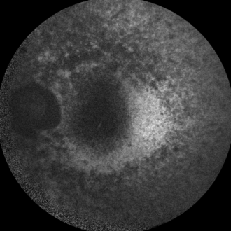
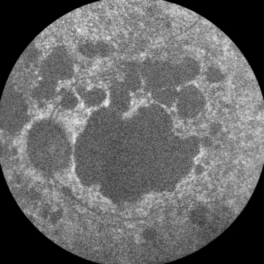
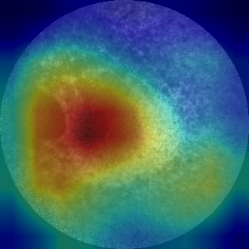
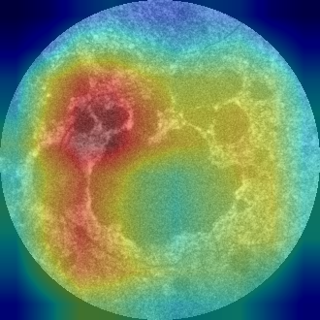
Grad-CAM: FAF uses retinal anatomy
What we see
Heat on the optic disc, the macula and lesions such as atrophy and flecks
These are the features a grader uses to recognise FAF (dark disc, autofluorescence pattern)
All 22 FAF test images correct; lowest confidence 84.2% (0004_AF)
Original
Original
Original
Pred FAF · 99.8%
Pred FAF · 99.9%
Pred FAF · 99.9%
Notes:
For FAF the heatmaps sit on clinically meaningful structures: the dark optic disc, the macula, and areas of atrophy or hyper-autofluorescence. This is the behaviour we want.

Slide 10
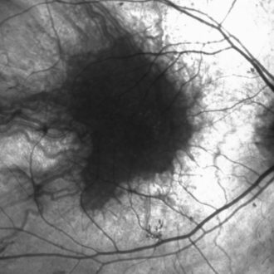
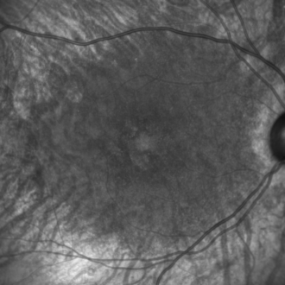
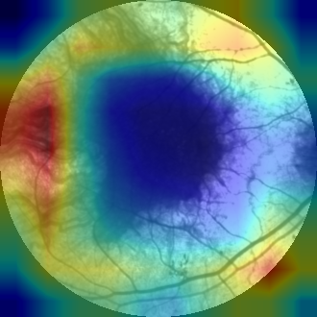
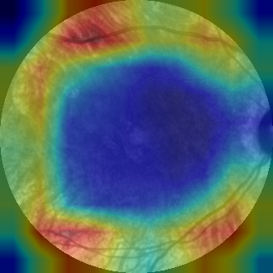
Grad-CAM: IR relies on the image border
Possible shortcut
Heat forms a ring at the edge of the field of view; the retina in the centre is cold (blue)
Consistent across all 13 IR test images
The model may be using the IR device's edge brightness or vignetting rather than retinal content
To test: tighten the circular mask (e.g. 0.85) or occlude the border, then re-evaluate
Original
Original
Original
Pred IR · 99.9%
Pred IR · 99.6%
Pred IR · 99.9%
Notes:
This is the most important Grad-CAM finding. For IR the evidence is almost entirely on the outer ring of the image, not on the retina. Accuracy is still 100%, but the model may be recognising a device-specific edge pattern, which may not hold for IR images from another machine. A border-occlusion or tighter-mask experiment would show whether accuracy depends on it.

Slide 11
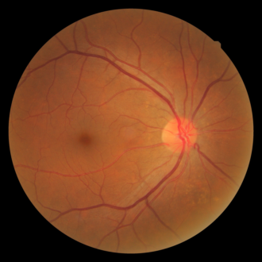
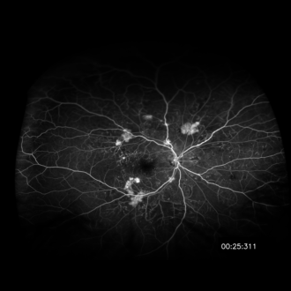
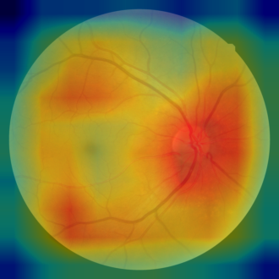
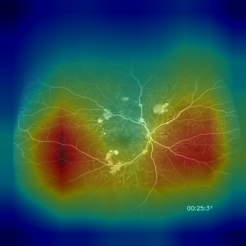
Grad-CAM: OTHER uses colour and framing
What we see
Colour fundus: heat spread over the disc and vessel arcades; colour alone separates these
Fluorescein angiography and montages: a rectangular central block
These images are not round, so the framing may be a cue
All 20 OTHER test images correct (≥ 99.1% confidence)
Original
Original
Original
Pred OTHER · 99.7%
Pred OTHER · 99.8%
Pred OTHER · 99.9%
Notes:
OTHER is a mixed class. Colour fundus photos are the only colour images, so they are trivially separable. For angiography and montage images the heat forms a rectangle, which suggests the model partly uses image shape and framing.

Slide 12
Limitations
1
No patient-level split
Images are split at image level (no patient IDs), so the same eye may appear in both training and test.
2
Small test set
3
Possible shortcuts
55 images: the 95% CI for accuracy is 93.5–100%; IR has only 13 test images.
IR evidence sits on the image border; OTHER may use colour and image framing.
4
Scratch baseline not yet run
Only ImageNet-pretrained models were trained (PRETRAINED_MODES = [True]).
Notes:
Limitations, most important first. 1: A hash check found 3 test images that are byte-identical to training images (0003_AF_B-1_0, A05_2 and A06_2), and 18 duplicate copies inside the training set, so CV folds can contain the same image in train and validation. Excluding the 3, the test result is still 52 of 52. 2: The split is image-level because there are no patient IDs, so the same eye can appear in both train and test. 3: 55 test images give a wide confidence interval. 4: the Grad-CAM shortcut concerns. 5: the from-scratch comparison has not been run.

Slide 13
Conclusion and next steps
Pretrained CNNs separate FAF, IR and other modalities almost perfectly: 99.2% CV macro-F1 and 55 / 55 on the test set.
Grad-CAM supports the FAF decisions, but the IR decisions may depend on the image border.
1
Re-run 5-fold CV and the held-out test
2
IR border test: tighter circular mask or border occlusion
Notes:
Proposed next steps. Remove duplicates with a hash check and, if patient IDs can be recovered, split by patient. Re-run cross-validation and the test. Then test the IR shortcut directly. Finally, run the from-scratch baseline and, ideally, validate on images from another site or device.

Slide 14
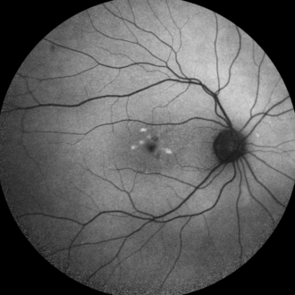
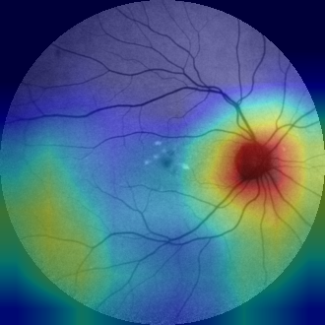
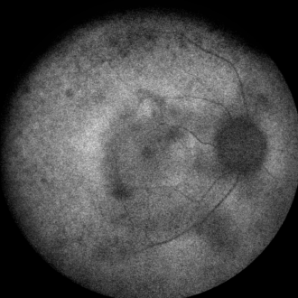
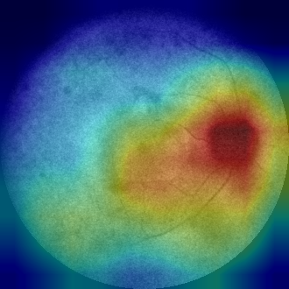
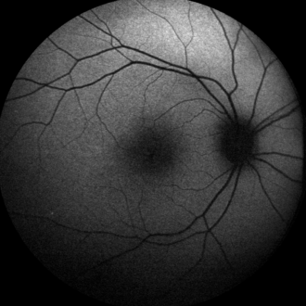
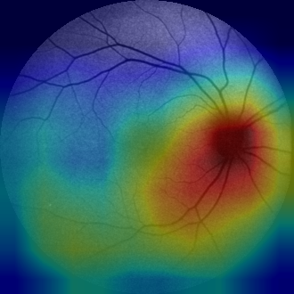
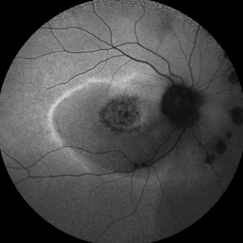
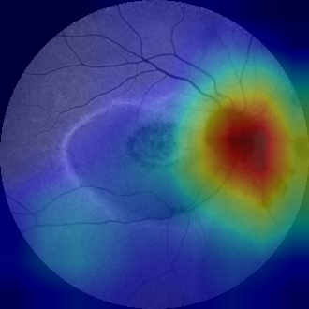
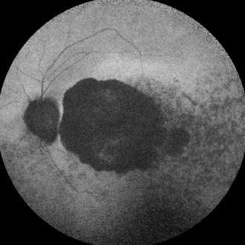
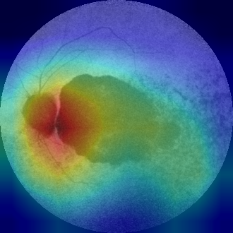
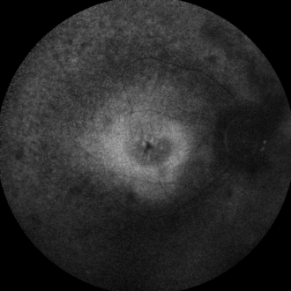
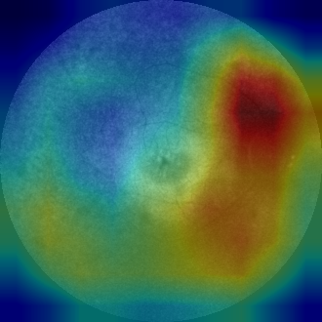
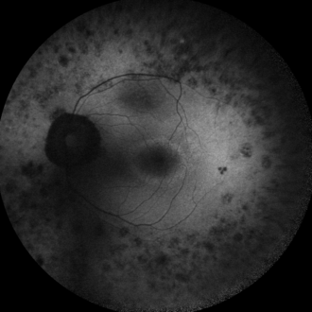
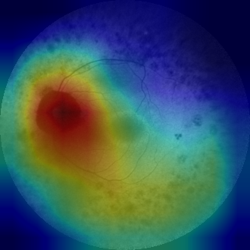
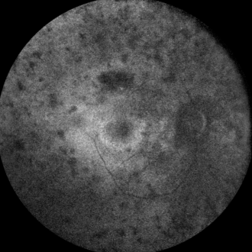
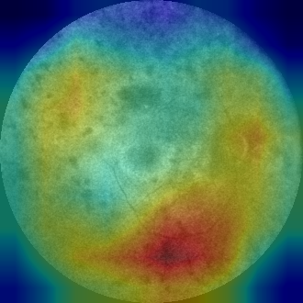
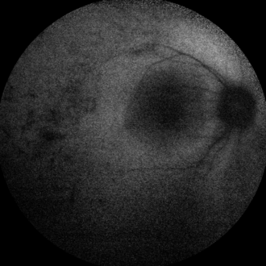
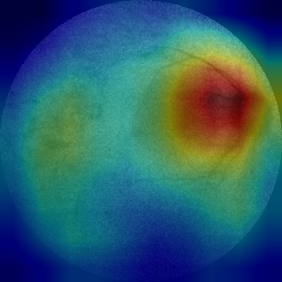
Appendix: Grad-CAM, FAF test images (1/2)
0003_AF_B-1_0 FAF 99.9%
0004_AF_B-0_0 FAF 84.2%
0005_AF_B-0_0 FAF 100.0%
0006_AF_B-0_0 FAF 99.8%
0009_AF_B-0_0 FAF 99.7%
0010_AF_B-0_0 FAF 99.3%
0011_AF_B-0_0 FAF 100.0%
0012_AF_B-1_0 FAF 99.8%
0013_AF_B-0_0 FAF 99.9%
0016_AF_B-1_0 FAF 99.9%
0017_AF_B-0_0 FAF 100.0%
Notes:
Appendix: original image and Grad-CAM overlay for every FAF test image. All predictions are correct; the label shows the predicted class and confidence.

Slide 15
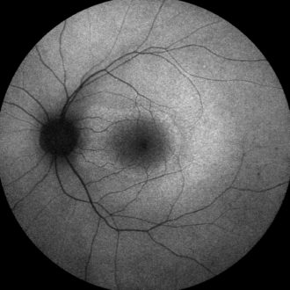
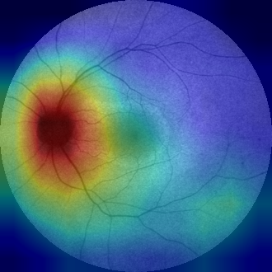
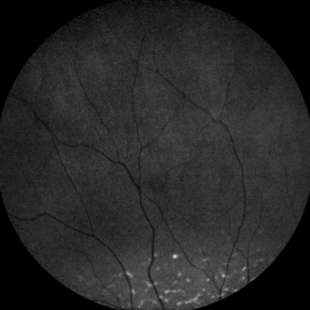
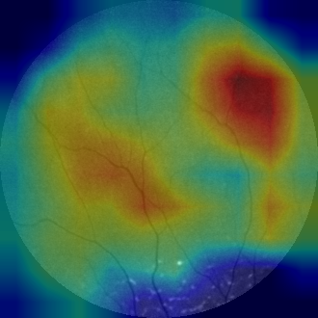
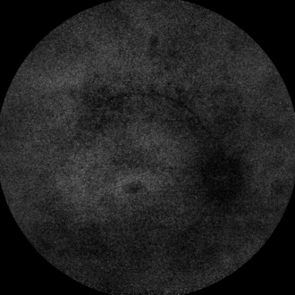
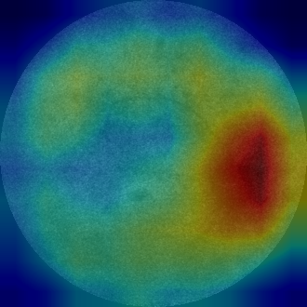
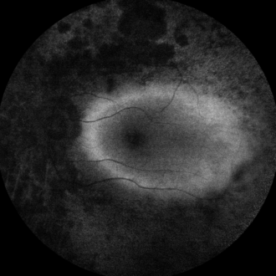
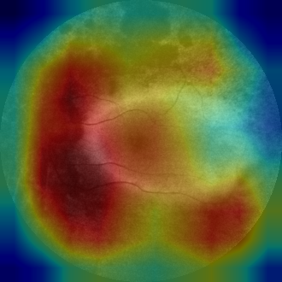
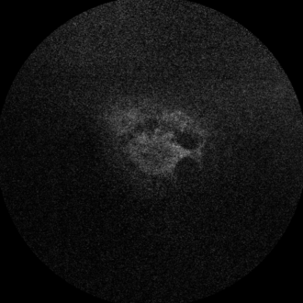
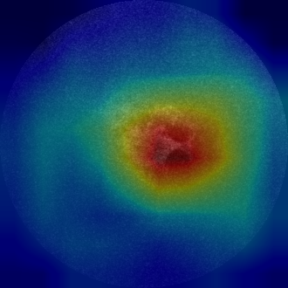
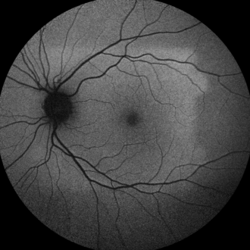
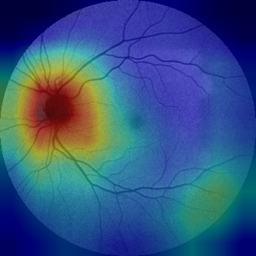








Appendix: Grad-CAM, FAF test images (2/2)
0018_AF_B-0_0 FAF 99.7%
0019_AF_B-0_0 FAF 94.7%
0020_AF_B-3_0 FAF 99.6%
0021_AF_B-0_0 FAF 99.9%
0022_AF_B-1_0 FAF 86.9%
0023_AF_B-1_0 FAF 99.7%
0037_AF_B-0_0 FAF 99.9%
0056_AF_B-1_0 FAF 99.4%
0062_AF_B-0_0 FAF 90.4%
0089_AF_B-0_0 FAF 99.9%
0100_AF_B-0_0 FAF 96.5%
Notes:
Appendix: original image and Grad-CAM overlay for every FAF test image. All predictions are correct; the label shows the predicted class and confidence.

Slide 16










Appendix: Grad-CAM, IR test images (1/2)
0003_SLO_IR-0_0 IR 99.9%
0004_SLO_IR-0_0 IR 99.9%
0005_SLO_IR-0_0 IR 99.5%
0006_SLO_IR-0_0 IR 99.8%
0007_SLO_IR-0_0 IR 99.9%
0093_SLO_IR-0_0 IR 99.9%
0094_SLO_IR-0_0 IR 99.6%
Notes:
Appendix: original image and Grad-CAM overlay for every IR test image. All predictions are correct; the label shows the predicted class and confidence.

Slide 17










Appendix: Grad-CAM, IR test images (2/2)
0095_SLO_IR-0_0 IR 99.9%
0096_SLO_IR-0_0 IR 99.2%
0097_SLO_IR-0_0 IR 93.6%
0098_SLO_IR-0_0 IR 99.9%
0099_SLO_IR-0_0 IR 99.8%
0100_SLO_IR-0_0 IR 99.9%
Notes:
Appendix: original image and Grad-CAM overlay for every IR test image. All predictions are correct; the label shows the predicted class and confidence.

Slide 18










Appendix: Grad-CAM, OTHER test images (1/2)
A05_1 OTHER 99.7%
A05_2 OTHER 99.7%
A06_1 OTHER 99.7%
A06_2 OTHER 99.7%
A07_1 OTHER 99.6%
A07_2 OTHER 99.7%
A08_1 OTHER 99.6%
A08_2 OTHER 99.3%
A09_1 OTHER 99.7%
A09_2 OTHER 99.3%
Notes:
Appendix: original image and Grad-CAM overlay for every OTHER test image. All predictions are correct; the label shows the predicted class and confidence.

Slide 19
















Appendix: Grad-CAM, OTHER test images (2/2)
Montage_Subject_4 OTHER 99.6%
P35_1 OTHER 99.6%
P35_2 OTHER 99.1%
P36_1 OTHER 99.8%
Raw_FA_1_Subject_3 OTHER 99.9%
Raw_FA_1_Subject_4 OTHER 99.7%
Raw_FA_2_Subject_3 OTHER 99.9%
Raw_FA_2_Subject_4 OTHER 99.8%
Raw_FA_3_Subject_2 OTHER 99.9%
Raw_FA_3_Subject_4 OTHER 99.8%
Notes:
Appendix: original image and Grad-CAM overlay for every OTHER test image. All predictions are correct; the label shows the predicted class and confidence.

