Slide 1


ElectroNick’s
Username/Email
Password
Forgot password?
Login
Create Account

Slide 2




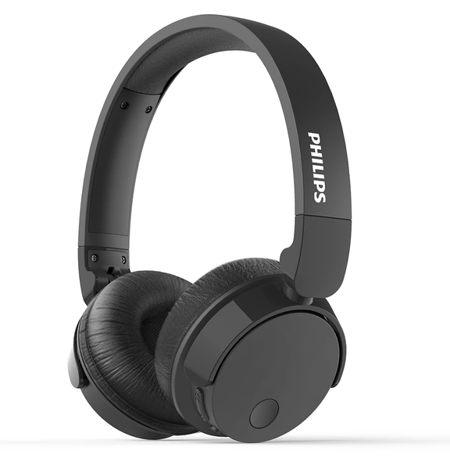
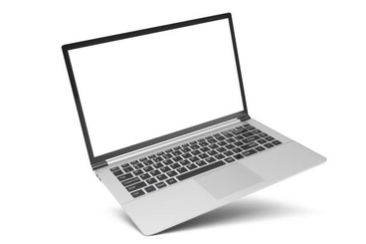
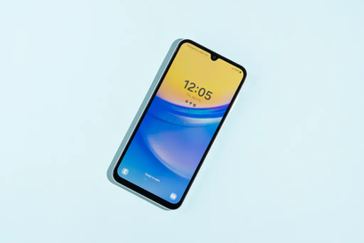
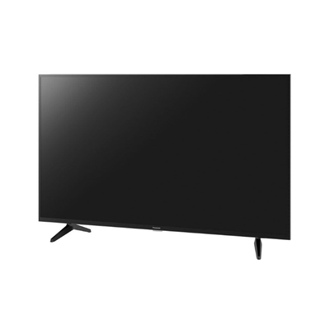
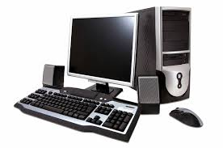
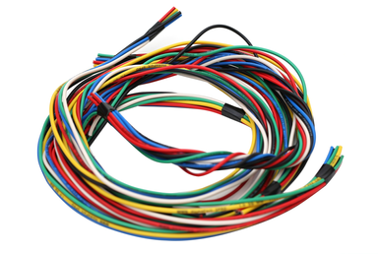
ElectroNick’s
Help
Settings
Contact us
Account
FAQ’s
Login Rewards
FEATURED
PHILIPS HEADPHONES
₱ 400.00
600 in stock
Fast shipping
-40%
4.9
BUY
Categories
Filters & Sorting
LAPTOP
MOBILE PHONE
TELEVISION
COMPUTER
ACCESSORIES

Slide 3

ElectroNick’s
CART
Philips headphones
Laptop
Computer
Iphone 16
PHILIPS HEADPHONES
₱ 400.00
600 in stock
Fast shipping
7-10 days
add to cart
4.9(600+ reviews)
add to wishlist
available vouchers
Proceed to
checkout

Slide 4


ElectroNick’s
Checkout
Order Summary
Payment Method
Philips headphones
Laptop
Computer
Iphone 16
₱ 400
₱ 15,000
₱ 45,000
₱ 40,000
Credit card
E-wallet
Loyalty and reward points
Cash on delivery
Shipping Method
Address:
somewhere in nevada
Standard
Express
Free
₱ 100
TOTAL:
₱100, 500
Confirm

Slide 5

ElectroNick’s
Order History
Order is currently: being shipped
2/22/2025
2/25/2025
2/27/2025
3/01/2025
3/04/2025
Notify me through:
Cancel
Email
Return
Phone Number
Exchange
Return exchange
policy info

Slide 6
ElectroNick’s
Please rate the seller and the product
Comment(optional)
Submit

Slide 7

ElectroNick’s
Help
Settings
Follow us
Account
Login Rewards
DAILY LOGIN REWARDS
FEATURED
PHILIPS HEADPHONES
₱ 400.00
600 in stock
Fast shipping
-40%
FREE EXPRESS DELIVERY FOR 1 ITEM
4.9
BUY
Categories
Confirm
LAPTOP
MOBILE PHONE
TELEVISION
COMPUTER
ACCESSORIES

Slide 8
ElectroNick’s
Help
Settings
Follow us
Account
Login Rewards
SETTINGS
FEATURED
Coupon code/s
Notification settings
PHILIPS HEADPHONES
Language Selection
Offers
event list
₱ 400.00
600 in stock
Fast shipping
-40%
English
Order
4.9
BUY
Light Mode
Updates
Categories
Dark Mode
LAPTOP
MOBILE PHONE
TELEVISION
COMPUTER
ACCESSORIES

