Slide 1
Scientific Museum
Tap anywhere on the screen to start

Slide 2



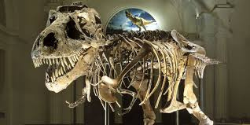
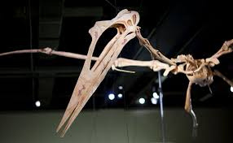
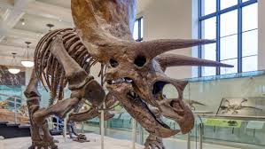
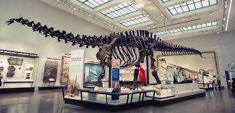
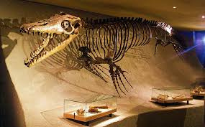
Science Museum
Tap to search
First Floor
First Floor
Triceratops Fossil
tap the picture for more info

Slide 3
Science Museum
Tap to search
First Floor
First Floor
Second Floor
Triceratops Fossil
tap the picture for more info

Slide 4
Science Museum
Tap to search
First Floor
First Floor
Tyrannosaurus Fossil
tap the picture for more info

Slide 5
Tyrannosaurus rex was one of the most ferocious predators to ever walk the Earth. With a massive body, sharp teeth, and jaws so powerful they could crush a car, this famous carnivore dominated the forested river valleys in western North America during the late Cretaceous period, 68 million years ago.
Although T. rex is a household name, what we know about this tyrannosaur is constantly evolving. Improved technologies, such as biomechanical modeling and x-ray imaging, have allowed scientists to gain a deeper understanding of how this apex predator lived.
Attraction:
Tyrannosaurus Fossil
Location:
First Floor, West Room
RETURN

Slide 6
Science Museum
Tap to search
First Floor
Second Floor
Tyrannosaurus Fossil
tap the picture for more info

Slide 7
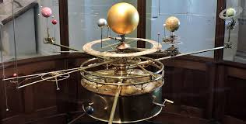
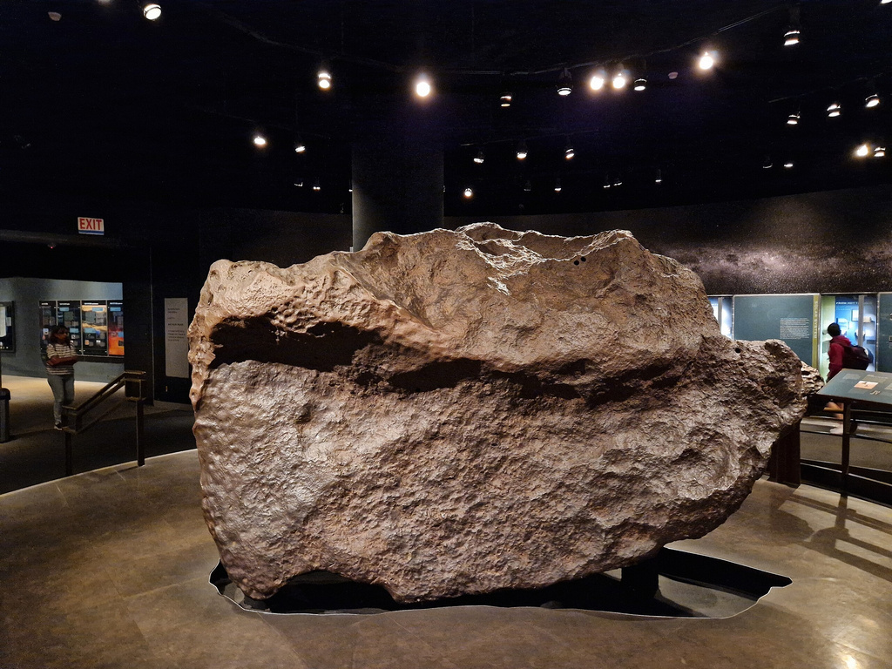

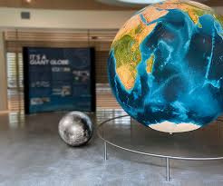

Science Museum
Tap to search
Second Floor
Meteorite
tap the picture for more info

Slide 8
Science Museum
Tap to search
Second Floor
First Floor
Meteorite
tap the picture for more info

Slide 9

Science Museum
Second Floor

Slide 10
Science Museum
Tyran
Results:
Located at: First Floor
RETURN
Tyrannosaurus Fossil
tap the picture for more info

Slide 11
Thank you

