Slide 1
TileGame
Theodore Bradley

Slide 2
Class diagram
GameObject
Piece
Board
SetRotation()
SetPosition()
SetScale()
Get..()
Draw()
Click()
DragPosition()
Selected/DeSelected()
Draw()
Click()
IsCorrect()
Scramble()
Swap()
Button
Draw()
Clicked()
Notes:
The gameobject class is the base class for an object that needs to be moved and handles the getting and setting of the position reotation and scale etc. It also has special functions for incrementing the positions like move instead of set position where the object can be moved by an amount. The Piece class represents each piece of the board. It handles drawing itself, and also has a function for when it is clicked, dragged and also when it is selected/deselected. These last two are critical for the clicking and dragging the pieces for mouse control. The board class holds an array of pieces, and has a special draw function so that the empty piece is drawn below all the others. The Board class holds all the functions that require changing the order of pieces on the board, such as Swap() or Scramble(). It also holds the function to check if the board is correct. The final class is the Button class that represents UI buttons, it has a Draw() function that handles drawing its background rectangle and icon. It also handles Clicking() the button as well. There is another class Game1 that inherits Game, but this is simply monogame’s way managing the program flow from entry point, into the update loop and then exiting.

Slide 3
Features
It allows custom textures
It can detect when the board is solved
It can scramble the board
The user can use the mouse or the keyboard to move tiles
It has UI buttons to control some aspects of the board
The game allows custom boards with multiple sizes
Notes:
The game can load a custom texture from Content/customAtlas.png in the execution directory. The game will pick a square subset from the custom atlas’ pixels so that no matter the aspect ratio the board will display the texture square. The board can also detect when it has been solved. The board can also be scrambled at will. The scrambling is very efficient and can be run 1 million times in less than a second. To move the tiles, the player can click and drag the tiles, or they can use the arrow keys instead. The game has UI buttons to control the changing of the board size, texture, and scrambling. The board can be any size in terms of tiles. The board will stay the same size on the screen. In theory.

Slide 4

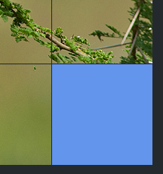
Eureka moments
Clicking and dragging pieces
Gaps in the board at different sizes
Notes:
The first eureka moment came from trying to figure out the code for dragging pieces. The issue was that the code on screen wouldn’t work when I passed in the mouse position. To fix this I had to pass in the mouse position from the last frame into oldMousePos. This took a while to fix, because the calculation for offset was a bit more complex and hid the original issue. Another eureka moment was when I fixed the gaps that appeared in the board at different sizes. This happened a few times and was fixed by rounding the values properly, however, it happened again and I couldn’t properly fix it. This last time the issue happened to be one I couldn’t fix due to limitations in the monogame/XNA implementation with my current framework.

Slide 5
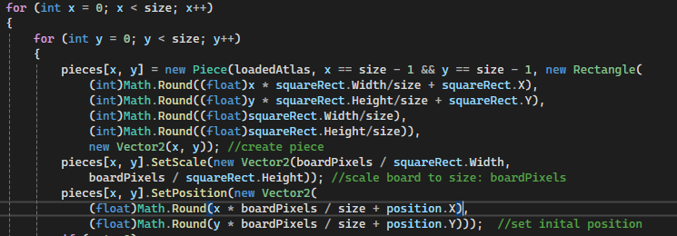
Limitations of framework
Monogame uses floating point values for it’s Vector classes
It also uses Rectangles for rendering that can only use integer values
These factors result in either a rounding error or a precision error in my code
Notes:
When creating the board class, my code, seen here, creates the pieces with the correct dimensions, then moves them to the proper position. Somehow, with certain board sizes, where boardPixels/size gets smaller, a gap appears in the pieces on screen. This could be because of three reasons, reason one: is an accumulation of floating point errors, this seems unlikely as I calculate boardPixels/size in the SetPosition call, so where could these errors come from. Option 2: is that because monogame uses floating points instead of doubles for all its vector classes, there is a floating point error there. This is unlikely as nVidia PhysX uses floats for its vector classes as well, and it had never struggled with precision for me. The final option is that because I am forced to round all my values to integers to create the rectangle to render to the screen, there is a massive loss of precision here. This to my knowledge shouldn’t be a requirement. My project uses OpenGL which happily takes floating point values to be displayed on screen. However, for some reason, monogame required integers for rectangles. There is an alternative to using a “destination” rectangle, but it still takes the piece’s onscreen dimensions from a “source” rectangle from the texture so the issue persists. Another option would be to “supersample”, where I scale everything up 2x including the render buffer, but then I would have to write a shader to downsample everything and this seem to not be so trivial in monogame.

Slide 6
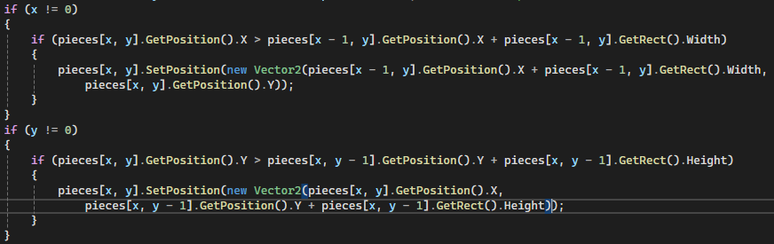
The “solution”
I couldn’t find a proper fix to the issue. Only a bandaid fix
The fix I settled on was to detect when pieces were out of position and move them back a bit to close the gap.
Notes:
I couldn’t properly fix the issue, only reduce its impact with the code shown on screen. This code moves pieces that are out of position back a bit to close the gap. The code detects when a piece is not in the position it should be and sets it to the proper position. It actually sets it as close as possible (because of the integer rounding). This closes the gap but causes another issue.

Slide 7


Limitations of the solution
The pieces move but the overall board becomes smaller.
This happens because the rounding error has not been fixed, only covered up.
This can be seen in the comparison >
Error
No Error
Notes:
The solution doesn’t actually fix the underlying problem. It instead tries to hide the obvious visual effect of it. This can be seen when rapidly changing between board sizes, the pieces appear to shift and the board gets smaller. This can be seen here where the edge of the board gets further from the button.

Slide 8
Final thoughts
The framework I have developed is quite flexible
There is only one major bug
Input system
UI buttons
Notes:
This framework allows the board to be different sizes, have custom textures of any size, and scramble as well. This allows the framework to be used to build basically any 15 puzzle game. The one major flaw with the game in it’s current state is that on some board sizes, the pieces don’t line up properly. This limits the flexibility of the framework it makes the resizability of the board less appealing. If I were to continue development I would rewrite the code to allow me to use the other version of _spriteBatch.Draw() which may fix the issue. Another issue is the input system is not flexible at all. It has been made for this game and it is possible that it might need to be altered if the game changes a lot. For example, the arrow keys are hard coded to do the swaps. The mouse control also has a lot of bespoke code that cannot be changed easily. The UI buttons are slightly less flexible than they could be. This is because each new button must have its click method in the update loop and its Draw function in the draw loop added manually.

