Slide 1
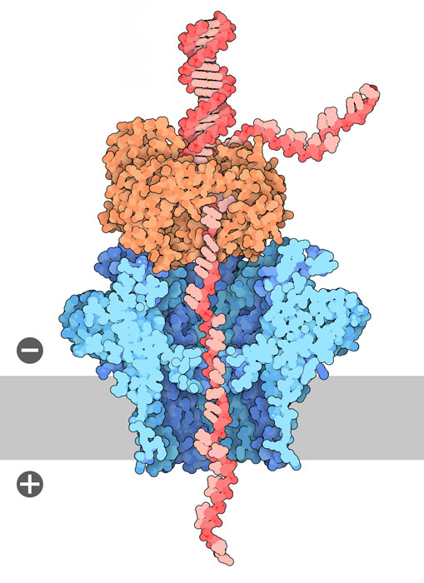


Nanopore Sequencing Lab Demo
Theodore M. Nelson
Mason Lab
03.26.2026
Notes:
original title: Studying the Effect of Traffic-Related Air Pollution on Neurodevelopment with Nanopore Direct-RNA Sequencing

Slide 2
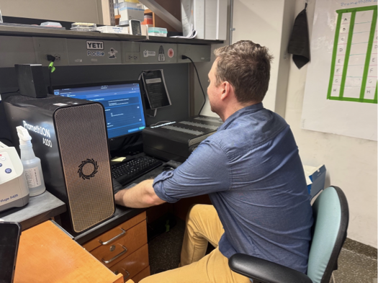
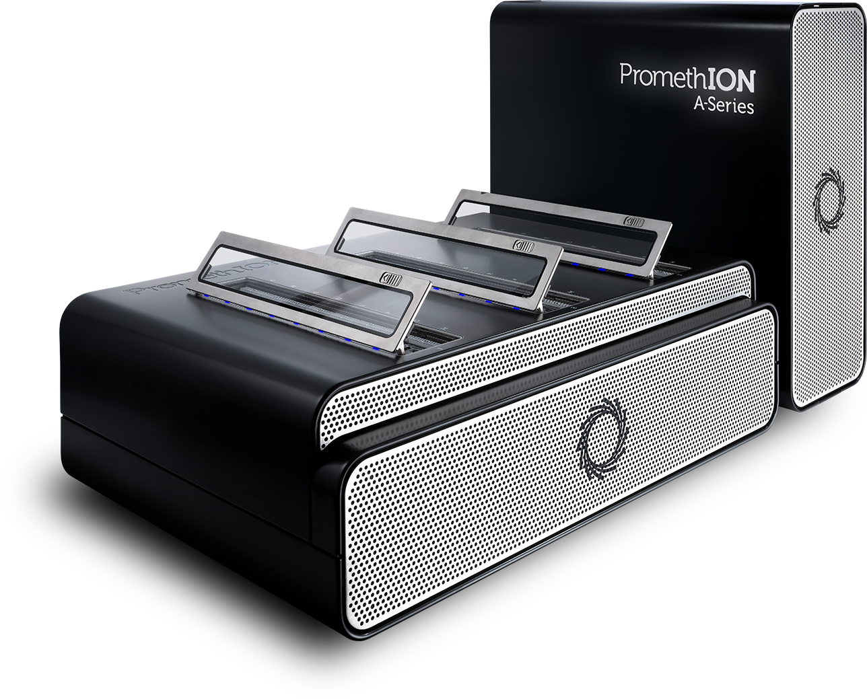
Nanopore Sequencing in the Mason Lab!
One P24,
One GridION,
Multiple MinIONs
~48 samples/week

Slide 3
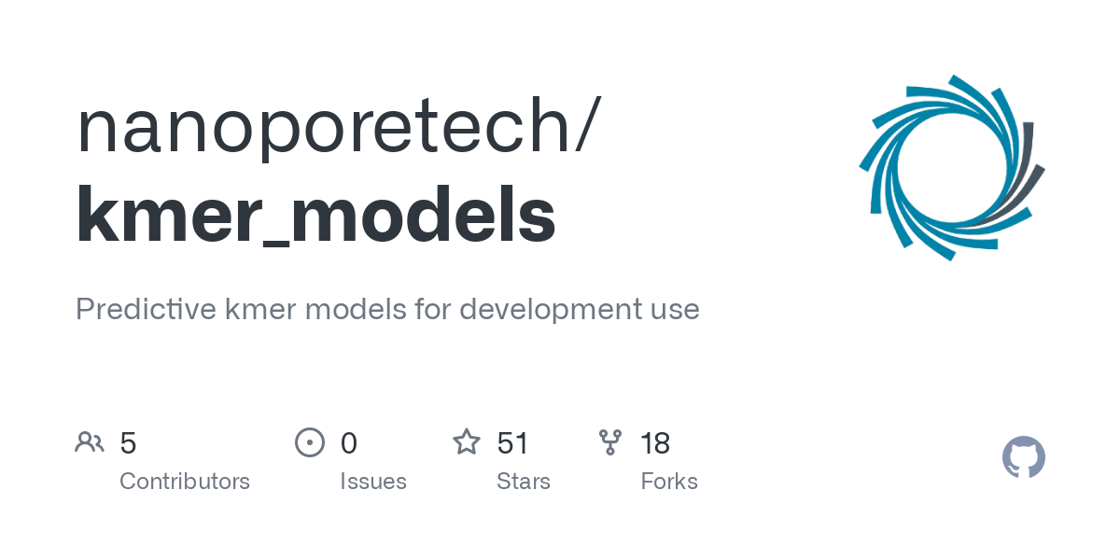
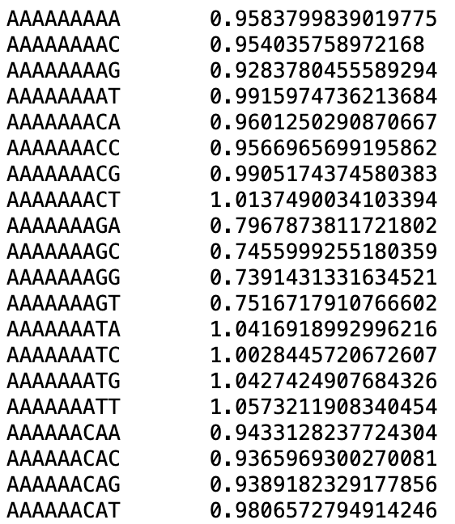
Nanopore Sequencing Measures DNA or RNA Electrical Signal Through a Pore

Slide 4
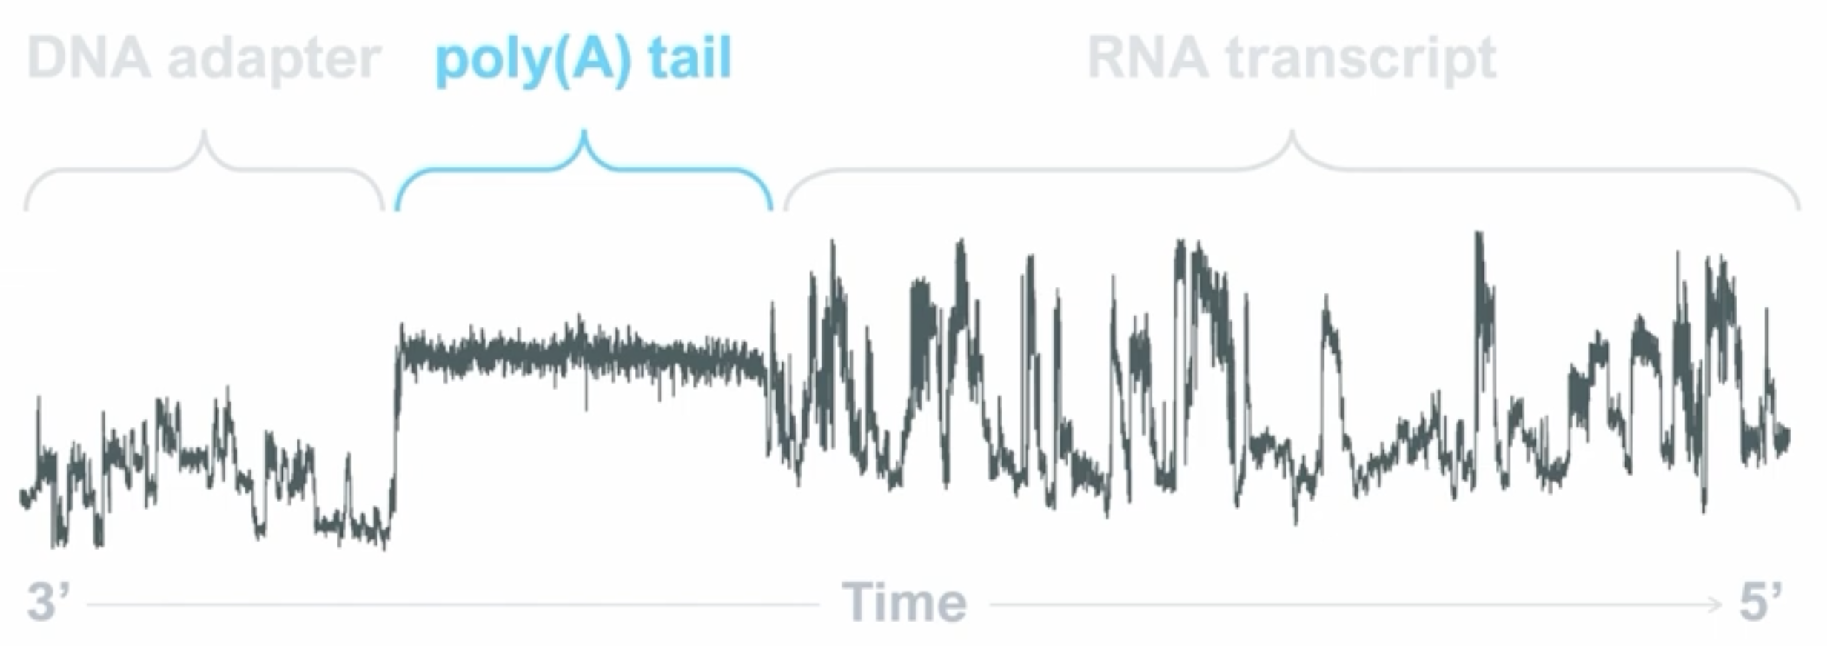
Distinctive Current Features Allow for Measurement of Bases and Poly(A) Tails
Source: Oxford Nanopore Technologies

