Slide 1
Figures of the PSD_LDA_vs_FC_RMDM project
Théo Coulon
2024

Slide 2
Data organisation
This presentation demonstrate an example of the pipeline used on PSD+NS session data of subject 05 from Braccio_Connect dataset. For each session from this dataset we have 8 or 16 runs per sessions organized like this :
Drive 1 : training
Drive 1 : test
3 runs*
3 runs*
2 runs*
Drive 2 : training
Drive 2 : test
* if it’s 16 runs, you have to double the number of runs in each part

Slide 3
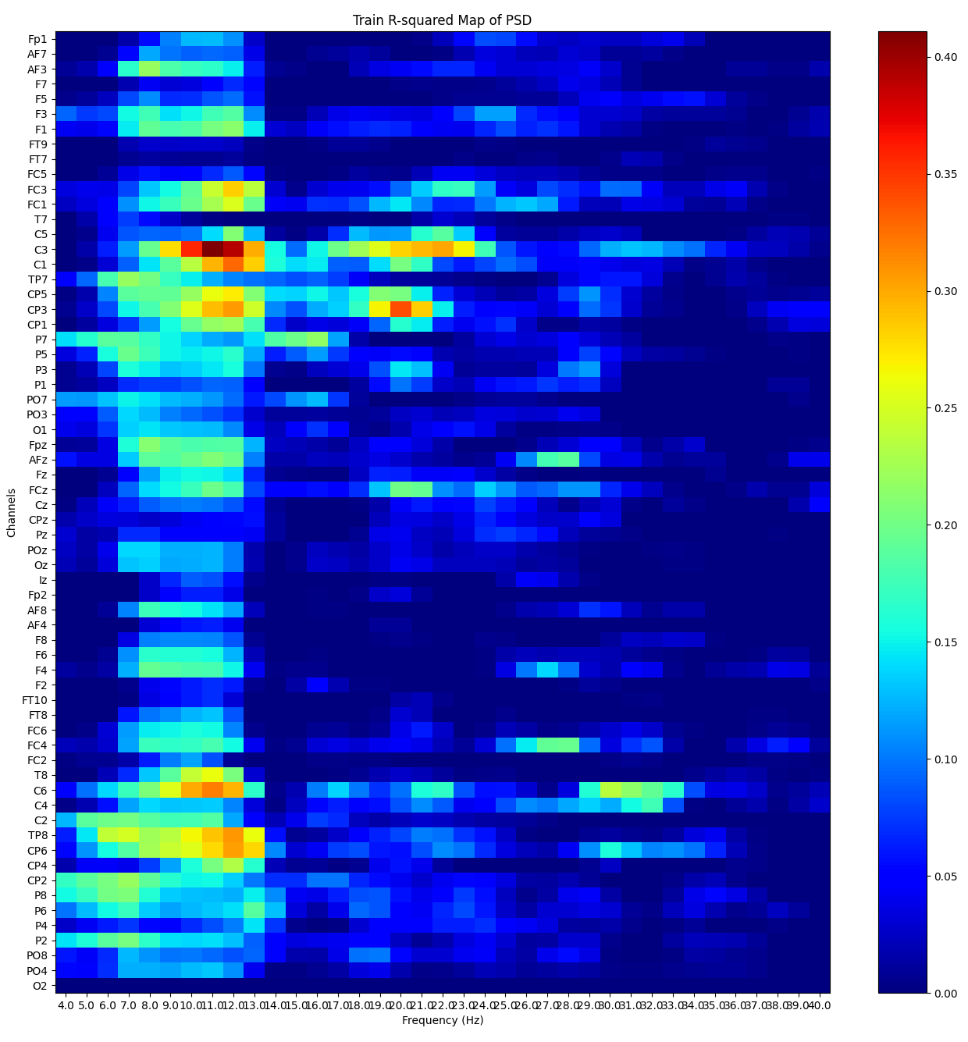
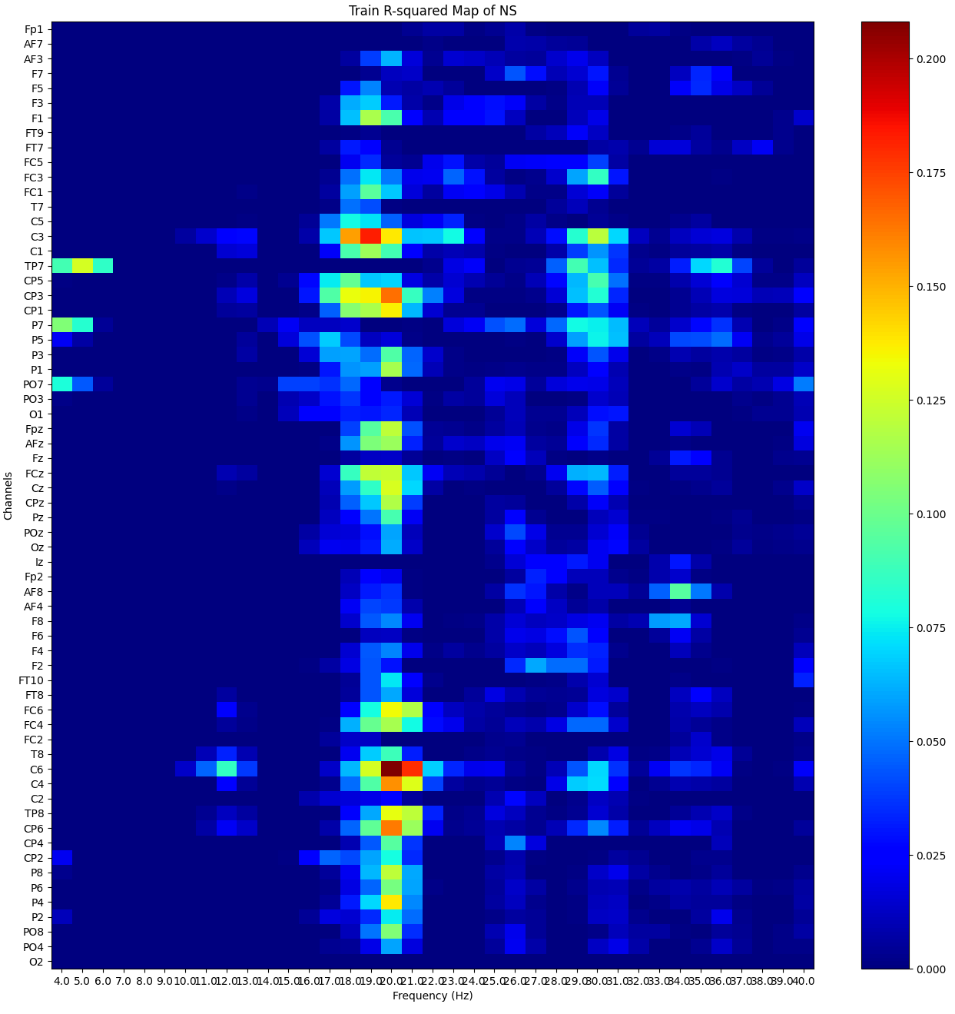
Train PSD and Node Strength signed R-squared map

Slide 4
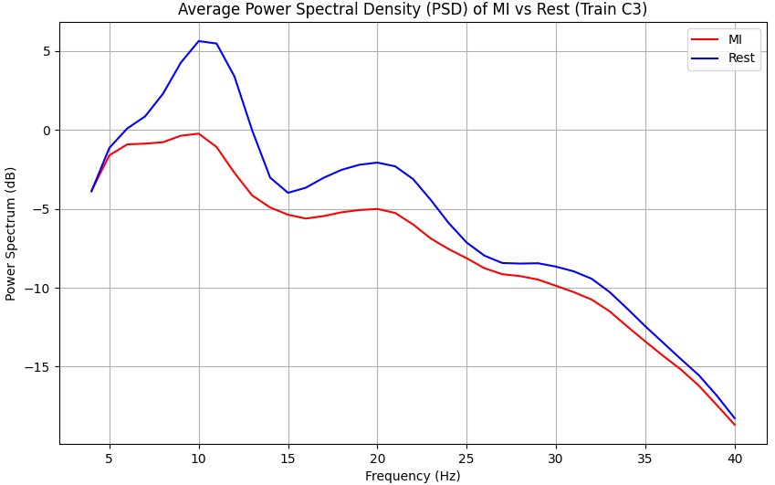
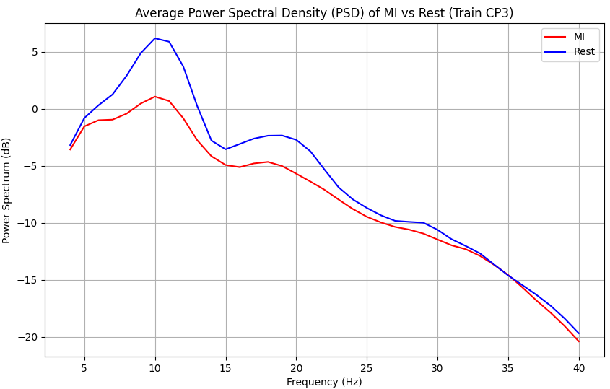
PSD electrodes of choice

Slide 5
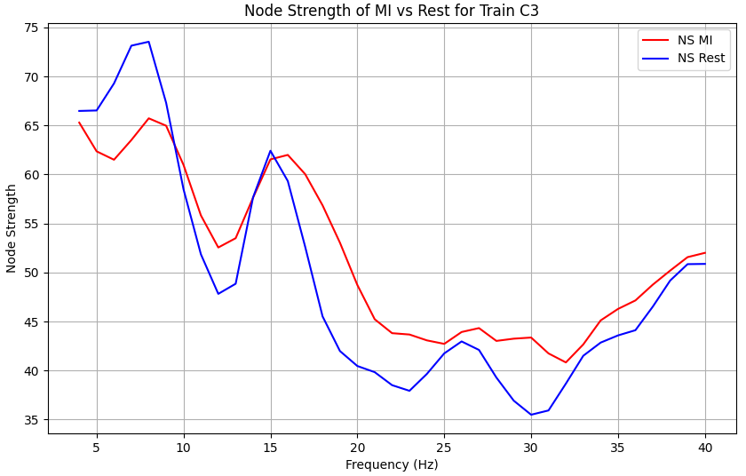
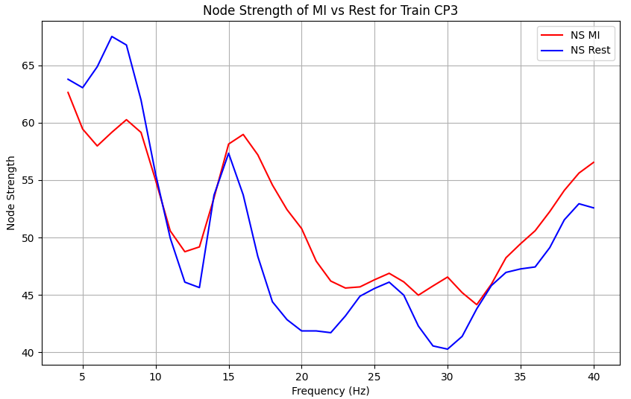
Node strength electrodes of choice

Slide 6
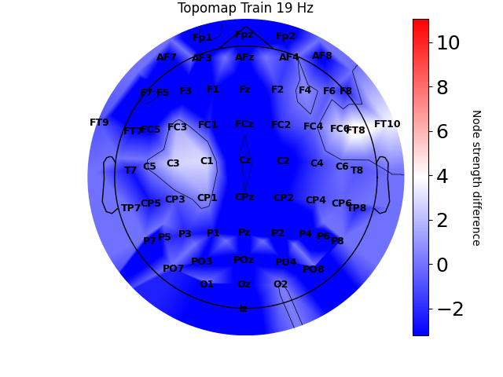
Frequency of choice for functional connectivity

Slide 7
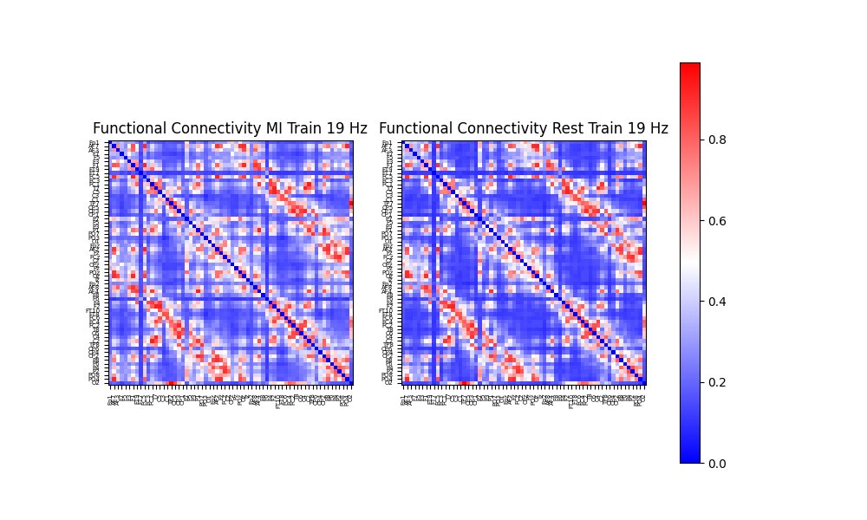
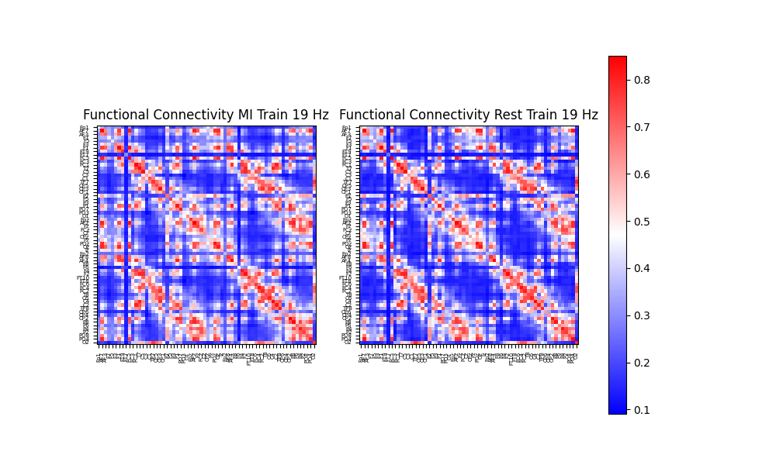
Imaginary coherence map before and after Symmetric Positive Definite transformation
Before SPD transformation
After SPD transformation

Slide 8
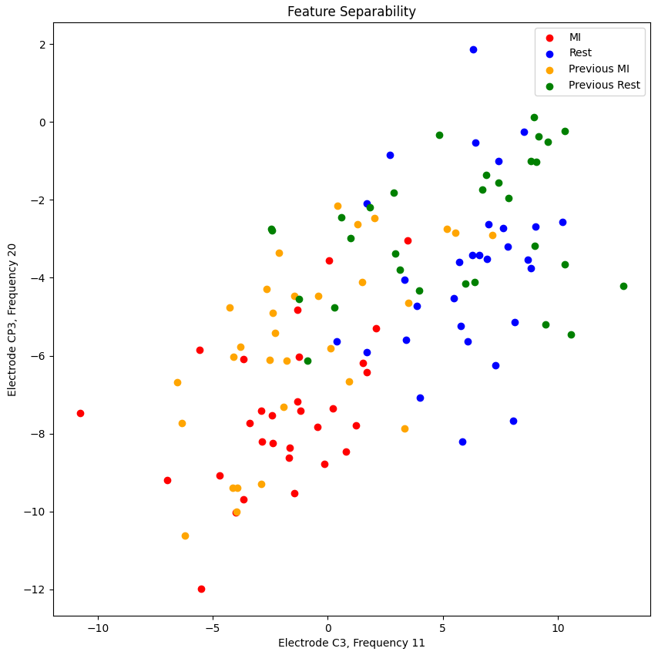
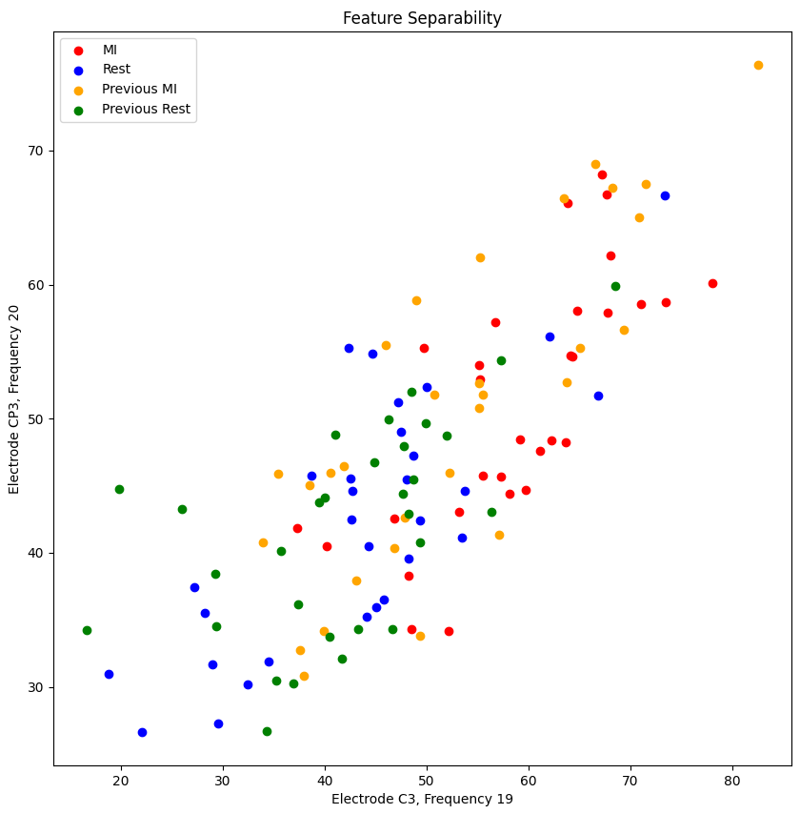
Feature separability representation for PSD-LDA and NS-LDA
PSD
Node Strength

Slide 9
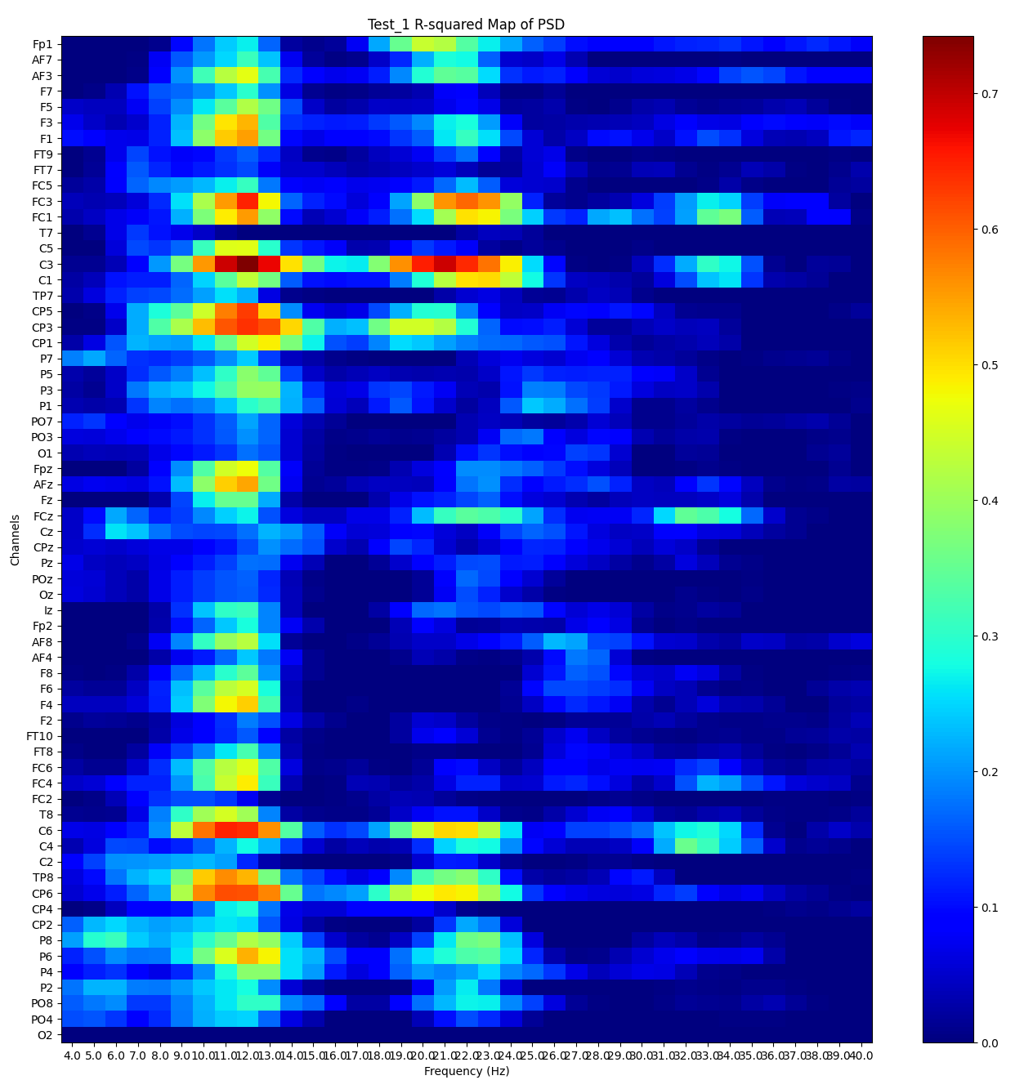
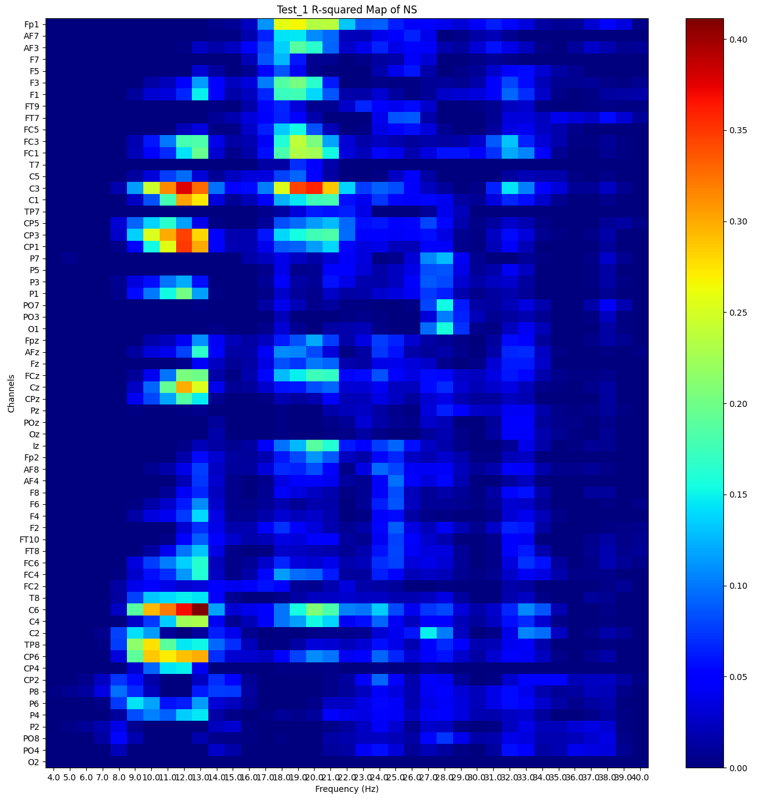
Test_1 PSD and Node Strength signed R-squared map

Slide 10
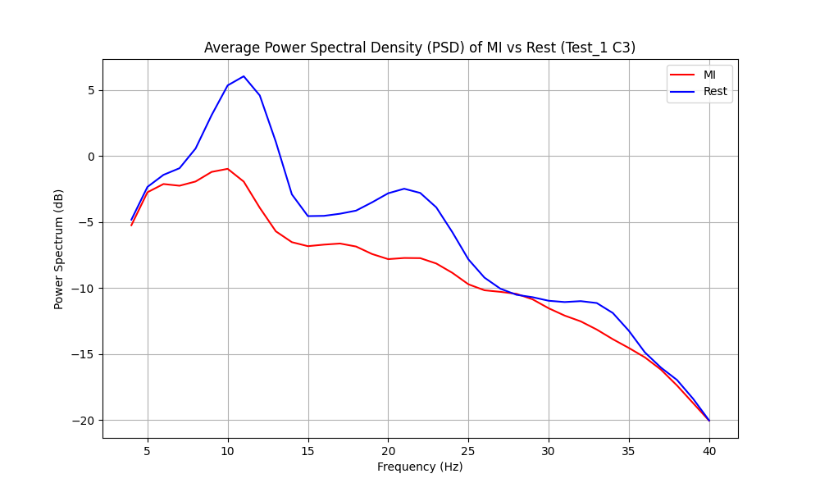
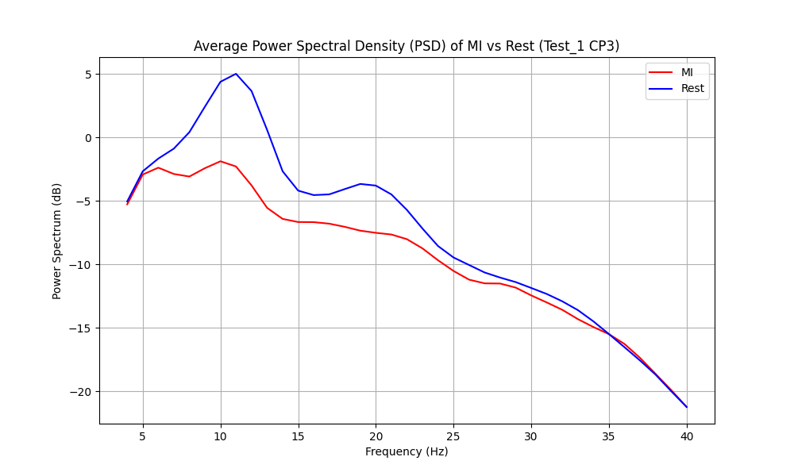
PSD electrodes of choice

Slide 11
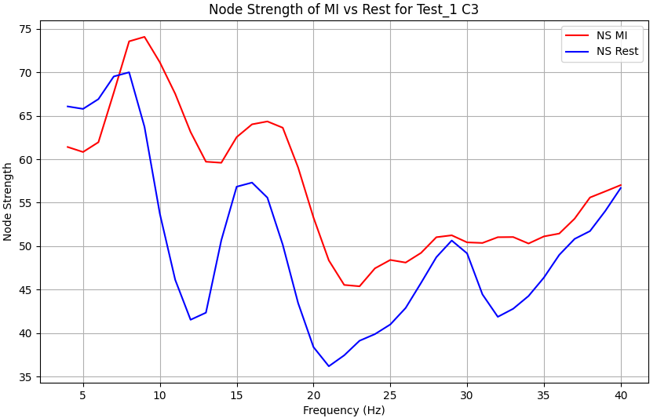
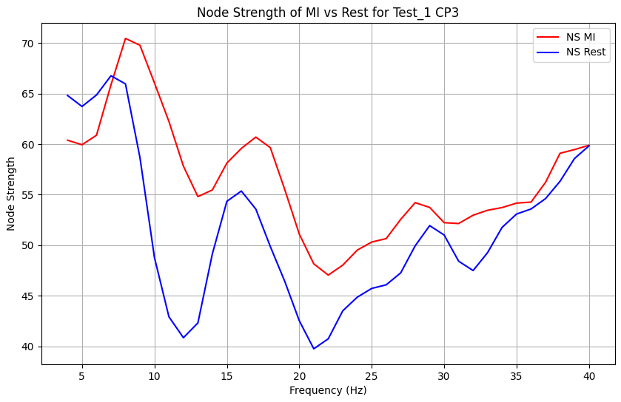
Node strength electrodes of choice

Slide 12
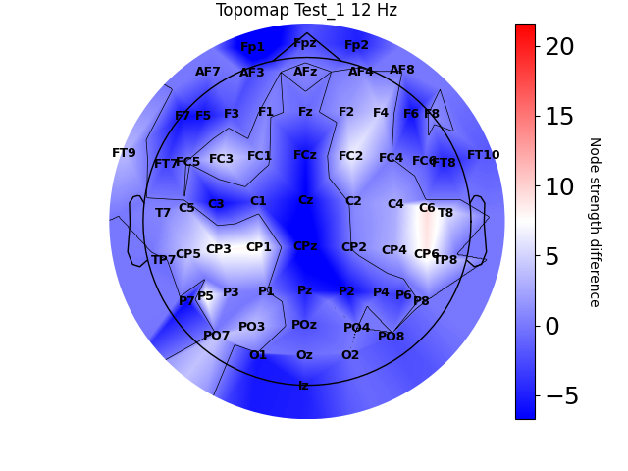
Frequency of choice for functional connectivity

Slide 13
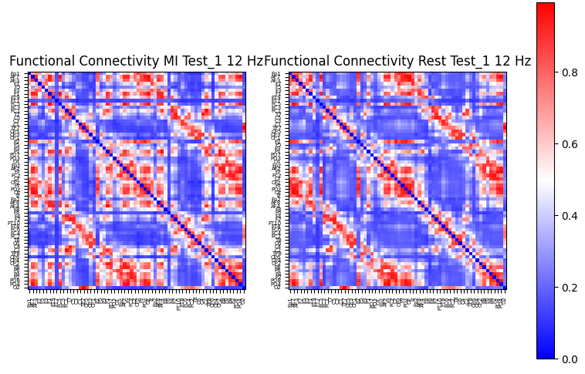
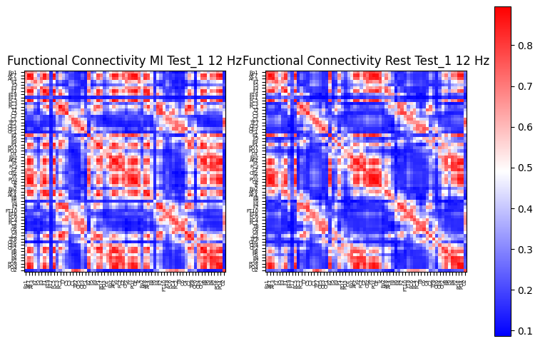
Imaginary coherence map before and after Symmetric Positive Definite transformation
Before SPD transformation
After SPD transformation

Slide 14
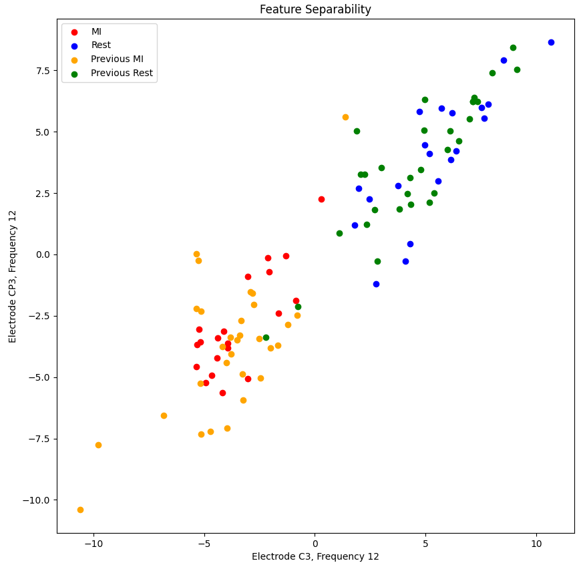
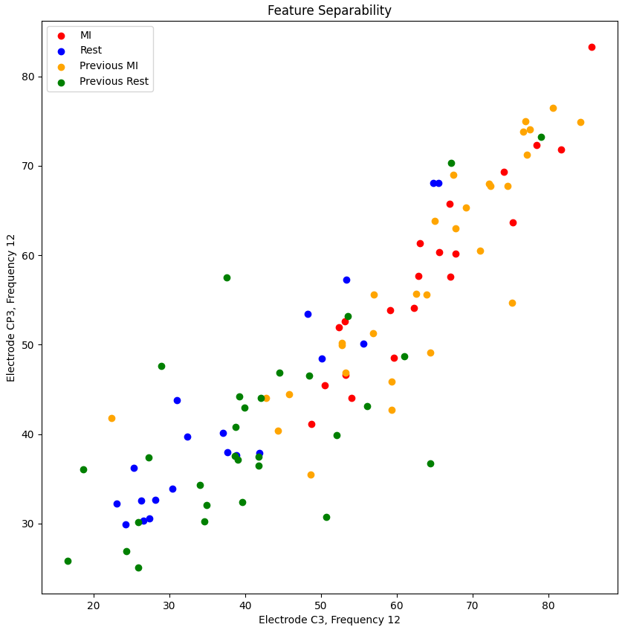
Feature separability representation for PSD-LDA and NS-LDA
PSD
Node Strength

Slide 15
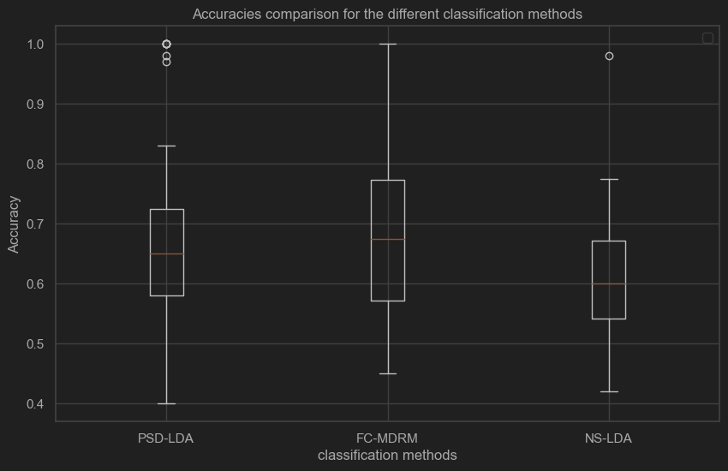
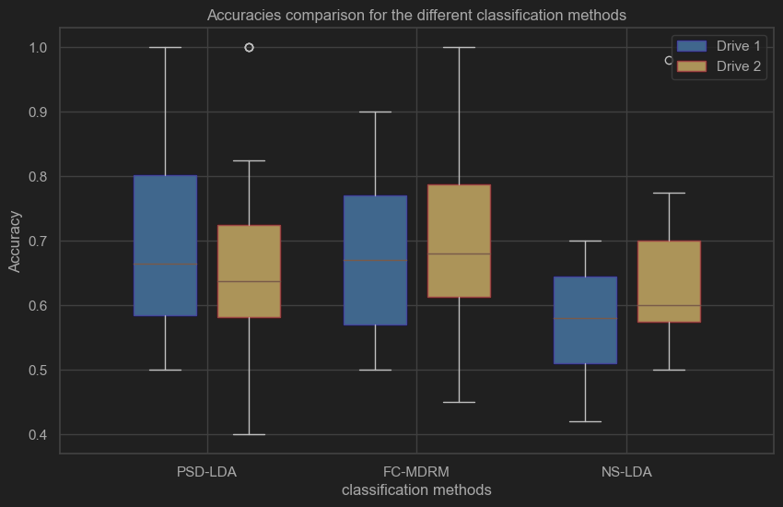
Results over the 20 sessions in the Braccio_Connect dataset

