Slide 2
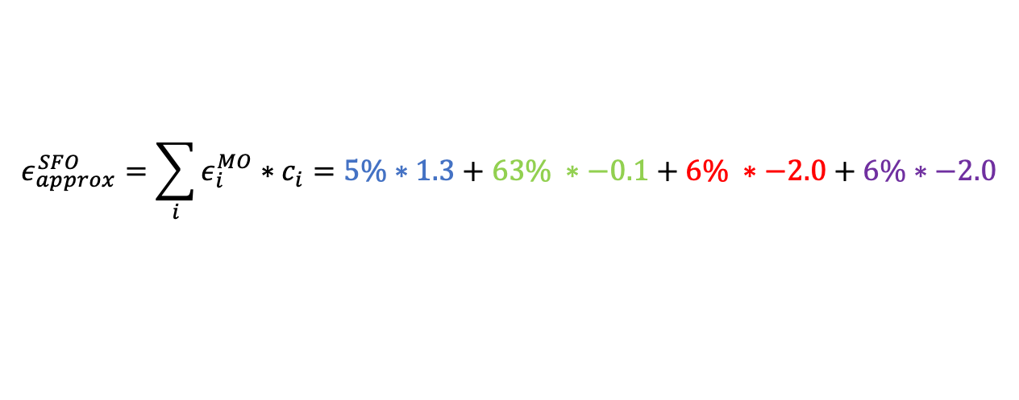
Approximated SFO energy
MOs
SFO
1.3 eV
c = 5%
-0.1 eV
c = 63%
??? eV
c = 6%
-2.0 eV
$$ε_{approx}^{SFO}=\sum_{i}{ε_{i}^{MO}∗c_{i}}=5\%∗1.3+63\% ∗−0.1+6\% ∗−2.0+6\%∗−2.0$$

Slide 3
The benchmark
Energy gaps are important properties for e.g. reactivity
How do they converge as a function of basis-set size?
  How do the different energies converge?
Bigger basis-sets include higher and higher energy LUMOs
  How does this influence the approximate energies?

Slide 4
Conclusions
PyOrb is in an advanced stage
  Can read SFO energies, site-energies and approximate energies
Energy-gaps converge with basis-set size
  Approximate energies generally close to site-energies
Approximate energies suffer from issues in some systems
  Due to issues in Mulliken contributions

