Slide 1
Moving an optical filter in front of a smartphone’s camera

Slide 2
Application Outline
Highly demanding application in terms of precision, accuracy, throughput and size, comparable to Scanning Microscopy applications.
The movement of the filter has to be as fast and accurate as possible, in order to achieve high resolution in a short time. This way we can extract the best information fast, and reduce movement artifacts.

Slide 3
Application Outline
The filter’s movement profile (velocity, step ‘n’ settle/ constant movement on micron scale) is determined by the way we capture the multi-spectral image.
The spectral images can be acquired through a set of pictures or a video. The first option, though raises many concerns about its effectiveness, as it can be highly demanding in terms of memory allocation and examination time, and it requires prior knowledge of some of the camera’s settings like exposure time. These details that are not widely accessible in today’s commercial smartphones.

Slide 4


Application Outline
The physical structure of the filter determines the type of motor that should be used.
A linear multi-spectral filter requires a linear actuator. In case of a 3cm filter, the travel length is almost 6cm which, moving at a constant speed of 8mm/s, results on a 7.5s examination time.
In another approach, the filter could be round, requiring a rotary motor. This implementation dramatically reduces the mechanism’s dimensions, thus making it easier to be embedded into new smartphones. At the same time, though, it makes the estimation of the spectral cube more complex.

Slide 5
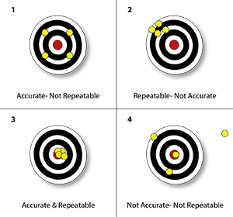
Application Requirements
Assuming that the spectral images are captured through a 30fps video, and each band-pass region of the filter is less than 1mm wide, it is obvious that in either approach (linear/rotary), the actuator must have:
Sub-mm precision,in terms of accuracy and repeatability
millisecond response in case of step ‘n’ settle
These specifications depend on each and every component of the motion control system.
Extra requirements for this application:
Self-locking when power is off
Silent

Slide 6
Motion Control System
The basic architecture of a motion control system contains:
A motion controller to generate set points (the desired output or motion profile) and (in closed loop systems) close a position or velocity feedback loop.
A drive or amplifier to transform the control signal from the motion controller into energy that is presented to the actuator. The DAC’s resolution is also vital for the system’s accuracy.
A prime mover or actuator such as a linear actuator, or electric motor for output motion.
In closed loop systems, one or more feedback sensors such as optical encoders, or Hall effect devices to return the position or velocity of the actuator to the motion controller in order to close the position or velocity control loops.
Mechanical components to transform the motion of the actuator into the desired motion(ball screw, belts, linear and rotational bearings etc)

Slide 7
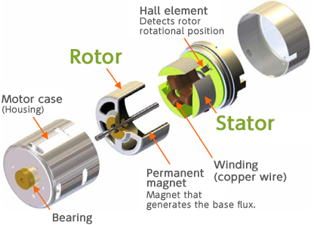
Permanent Magnet Motors
Permanent magnet motors can be used both as rotary actuators and as linear actuators.
BLDC Motors
Electronically commutated 3-phase brushless motors (EC motors) are particularly well suited for applications that need smooth running and a long service life
Optional encoders with up to 1000pulses/rev. allow high-resolution position controlling

Slide 8
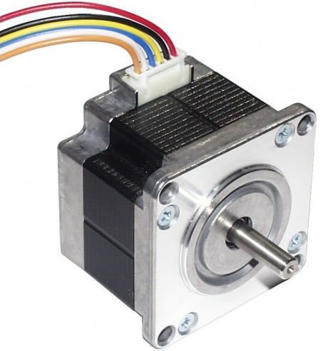
Permanent Magnet Motors
Stepper Motors
Brushless DC electric motor that divides a full rotation into a number of equal steps. The motor's position can then be commanded to move and hold at one of these steps without any feedback sensor (an open-loop controller), as long as the motor is carefully sized to the application in respect to torque and speed.
They provide high step angle precision (e.g. 1,8*) and step resolution.
A way of increasing the number of steps,called Microstepping, is sending a sine/cosine waveform to the coils inside the stepper motor. In most cases, micro stepping allows stepper motors to run smoother and more accurately.

Slide 9
Permanent Magnet Motors
Stepper motors have some inherent ability to control position, as they have built-in output steps. Their drive signal specifies the number of steps of movement to rotate, but for this the controller needs to 'know' the position of the stepper motor on power up. Therefore, on first power up, the controller will have to activate the stepper motor and turn it to a known position (e.g. inkjet printers).
Servomotors
A servomotor is a rotary actuator or linear actuator that allows for precise control of angular or linear position, velocity and acceleration. It consists of a suitable motor coupled to a sensor for position feedback. It also requires a relatively sophisticated controller, often a dedicated module designed specifically for use with servomotors.

Slide 10
Permanent Magnet Motors
A servomotor will immediately turn to whatever angle the controller instructs it to, regardless of the initial position at power up.
Brushless DC Servo Motors are ideal for applications that require dynamic, precise positioning or smooth running characteristics.
Generally used as a high-performance alternative to the stepper motor.
A servomotor consumes power as it rotates to the commanded position but then it rests.

Slide 11
Permanent Magnet Linear Motors
BLDC, Stepper and Servo motors can be used to drive linear stages when combined with other mechanical parts such as lead screws and ball screws. They can provide good positioning accuracy and self-locking at rest, especially when preload and bearing support is used.
Ball screws, though, can have significant lead error or lead deviation within the ball screw or ball nut. Grinding can introduce lead error from the inherent machine inaccuracies, tool wear, or heating of the ball-screw shaft during the grinding process.
Electronic correction techniques, which compensate for small lead errors across standard travel runs, can further improve accuracy.
Demanding, high-throughput applications present tough challenges because short cycle times sometimes have speed requirements that tax the limits of linear-guide and ball-screw speed and acceleration capabilities.

Slide 12
Permanent Magnet Linear Motors
The machine’s frame and base rigidity, thickness, material (e.g., aluminum versus steel), and frame construction (solid or tubular) can all have an impact on precision. Mechanical-drive-based factors such as preload, axis length, types of antifriction elements and bearing support, as well as the fasteners connecting the linear-motion system to the frame can all indirectly influence machine precision.
All linear-motion components (motor, bearings, and nut) generate heat that must be accounted for. Proper management of these thermal influences can improve the performance and precision of a system.
Different parts of an axis can have different temperatures based on running time, dynamic cycle, and forces on each part.
Thermoelastic deformation presents another challenge, as heat influences linear expansion of all components. Deformation could cause misalignment or displacement, which puts excess force on the bearings and nuts. This force creates friction, which leads to even more heat generation. The higher the rigidity an application requires, the more friction-generated heat will affect alignment, stiffness, and performance.

Slide 13

Voice Coil Motors
Voice Coil Motors
Linear DC Motors, Voice Coil Motors (VCM) or Voice Coil Actuators (VCA) are the simplest type of electric motors. These motors consist of two separate parts; the magnetic housing and the coil.
Applying a voltage across the terminals of the motor causes the motor to move to one direction. Reversing the polarity of the applied voltage will move the motor to the opposite direction. The generated force is proportional to the current that flows through the motor coil. This force is almost constant in the specified stroke range of the motor.
Voice coil motors do not need commutation and using a position sensor, positioning accuracy of less than one micron or 0.00004 inches are achievable.
The non-commutated motor construction increases reliability. The direct coupling of the motor to the load allows for fast acceleration / deceleration and high speed operation.

Slide 14
Piezoelectric Motion
While Permanent magnet motors can provide good accuracy and can be driven by 12-24 Volts, problems like backlash, heat generation , friction, need for lubrication and machine wear must be compensated.
Piezoelectric Actuators and Motors
When we need to position a rather small object with high accuracy, the piezoelectric element seems to be the most convenient actuator.
As for the frequency response, a piezo element itself can deform much faster than usual electric linear motors like a voice coil motor.
The field of piezo motion control has expanded rapidly in recent years, with many new concepts introduced, all aimed at eliminating previous limitations while preserving their unmatched resolution, force, and responsiveness capabilities. Consequently, not only is piezo actuation increasingly suitable for applications formerly addressable only by magnetic linear and rotary motors, but significant benefits accrue in terms of size, speed, fieldlessness, reliability, vacuum compatibility, resolution, dynamics, and reliability.

Slide 15
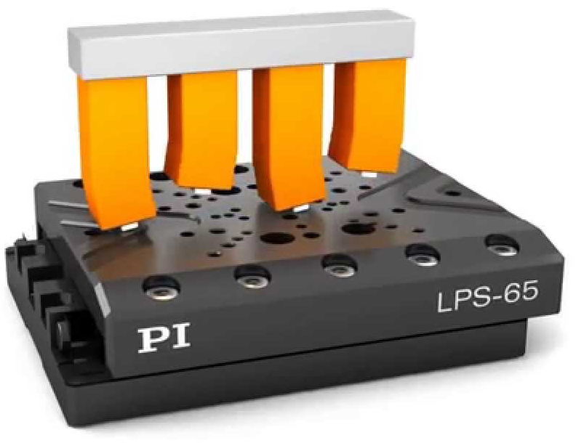
Why Piezo Motion?
Piezo motion is generally used when a combination of any of these parameters is required:
Fast response
High precision
High force
Long life
Maintenance and lubricants free
Compact dimensions
Non-magnetic, UHV compatible
Self-Locking at rest
Silent
Thus, making them the most suitable actuators for this particular application.

Slide 16
Piezoelectric Motion
Piezoelectric materials are used to convert electrical energy to mechanical energy, and vice-versa. The precise motion that results when an electric potential is applied to a piezoelectric material is of primordial importance for nanopositioning.
In most applications, piezo positioners are used with a position feedback sensor and closed-loop control.
With suitable controllers, closed-loop operation enables reproducibilities even in the sub-nanometer range as well as elimination of the piezo hysteresis.

Slide 17
Piezoelectric Motion
Piezo motion devices are often divided into two groups: actuators and motors.
Traditional piezo actuators expand analogous to the applied drive voltage. They provide short travel ranges typically under 1mm.
Piezoelectric motors require more complex drive electronics and can provide long travel ranges (up to 100’s of mm). They typically consist of one or more of piezo elements driving a runner.
A great advantage of piezo motors is their intrinsic steady-state auto-locking capability. It does away with servo dither and the accompanying heat generation, an undesirable feature of electromagnetic linear motors.

Slide 18
Piezoelectric Motion
They offer extraordinary stiffness and holding force and are optimized for reliability in applications requiring long-term position hold while providing centimeters of travel with picometer-class resolution.
Stepping and resonant (continuous) piezo motors are in principle nonmagnetic and vacuum-compatible, a requirement for many applications in the semiconductor optics and medical industry.
They also offer very fast response (several milliseconds) and positioning accuracy in sub-μm, even in sub-nm range, depending on the motion control system
Ultrasonic Motor Operating Principle
https://youtu.be/9F8qU5LaHXY
Piezo Walk Operating Principle
https://youtu.be/5kUC3Nv_jnQ

Slide 19
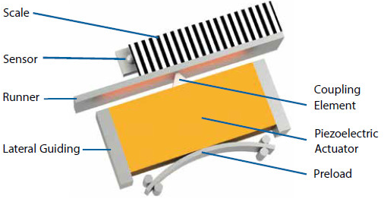
Piezoelectric Motion
Resonant Motors (Ultrasonic Piezo Motors)
The motion of resonant piezo motors is based on high frequency oscillation with microscopic amplitudes. The oscillatory motion of the piezo ceramic block is transmitted to a ceramic runner (linear or circular) coupled to a moving stage. Ultrasonic motors are very compact and can attain high speeds combined with resolutions down to a few nanometers or better. Rotary motors feature high torques, especially at low rpm.
By eliminating lead-screws and their inertia and associated linkages and structures, such mechanisms can be significantly smaller and more responsive than classical motor drives. For example, off-the-shelf linear stages can provide 20mm of travel at up to 100’s of mm/s speed, 10g acceleration with a 0.1 mm resolution linear encoder, all in a package 35mm square.

Slide 20
Piezoelectric Motion
In-position stability is superior to conventional stages since the actuator acts as a brake when quiescent. Fieldlessness, vacuum-compatibility, long life, and other signature advantages of piezo actuation also apply.
Since the ultrasonic piezo motors oscillate in frequencies above 20kHz (ultrasonic), they are inaudible to humans.
Ultrasonic Piezo Linear Stages are operated in closed-loop mode, using position sensors (optical/ magnetic, absolute/ incremental) and a PID algorithm that adjusts the controller output in an attempt to minimize the following error.
The drawback to these piezomotors has traditionally been their difficulty of control and the fact that they are usually driven by high voltages.
Dedicated drivers and controllers are needed, components that are bigger than the actuator itself.

Slide 21
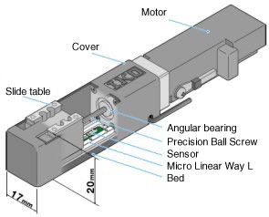
Products
IKO Micro Precision Positioning Table TM15 -60
http://www.ikont.eu/en/products/mecha/mch22.html
Ball Screw, Servo or Stepper driven
Input: Servo DC24V, Stepper DC 15/24V
Driver with similar dimensions
Stroke: 60mm
Accuracy 0.015mm, Repeatability +-0.002mm
Speed max (depending on the screw diameter)
  50, 100, 150 mm/s on Servo
  15, 30, 45 mm/s on Stepper
Overal Length: 115.5 mm , Total weight <1kg
Position sensor built in

Slide 22
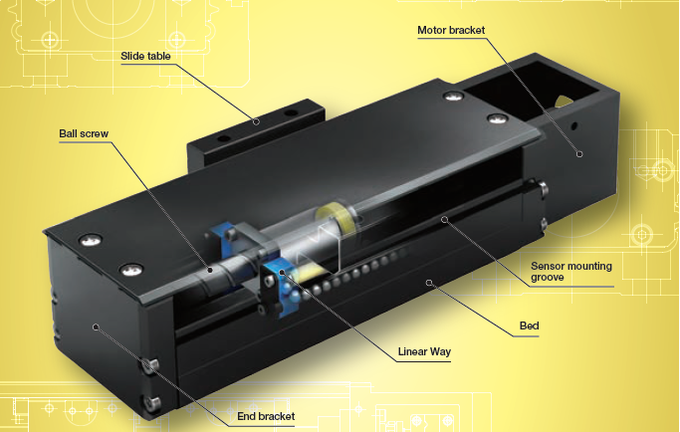
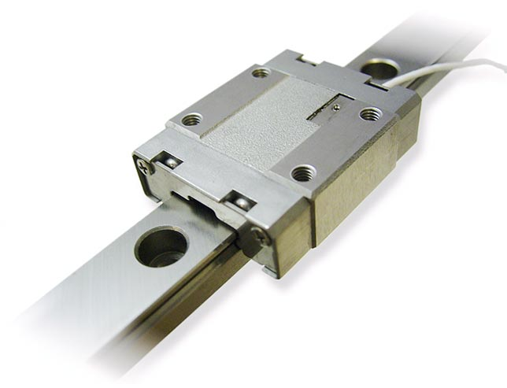
Products
IKO Precision Positioning Table TE50B
http://www.ikont.eu/en/products/mecha/mch26.html
Similar with the above in terms of drive method, size, accuracy and repeatability
Self Lubricating
Low Profile
Weight: 0.52kg
Smaract Nanometer Precision Linear Rail Positioner SLL12
http://www.smaract.com/products/linear-positioners/sll-series/sll12
Ball Bearing
Rail length 70mm
Resolution<1nm
Step width 1-1.500nm
Velocity >20mm/s
Max frequency 18.5kHz

Slide 23
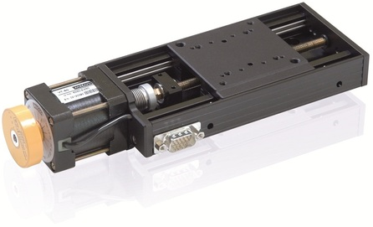
Products
Physikinstrumente VT-80 Translation Stage https://www.physikinstrumente.com/en/products/linear-stages-and-actuators/stages-with-motor-screw-drives/vt-80-translation-stage-1206300/
Stepper motor driven
Voltage range 24V, Nominal Current 0.98 or 1.7 A depending on the motor
Travel range 50, 75 mm available
Uni-directional repeatability down to 0.4 um
Max speed 20 mm/s
Weight < 1kg
Backlash-free re-circulating ball bearing along with a back-lash compensated lead screw guarantees quiet and smooth motion

Slide 24
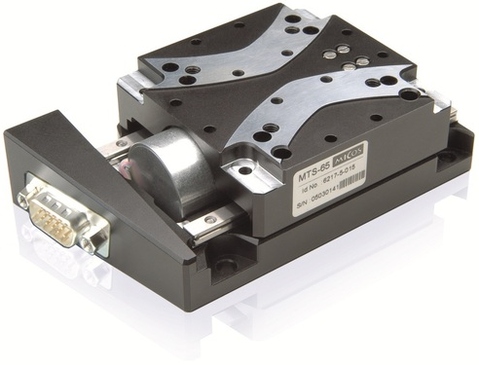
Products
Physikinstrumente MTS-65 Micro Stage
https://www.physikinstrumente.com/en/products/linear-stages-and-actuators/stages-with-motor-screw-drives/mts-65-micro-stage-1203500/
2-Phase Stepper motor microstepping
Voltage Range <100V, Nominal current 0.1A (LS-050)
Travel Range: 52mm
Positioning accuracy and repeatability up to 0.1um
Max speed: 8mm/s
Weight: 0.8kg
Equipped with two optical or hall limit switches
“The micro stage MTS-65 was developed for industrial application with limited space conditions and is typically used for the positioning of laser diodes and optical parts.”

Slide 25
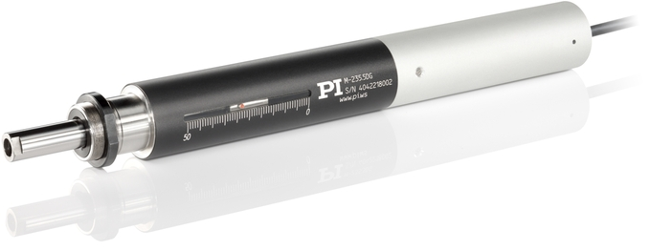
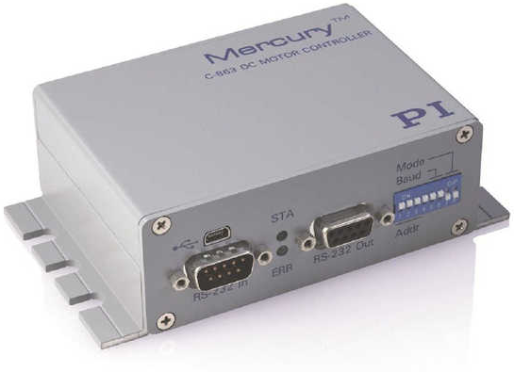
Products
Physikinstrumente M-235 High- Resolution Linear Actuator with DC Motor
https://www.physikinstrumente.com/en/products/linear-stages-and-actuators/stages-with-motor-screw-drives/m-235-high-resolution-linear-actuator-with-dc-motor-703700/
Ball screw driven by DC motor with or without gearhead (M-235.5DG / M-235.5DD)
Operating voltage 0 to +-12V, Electrical Power 4 / 17 W
Travel range 50mm
Min. incremental motion, and repeatability 0.1 / 0.5 mm
Max. velocity 2.6 / 30 mm/s
Mass : 0.7kg
Integrated Rotary encoder
Recommended Controller/Driver: C-863 Mercury Servo Controller
https://www.physikinstrumente.com/en/products/controllers-and-drivers/motion-controllers-for-motor-screw-drives/c-863-mercury-servo-controller-900606/
  external power supply 15 V / 2 A
  PID controller, parameter changes on the fly
  Supports motor brake
  Interfaces: USB and RS-232 for commands
  dimensions: 130*76*40 mm Mass: 0.3kg

Slide 26
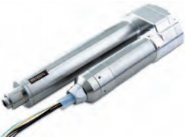
Products
Physikinstrumente MP-20-B Precision Linear Actuator 2Phase-017
http://www.pi-usa.us/products/precision_positioning_pi-micos/Linear_Actuator_Datasheets_Mc/Precision_Linear_Actuators_Motorized_Stepper_Servo.pdf
Driven by 2-phase geared stepper motor
Voltage range: 12V, Nominal current 0.6A
Travel Range: 76mm
Repeatability: +-1.5um
Max speed: 10mm/s
Total length 126mm
“The new MP-20 B micro pusher is designed to motorize manual drives or mirror mounts and it is an ideal component for limited space conditions. Small light components such as mirrors and diodes can be directly mounted to the tip.”

Slide 27
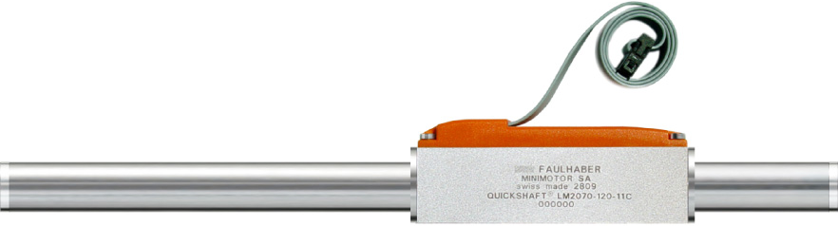
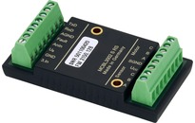
Products
FAULHABER LM1247-060-11
http://www.micromo.com/media/pdfs/LM1247_11_FMM.PDF
QUICKSHAFT® Linear DC-Servomotor
Stroke Length: 60mm
Precision: 160um, repeatability: 40um
Max Speed: 2.8m/s
Weight: 67g
Total Length: 127mm
Controller MCLM3002 F:
http://www.micromo.com/media/pdfs/MCLM3002_V2_5_DFF.PDF
  Dimensions: 49.6*25*14mm
  Power Supply 5..30VDC
  PWM frequency : 78kHz
  Programmable memory 33kWord
  Interface RS232

Slide 28
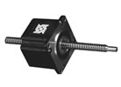
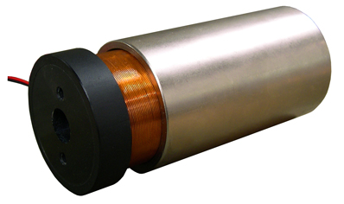
Products
Haydonkerk 57000 SERIES SIZE 23 STEPPER MOTOR LINEAR ACTUATOR
http://www.haydonkerk.com/LinearActuatorProducts/StepperMotorLinearActuators/LinearActuatorsHybrid/Size23LinearActuator/tabid/82/Default.aspx
Hybrid stepper motor lead screw linear actuator
Operating Voltage: 3.5, 5, 12 VDC depending on the model
Great resolution per step available (<20um)
Weight: 511g
Moticont Linear Voice Coil motor lvcm-051-089-01
http://www.moticont.com/pdf/lvcm-051-089-01.pdf
Stroke: 57.2mm
Body mass: 1155g
Coil Assembly mass: 195g
Continuous Force: 26.2N
Housing Length: 88.9mm
Housing diameter 50.8mm

Slide 29
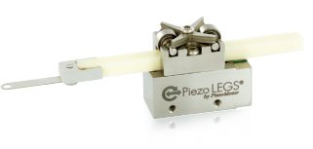
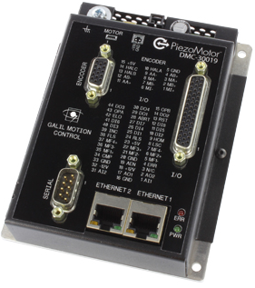
Products
PiezoMotor Piezo LEGS LL1011A
http://www.micromo.com/media/pdfs/150010-06_LL10.pdf
Maximum Voltage: 48V
Maximum stroke: 80mm
Step Length: 4um
Weight: 23g
Controller: DMC-30019
http://www.piezomotor.com/products/drivers/dmc-30019/
  dimensions: 99*127*37mm
  48V 0.5A Power Supply
  PID compensation with velocity and acceleration feed forward, integration limits, notch filter and low-pass filter
  Non-volatile memory for programs, variables and arrays. Concurrent execution of four programs

Slide 30
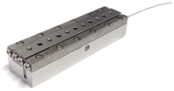
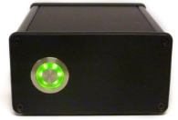
Products
Xeryon XLS-120
http://www.xeryon.com/products/XLS.html
Drive Principle: Ultrasonic
Stroke: 70mm
Encoder resolution 80nm
High speed up to 100mm/s
Size :120*24*18 mm, Weight: 190g
Driver: http://xeryon.com/products/XDriver.html
  48VDC in
  dimensions: 160 x 103 x 53 mm
  Programmable

