Slide 1
Predicting Potential for Suicide from Reddit Posts with NLP
THEODOROS EFTHYMIADIS
MARIA MOUTTI

Slide 2
Reddit C-SSRS Suicide (Problem definition)
Gold Standard Data Set:
  Reddit posts annotation by 4 practicing psychiatrists for getting information about suicidal tendencies and other related mental health conditions afflicting depressed users.
User ID | Post | Label
User-0 | "['Its not a viable option, and youll be leaving your wife behind. Youd Pain her beyond comprehension. … . This is a big test for you, and youll pull through. Just try to stay as positive as you can and everything will work out.']" | Supportive
User-26 | "['So your place could use a cleaning, I dont think that makes you evil. … 'Dont hate yourself. You are not hopeless.] " | Indication
User-1 | "['It can be hard to appreciate the notion that you could meet someone else who will make you happy when you are so deeply in love with your boyfriend. … But you have to be willing to learn.']" | Ideation
User-2 | "['Hi, so last night i was sitting on the ledge of my window contemplating whether or not i should jump. … But its only the people that keep living that get to experience it. ']", | Behavior
User-30 | ['Came back home about 2 hours ago...', 'It is true that there are people in this world who can love. … 'may be looking at my post history would help. There are just a few posts...']" | Attempt

Slide 3
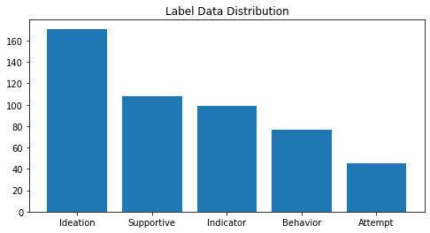
Data Labels
Label Scale: Supportive < Indicator < Ideation < Behavior < Attempt

Slide 4
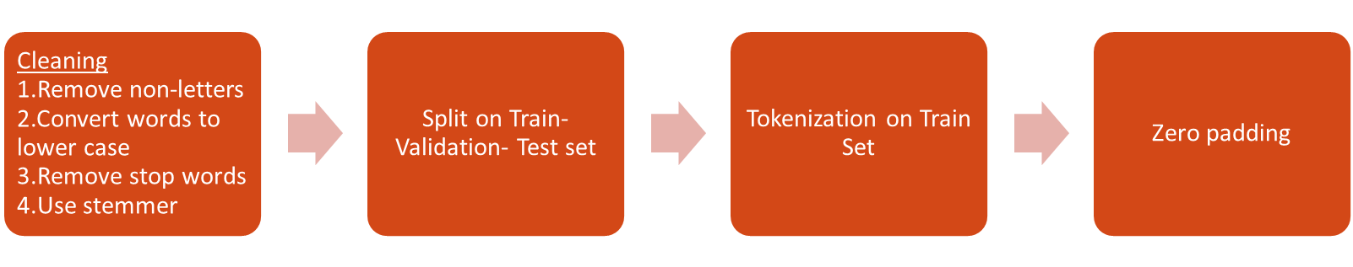
Data preprocessing
Word Embeddings from Glove (large open-source knowledge graph)

Slide 5
Problem formulation-evaluation
    Ordered multi class classification problem
    Solved as: Classification
    OR
    Regression?
Evaluation
Customized evaluation metric: CEM (Closeness Evaluation Measure)
Ιnformational closeness that depends on how items are distributed in the rank of classes
Τhe more unexpected it is to find an item between True and Predicted, the more information such an event provides.

Slide 6
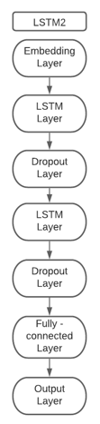
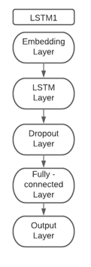
LSTM architectures
Embedding Layer
  Glove word embeddings of dimension 300
  Max Post Length -> 3183
LSTM Layers
  Relu activation function
Output Layer
  Linear activation function
ReduceonPlateau learning rate decay
Early Stopping with patience=5

Slide 7
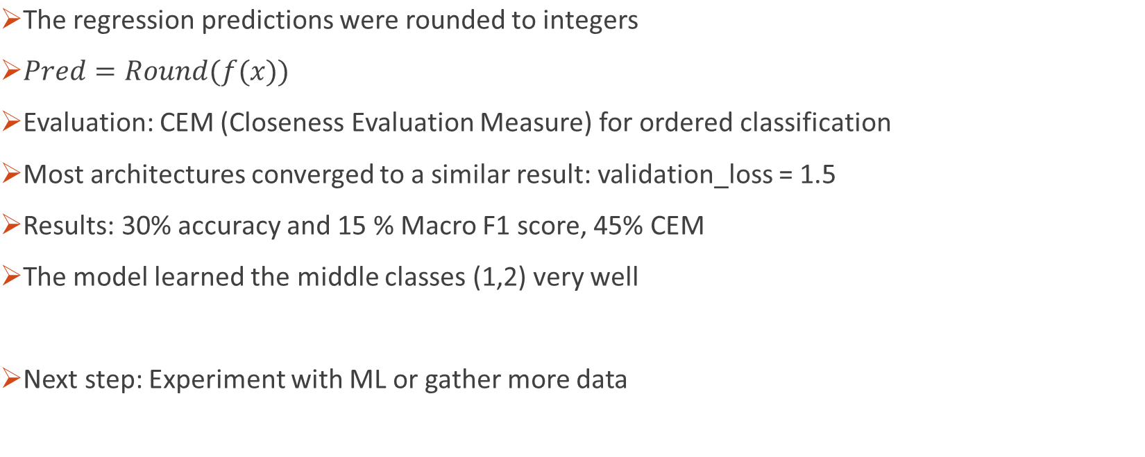
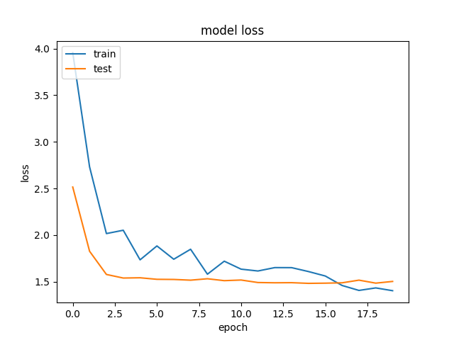
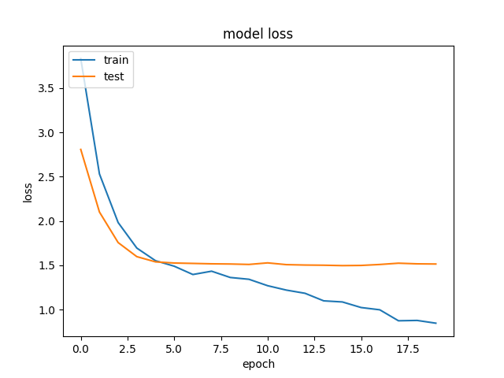

Results

Slide 8


