Slide 1
Let’s Waste Time On the Internet
Theodora Harrington

Slide 2



The websites

Slide 3


The Websites

Slide 4
WHY THE TOAST WAS DROPPED

Slide 5
Methods For Scrapping
5 SELENIUM
4 SCRAPPY
WAIT BUT WHY
OATMEAL
1 SELENIUM
MEDIUM
XKCD
THE TOAST

Slide 6
SHINY APP

Slide 7
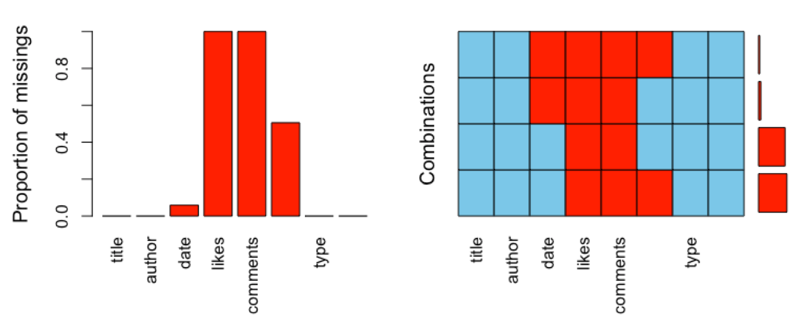
MISSINGNESS
Medium

Slide 8
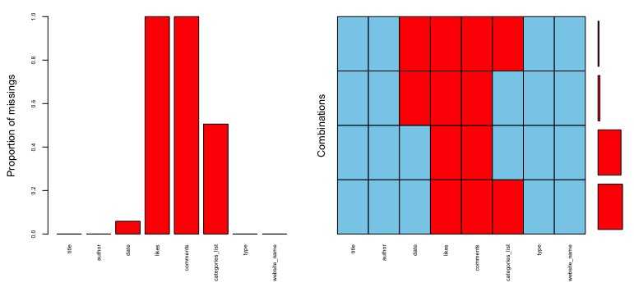
MISSINGNESS
XKCD

Slide 9
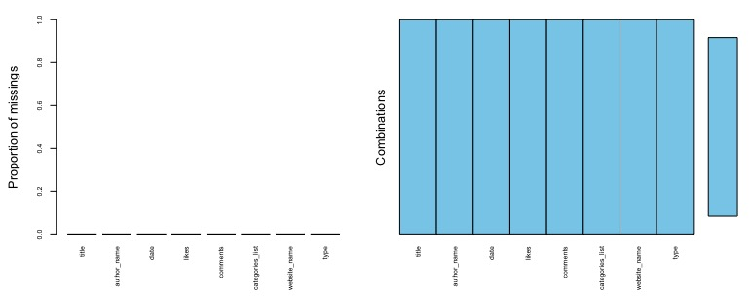
MISSINGNESS
WAIT BUT WHY

Slide 10
MISSINGNESS
OATMEAL

Slide 11
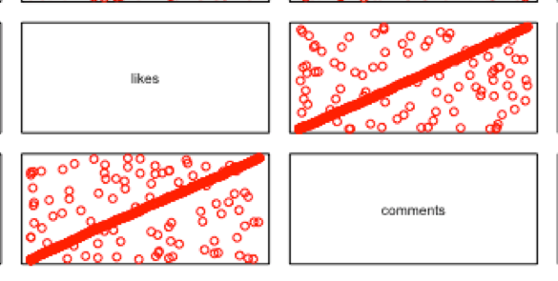
I REALLY DID TRY

Slide 12
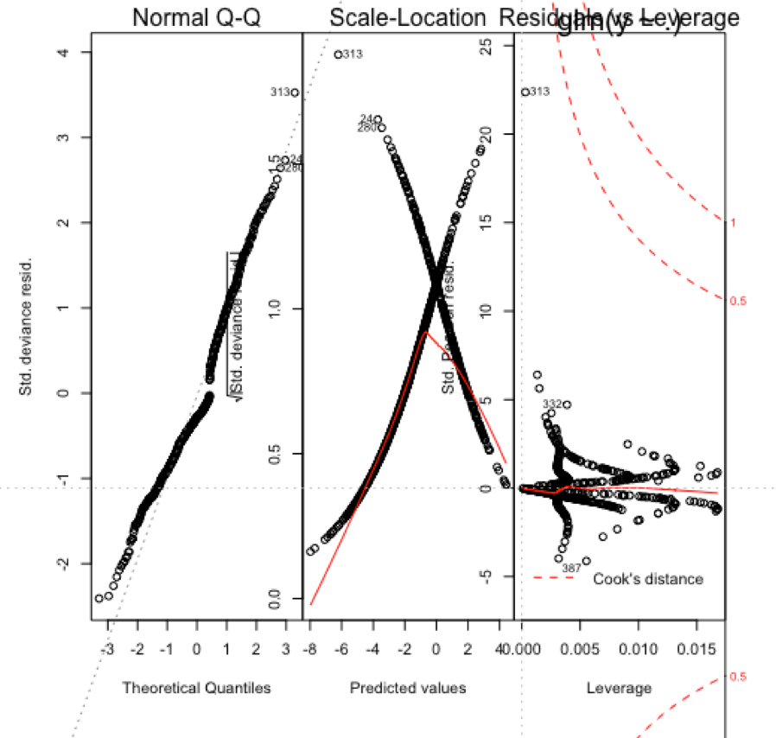
AND THEN THIS HAPPENED

Slide 13
LESSONED LEARNED
CHECK ALL OF YOUR DATA AFTER SCRAPPING
I LIKE SELENIUM MORE THAN

