Slide 1

Definitions Matter. Are Covid Vaccines really vaccines?
If not, what are they? Are there any other technologies that work similarly?

Slide 2
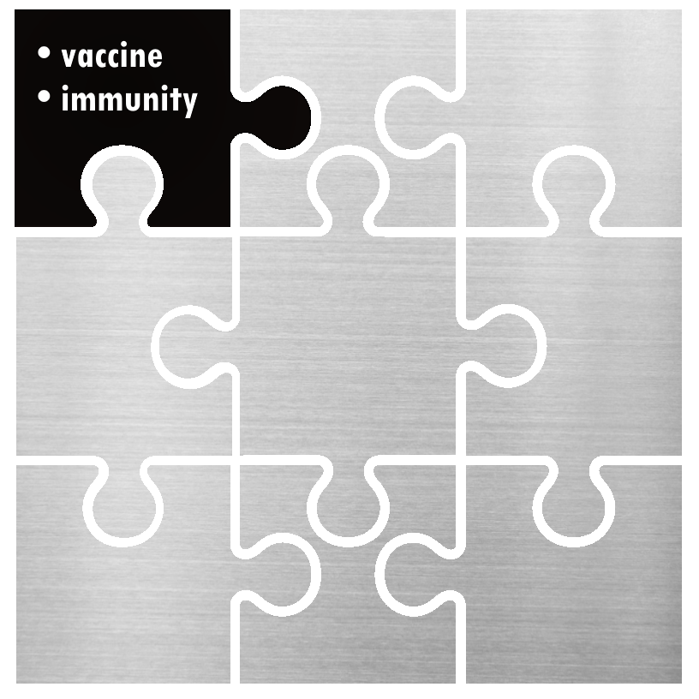

Definition of immunity
According to Merriam-Webster dictionary it's "the power to keep yourself from being affected by a disease“. According to Oxford Languages it's "the ability of an organism to resist a particular infection or toxin by the action of specific antibodies".

Slide 3


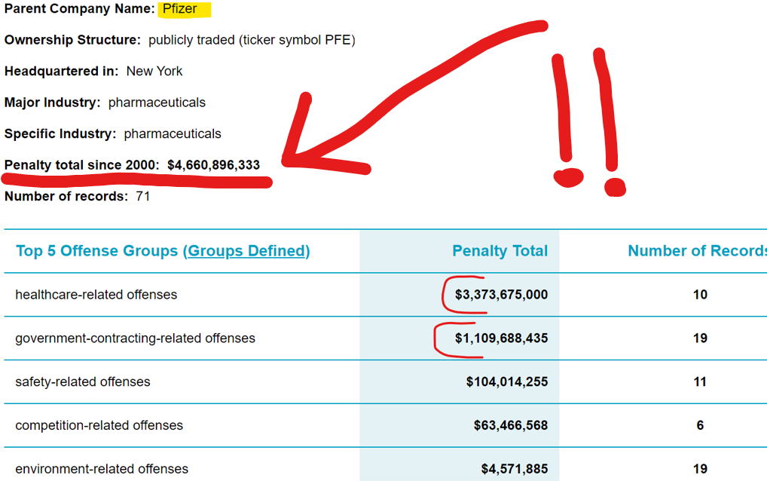
W
Source: FORBES
Date Published: 24/10/1929

Slide 4




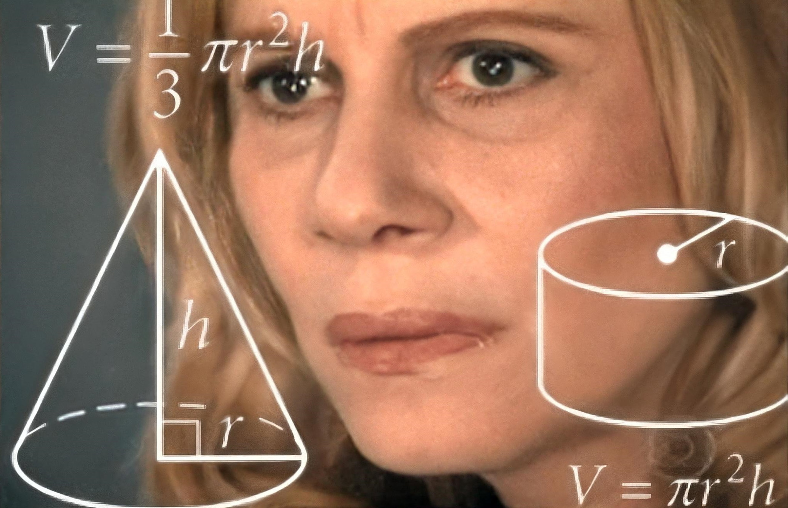

Slide 5
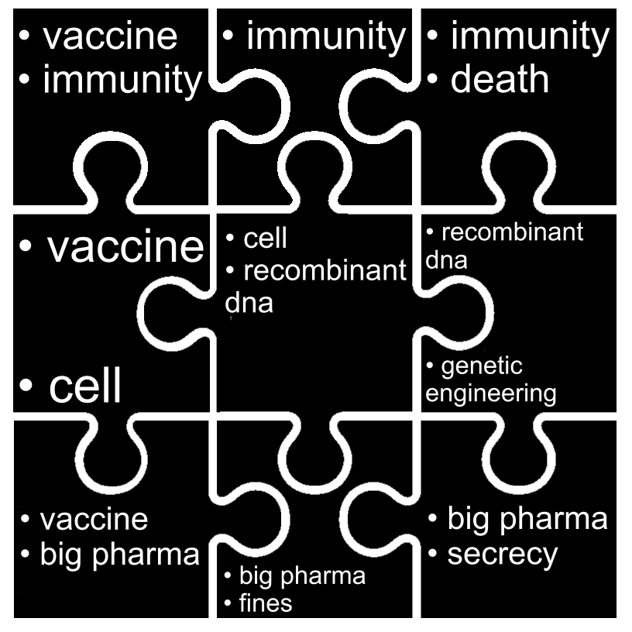
Covid "vaccines" are actually gene therapy.
Covid "vaccines" use the same technology as GM foods. Begs the question, are vaccine takers Genetically Modified Organisms?
Big Pharma would be liable for injuries had their gene therapy product not been labeled "vaccines".
- Big Pharma is regularly paying huge fines for all kinds of nefarious practices.
- Government bodies such as the European Comission and the US Food and drug administration have Big Pharma's back.
#FactCheckThisBitch

