Slide 1



Slide 2

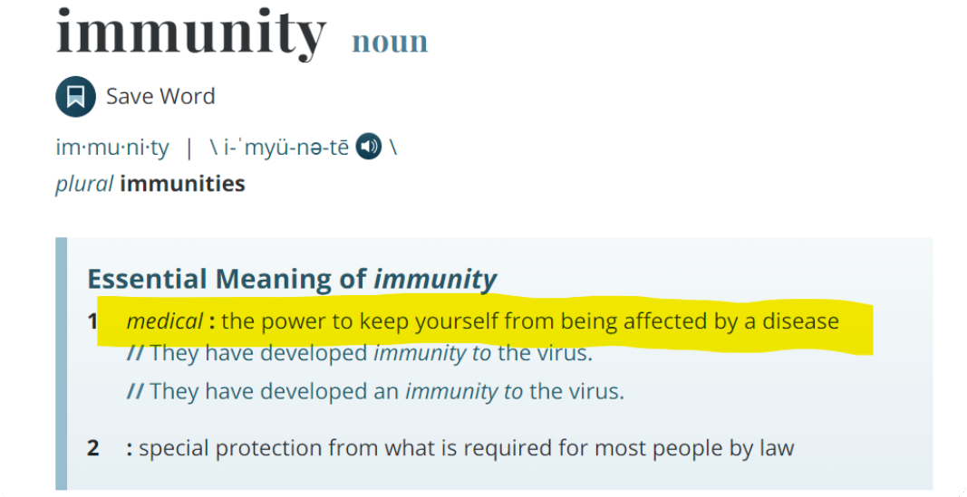
https://www.hsj.co.uk/finance-and-efficiency/5bn-contingncy-fund-announced-for-123
Source: FORBES
Date Published: 24/10/1929

Slide 3






Slide 4

#FactCheckThisBitch

