Slide 1

Definitions Matter. Are Covid Vaccines really vaccines?
If not, what are they? Are there any other technologies that work similarly?
Created with a trial version of Syncfusion Essential Presentation

Slide 2


Definition of vaccine
According to Cambridge Dictionary, it prevents disease and often contains a weakened or dead form of the disease-causing organism. According to Wikipedia, it provides immunity and contains a weakened or killed form of a virus.

Slide 3


Definition of immunity
According to Merriam-Webster dictionary it's "the power to keep yourself from being affected by a disease" and according to Oxford Languages it's "the ability of an organism to resist a particular infection or toxin by the action of specific antibodies".

Slide 4


Definitions Matter. Is this a vaccine?
A vaccine is supposed to give immunity. Immunity means protection. And yet Covid-vaccinated patients are dying left and right.

Slide 5


Covid mRNA Vaccines do not give you immunity and do not contain a weakened virus. So what do they do?
Their mode of operation is to literally hack your human cells into producing a non human spike protein. What is a more suitable name for that technology? What do the vaccine makers call their product?

Slide 6
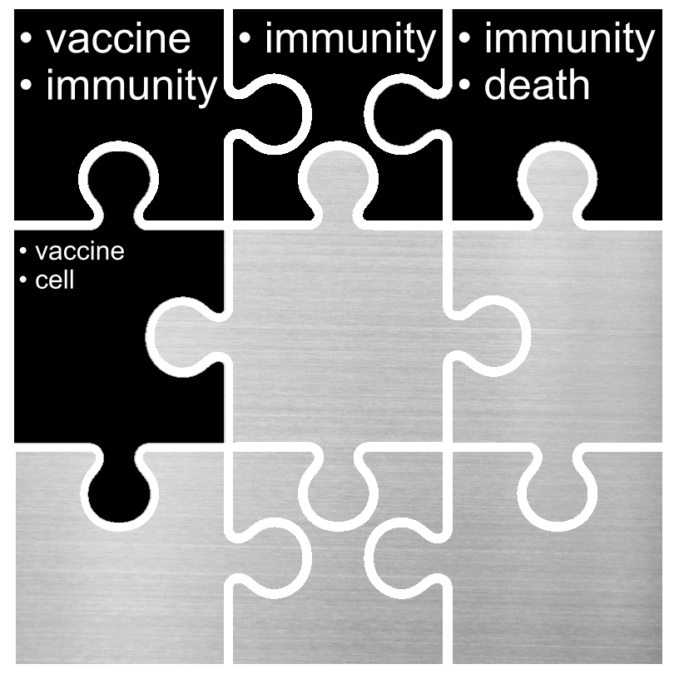
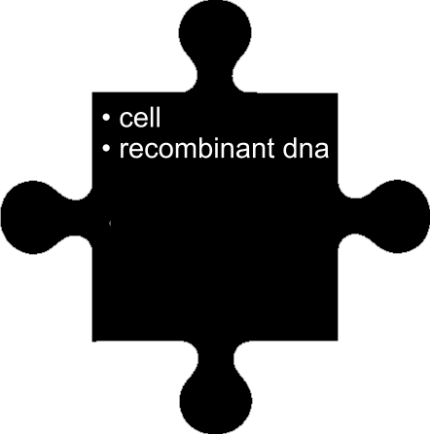
Recombinant DNA is a also a technology that allows cells to produce foreign proteins.
Recombinant DNA is inserted in host cells and these cells then produce new proteins that would not be produced without the inserted DNA.

Slide 7
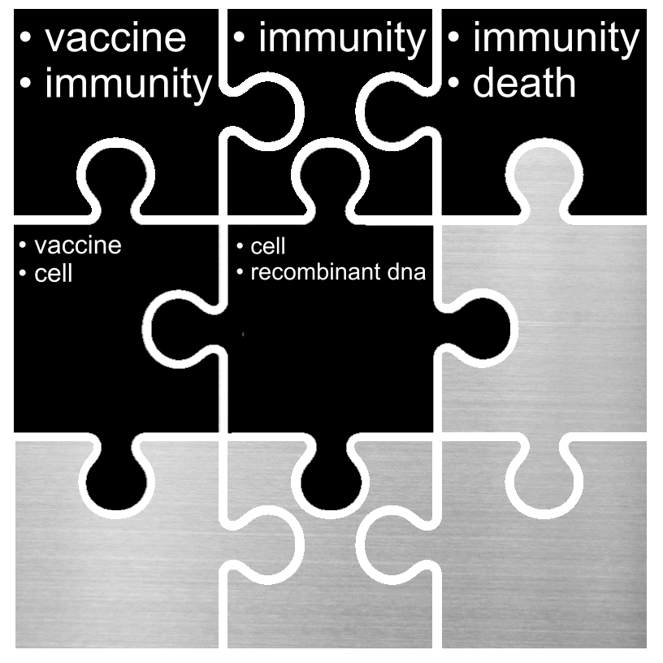

GMO crops and foods are made with Recombinant DNA Technology
So in Covid vaccine takers and in Genetically Modified Organisms alike, the cells are hacked into producing foreign proteins that they would never produce otherwise.

Slide 8
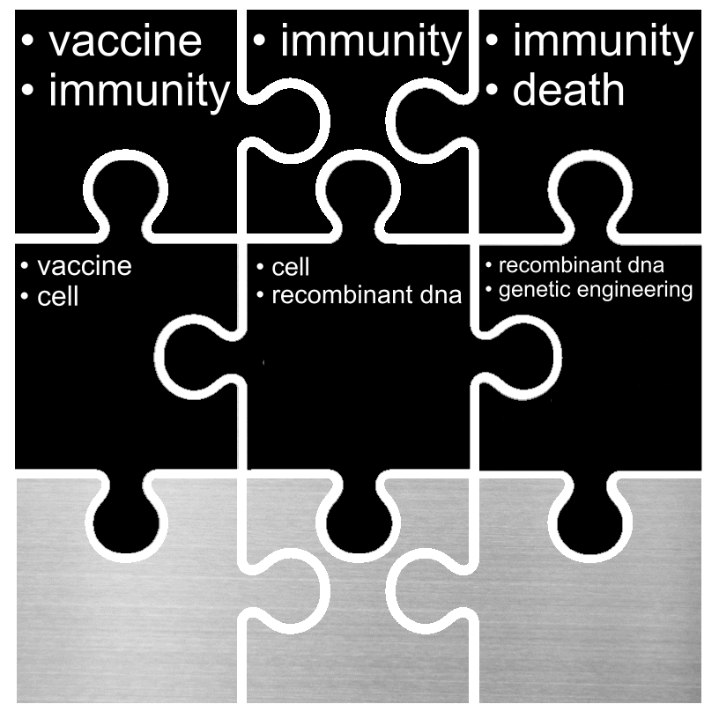
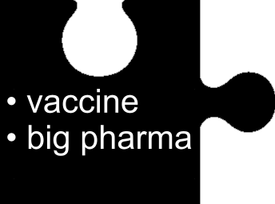
What is the significance of a medical procedure labeled a "vaccine"?
If a medical procedure is labeled a Vaccine, the pharmaceutical company is not liable for damages. In the unlike scenario that damages are awarded to an injured vaccine taker, it's the government that is paying.

Slide 9
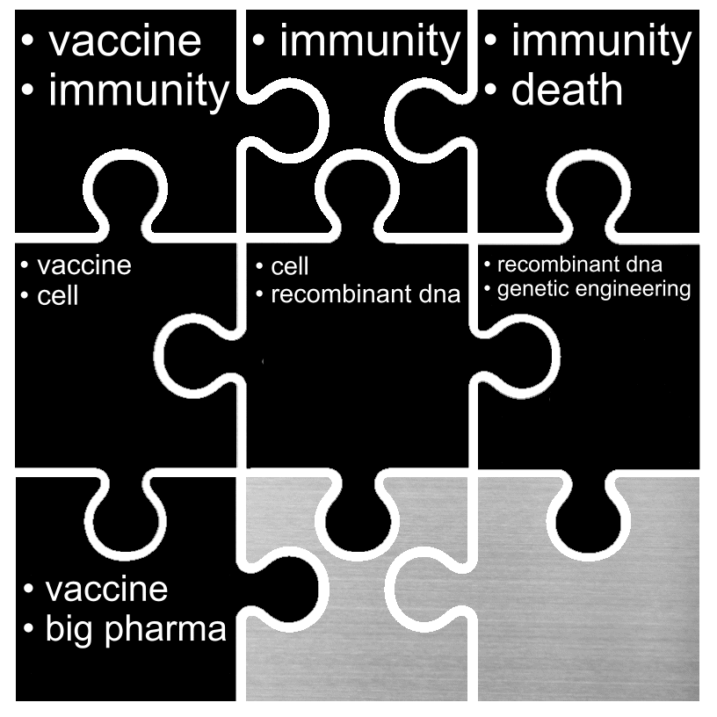
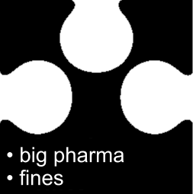
Do Pharmaceutical giants like Pfizer at least have a good track record? Maybe we should just trust them.
Pfizer is regularly paying huge fines up to billions of dollars for false claims and illegally lobbying governments and doctors to push their products. Only the Japanese Tepco who almost siglehandedly ended the world with the Fukushima disaster, has paid a larger fine.

Slide 10
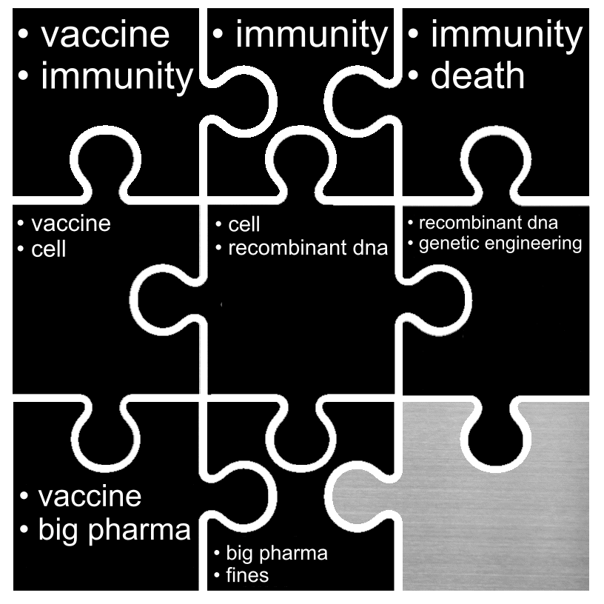
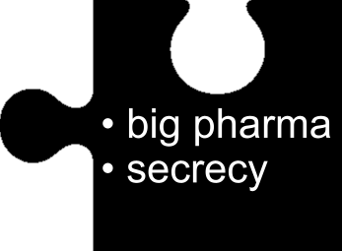
Ok so Big Pharma have been naughty in the past.
At least has there been transparency in the proccess of approving their Covid vaccines?

