Slide 1

Definitions Matter. Are Covid Vaccines really vaccines?
If not, what are they? Are there any other technologies that work similarly?
Created with a trial version of Syncfusion Essential Presentation
Created with a trial version of Syncfusion Essential Presentation
Created with a trial version of Syncfusion Essential Presentation

Slide 2
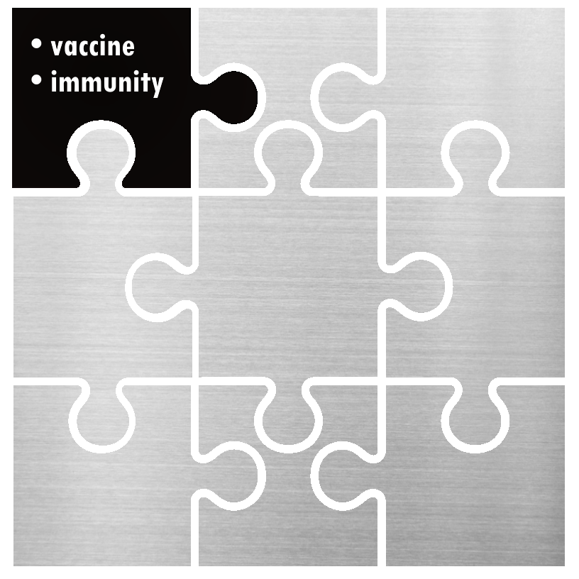
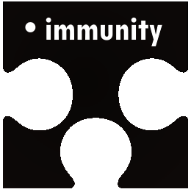
Definition of immunity
According to Merriam-Webster dictionary it's "the power to keep yourself from being affected by a disease“. According to Oxford Languages it's "the ability of an organism to resist a particular infection or toxin by the action of specific antibodies".
Created with a trial version of Syncfusion Essential Presentation
Created with a trial version of Syncfusion Essential Presentation

Slide 3


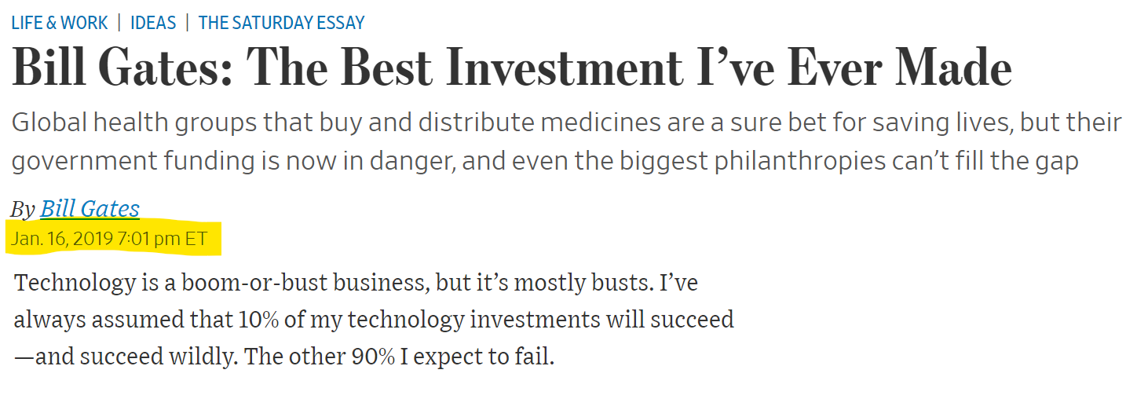
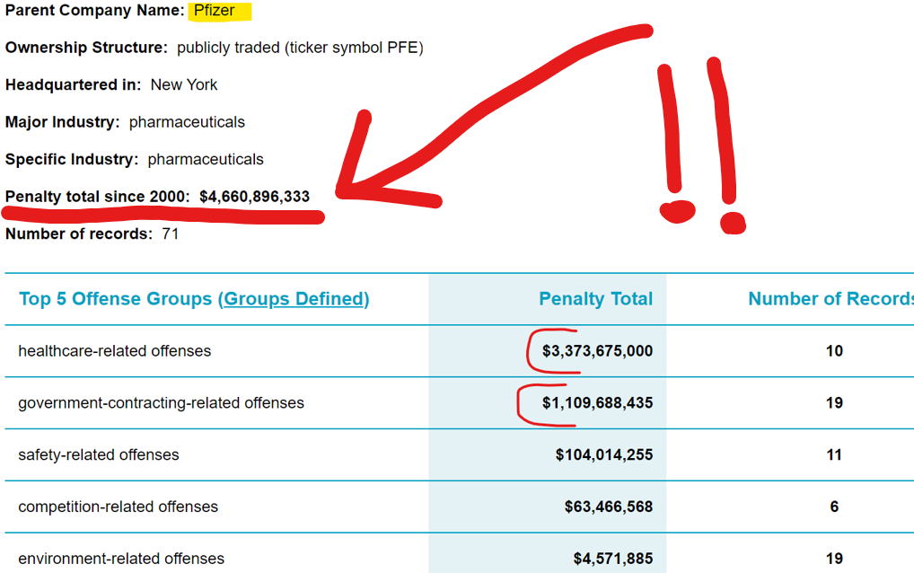
http://www.in.grngr.grgrgrgrgrgrgrgrgrgrgrgrgrgrgrgrgrgrgrgrgrgrgrgrgr

