Slide 1

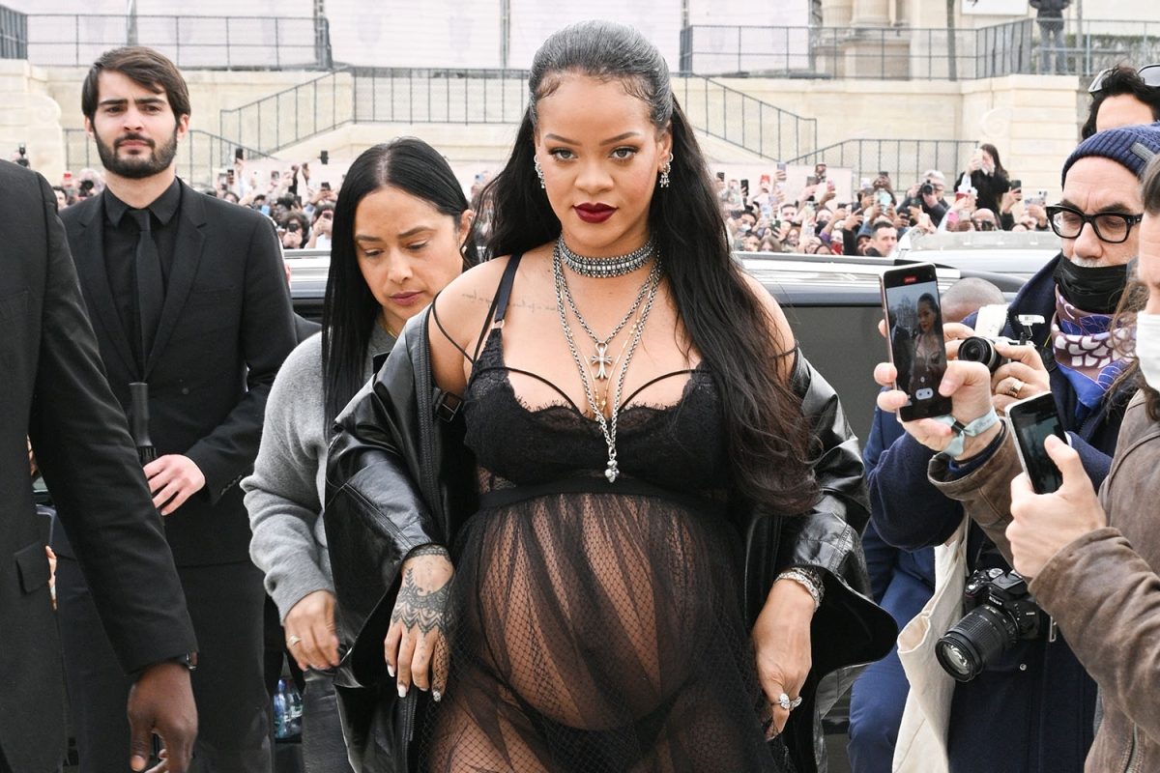
16/12/2022
https://www.thesun.co.uk/tvandshowbiz/celebrities/17811430/pregnant-rihanna-baby-bump-black-lace-lingerie-dior-photos
Rihanna flaunts baby bump in black lace lingerie during Paris Fashion Week

