Slide 1
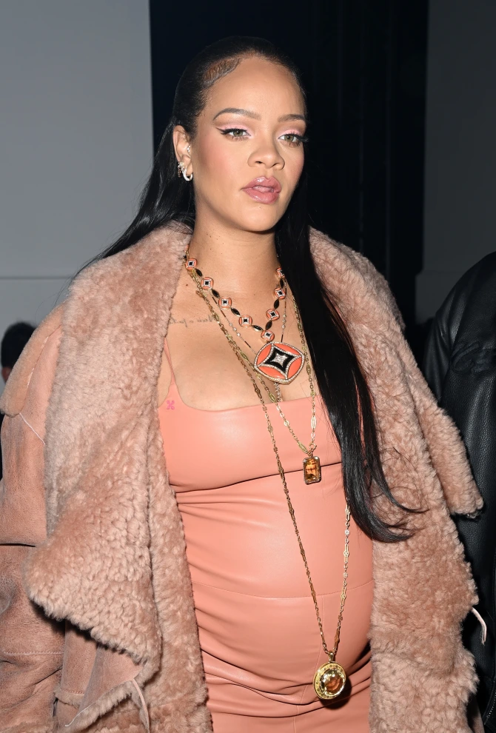
The Sun
16/12/2022
https://www.thesun.co.uk/tvandshowbiz/celebrities/17811430/pregnant-rihanna-baby-bump-black-lace-lingerie-dior-photos
This is the title this is the title this is the title this is the title this is the title

