Slide 1

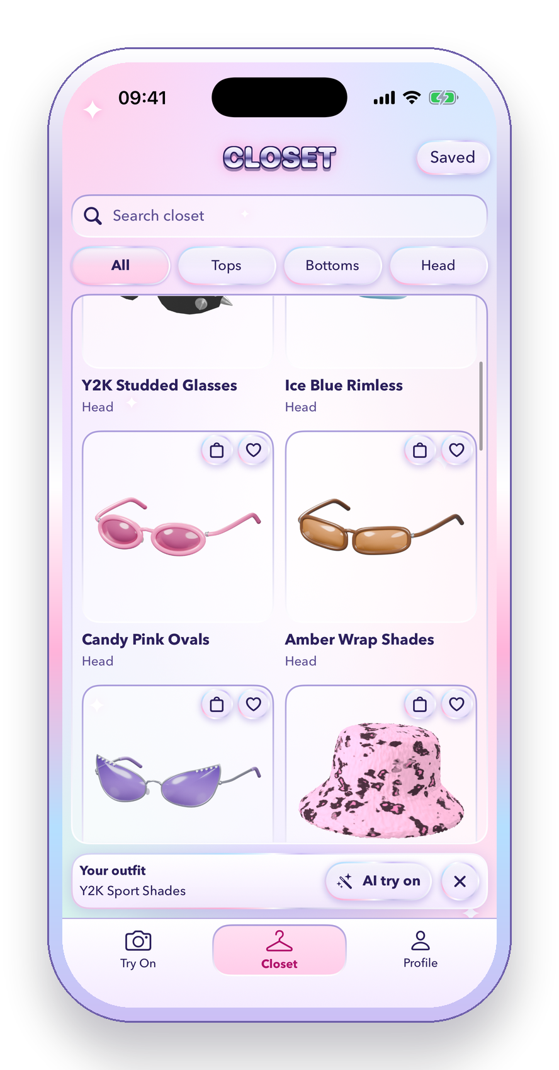




Try on Y2K fashion with AR and AI, then find it second-hand
Live AR try-on
Glasses and hats on your face, in real time
AI try-on
Take a photo and see yourself wearing any piece
Find it second-hand
Search Depop, Vinted or eBay in one tap
HackNotts '26 · Theo Rook & Rafferty Carter-Lazenbury
Notes:
THEO (about 30 seconds)
Hi, we're Theo and Raff, and this is RetroFit.
Y2K fashion is everywhere right now, but most of it is second-hand, so you can't try it on before you buy.
RetroFit fixes that. You can try glasses and hats on live with AR, see yourself wearing any piece with AI, and then find the real thing second-hand on Depop, Vinted or eBay.

Slide 2
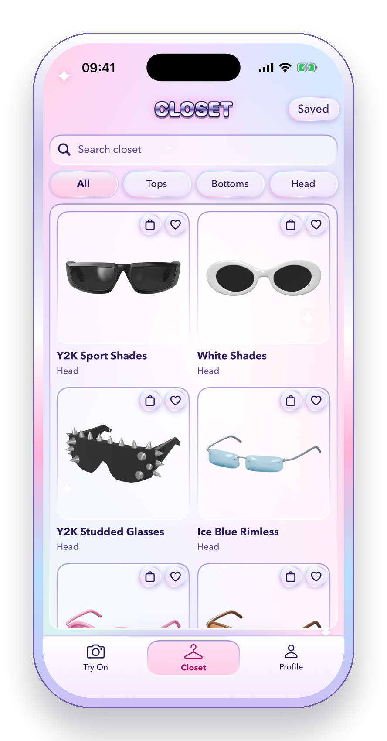
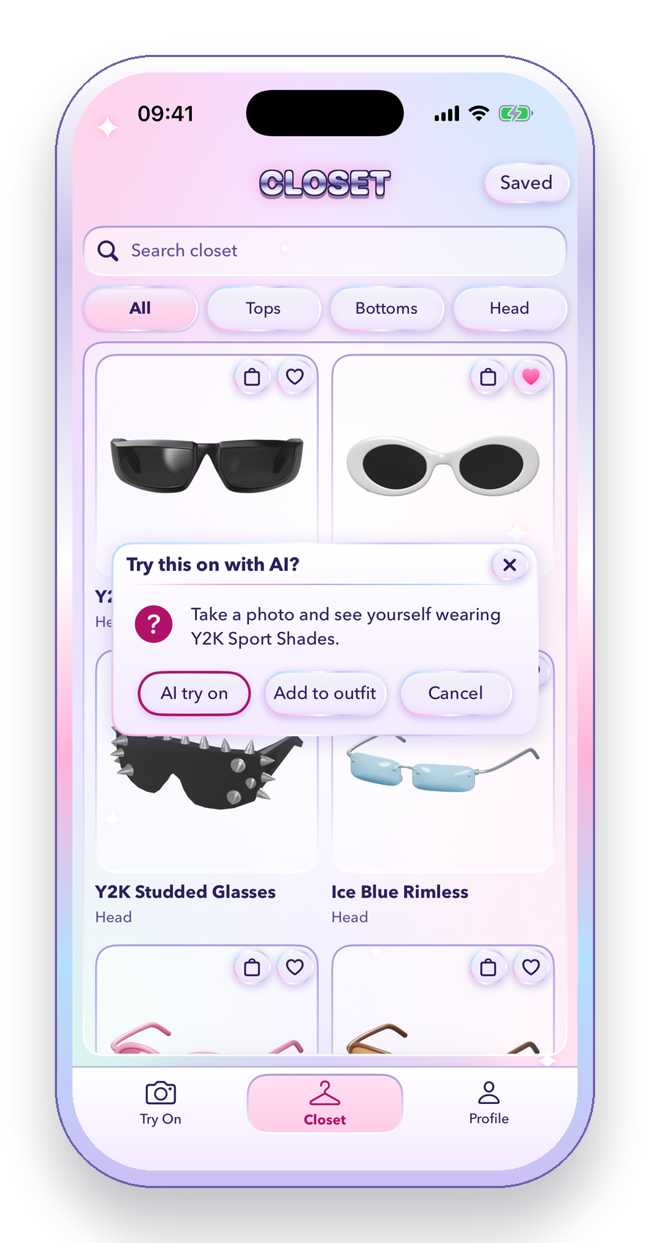
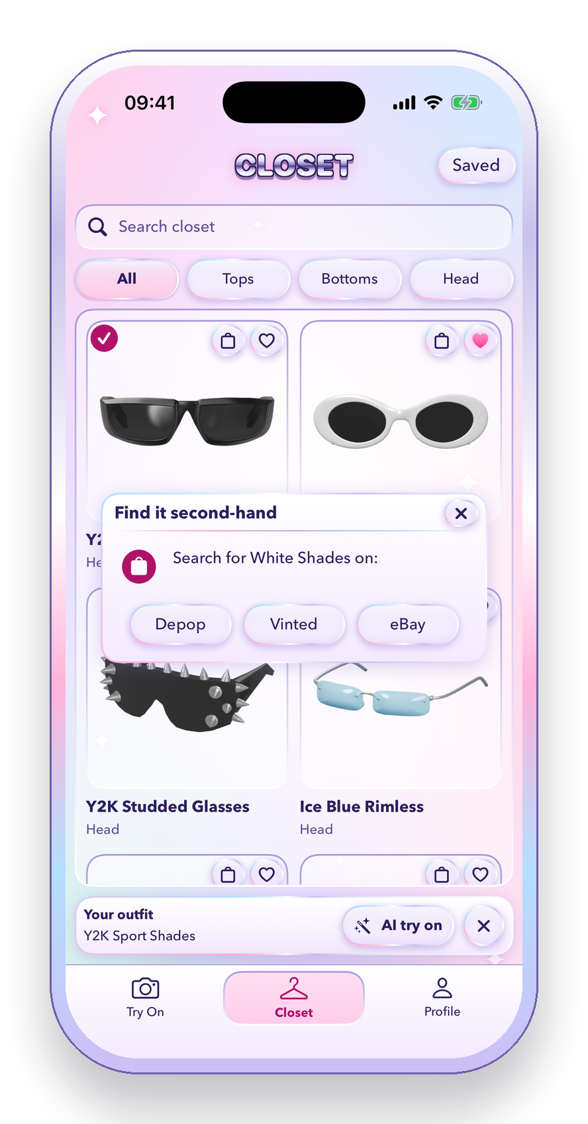
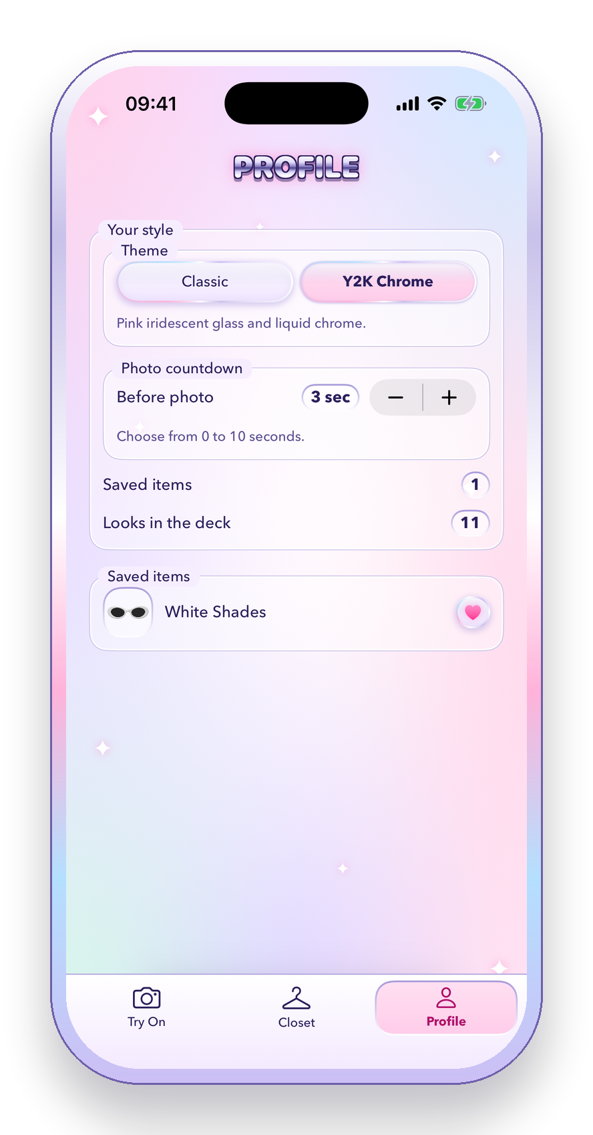
Inside the app
Browse the closet
Try it on with AI
Find it second-hand
Pick your theme
26 Y2K pieces, with search and filters
Take a photo, or build an outfit first
Depop, Vinted or eBay in one tap
Classic Windows or Y2K Chrome, live
Notes:
THEO (about 40 seconds)
This is the closet: 26 Y2K pieces you can search and filter.
Tap any piece and RetroFit offers an AI try-on. You can also add it to an outfit and try several pieces on together.
The bag button finds that exact piece second-hand on Depop, Vinted or eBay.
And on Profile you can change the whole look of the app.

Slide 3
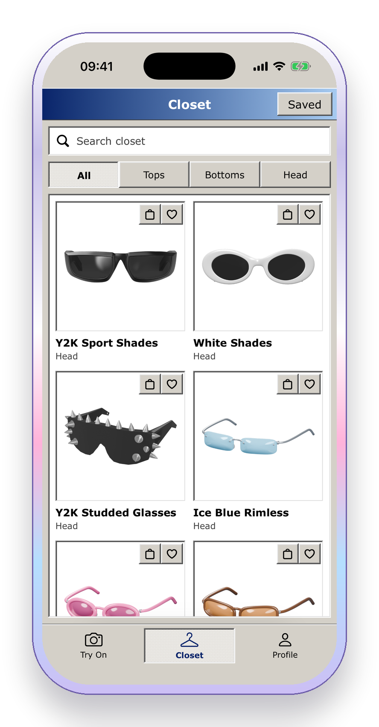
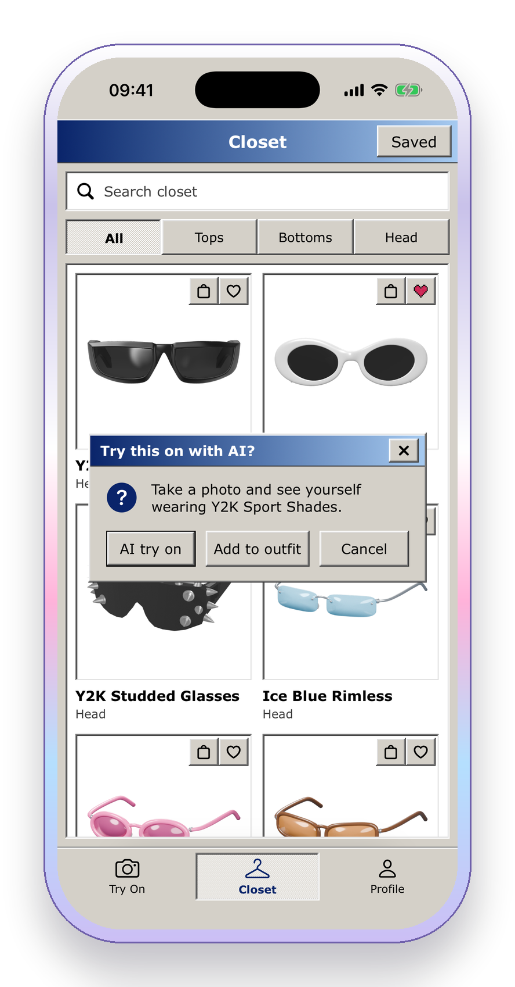
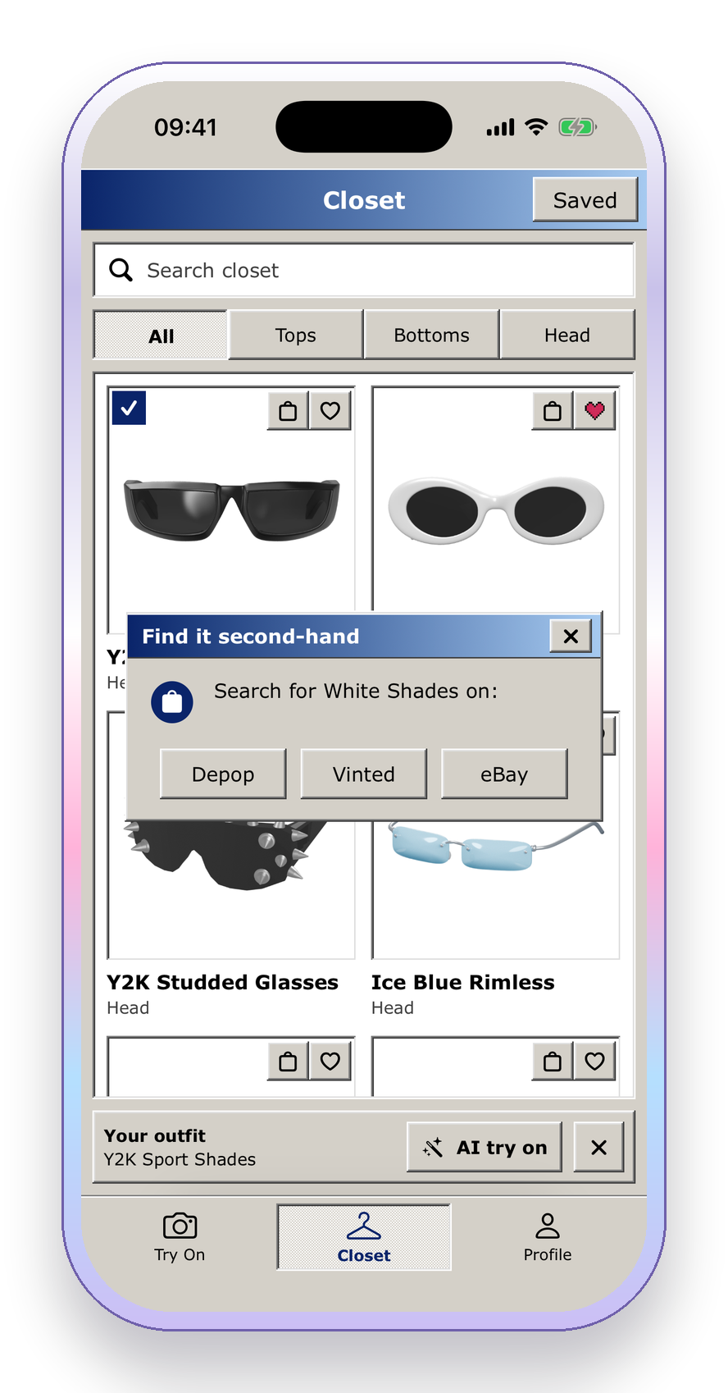
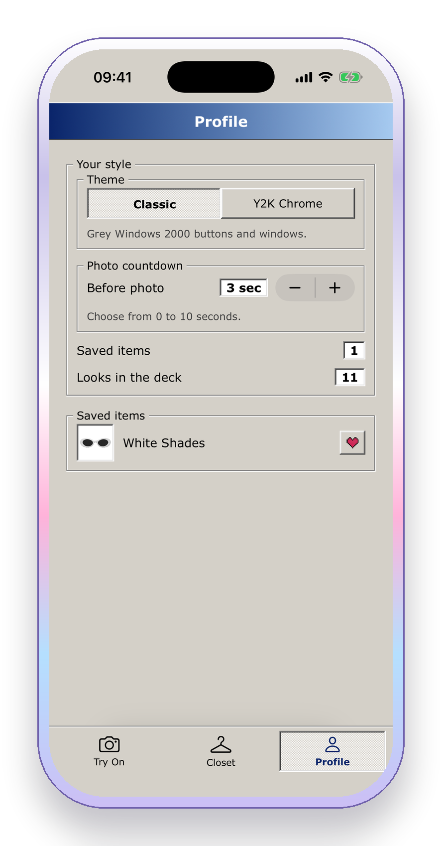
Prefer it Classic?
Classic closet
Windows dialogs
Same shops
One switch
Grey bevelled buttons and windows
The same AI try-on, Windows 2000 style
Depop, Vinted or eBay, still one tap
Flip between the two themes any time
Notes:
THEO (about 15 seconds)
Not into Y2K? One tap on Profile and the whole app switches to our original Classic Windows 2000 look: the same closet, dialogs and shops.
Both themes are drawn by the same components, so every feature works in either one.
Raff built the engine behind all of this.

Slide 4




How we built it
iPhone app
Vercel function
fal.ai try-on
SwiftUI, ARKit and RealityKit
TypeScript. Keeps the AI key off the phone
Renders you wearing the piece
Photos go up, the rendered picture comes back, with live queue progress on the way
Live AR try-on
Our own design system
Second-hand search
ARKit tracks your face. USDZ glasses, and hats we modelled in Blender, are fitted to your eyes and head every frame.
A Windows 2000 component kit that also draws Y2K Chrome. Swift Observation restyles every screen the moment you switch.
Every garment has its own search phrase. One tap opens it on Depop, Vinted or eBay, in the shop's app if you have it.
Notes:
RAFF (about 50 seconds)
RetroFit is a native SwiftUI app.
Live try-on uses ARKit face tracking with RealityKit. The USDZ glasses, and the hats we modelled in Blender, are fitted to your eyes and head every frame.
For AI try-on the phone never holds the API key. It sends the photos to our Vercel function, which checks an app token and queues the job on fal.ai's virtual try-on model. The app polls it for progress, which is why you see a buffering bar with your place in the queue.
We built our own design system, so the same components draw both the Classic and the Y2K Chrome theme.
And Find it turns each garment's own search phrase into a Depop, Vinted or eBay search, opening the shop's app if you have it.

Slide 5



Thank you!
LIVE DEMO
Theo Rook · Rafferty Carter-Lazenbury
RetroFit · HackNotts '26
Notes:
RAFF (about 20 seconds)
That's RetroFit: try it on, then find it second-hand.
Thanks for listening. Let's try it on.
Hand the phone to Theo for the live demo: AR glasses, then an AI try-on, then Find it.

