Slide 1
Web framework for Systemic Lupus Erythematosus (SLE) project using Flask
Theodor Rumetshofer
BINP29 project
2020-03-16

Slide 2
Background information
Systemic Lupus Erythematous (SLE) is a very rare autoimmune diseases with heterogeneous symptoms and needs differential diagnostic
Therefore, interdisciplinary research is necessary and different information are collected for the cohort in Lund¹, e.g. blood samples, MRI abnormalities and cognitive tests
Different radiologists, rheumatologists, psychologists and researchers are working with these dataset
==> Need for a central “database” to store, filter and receive data
1 https://portal.research.lu.se/portal/en/projects/advanced-mri-in-sle-and-correlation-to-cognitive-function(ed329e2c-cd39-48a9-9f92-4a60f840cbbb).html

Slide 3
Material and Methods I
Start
Login
Control
Queries
Output
Goal: every collaborator should have access to the dataset by filtering information and receive an output (csv-file).
First approach: instead of a real database, a manually curated csv-file saves all the information
Features: - Login: only collaborators have access - Queries: search only for that information that is of interest - Control: results of the csv-file queries - Output: download the selected queries in a csv-file
Notes:
Situation now: sending excel sheets
First step a CSV file, but in the near future a relational database → project is growing
Features
Which features does it have? 4. Explain the methodology and technology you used (which language you used and why? What is your experience with this technology?)

Slide 4
Material and Methods II
=> Software packages used:
Python/Flask: framework to integrate python code in web browser
WTForms: webforms and fields
Jinjia2: used to customize filters and texts
=> Tested for simple queries
=> Tested for invalid input
Notes:
Why flask and not django? Very easy to implement for the first approach
Flask renders a template into into HTML code
What tests did you do? How robust is your tool? How did you test it?

Slide 5
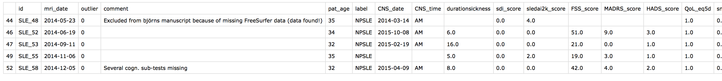
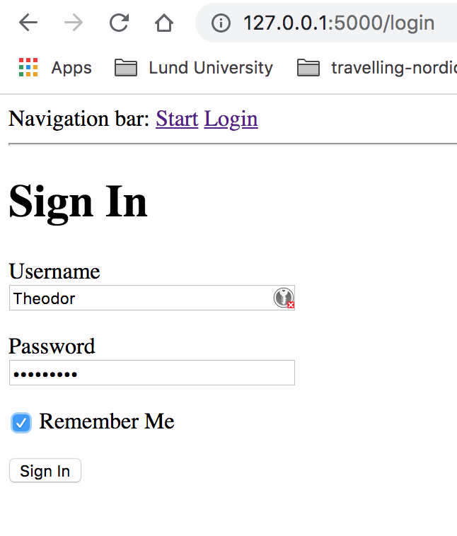
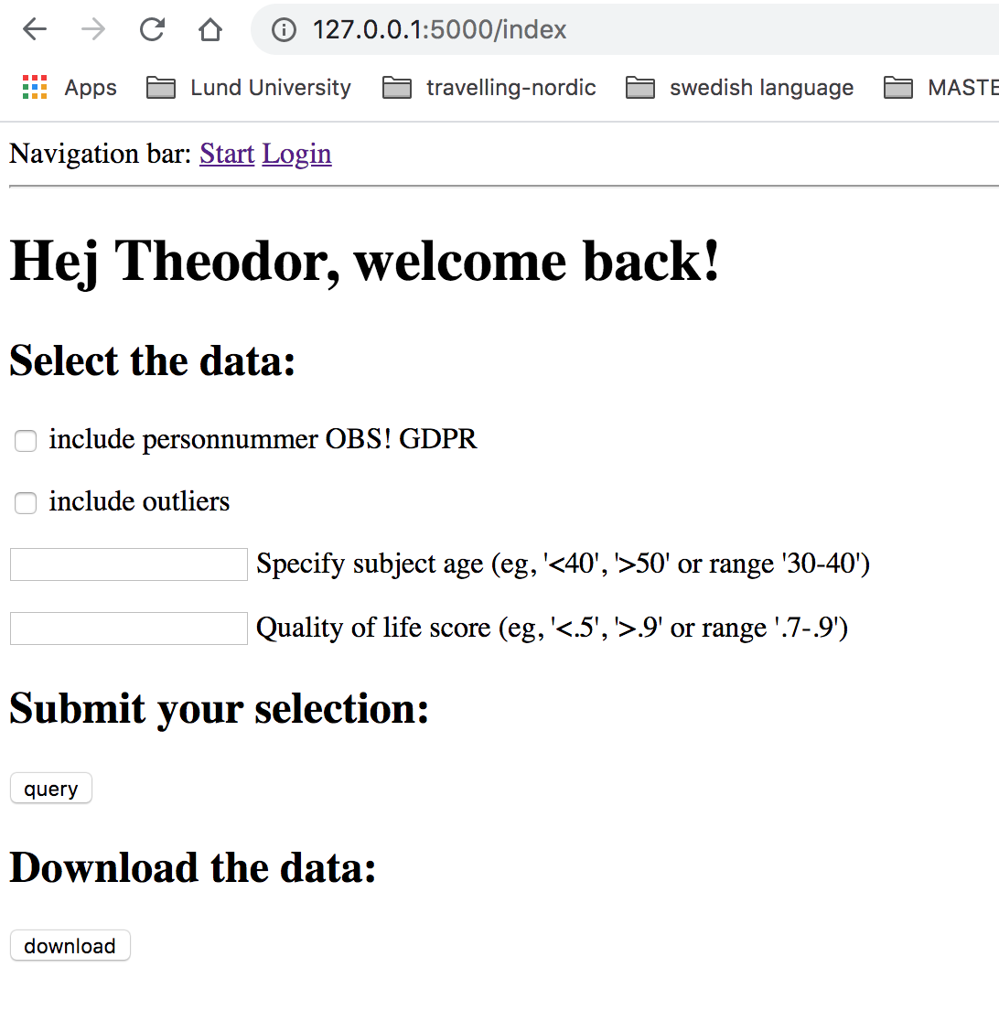
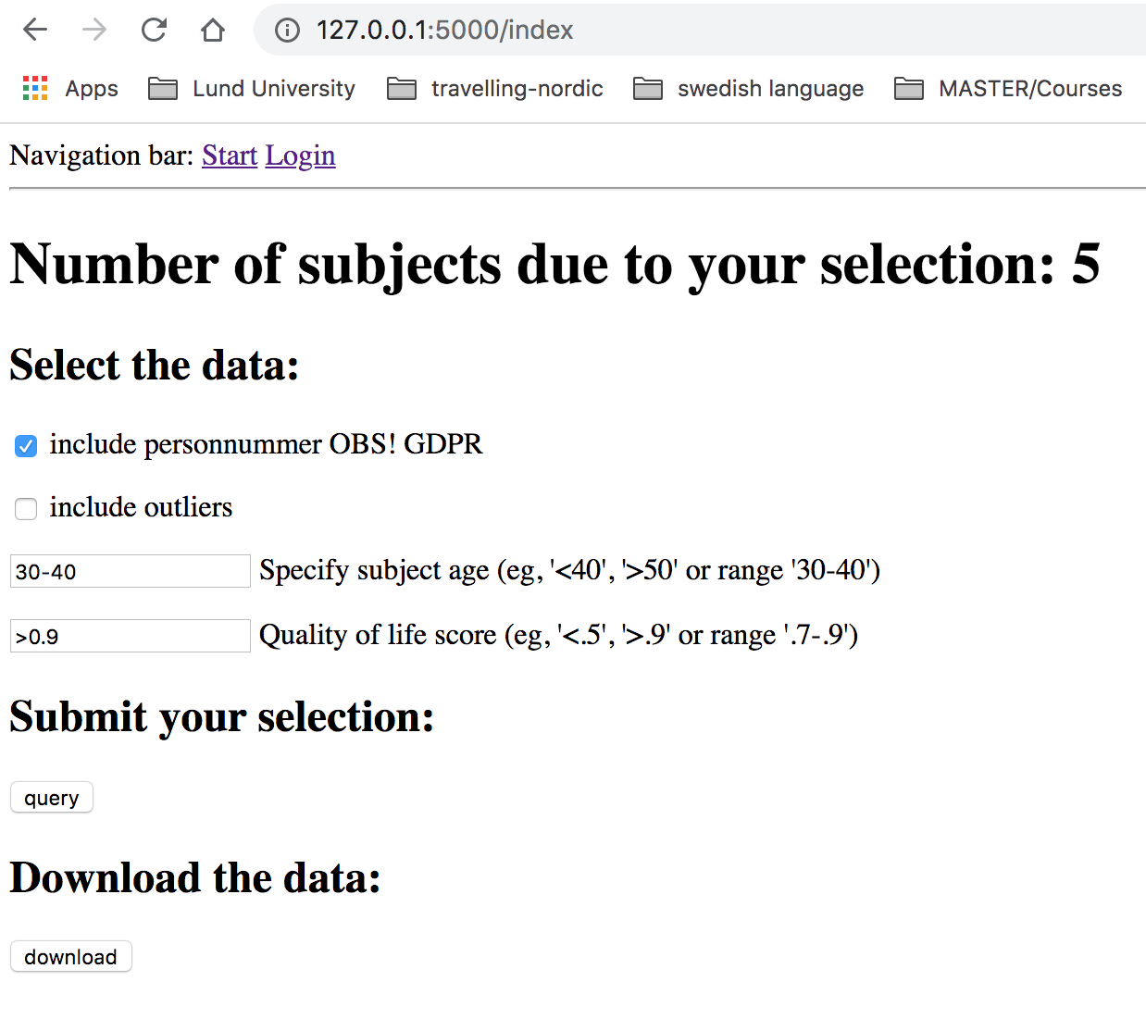
Results
Notes:
It is very rudimentary and not very pretty code but it is the first approach AND it works!

Slide 6
Discussion
+ user login (collaborators only)
+ filtering using webforms
+ queries with status update (number of subjects)
+ output as csv-file
no real users database implemented yet
just few filters applied
relational database instead of csv-file
Notes:
Overview of the things that were implemented

Slide 7
Outlook
=> First approach to handle the data and queries
=> Flask is
… easy to install and implement BUT … requires knowledge of different languages and packages (!) … just a development server … later real productive environment
Notes:
WHAT HAVE I LEARNED new and what was challenging!
5. Discuss the results and your experience (How useful are these results? How challenging was your project? What did you learn?)
OBS! Flask is just a very quick development server BUT it should not be used for real production environment. see here for solutions:
https://flask.palletsprojects.com/en/1.0.x/deploying/
MENTION THE THINGS THAT YOU CAN IMPROVE IN THE NEXT STEPS

