Slide 1
ELECTROCATALYSISDB
ElectroCatalysisDB:
From Cyclic Voltammetry
Data to Structured SQL-Based Insight
Building a relational database from Pt and Au cyclic-voltammetry measurements
Python · Pandas · SQLite · SQL · Matplotlib · Seaborn · Jupyter
Theophilus Kobina Sarpey

Slide 2
The Problem: Scientific Data Are Not Analysis-Ready
Raw Scientific Data from echemdb
Heterogeneous metadata
Materials: Ag, Au, Co, Cu, Fe, Ir, Ni, Pb, Pd, Pt, Rh, Ru
→ Multiple levels of data
(One experiment →
thousands of CV points) →
Need for structure
Different fields
Different studies
Different metadata
Different conventions/representations
Varied Experimental conditions
Non-uniform measurement parameters
Data-Science Problem
How do we turn this into something we can query reliably?
echemdb → Python extraction → Clean → Normalize → Relational table → Database → SQLite → SQL Queries/Analysis → Python visualization → Interpretation/Insight
The datasets on the echemdb.org website are licensed under CC BY 4.0.
2

Slide 3
Dataset → Scope → 207 Measurements
Filtering = reproducible data selection
echemdb v 0.9.2 | 93 references, 358 entries
Pt + Au electrodes | 62 references, 270 entries
Single-crystal working electrodes | Orientations: (100), (110), (111)
FINAL DATASET | 207 CV measurements 704,968 digitized CV points
Why this scope?
Pt/Au + single crystals + three orientations
The final dataset represents the literature records available in echemdb that match the project scope.
3

Slide 4
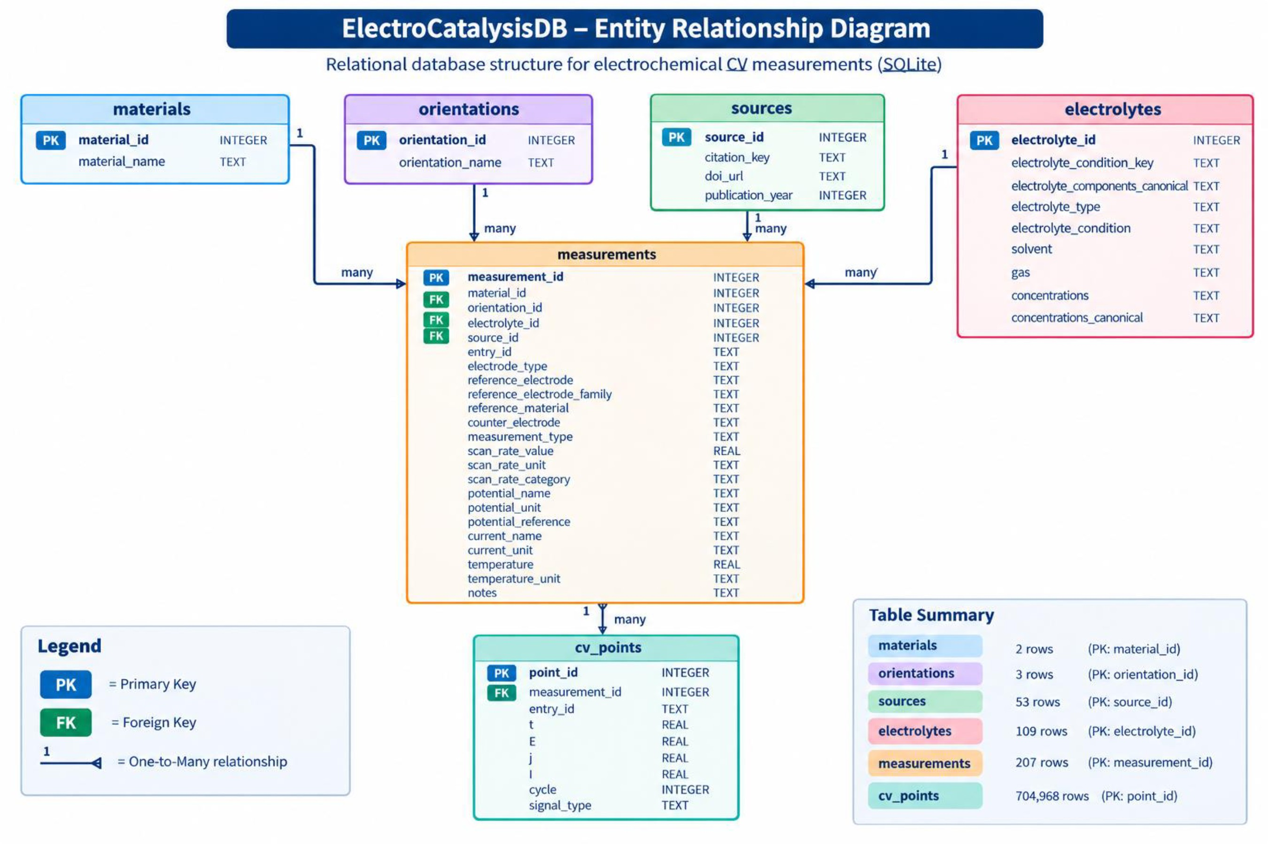
From Raw Data to a Relational Database
Relational structure
The key modeling decision
One row ≠ one CV point
Separate experimental identity from experimental observations.
1 measurement
Pt(111)
0.1 M HClO₄
50 mV/s
1,773 CV points
Measurement metadata
Material + orientation
Electrolyte condition
Experimental parameter
4

Slide 5
Cleaning, Transformation & Feature Engineering
01
02
03
Cleaning
Transformation
Normalization
Raw metadata
Standardized text
Canonical electrolyte conditions
Clean concentration fields
Scan_rate_value
Scan_rate_category
≤ 10 mV/s → Low
> 10 to ≤ 50 → Medium
> 50 to ≤ 100 → High
Repeated categorical information
Lookup tables:
materials
orientations
sources
electrolytes
IDs stored as foreign keys in measurements
Missing scientific metadata were retained as missing information, rather than imputed values that
Were never reported
5

Slide 6
RQ1 - What Does the Dataset Represent?
How are Pt & Au single-crystal CV measurements distributed across crystallographic orientations?
SQL → aggregated dataset → Pandas → visualization
Aggregated measurement counts
material_name | orientation_name | measurement_count | index
Au | 100 | 8 | 0
Au | 110 | 3 | 1
Au | 111 | 31 | 2
Pt | 100 | 11 | 3
Pt | 110 | 9 | 4
Pt | 111 | 95 | 5
The distribution describes dataset repre-
sentation, not intrinsic electrochemical
activity
6

Slide 7
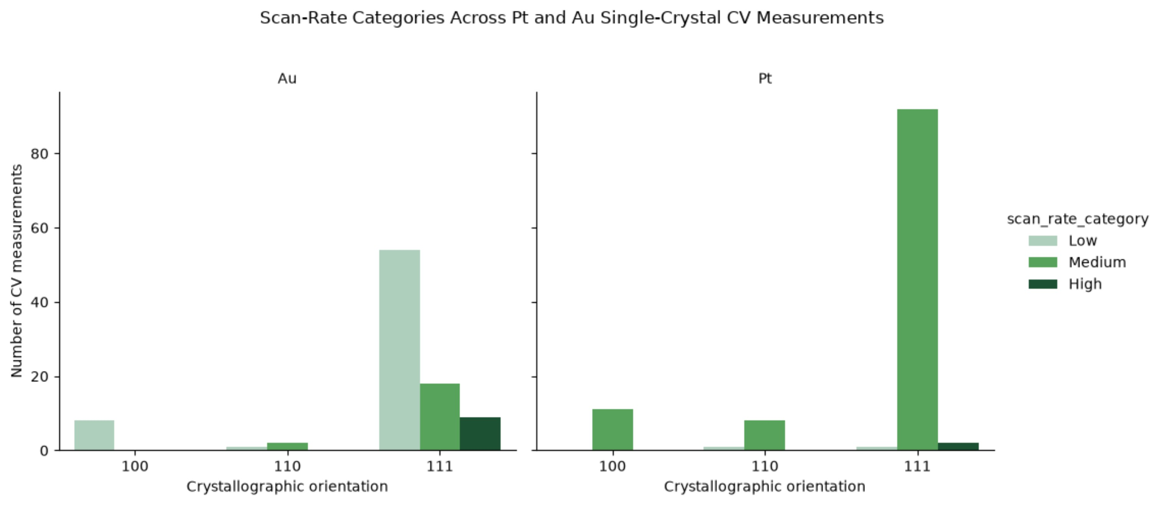
RQ2 - How Do Experimental Conditions Vary?
How do reported scan rates vary across Pt and Au single-crystal electrodes and their crystallographic orientations?
Raw:
Scan-rate categories
10, 20, 50, 100, …
Feature engineering:
Low | Medium | High
SQL:
GROUP BY
Material
Orientation
Scan_rate_category
Python:
Experimental scan-rate conditions vary across the material-orientation combinations represented in the dataset.
Visualization
Scan rate is an experimental condition, not a performance metric.
8

Slide 8
RQ2 - How Do Experimental Conditions Vary?
How do reported scan rates vary across Pt and Au single-crystal electrodes and their crystallographic orientations?
Material · orientation · scan-rate category
index | material_name | orientation_name | scan_rate_category | measurement_count
0 | Au | 100 | low | 8
1 | Au | 110 | low | 1
2 | Au | 110 | medium | 2
3 | Au | 111 | high | 9
4 | Au | 111 | low | 54
5 | Au | 111 | medium | 18
6 | Pt | 100 | medium | 11
7 | Pt | 110 | low | 1
8 | Pt | 110 | medium | 8
9 | Pt | 111 | high | 2
10 | Pt | 111 | low | 1
11 | Pt | 111 | medium | 92
Experimental scan-rate conditions vary across the material-orientation combinations represented in the dataset.
9
Raw values become queryable categories: low, medium and high.

Slide 9
Validation, Data Quality & What We Learned
Database validation
What did I learn?
207 measurements
704,968 CV points
0 FK errors
Integrity: OK
Good scientific data analysis requires both domain knowledge and data engineering
Data quality
Current metadata are heterogeneous
Raw current and current density are not directly comparable across all records
Missing metadata were retained rather than invented
Reproducible pipeline
The main result is a reproducible pipeline that takes heterogeneous
Scientific data and turns it into structured, queryable data.
Thank you!
10

