Slide 1
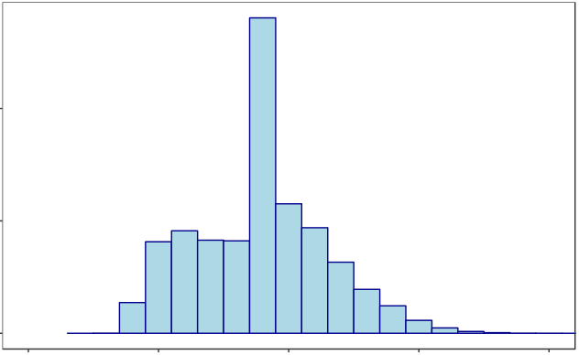
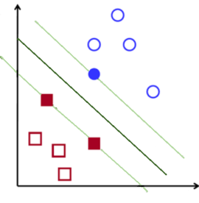
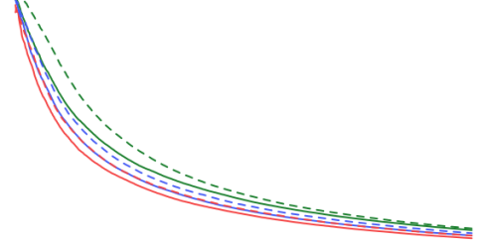

Retention campaign
Historical data
Data mining
Machine learning
Prediction
New data
Visualization
Model evaluation
Model selection
Feature selection

