Slide 1
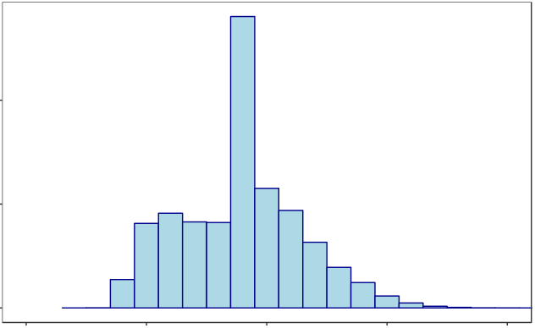
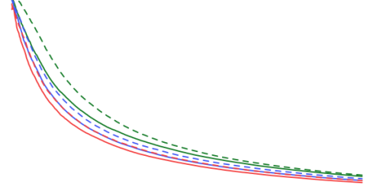
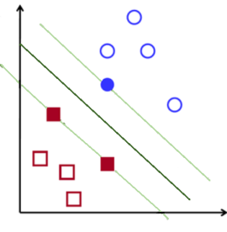

Historical data
Visualization
Data mining and
understanding
Model evaluation
Machine learning
Model selection
Predictions
Campaign on target and control group
Feature selection
New data

