Slide 1
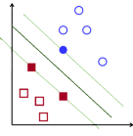
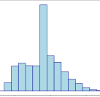
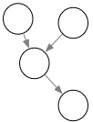

Data warehouse update
Orange historical customer data
Validation
Predictive models
Data understanding
Causal models
Intervention variables
List of potential churners
Retention campaign

