Slide 1
Mobile Application for Landmark Identification
Prof. dr. Dalia Čalnerytė
Supervisor
Team MT1

Slide 2
What are we building and what was done
A mobile-first AI system that can recognize Lithuanian landmarks from a single smartphone photo.
Key goals
Lightweight model that runs fast to recognize landmarks
High accuracy on real photos
Full system: data → model → backend → mobile
Full ML pipeline integrated with PostgreSQL backend
2

Slide 3
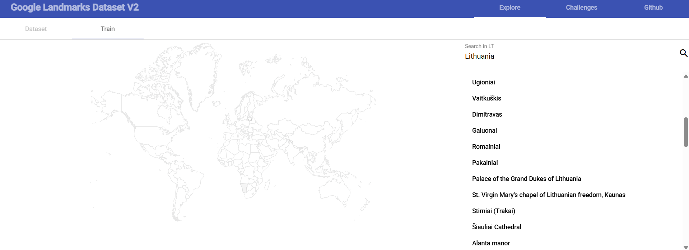
Data Pipeline (GLDv2 Lithuania)
Source: Google Landmarks Dataset v2
Queried Lithuanian landmarks only (saved in /data/gldv2_lithuania.json)
Scripts implemented:
  query_gld_v2.py → get landmark IDs & image counts
  fetch_metadata.py → download per-landmark metadata
  create_split.py → build train/val/test splits
  gldv2_dataset.py → efficient data loader with caching
3

Slide 4
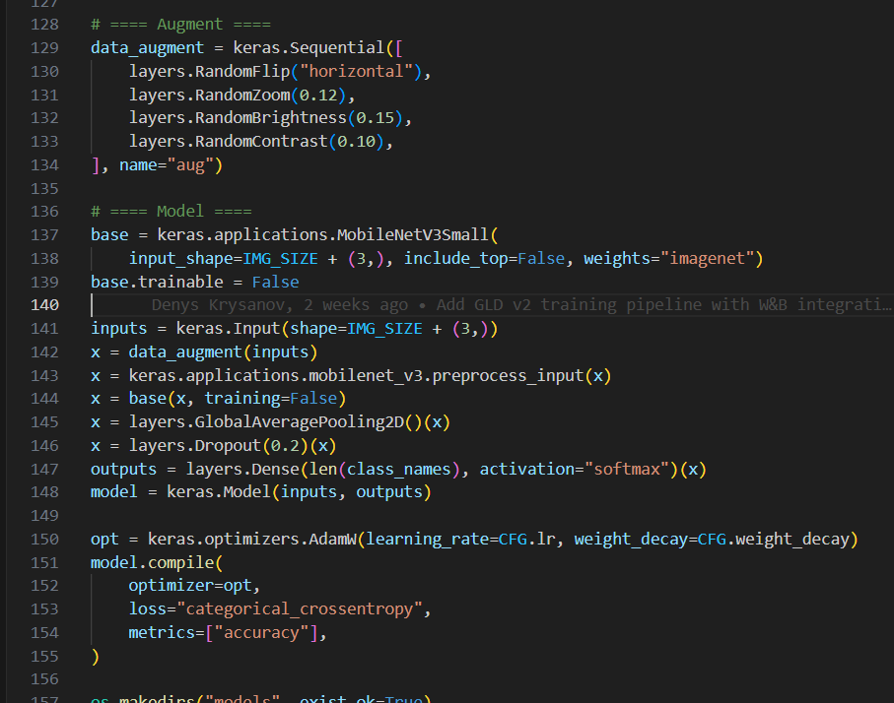
Model Overview
Our system uses a MobileNetV3-Small backbone pretrained on ImageNet.
On top, we added a custom classification head:
GlobalAveragePooling
Dropout
Dense softmax classification layer
Additional elements:
Data augmentation: flip, zoom, brightness, contrast
Loss: categorical cross-entropy with label smoothing
Class weights to handle dataset imbalance
Why MobileNetV3-Small?
Lightweight, efficient, and optimized for mobile deployment (TFLite-friendly).
Figure 1 Model overview
4

Slide 5
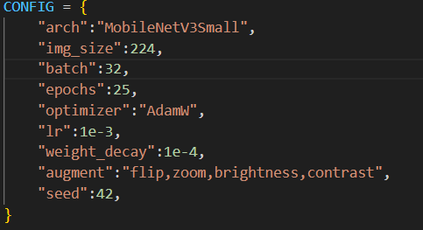
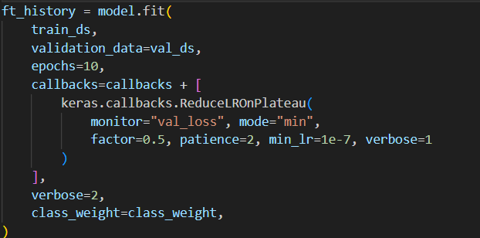
Model Training Configuration
Initial Training Configuration
Learning rate is set to 1e-3
Base model (MobileNetV3Small) is frozen
Only the newly added dense layers are trained
Number of epochs is set to 25
Fine-tuning Phase:
Uses a lower learning rate of 3e-6
Unfreezes the base model
Runs for 10 additional epochs
Uses learning rate reduction on plateau:
  Reduces LR by 50% if no improvement for 2 epochs
  Minimum LR: 1e-7
Uses AdamW optimizer for both initial training and fine-tuning
Figure 2 Model training configuration
Figure 3 Fine Tuning
5

Slide 6
Exporting for Mobile Deployment (TFLite)
TFLite Models Generated
FP32 TFLite:
landmark_mnv3_fp32.tflite
INT8 (quantized) TFLite:
landmark_mnv3_int8.tflite
Backend receives image → resizes → calls Python → returns top-3 predictions
React Native app -> Captures photo -> Sends to backend -> Displays landmark name + confidence
6

Slide 7
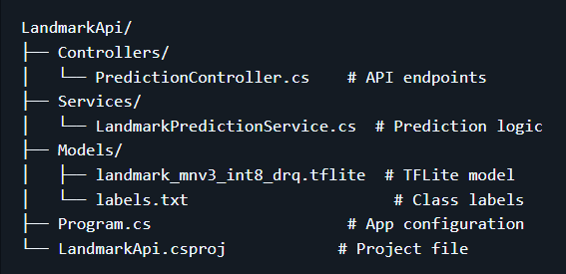
System Architecture - Backend API
Overview
Framework: ASP.NET Core 8.0 Web API
Model: TensorFlow Lite INT8 (1.12 MB)
Image Processing: SixLabors.ImageSharp
Inference: Python TFLite interpreter (subprocess bridge)
Architecture
Exposes POST /api/prediction endpoint
Validates image format and size
Calls Python TFLite process asynchronously
Returns JSON response with:
  Top-3 labels
  Confidence scores
Stores prediction history in PostgreSQL
Exposes /api/prediction/history endpoint
Figure 4 Project structure
7

Slide 8
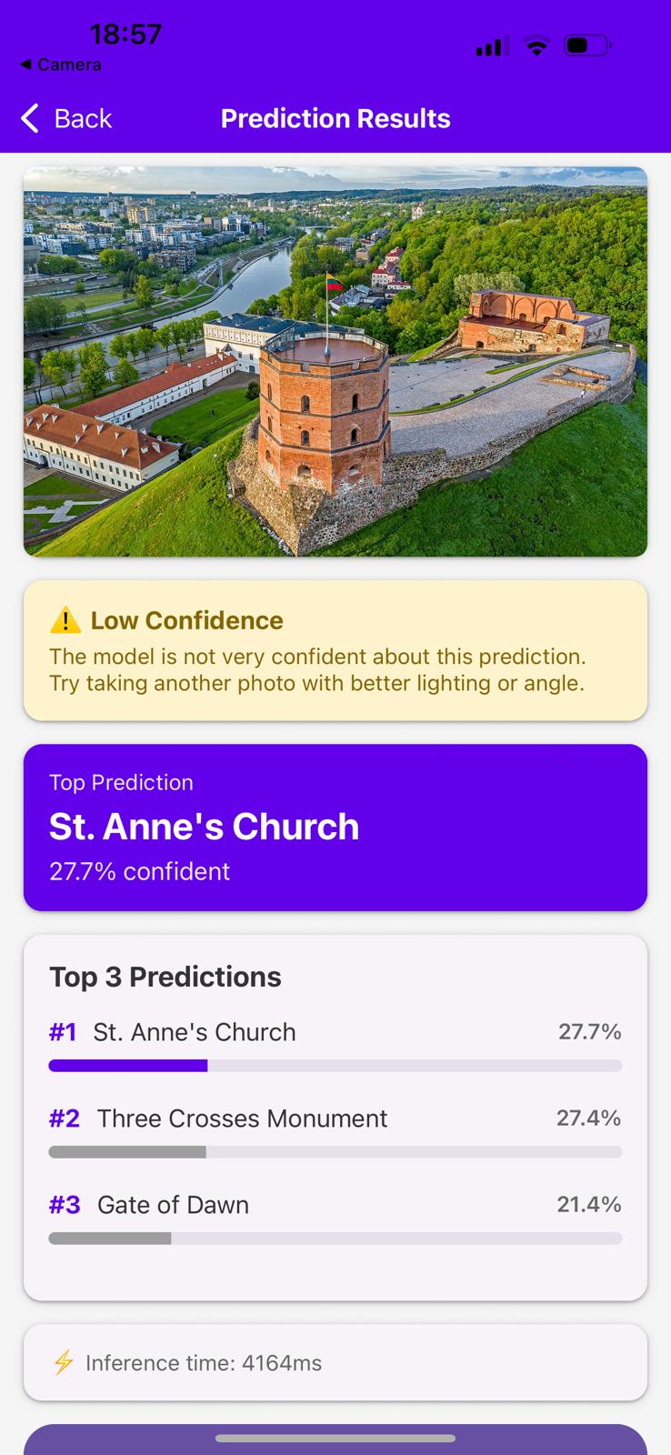
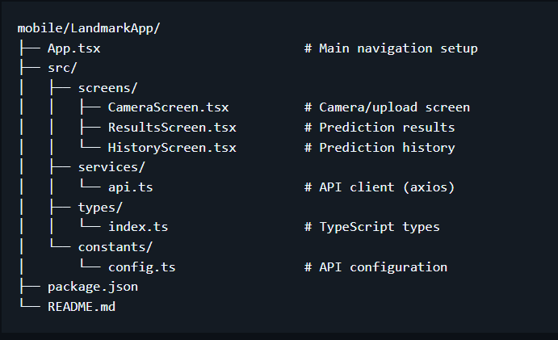
System Architecture
Mobile App (React Native / Expo)
Lets user pick or capture an image
Sends the image to backend via HTTP POST
Receives top-3 landmark predictions
Displays predictions & confidence
Handles timeouts and API errors
Figure 5 Project structure
Figure 6 Current UI
8

Slide 9
9

Slide 10
Future Work
Improve Model Accuracy
2) Better Dataset
3) Integrate Wikipedia Information
  Use Wikipedia API to fetch:
    Short landmark descriptions
    History summary
    Official page link
  Add Wikipedia link to API response
  Display nicely in the frontend
4) Frontend Improvements
10

