Slide 1
PYTHON FOR DATA ANALYSIS
Household power consumption
Paul Malaud, Theophile Jegou du Laz, DIA5

Slide 2
DATASET CHARACTERISTICS
Name :
Household power consumption
Source of sampling :
one household in Sceaux, France
Sampling rate :
every one minute
Sampling Period :
4 years
Nb of lines:
~ 2 million
Source of dataset :
EDF Researcher & EDF Engineering Intern

Slide 3
DATASET CHARACTERISTICS
date
day-month-year
time
hour:minute:second
Global_active_power
active energy consumed every minute (in watt hour)
Global_reactive_power
reactive energy consumed every minute (in watt hour)
9 variables
Voltage
Voltage
Global_intensity
Intensity (P=U x I)
Sub_metering_1
Kitchen (mainly dishwasher, an oven and a microwave)
Sub_metering_2
Laundry room (mainly washer, dryer, refrigerator)
Sub_metering_3
electric water-heater and an air-conditioner

Slide 4
DATA PREPROCESSING
?
Missing data
Replaced by their mean value
NaN
Date
Missing DateTime format
Date + Time as a DateTimeIndex
Time

Slide 5
DATA PREPROCESSING
Missing Temperatures
Web Scraping data in a time range
Temperatures.csv

Slide 6
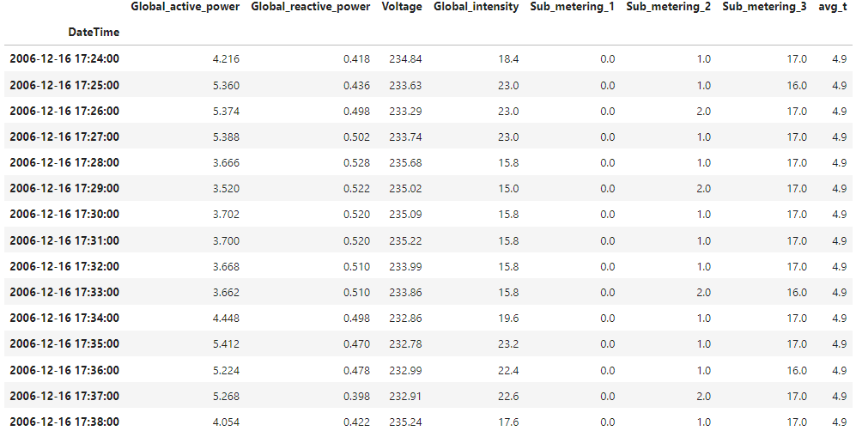
DATASET CHARACTERISTICS

Slide 7
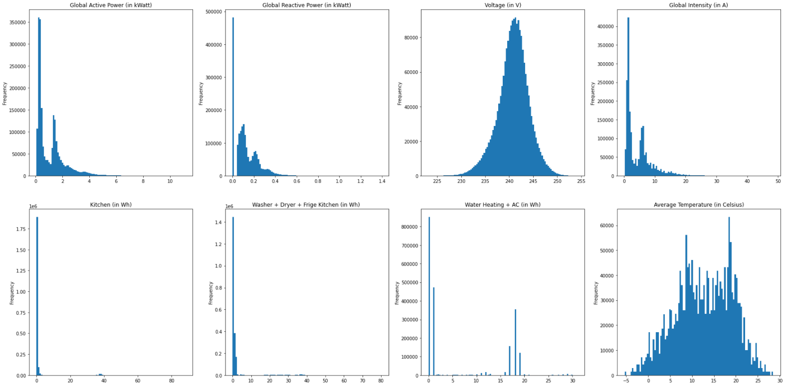
DATA VISUALIZATION
| VARIABLES RELATIONSHIPS
Distribution of all 7 variables

Slide 8
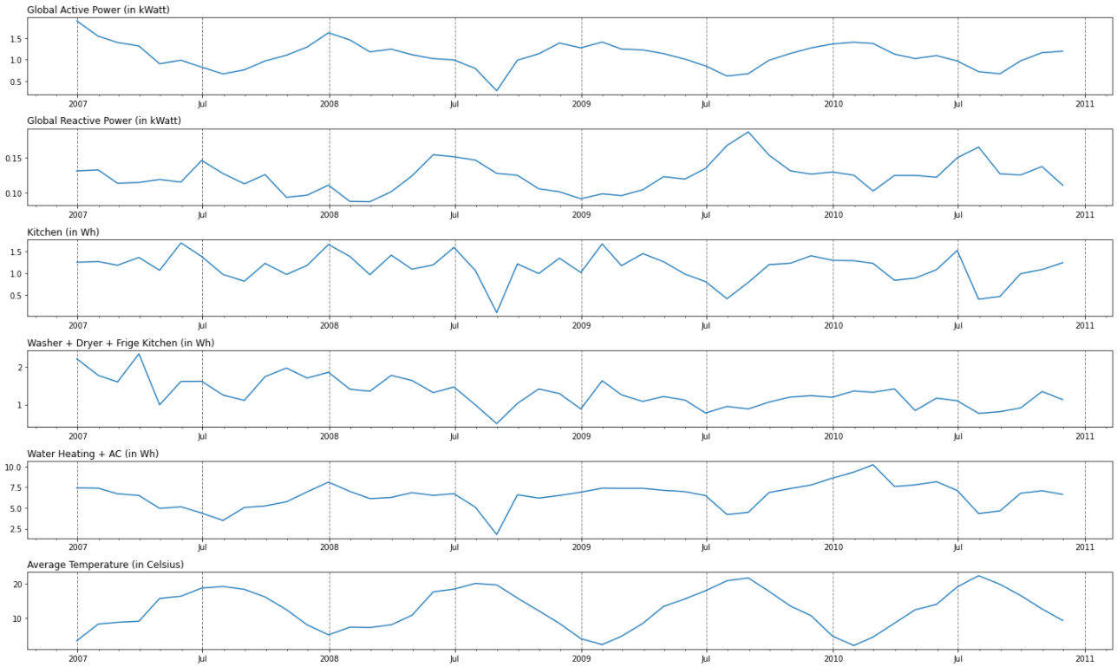
DATA VISUALIZATION
| VARIABLES RELATIONSHIPS
Monthly mean values of all variables

Slide 9
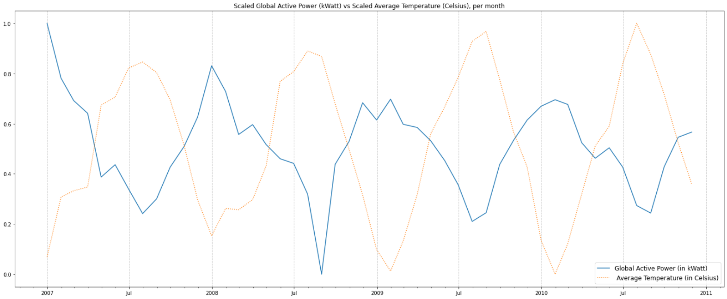
DATA VISUALIZATION
| VARIABLES RELATIONSHIPS
Scaled Monthly mean values of Global Active Power and Average Temperature variables

Slide 10
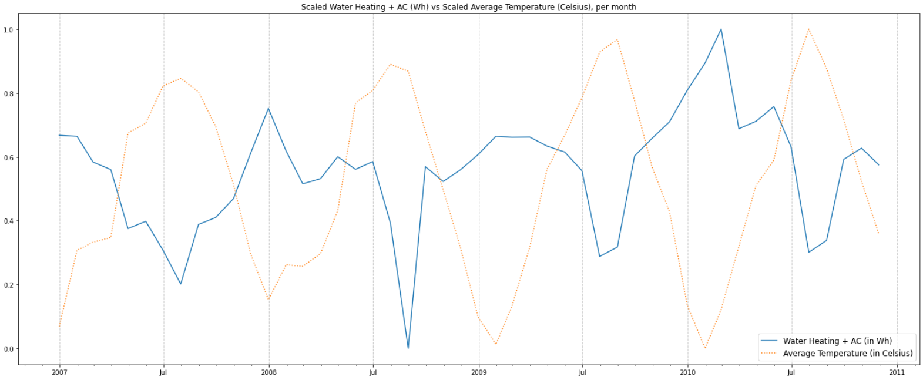
DATA VISUALIZATION
| VARIABLES RELATIONSHIPS
Monthly mean values of the Water Heating + AC and the Average Temperature

Slide 11
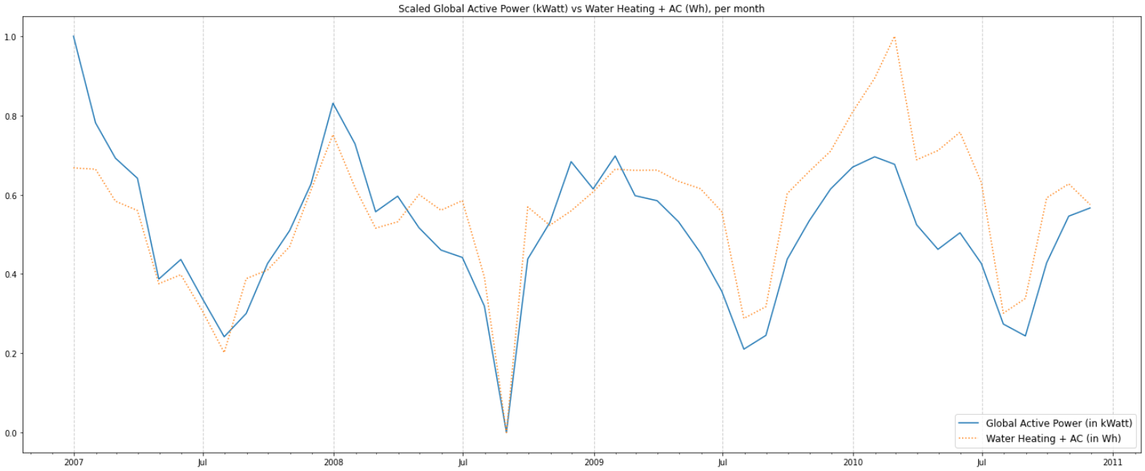
DATA VISUALIZATION
| VARIABLES RELATIONSHIPS
Monthly mean values of the Global Active Power and Water Heating + AC

Slide 12
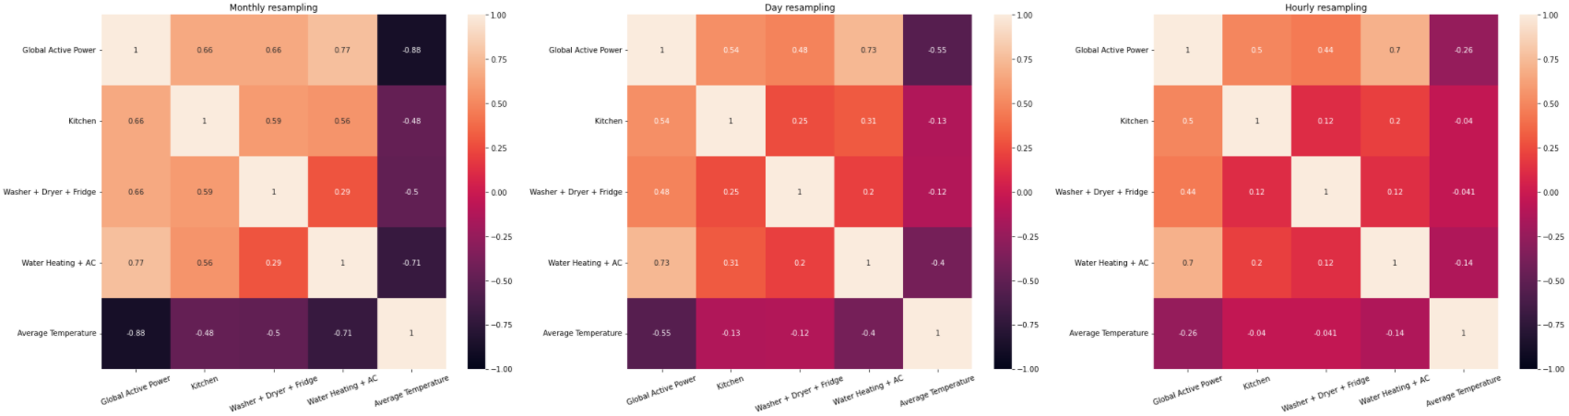
DATA VISUALIZATION
| VARIABLES RELATIONSHIPS
Correlation matrix of all resampled variables

Slide 13
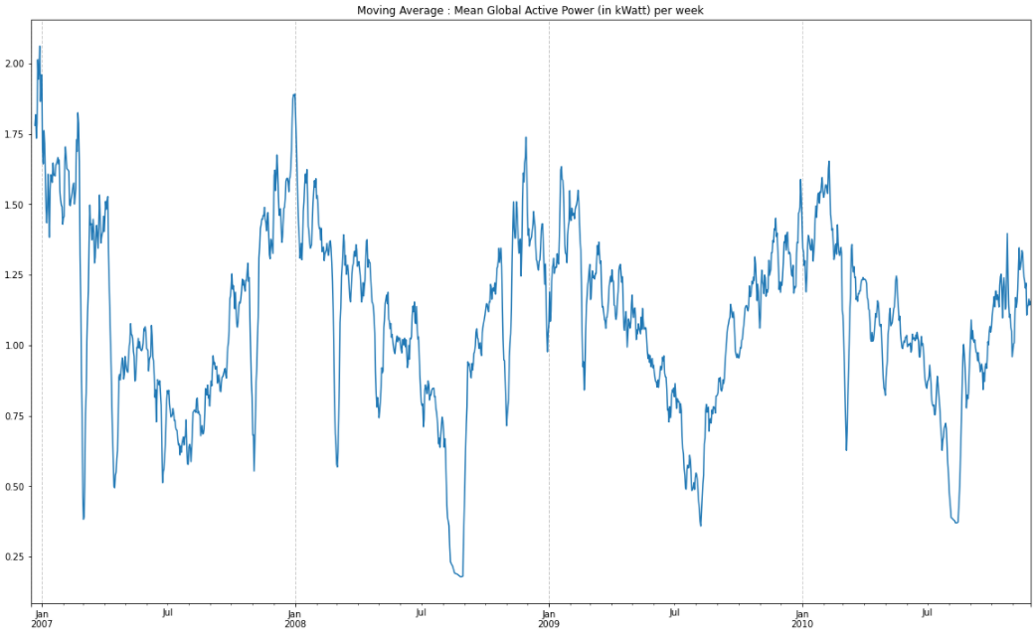
DATA VISUALIZATION
| Global_active_power
Daily moving average over the whole time period

Slide 14
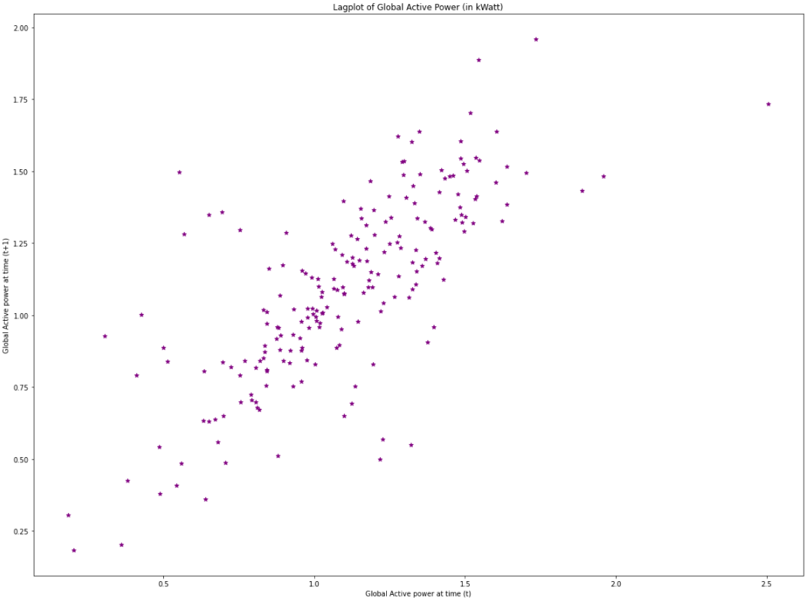
DATA VISUALIZATION
| Global_active_power
TIME SERIES ANALYSIS | Lag plot

Slide 15
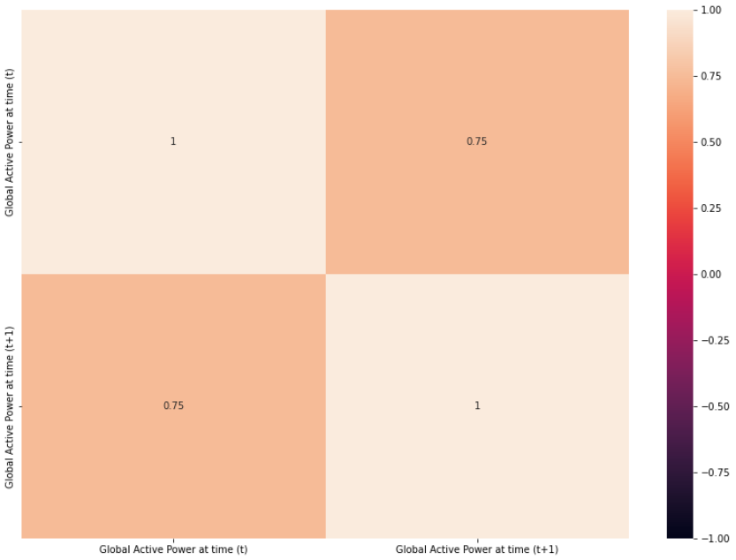
DATA VISUALIZATION
| Global_active_power
TIME SERIES ANALYSIS | Lagged variable correlation matrix

Slide 16
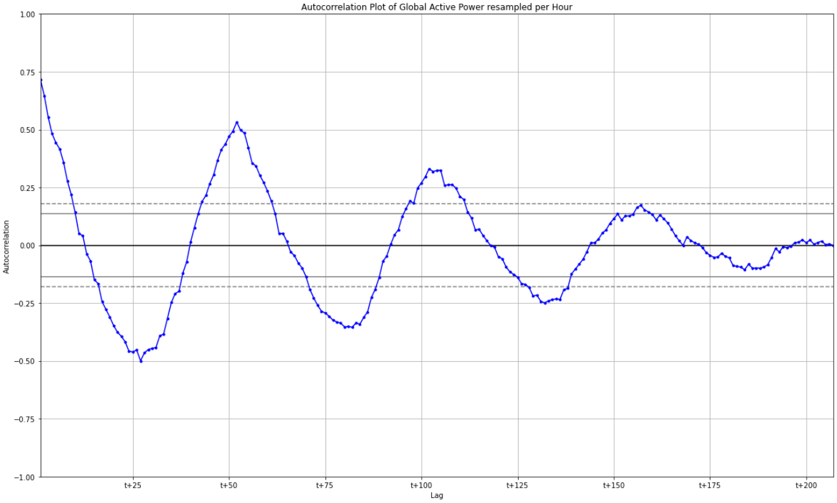
DATA VISUALIZATION
| Global_active_power
TIME SERIES ANALYSIS | Lagged variable correlation matrix

Slide 17
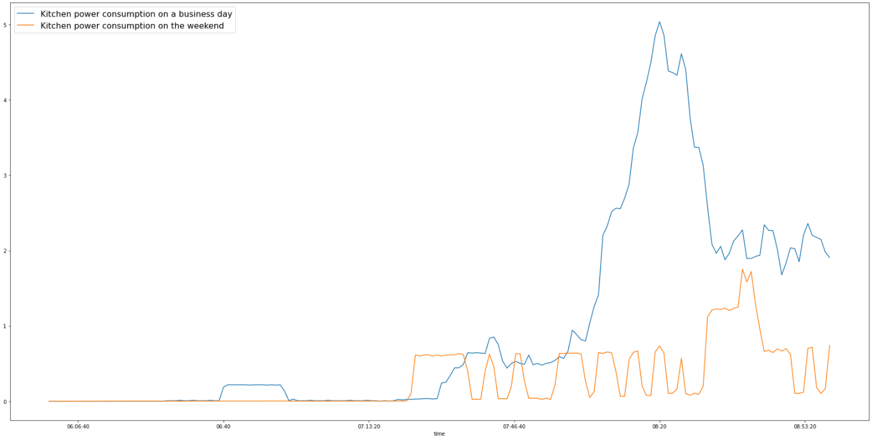
DATA VISUALIZATION
| Finding patterns and habits
Kitchen power consumption between 6AM and 9AM

Slide 18
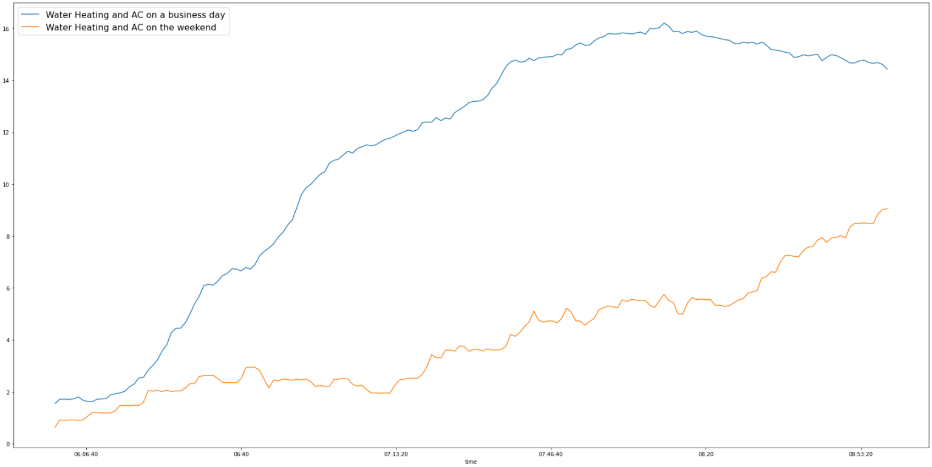
DATA VISUALIZATION
| Finding patterns and habits
Water Heating + AC between 6AM and 9AM

Slide 19
| Predicting Global Active Power (per week, day and hour)
MODELING
Autoregressive models (per Week):
AR
ARIMA
SARIMA
LSTM models :
Minutes
Hours
Days
Random Forest models :
Prediction of one timestamp
Forecasting of multiple timestamps

Slide 20
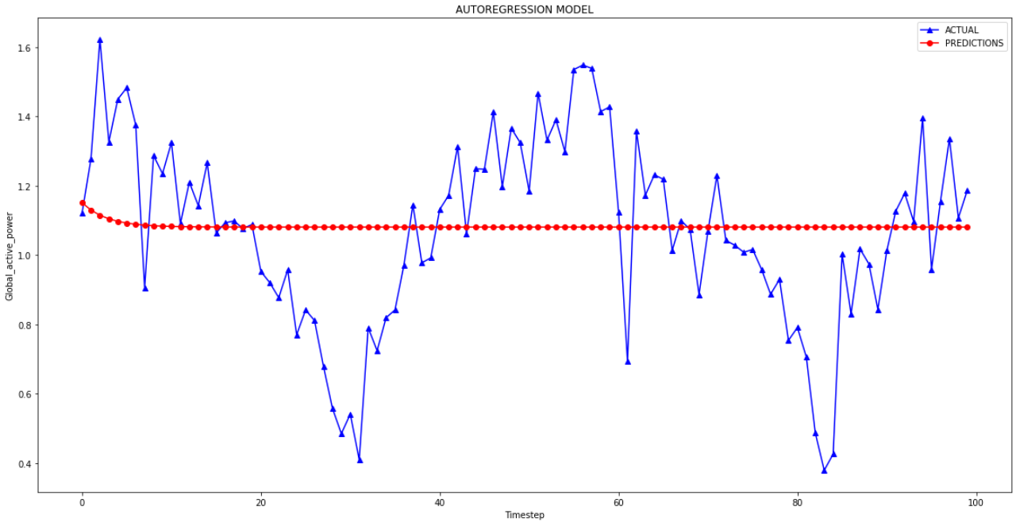
MODELING
| AR, ARIMA and SARIMA models

Slide 21
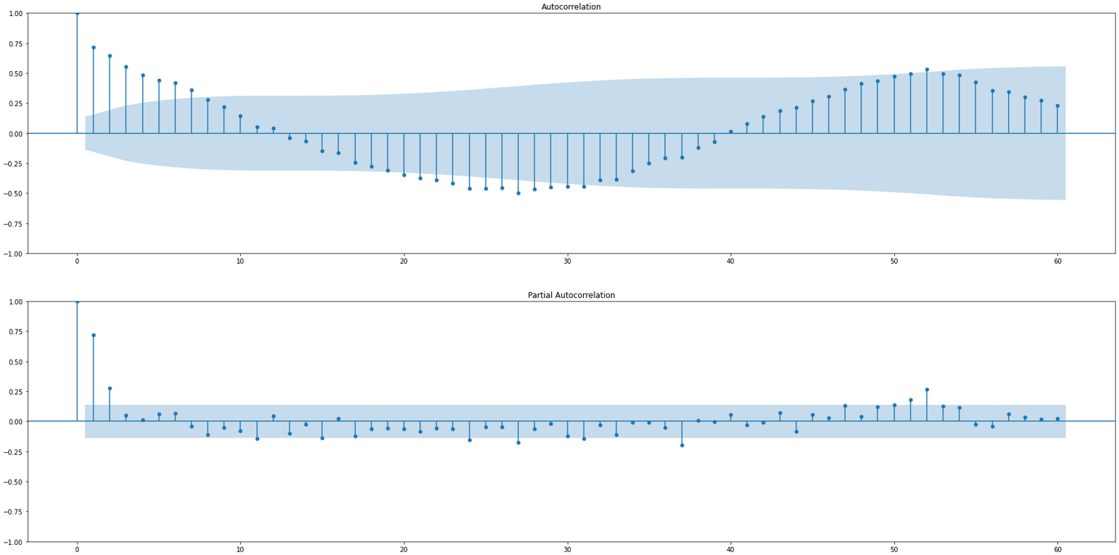
MODELING
| AR, ARIMA and SARIMA models
TIME SERIES ANALYSIS | Lagged variable correlation matrix

Slide 22
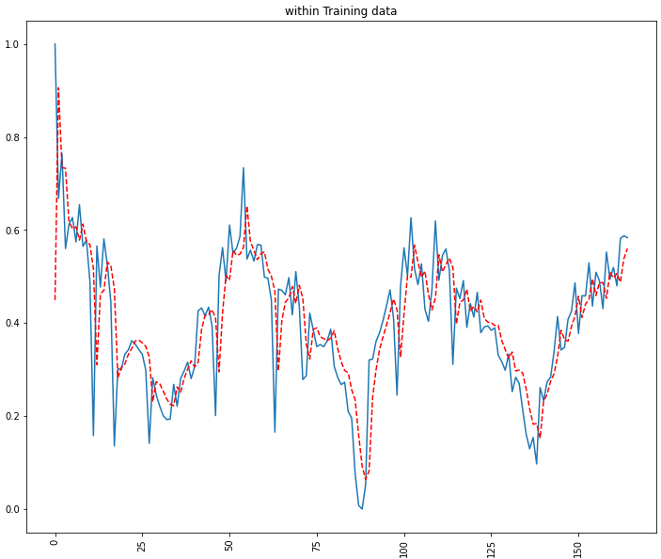
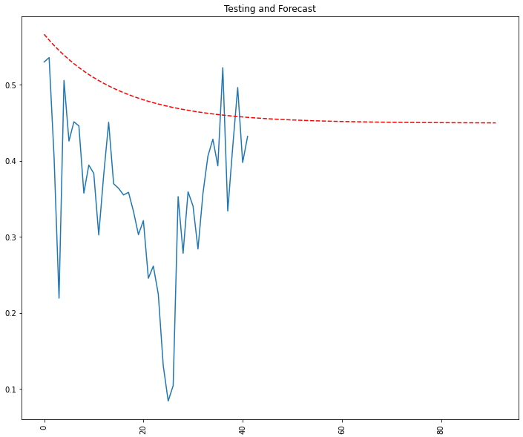
MODELING
| AR, ARIMA and SARIMA models

Slide 23
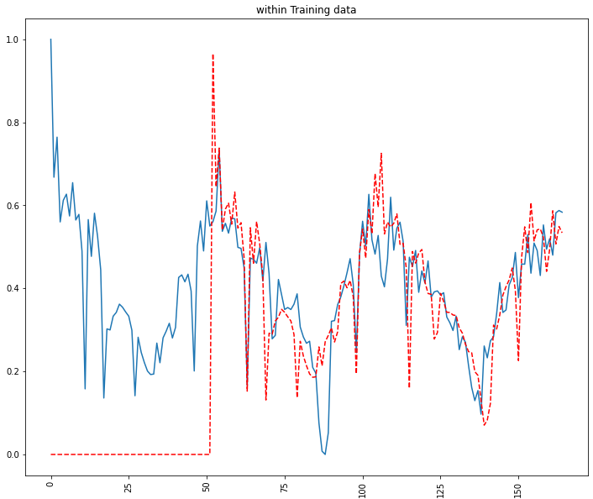
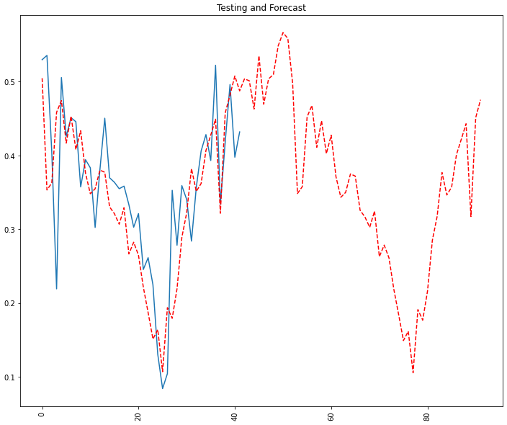
MODELING
| AR, ARIMA and SARIMA models

Slide 24
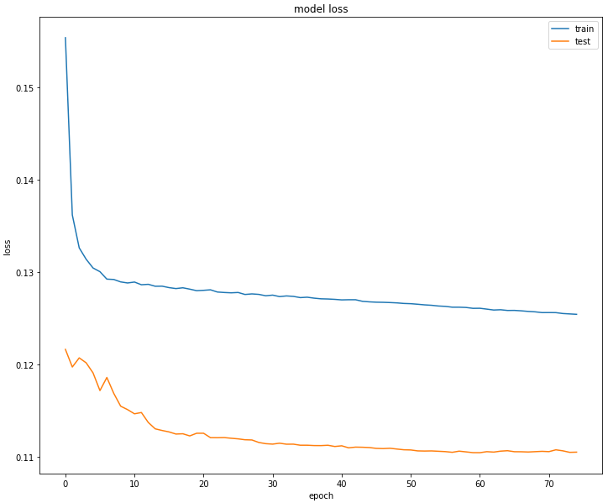
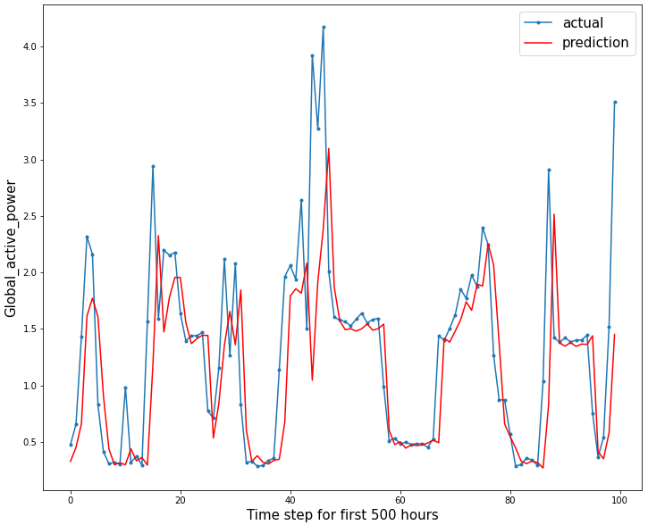
MODELING
| LSTM model

Slide 25
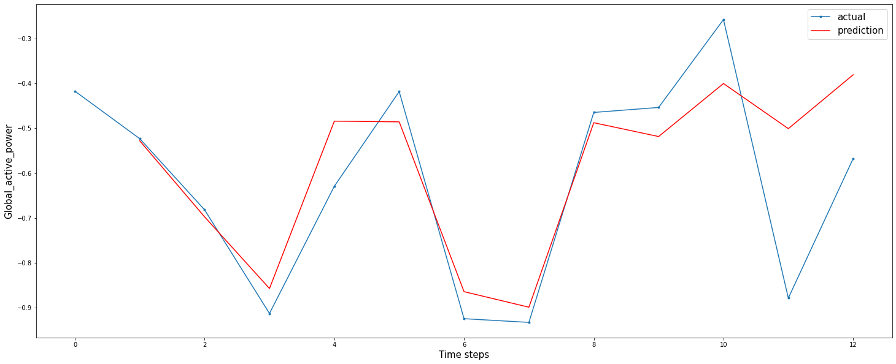
MODELING
| RANDOM FOREST model
Recursive forecast using values from the 04-05-2009 at 6AM

Slide 26
MODELING
| Summary
Conclusions

Slide 27
REAL WORLD APPLICATION
| using Flask
Demo

