Slide 1
Course Outline
CSE344 - Database Systems
Prerequisite: There is no prerequisite for the course.
Attendance: A minimum of 70% attendance to the lecture and laboratory hours is compulsory. Violation of this rule will result in an F2 grade.
Instructors: Prof. Dr. Murat Hacıömeroğlu (mhaciomeroglu@baskent.edu.tr)

Slide 2
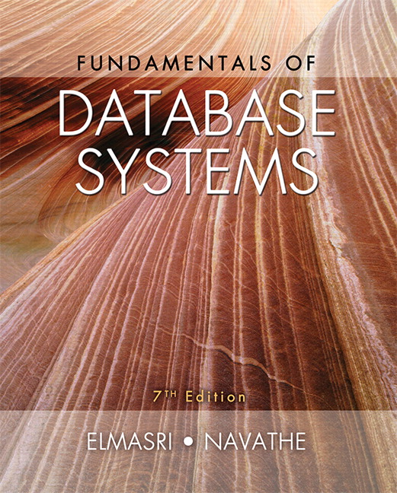
Course Outline
Textbook: Fundamentals of Database Systems (7th Edition) by Ramez Elmasri (Author), Shamkant Navathe (Author)

Slide 3
Course Outline
Week | Topics
1 | Introduction to course and database systems
2 | Entity Relationship (ER)
3 | Enhanced ER (EER) Model, Relational Data Model and Integrity Constraints.
4 | Relational Database Design by ER- and EER-to-Relational Mapping
5 | Relational Algebra
6 | Structured Query Language (SQL) – DDL subset of SQL
7 | Structured Query Language (SQL) – DML subset of SQL
8 | Public Holiday
9 | Midterm Exam Week (Subject to change according to the faculty regulations)
10 | Dependency Theory and Normalization
11 | Physical DB design (storage, file structures, and indexing)
12 | Project Presentations
13 | Project Presentations
14 | Introduction to Transaction Processing Concepts and Theory
15 | Project Presentations

Slide 4
Grading
Lab Activities and Quizzes (20%),
Final Project (25%),
Midterm Exam (25%),
Final Exam (30%)

Slide 5
CHAPTER 1
Databases and Database Users

Slide 6
OUTLINE
Types of Databases and Database Applications
Basic Definitions
Typical DBMS Functionality
Example of a Database (UNIVERSITY)
Main Characteristics of the Database Approach
Types of Database Users
Advantages of Using the Database Approach
Historical Development of Database Technology
Extending Database Capabilities
When Not to Use Databases

Slide 7
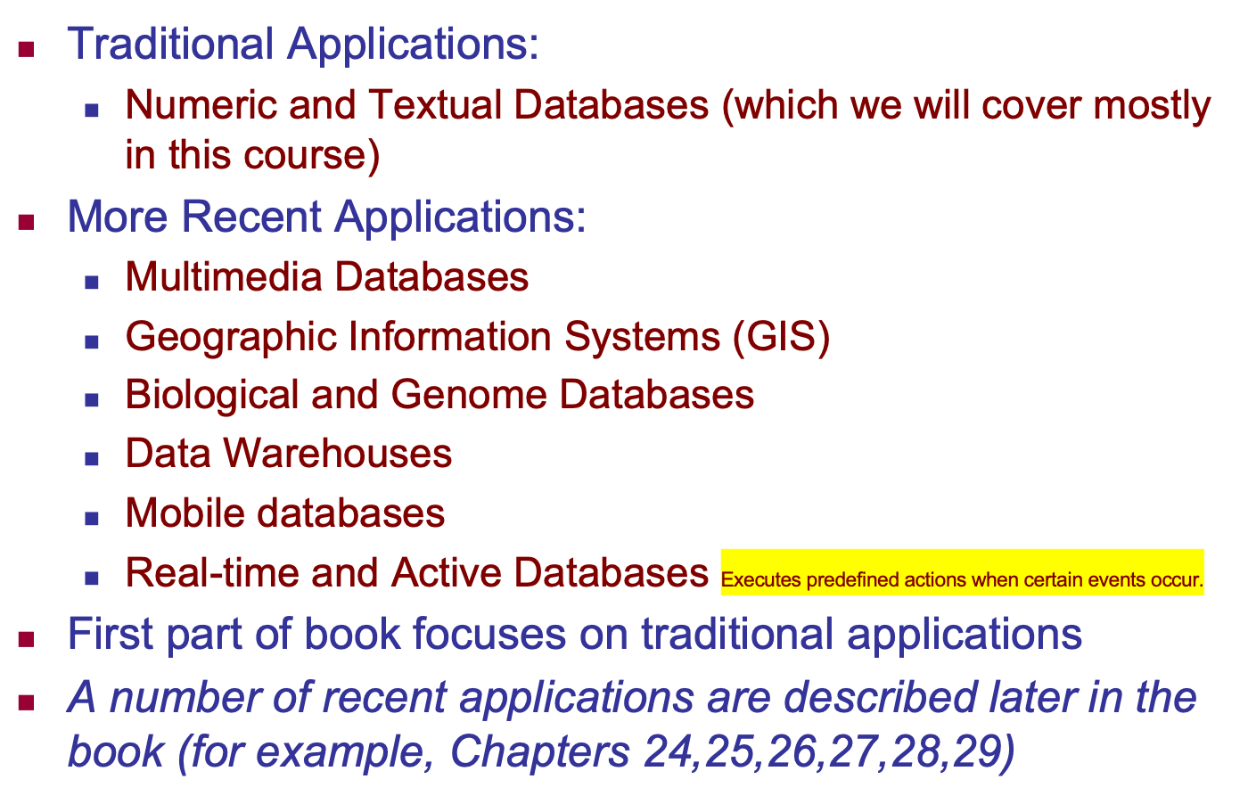
Types of Databases and Database Applications

Slide 8
GIS Database Systems
A GIS DBMS is a database system that integrates geospatial (spatial) and attribute (non-spatial) data for storage, retrieval, and analysis.
Key Components:
Spatial Data – Includes maps, coordinates, satellite images, and vector/raster layers.
Attribute Data – Descriptive data about spatial features (e.g., name, population, elevation).
Data Models – Methods to represent spatial data (vector or raster).
Indexing Mechanisms – Used for efficient retrieval of spatial data (e.g., R-trees, Quad-trees).
Query and Analysis Tools – Spatial SQL (e.g., PostGIS, SQL with spatial extensions).

Slide 9
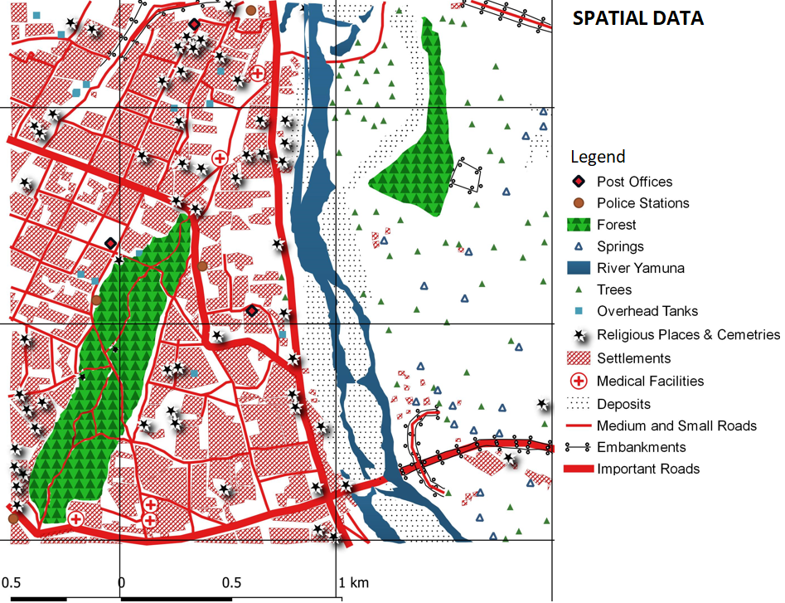
Spatial Data

Slide 10
Real-time Databases
A real-time database (RTDB) is designed to process transactions within strict time constraints. It is often used in applications where data updates and queries must be executed within predefined deadlines.
Use Cases:
Stock Trading Systems (e.g., monitoring stock prices in milliseconds)
Air Traffic Control Systems (e.g., tracking aircraft positions in real-time)
Industrial Automation (e.g., controlling robotic assembly lines)
Healthcare Monitoring (e.g., real-time patient vital signs)

Slide 11
Real-time Databases - Examples
Oracle TimesTen In-Memory Database
Type: High-performance, in-memory relational database.
SAP HANA
Type: In-memory, column-oriented database.
IBM Informix
Type: Time-series and real-time database.
Microsoft Azure Cosmos DB
Type: Globally distributed, NoSQL database.

Slide 12
Recent Developments (1)
Social Networks started capturing a lot of information about people and about communications among people-posts, tweets, photos, videos in systems such as:
- Facebook
- Twitter
- Linked-In
All of the above constitutes data
Search Engines- Google, Bing, Yahoo : collect their own repository of web pages for searching purposes

Slide 13
Recent Developments (2)
New Technologies are emerging from the so-called non-database software vendors to manage vast amounts of data generated on the web:
Big Data storage systems involving large clusters of distributed computers (Chapter 25)
NOSQL (Not Only SQL) systems (Chapter 24)
A large amount of data now resides on the “cloud” which means it is in huge data centers using thousands of machines.

Slide 14
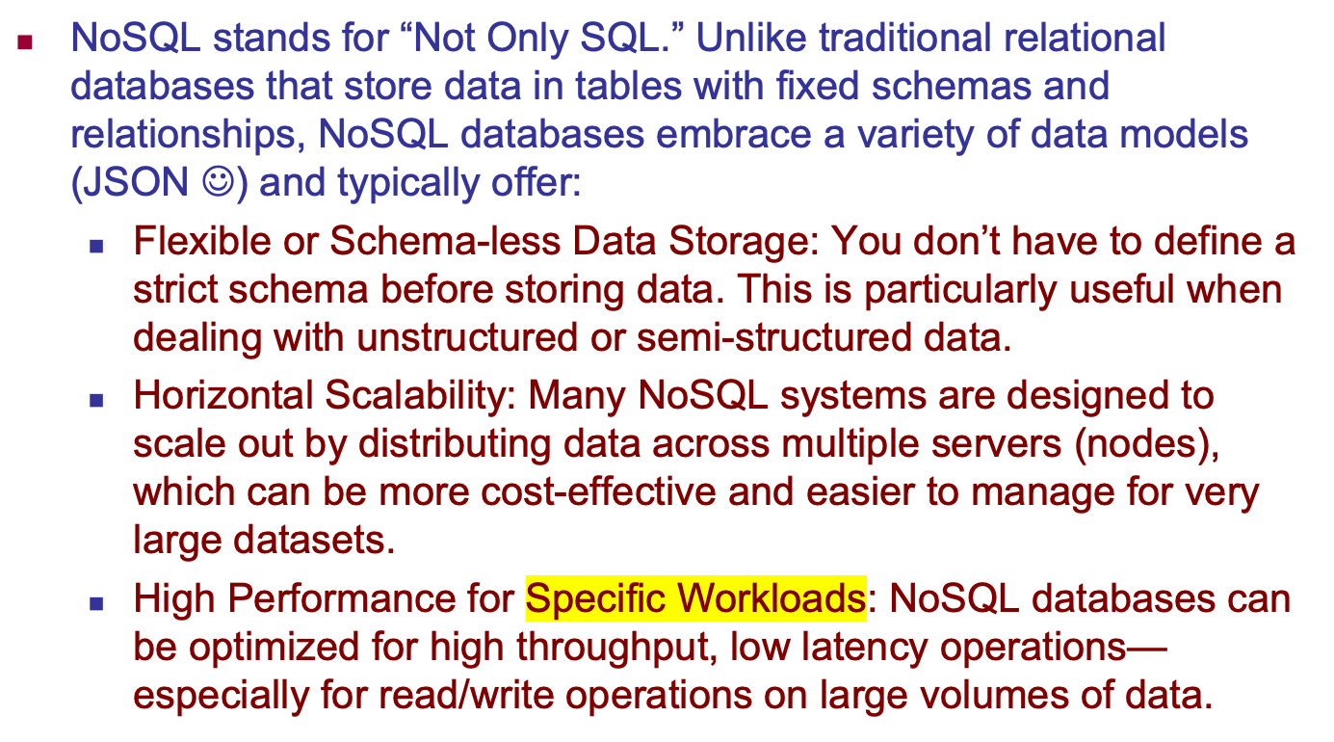
NoSQL Databases

Slide 15
Types of NoSQL Databases
Document Databases
Data Model: Store data in document-like structures (usually JSON, BSON, or XML) that can have nested values.
Examples: MongoDB, CouchDB.
Use Cases: Content management, user profiles, and applications with evolving data structures.
Key-Value Stores
Data Model: Use a simple key-value pair where a key is mapped directly to a value.
Examples: Redis, Amazon DynamoDB, Riak.
Use Cases: Caching, session management, and scenarios where quick lookup of data is critical.

Slide 16
Types of NoSQL Databases
Column-Family Stores (Wide-Column Stores)
Data Model: Store data in columns rather than rows, which can be more efficient for certain queries and analytics.
Examples: Apache Cassandra, HBase.
Use Cases: Time-series data, logging, and scenarios requiring fast write and read operations over large datasets.
Graph Databases
Data Model: Represent data as nodes (entities) and edges (relationships) making them ideal for connected data.
Examples: Neo4j, ArangoDB.
Use Cases: Social networks, recommendation engines, and network topology.

Slide 17
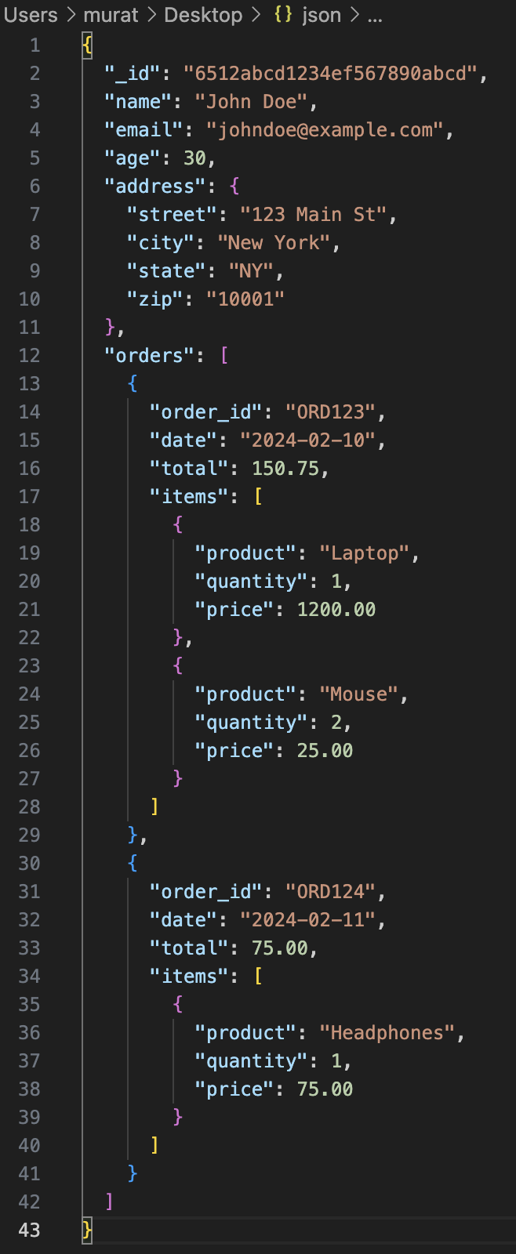
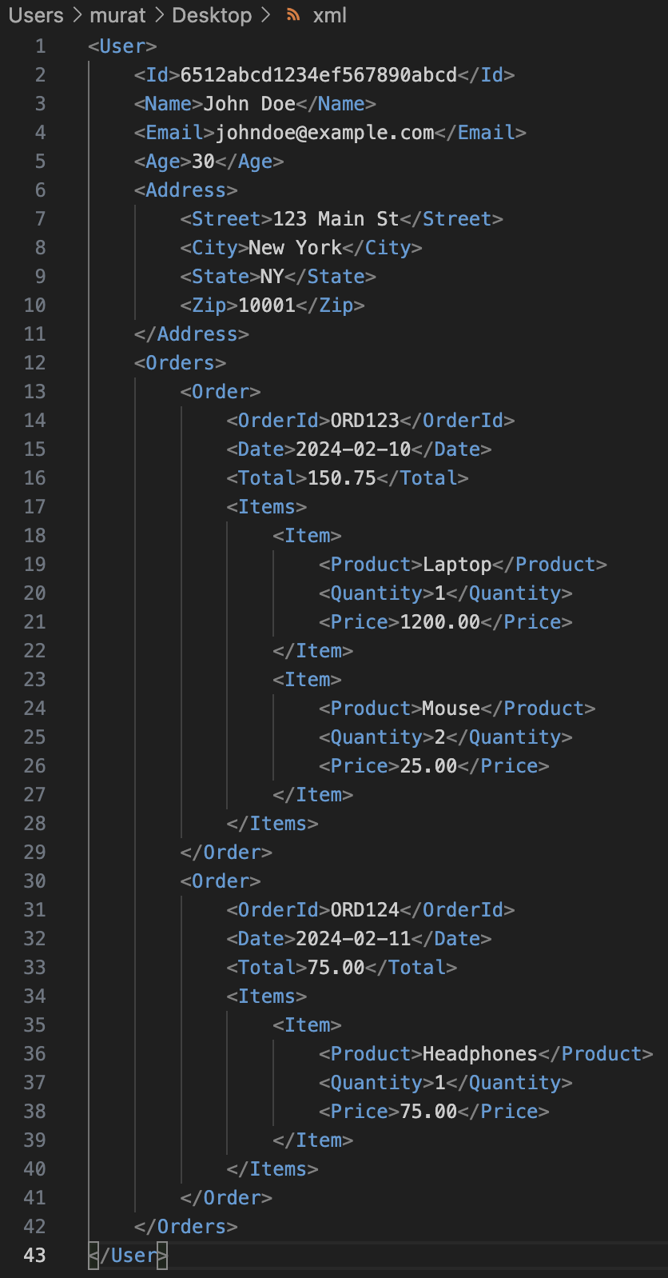
An Exmaple of NoSQL data

Slide 18
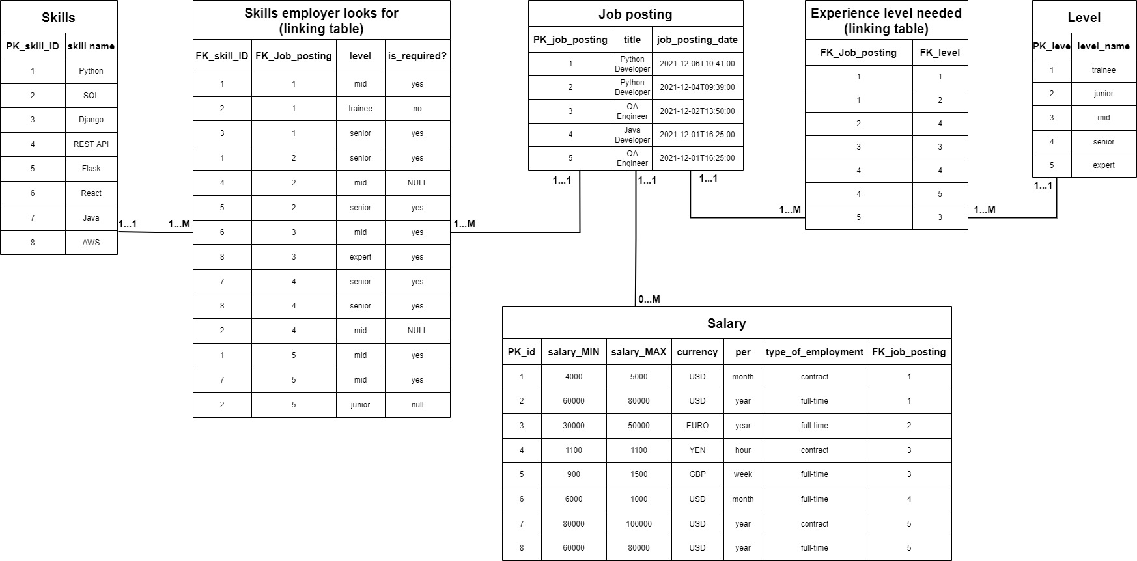
Anyway we mostly use this

Slide 19
Basic Definitions
Database:
A collection of related data.
Data:
Known facts that can be recorded and have an implicit meaning.
Mini-world:
Some part of the real world about which data is stored in a database. For example, student grades and transcripts at a university.
Database Management System (DBMS):
A software package/ system to facilitate the creation and maintenance of a computerized database.
Database System:
The DBMS software together with the data itself. Sometimes, the applications are also included.

Slide 20
Impact of Databases and Database Technology
Businesses: Banking, Insurance, Retail, Transportation, Healthcare, Manufacturing
Service Industries: Financial, Real-estate, Legal, Electronic Commerce, Small businesses
Education : Resources for content and Delivery
More recently: Social Networks, Environmental and Scientific Applications, Medicine and Genetics
Personalized Applications: based on smart mobile devices

Slide 21
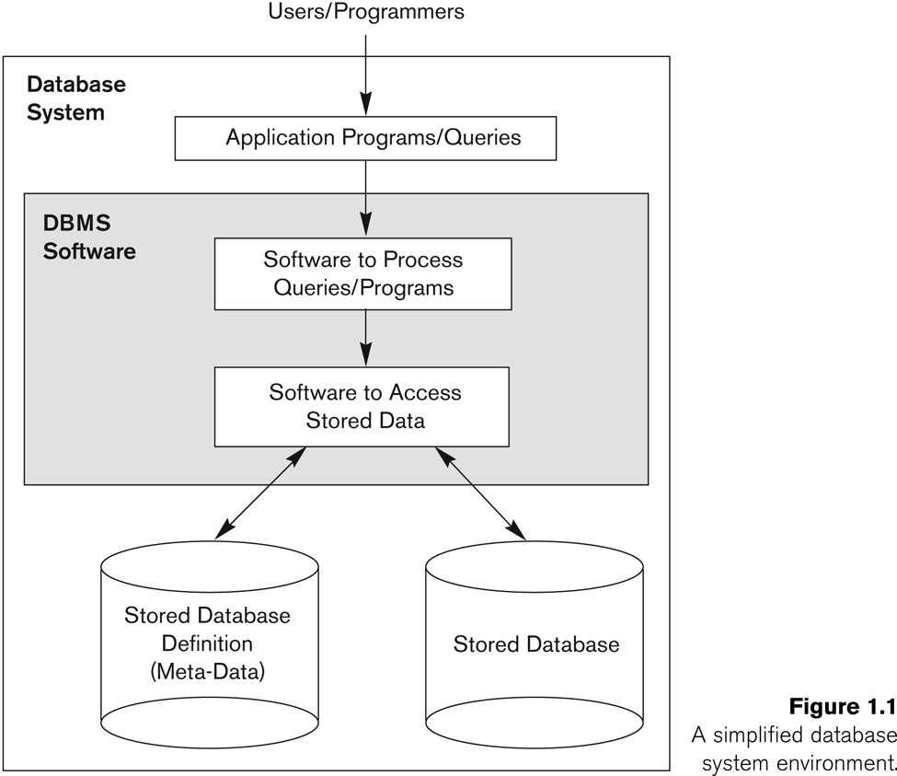
Simplified database system environment

Slide 22
Typical DBMS Functionality
Define a particular database in terms of its data types, structures, and constraints
Construct or Load the initial database contents on a secondary storage medium
Manipulating the database:
Retrieval: Querying, generating reports
Modification: Insertions, deletions and updates to its content
CRUD stands for Create, Read, Update, and Delete
Accessing the database through Web applications
Processing and Sharing by a set of concurrent users and application programs – yet, keeping all data valid and consistent

Slide 23
Application Activities Against a Database
Applications interact with a database by generating
- Queries: that access different parts of data and formulate the result of a request
- Transactions: that may read some data and “update” certain values or generate new data and store that in the database
Applications must not allow unauthorized users to access data
Applications must keep up with changing user requirements against the database

Slide 24
Query and Transaction
Feature | Query | Transaction
Definition | A single operation to retrieve or manipulate data in a database. | A sequence of one or more queries executed as a single unit of work.
Scope | A single SQL statement (e.g., SELECT, INSERT, UPDATE, DELETE). | A group of SQL statements that must be executed together.
Atomicity | Each query executes independently and does not ensure atomicity. | A transaction follows ACID properties to ensure atomicity, consistency, isolation, and durability.
Rollback Support | Cannot be rolled back once executed. | Can be rolled back if an error occurs or if a condition is not met.
Query Example:
SELECT * FROM users WHERE id = 1;
Transaction Example:
BEGIN;
UPDATE accounts SET balance = balance - 100 WHERE id = 1;
UPDATE accounts SET balance = balance + 100 WHERE id = 2;
COMMIT;

Slide 25
ACID Transactions
Atomicity (All or Nothing)
Transactions are indivisible
Consistency (Valid State)
From one valid state to another
Isolation (Concurrent Transactions)
From other transactions
Durability (Permanent Changes)
Cahanges stays even in case of a system crash.

Slide 26
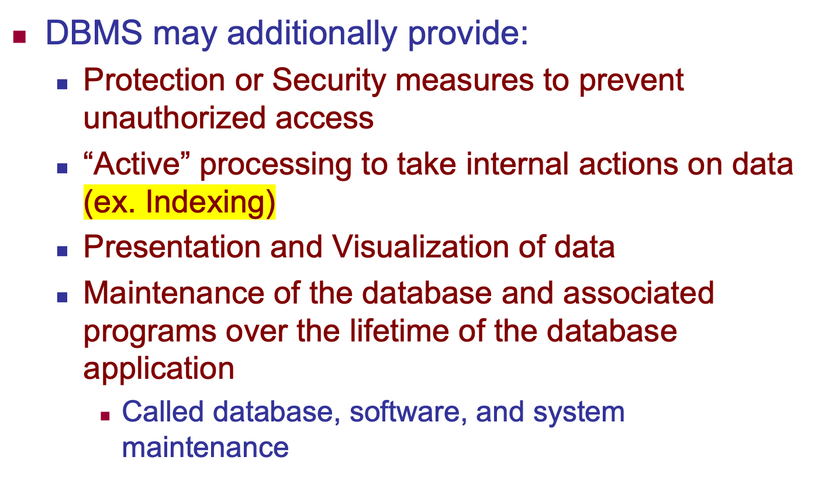
Additional DBMS Functionality

Slide 27
Example of a Database (with a Conceptual Data Model)
Mini-world for the example:
Part of a UNIVERSITY environment.
Some mini-world entities:
STUDENTs
COURSEs
SECTIONs (of COURSEs)
(academic) DEPARTMENTs
INSTRUCTORs

Slide 28
Example of a Database (with a Conceptual Data Model)
Some mini-world relationships:
SECTIONs are of specific COURSEs
STUDENTs take SECTIONs
COURSEs have prerequisite COURSEs
INSTRUCTORs teach SECTIONs
COURSEs are offered by DEPARTMENTs
STUDENTs major in DEPARTMENTs
Note: The above entities and relationships are typically expressed in a conceptual data model, such as the ENTITY-RELATIONSHIP data model (see Chapters 3, 4)

Slide 29
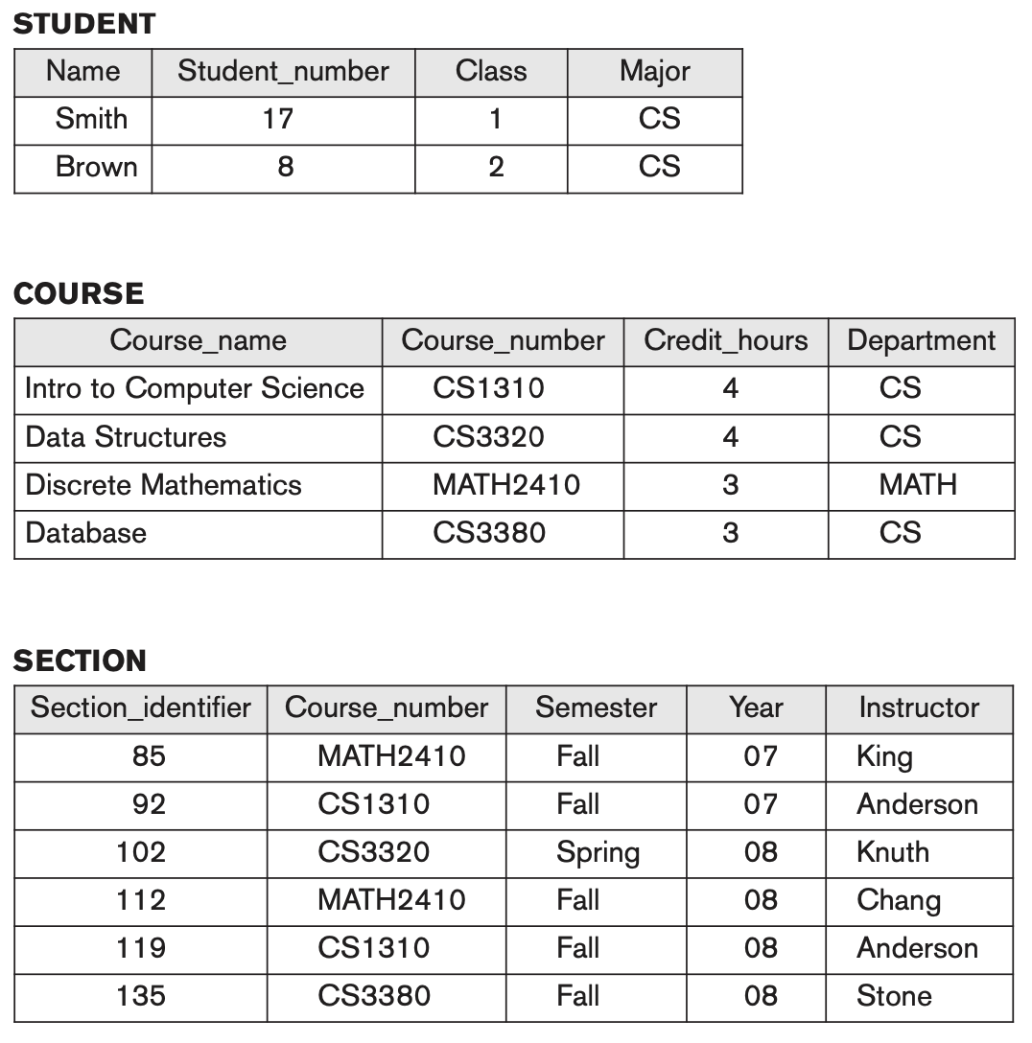
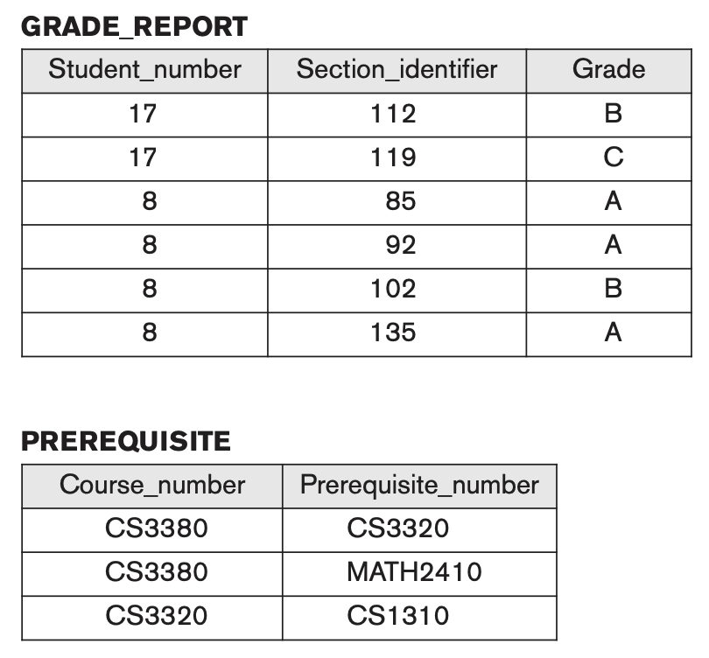
Example of a simple database

Slide 30
Main Characteristics of the Database Approach
Self-describing nature of a database system:
A DBMS catalog stores the description of a particular database (e.g. data structures, types, and constraints)
The description is called meta-data*.
This allows the DBMS software to work with different database applications.
Insulation between programs and data:
Called program-data independence.
Allows changing data structures and storage organization without having to change the DBMS access programs.
-----------------------------------------------------------------------------
* Some newer systems such as a few NOSQL systems need no meta-data: they store the data definition within its structure making it self describing

Slide 31
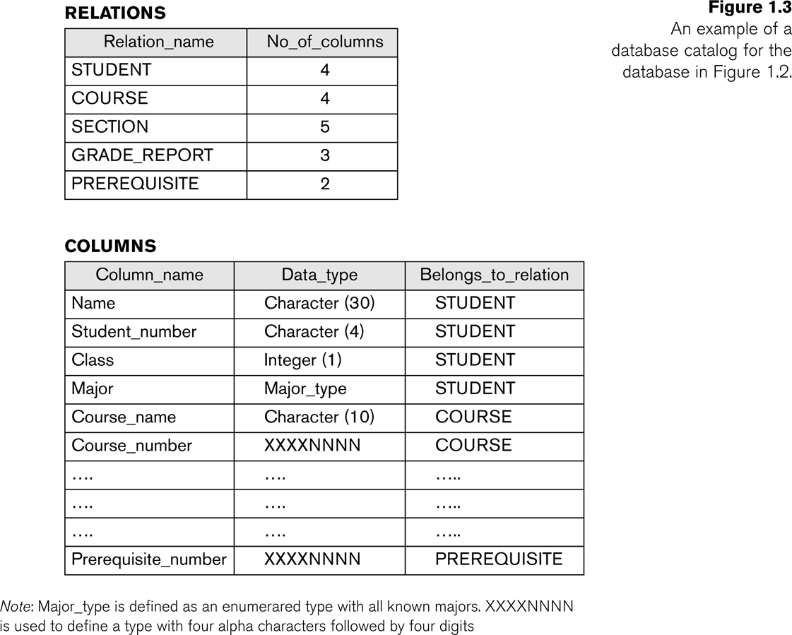
Example of a simplified database catalog

Slide 32
Main Characteristics of the Database Approach (continued)
Data Abstraction:
A data model is used to hide storage details and present the users with a conceptual view of the database.
Programs refer to the data model constructs rather than data storage details
Support of multiple views of the data:
Each user may see a different view of the database, which describes only the data of interest to that user.

Slide 33
Multiple Views of Data
A view is a virtual table that represents a subset of data from one or more tables. It does not store data itself but provides a way to customize, filter, or restructure data for different use cases.
Original Data
id | name | department | salary
1 | Alice | HR | 5000
2 | Bob | IT | 7000
3 | Charlie | Finance | 6000
HR View
name | department
Alice | HR
Bob | IT
Charlie | Finance
Finance View
name | salary
Alice | 5000
Bob | 7000
Charlie | 6000

Slide 34
Why Use Multiple Views?
Security
Restrict access to sensitive data (e.g., salaries).
Customization
Different users see data in different formats.
Simplification
Users work with pre-defined queries instead of complex joins.
Performance Optimization
Indexing and caching can improve query speed.

Slide 35
Main Characteristics of the Database Approach (continued)
Sharing of data and multi-user transaction processing:
Allowing a set of concurrent users to retrieve from and to update the database.
Concurrency control within the DBMS guarantees that each transaction is correctly executed or aborted
Recovery subsystem ensures each completed transaction has its effect permanently recorded in the database
OLTP (Online Transaction Processing) is a major part of database applications. This allows hundreds of concurrent transactions to execute per second.

Slide 36
Online Analytical Processing (OLAP)
Online Analytical Processing (OLAP) is a category of database systems designed for complex data analysis and reporting
Unlike Online Transaction Processing (OLTP), which focuses on handling transactions in real time, OLAP is optimized for querying and analyzing large amounts of historical data.

Slide 37
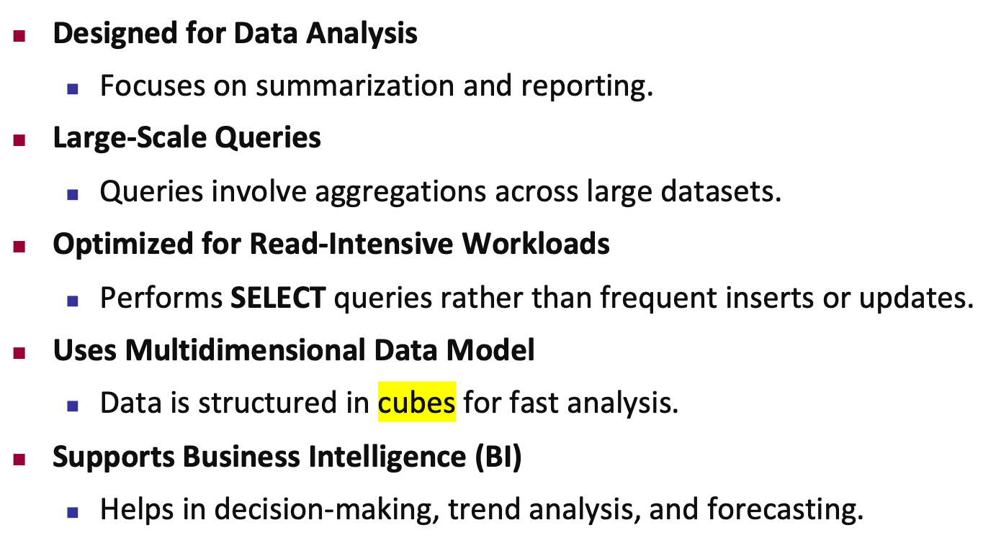
Characteristics of OLAP Systems

Slide 38
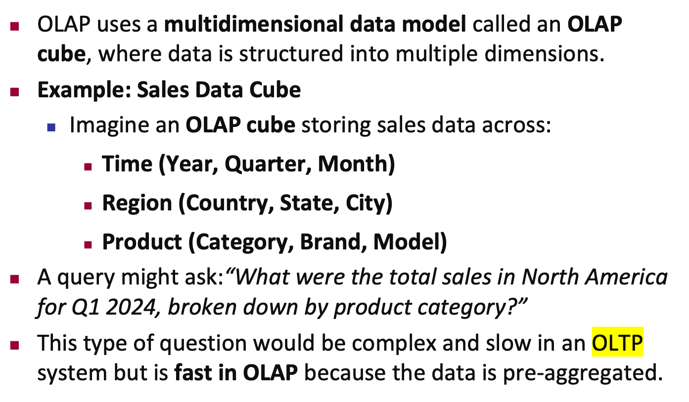
OLAP Data Model (Multidimensional Cube)

Slide 39
Advantages of OLAP
Fast Query Performance – Precomputed aggregations speed up analytics.
Complex Analysis – Handles multidimensional queries easily.
Historical Data Insights – Great for trend analysis and forecasting.
Supports Business Intelligence (BI) – Used in decision-making dashboards.

Slide 40
Database Users
Users may be divided into
Those who actually use and control the database content, and those who design, develop and maintain database applications (called “Actors on the Scene”), and
Those who design and develop the DBMS software and related tools, and the computer systems operators (called “Workers Behind the Scene”).

Slide 41
Database Users – Actors on the Scene
Actors on the scene
Database administrators:
Responsible for authorizing access to the database, for coordinating and monitoring its use, acquiring software and hardware resources, controlling its use and monitoring efficiency of operations.
Database Designers:
Responsible to define the content, the structure, the constraints, and functions or transactions against the database. They must communicate with the end-users and understand their needs.

Slide 42
Database End Users
Actors on the scene (continued)
End-users: They use the data for queries, reports and some of them update the database content. End-users can be categorized into:
Casual: access database occasionally when needed
Naïve or Parametric: they make up a large section of the end-user population.
They use previously well-defined functions in the form of “canned transactions” against the database.
Users of Mobile Apps mostly fall in this category
Bank-tellers or reservation clerks are parametric users who do this activity for an entire shift of operations.
Social Media Users post and read information from websites

Slide 43
Database End Users (continued)
Sophisticated:
These include business analysts, scientists, engineers, others thoroughly familiar with the system capabilities.
Many use tools in the form of software packages that work closely with the stored database.
Stand-alone:
Mostly maintain personal databases using ready-to-use packaged applications.
An example is the user of a tax program that creates its own internal database.
Another example is a user that maintains a database of personal photos and videos.

Slide 44
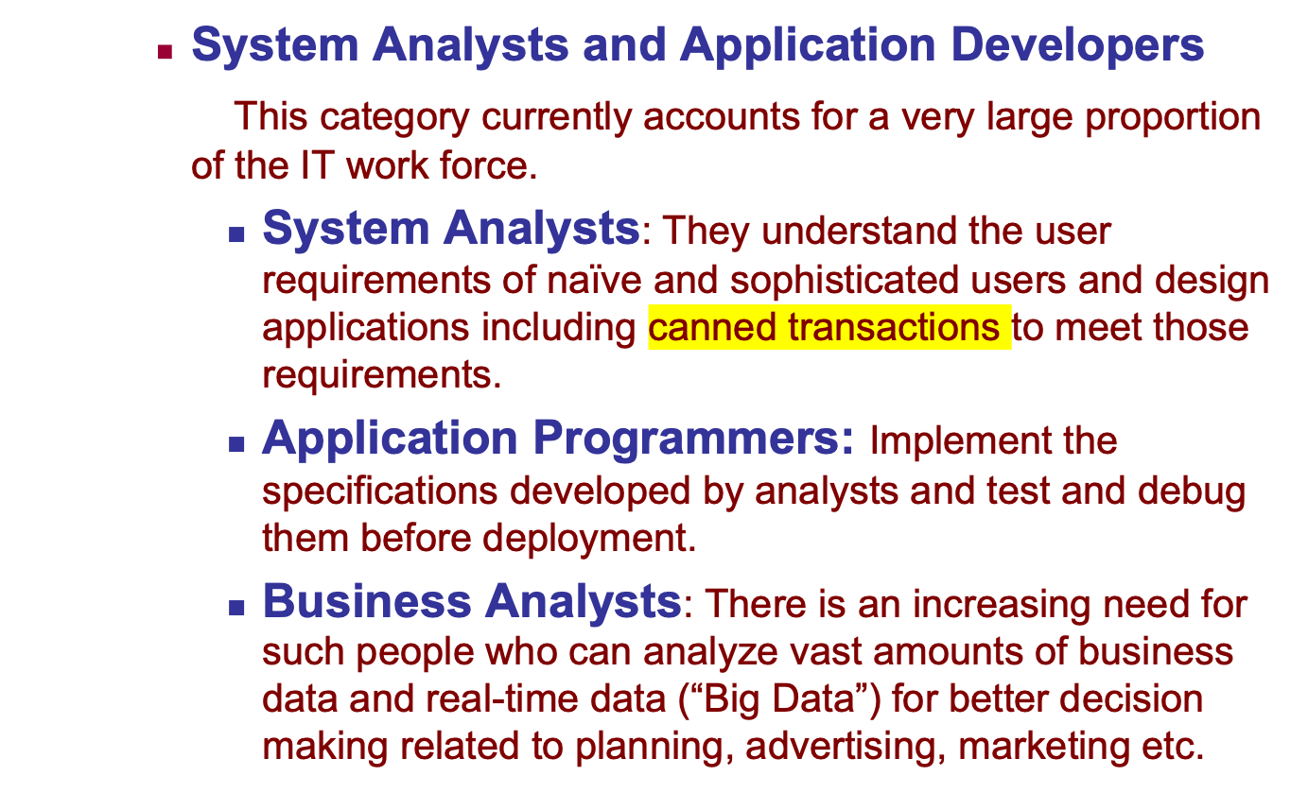
Database Users – Actors on the Scene (continued)

Slide 45
Database Users – Actors behind the Scene
System Designers and Implementors: Design and implement DBMS packages in the form of modules and interfaces and test and debug them. The DBMS must interface with applications, language compilers, operating system components, etc.
Tool Developers: Design and implement software systems called tools for modeling and designing databases, performance monitoring, prototyping, test data generation, user interface creation, simulation etc. that facilitate building of applications and allow using database effectively.
Operators and Maintenance Personnel: They manage the actual running and maintenance of the database system hardware and software environment.

Slide 46
Advantages of Using the Database Approach
Controlling redundancy in data storage and in development and maintenance efforts.
Sharing of data among multiple users.
Restricting unauthorized access to data. Only the DBA staff uses privileged commands and facilities.
Providing persistent storage for program Objects
E.g., Object-oriented DBMSs make program objects persistent– see Chapter 12.
Providing Storage Structures (e.g. indexes) for efficient Query Processing – see Chapter 17.

Slide 47
Advantages of Using the Database Approach (continued)
Providing optimization of queries for efficient processing.
Providing backup and recovery services.
Providing multiple interfaces to different classes of users.
Representing complex relationships among data.
Enforcing integrity constraints on the database.
Drawing inferences and actions from the stored data using deductive and active rules and triggers.

Slide 48
Additional Implications of Using the Database Approach
Potential for enforcing standards:
This is very crucial for the success of database applications in large organizations. Standards refer to data item names, display formats, screens, report structures, meta-data (description of data), Web page layouts, etc.
Reduced application development time:
Incremental time to add each new application is reduced.

Slide 49
Additional Implications of Using the Database Approach (continued)
Flexibility to change data structures:
Database structure may evolve as new requirements are defined.
Availability of current information:
Extremely important for on-line transaction systems such as shopping, airline, hotel, car reservations.
Economies of scale:
Wasteful overlap of resources and personnel can be avoided by consolidating data and applications across departments.

Slide 50
Historical Development of Database Technology
Early Database Applications:
The Hierarchical and Network Models were introduced in mid 1960s and dominated during the seventies.
A bulk of the worldwide database processing still occurs using these models, particularly, the hierarchical model using IBM’s IMS system.
Relational Model based Systems:
Relational model was originally introduced in 1970, was heavily researched and experimented within IBM Research and several universities.
Relational DBMS Products emerged in the early 1980s.

Slide 51
Historical Development of Database Technology (continued)
Object-oriented and emerging applications:
Object-Oriented Database Management Systems (OODBMSs) were introduced in late 1980s and early 1990s to cater to the need of complex data processing in CAD and other applications.
Their use has not taken off much.
Many relational DBMSs have incorporated object database concepts, leading to a new category called object-relational DBMSs (ORDBMSs)
Extended relational systems add further capabilities (e.g. for multimedia data, text, XML, and other data types)

Slide 52
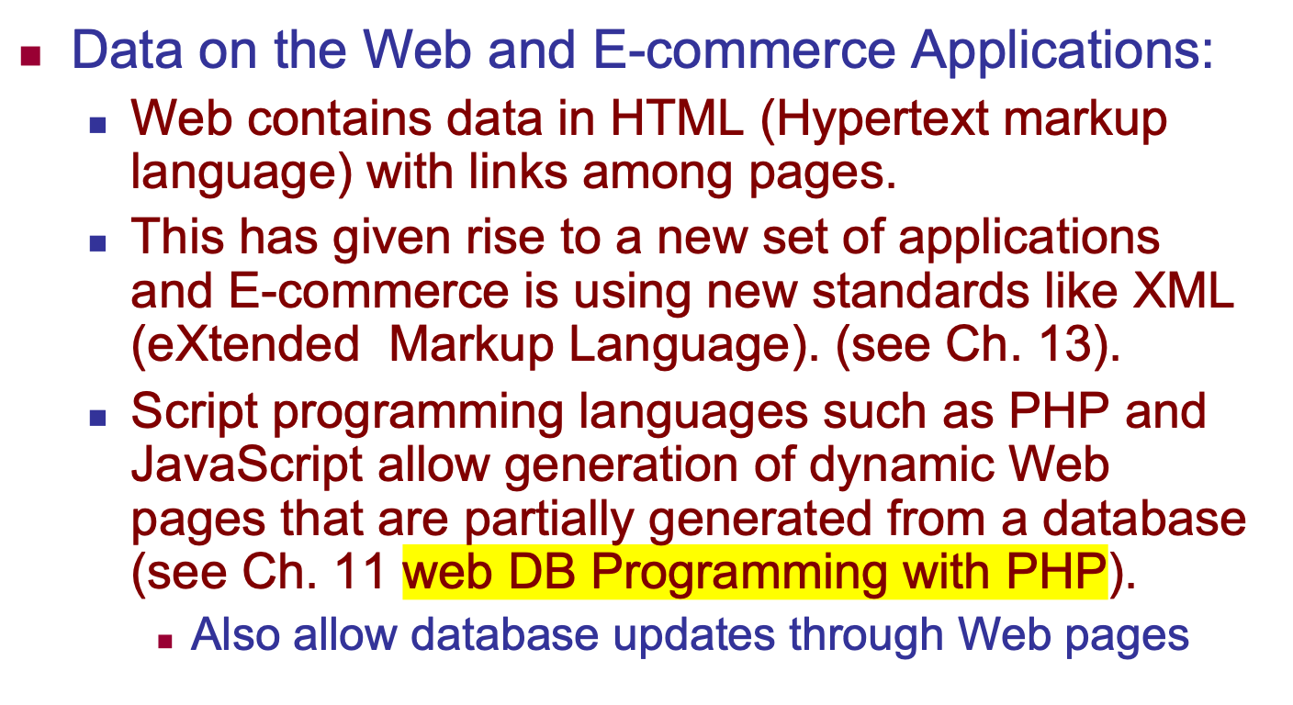
Historical Development of Database Technology (continued)

Slide 53
Extending Database Capabilities (1)
New functionality is being added to DBMSs in the following areas:
Scientific Applications – Physics, Chemistry, Biology - Genetics
Earth and Atmospheric Sciences and Astronomy
XML (eXtensible Markup Language)
Image Storage and Management
Audio and Video Data Management
Data Warehousing and Data Mining – a very major area for future development using new technologies (see Chapters 28-29)
Spatial Data Management and Location Based Services
Time Series and Historical Data Management (ex: sensor readings, stock prices etc. Time is an essential dimension)
The above gives rise to new research and development in incorporating new data types, complex data structures, new operations and storage and indexing schemes in database systems.

Slide 54
Extending Database Capabilities (2)
Background since the advent of the 21st Century:
First decade of the 21st century has seen tremendous growth in user generated data and automatically collected data from applications and search engines.
Social Media platforms such as Facebook and Twitter are generating millions of transactions a day and businesses are interested to tap into this data to “understand” the users
Cloud Storage and Backup is making unlimited amount of storage available to users and applications

Slide 55
Extending Database Capabilities (3)
Emergence of Big Data Technologies and NOSQL databases
New data storage, management and analysis technology was necessary to deal with the onslaught of data in petabytes a day (10**15 bytes or 1000 terabytes) in some applications – this started being commonly called as “Big Data”.
Hadoop (which originated from Yahoo) and Mapreduce Programming approach to distributed data processing (which originated from Google) as well as the Google file system have given rise to Big Data technologies (Chapter 25). Further enhancements are taking place in the form of Spark based technology.
NOSQL (Not Only SQL- where SQL is the de facto standard language for relational DBMSs) systems have been designed for rapid search and retrieval from documents, processing of huge graphs occurring on social networks, and other forms of unstructured data with flexible models of transaction processing (Chapter 24).

Slide 56
When not to use a DBMS
Main inhibitors (costs) of using a DBMS:
High initial investment and possible need for additional hardware.
Overhead for providing generality, security, concurrency control, recovery, and integrity functions.
When a DBMS may be unnecessary:
If the database and applications are simple, well defined, and not expected to change.
If access to data by multiple users is not required.
When a DBMS may be infeasible:
In embedded systems where a general purpose DBMS may not fit in available storage (consider: SQLite)

Slide 57
When not to use a DBMS
When no DBMS may suffice:
If there are stringent real-time requirements that may not be met because of DBMS overhead (e.g., telephone switching systems)
If the database system is not able to handle the complexity of data because of modeling limitations (e.g., in complex genome and protein databases)
If the database users need special operations not supported by the DBMS (e.g., GIS and location based services).

Slide 58
Chapter Summary
Types of Databases and Database Applications
Basic Definitions
Typical DBMS Functionality
Example of a Database (UNIVERSITY)
Main Characteristics of the Database Approach
Types of Database Users
Advantages of Using the Database Approach
Historical Development of Database Technology
Extending Database Capabilities
When Not to Use Databases

