Slide 1


Slide 2
CHAPTER 2
Database System Concepts
and Architecture
Slide 1- <number>

Slide 3
Outline
Data Models and Their Categories
History of Data Models
Schemas, Instances, and States
Three-Schema Architecture
Data Independence
DBMS Languages and Interfaces
Database System Utilities and Tools
Centralized and Client-Server Architectures
Classification of DBMSs
Slide 2- <number>

Slide 4
Data Models
Data Model:
  A set of concepts to describe the structure of a database, the operations for manipulating these structures, and certain constraints that the database should obey.
Data Model Structure and Constraints:
  Constructs are used to define the database structure
  Constructs typically include elements (and their data types) as well as groups of elements (e.g. entity, record, table), and relationships among such groups
  Constraints specify some restrictions on valid data; these constraints must be enforced at all times
Slide 2- <number>

Slide 5
Data Models (continued)
Data Model Operations:
  These operations are used for specifying database retrievals and updates by referring to the constructs of the data model.
  Operations on the data model may include basic model operations (e.g. generic insert, delete, update) and user-defined operations (e.g. compute_student_gpa, update_inventory)
Slide 2- <number>

Slide 6
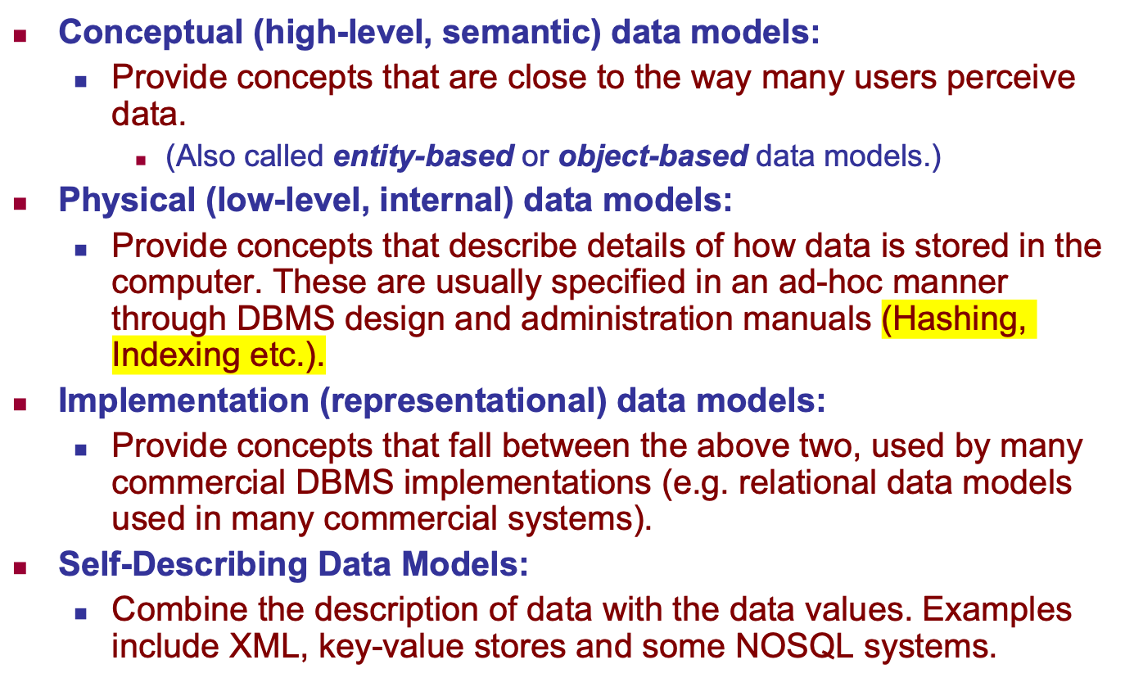
Categories of Data Models
Slide 2- <number>

Slide 7
XML
<note>
<to>Tove</to>
<from>Jani</from>
<heading>Reminder</heading>
<body>Don't forget me this weekend!</body>
</note>
Slide 2- <number>

Slide 8
JSON vs XML
{"employees":[
{ "firstName":"John", "lastName":"Doe" },
{ "firstName":"Anna", "lastName":"Smith" },
{ "firstName":"Peter", "lastName":"Jones" }
]}
<employees>
<employee>
<firstName>John</firstName> <lastName>Doe</lastName>
</employee>
<employee>
<firstName>Anna</firstName> <lastName>Smith</lastName>
</employee>
<employee>
<firstName>Peter</firstName> <lastName>Jones</lastName>
</employee>
</employees>
Slide 2- <number>

Slide 9
Schemas versus Instances
Database Schema:
  The description of a database.
  Includes descriptions of the database structure, data types, and the constraints on the database.
Schema Diagram:
  An illustrative display of (most aspects of) a database schema.
Schema Construct:
  A component of the schema or an object within the schema, e.g., STUDENT, COURSE.
Slide 2- <number>

Slide 10
Schemas versus Instances
Database State:
  The actual data stored in a database at a particular moment in time. This includes the collection of all the data in the database.
  Also called database instance (or occurrence or snapshot).
    The term instance is also applied to individual database components, e.g. record instance, table instance, entity instance
Slide 2- <number>

Slide 11
Database Schema vs. Database State
Database State:
  Refers to the content of a database at a moment in time.
Initial Database State:
  Refers to the database state when it is initially loaded into the system.
Valid State:
  A state that satisfies the structure and constraints of the database.
Slide 2- <number>

Slide 12
Database Schema vs. Database State (continued)
Distinction
  The database schema changes very infrequently.
  The database state changes every time the database is updated.
Schema is also called intension.
State is also called extension.
Slide 2- <number>

Slide 13

Example of a Database Schema
Slide 2- <number>

Slide 14
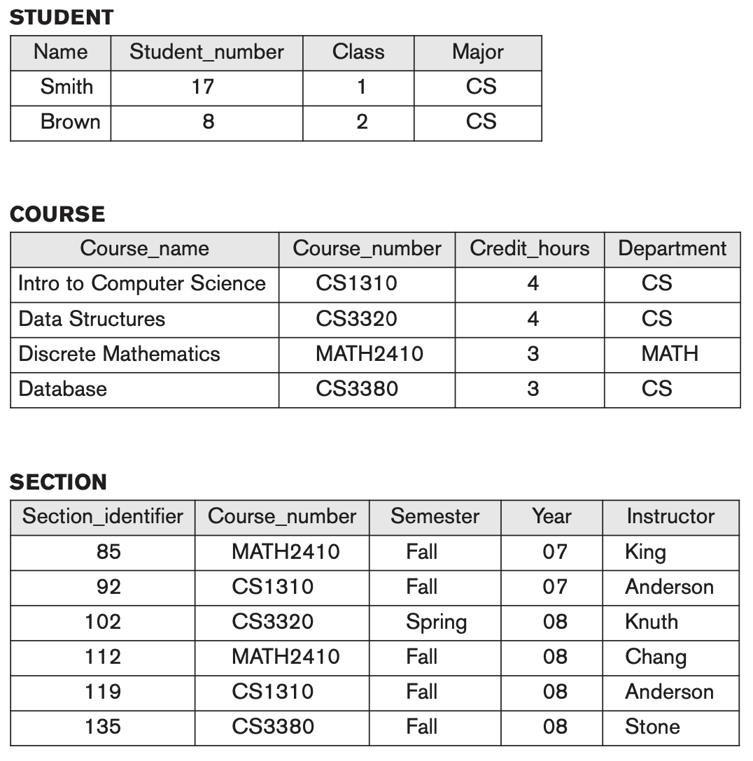
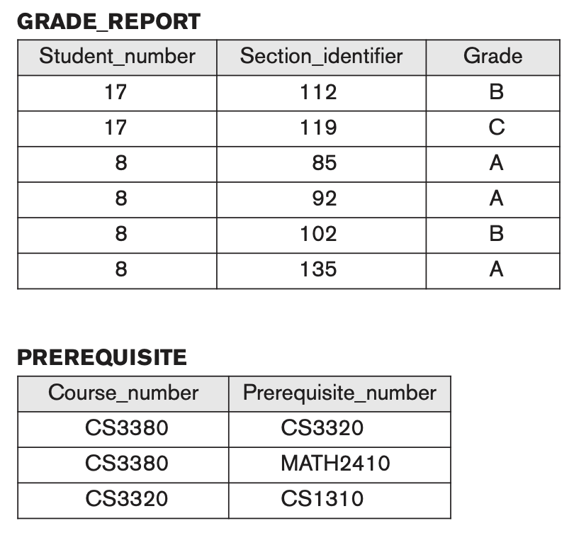
Example of a database state
Slide 2- <number>

Slide 15
Three-Schema Architecture
Proposed to support DBMS characteristics of:
  Program-data independence.
  Support of multiple views of the data.
Not explicitly used in commercial DBMS products, but has been useful in explaining database system organization
Slide 2- <number>

Slide 16
Three-Schema Architecture
Defines DBMS schemas at three levels:
  Internal schema at the internal level to describe physical storage structures and access paths (e.g indexes).
    Typically uses a physical data model.
  Conceptual schema at the conceptual level to describe the structure and constraints for the whole database for a community of users.
    Uses a conceptual or an implementation data model.
  External schemas at the external level to describe the various user views.
    Usually uses the same data model as the conceptual schema.
Slide 2- <number>

Slide 17

The three-schema architecture
Slide 2- <number>

Slide 18
Three-Schema Architecture
Mappings among schema levels are needed to transform requests and data.
  Programs refer to an external schema, and are mapped by the DBMS to the internal schema for execution.
  Data extracted from the internal DBMS level is reformatted to match the user’s external view (e.g. formatting the results of an SQL query for display in a Web page)
Slide 2- <number>

Slide 19
Data Independence
Logical Data Independence:
  The capacity to change the conceptual schema without having to change the external schemas and their associated application programs.
Physical Data Independence:
  The capacity to change the internal schema without having to change the conceptual schema.
  For example, the internal schema may be changed when certain file structures are reorganized or new indexes are created to improve database performance
Slide 2- <number>

Slide 20
Data Independence (continued)
When a schema at a lower level is changed, only the mappings between this schema and higher-level schemas need to be changed in a DBMS that fully supports data independence.
The higher-level schemas themselves are unchanged.
  Hence, the application programs need not be changed since they refer to the external schemas.
Slide 2- <number>

Slide 21
DBMS Languages
Data Definition Language (DDL)
Data Manipulation Language (DML)
  High-Level or Non-procedural Languages: These include the relational language SQL
    May be used in a standalone way or may be embedded in a programming language
  Low Level or Procedural Languages:
    These must be embedded in a programming language.
Slide 2- <number>

Slide 22
DBMS Languages
Data Definition Language (DDL):
  Used by the DBA and database designers to specify the conceptual schema of a database.
  In many DBMSs, the DDL is also used to define internal and external schemas (views).
  In some DBMSs, separate storage definition language (SDL) and view definition language (VDL) are used to define internal and external schemas.
    SDL is typically realized via DBMS commands provided to the DBA and database designers
Slide 2- <number>

Slide 23
DBMS Languages
Data Manipulation Language (DML):
  Used to specify database retrievals and updates
  DML commands (data sublanguage) can be embedded in a general-purpose programming language (host language), such as COBOL, C,
  C++, or Java.
    A library of functions can also be provided to access the DBMS from a programming language
  Alternatively, stand-alone DML commands can be applied directly (called a query language).
Slide 2- <number>

Slide 24
Types of DML
High Level or Non-procedural Language:
  For example, the SQL relational language
  Are “set”-oriented and specify what data to retrieve rather than how to retrieve it.
  Also called declarative languages.
Low Level or Procedural Language:
  Retrieve data one record-at-a-time;
  Constructs such as looping are needed to retrieve multiple records, along with positioning pointers.
Slide 2- <number>

Slide 25
Procedural Language (PL)
A Procedural Language (PL) in DBMS is a structured, programming-like extension of SQL that allows users to write procedures, functions, loops, and conditions for handling complex database logic.
  Traditional SQL is declarative, meaning it specifies what to do but not how.
  Procedural languages add programming constructs like loops, conditions (IF, CASE), variables, and exception handling to SQL.
  These languages execute procedural logic directly in the database.
Slide 2- <number>

Slide 26
Procedural Languages (PLs)
Database | Procedural Language
PostgreSQL | PL/pgSQL
MySQL | PL/SQL (Stored Procedures)
Oracle | PL/SQL
SQL Server | T-SQL
IBM Db2 | SQL PL
Slide 2- <number>

Slide 27
DBMS Interfaces
Stand-alone query language interfaces
  Example: Entering SQL queries at the DBMS interactive SQL interface (e.g. SQL*Plus in ORACLE, PgAdmin)
Programmer interfaces for embedding DML in programming languages
User-friendly interfaces
  Menu-based, forms-based, graphics-based, etc.
Mobile Interfaces: Interfaces allowing users to perform transactions using mobile apps
Slide 2- <number>

Slide 28
DBMS Programming Language Interfaces
Programmer interfaces for embedding DML in a programming languages:
  Embedded Approach: e.g embedded SQL (for C, C++, etc.), SQLJ (for Java)
  Procedure Call Approach: e.g. JDBC for Java, ODBC (Open Databse Connectivity) for other programming languages as API’s (application programming interfaces)
  Database Programming Language Approach: e.g. ORACLE has PL/SQL, a programming language based on SQL; language incorporates SQL and its data types as integral components
  Scripting Languages: PHP (client-side scripting) and Python (server-side scripting) are used to write database programs.
Slide 2- <number>

Slide 29
Embedded Approach: SQLJ
#sql { INSERT INTO employees (first_name, salary) VALUES ('Joe', 43000) };
Inside a .sqlj File (if
Then converted into a java file
SQLJ enables applications programmers to embed SQL statements in Java code
Slide 2- <number>

Slide 30
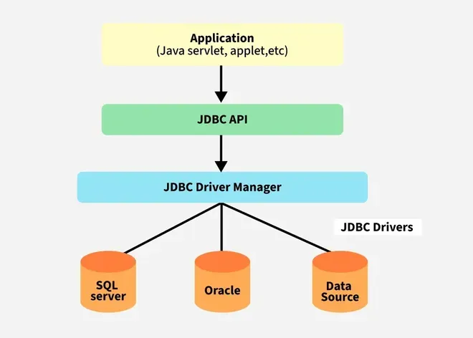
Procedure Call Approach: JDBC
JDBC (Java Database Connectivity) is an API in Java that enables applications to interact with databases.
Slide 2- <number>

Slide 31
SQLJ vs. JDBC
#sql iterator EmpIterator (int emp_id, String name, double salary);
public void getEmployees() throws SQLException {
EmpIterator empIterator;
#sql empIterator = { SELECT id, name, salary FROM employees };
while (empIterator.next()) {
System.out.println("ID: " + empIterator.emp_id() +
", Name: " + empIterator.name() +
", Salary: " + empIterator.salary());
}
empIterator.close();
}
Connection conn = DriverManager.getConnection("jdbc:mysql://localhost/db", "user", "password");
Statement stmt = conn.createStatement();
ResultSet rs = stmt.executeQuery("SELECT id, name, salary FROM employees");
while (rs.next()) {
System.out.println("ID: " + rs.getInt("id") +
", Name: " + rs.getString("name") +
", Salary: " + rs.getDouble("salary"));
}
rs.close();
stmt.close();
conn.close();
Slide 2- <number>

Slide 32
User-Friendly DBMS Interfaces
  Menu-based (Web-based), popular for browsing on the web
  Forms-based, designed for naïve users used to filling in entries on a form
  Graphics-based
    Point and Click, Drag and Drop, etc.
    Specifying a query on a schema diagram
  Natural language: requests in written English
  Combinations of the above:
    For example, both menus and forms used extensively in Web database interfaces
Slide 2- <number>

Slide 33
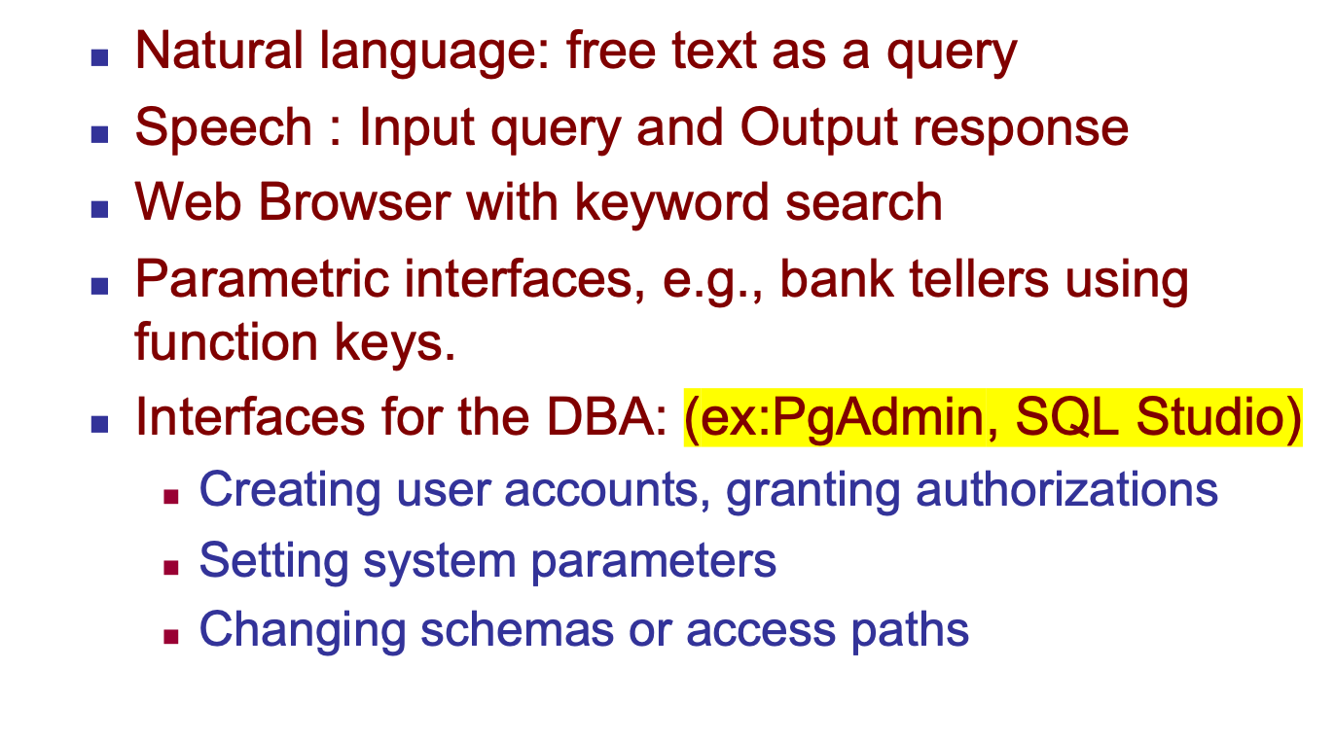
Other DBMS Interfaces
Slide 2- <number>

Slide 34

Typical DBMS Component Modules
stored data manager, which in turn uses basic operating system services for carrying out low-level input/output (read/write) operations between the disk and main memory.
The catalog includes information such as the names and sizes of files, names and data types of data items, storage details of each file, mapping information among schemas, and constraints.
Slide 2- <number>

Slide 35
Database System Utilities
To perform certain functions such as:
  Loading data stored in files into a database. Includes data conversion tools.
  Backing up the database periodically on tape.
  Reorganizing database file structures.
  Performance monitoring utilities.
  Report generation utilities.
  Other functions, such as sorting, user monitoring, data compression, etc.
Slide 2- <number>

Slide 36
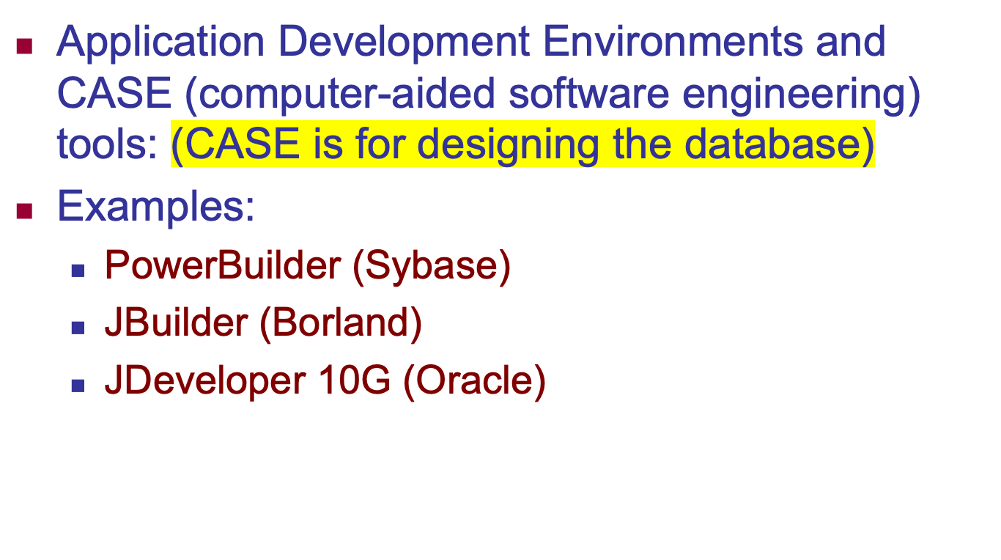
Other Tools
Slide 2- <number>

Slide 37
CASE Tools for DB
Type | Function
Data Modeling Tools | Create ERD (Entity-Relationship Diagrams)
Database Schema Design Tools | Generate tables, attributes, relationships
SQL Code Generators | Convert models into SQL scripts
Database Reverse Engineering Tools | Extract schema from existing databases
Data Dictionary Tools | Maintain metadata and documentation
Performance Optimization Tools | Analyze queries and optimize performance
Slide 2- <number>

Slide 38
Data Modeling & ERD Tools
Tool | Description
IBM InfoSphere Data Architect | Enterprise-grade tool for data modeling and integration
Microsoft Visio | Supports ERD and database schema diagrams
Lucidchart | Online tool for collaborative database design
Draw.io | Free, cloud-based ERD drawing tool
dbdiagram.io | Web-based tool for quick database schema visualization
Slide 2- <number>

Slide 39
Database Schema Design & SQL Generation
Tool | Description
MySQL Workbench | MySQL schema design, SQL script generation
pgModeler | PostgreSQL-specific schema designer
Toad Data Modeler | Supports multiple databases (MySQL, Oracle, SQL Server)
Oracle SQL Developer Data Modeler | Oracle-specific database design tool
ER/Studio | Advanced data modeling for large systems
Slide 2- <number>

Slide 40
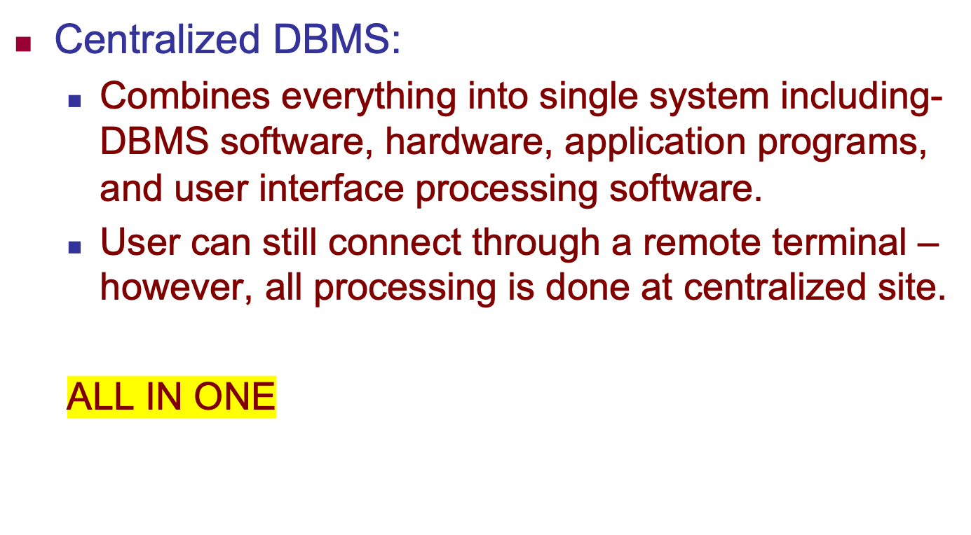
Centralized and
Client-Server DBMS Architectures
Slide 2- <number>

Slide 41

A Physical Centralized Architecture
Slide 2- <number>

Slide 42
Basic 2-tier Client-Server Architectures
Specialized Servers with Specialized functions
  Print server
  File server
  DBMS server
  Web server
  Email server
Clients can access the specialized servers as needed
Slide 2- <number>

Slide 43

Logical two-tier client server architecture
Slide 2- <number>

Slide 44
Clients
Provide appropriate interfaces through a client software module to access and utilize the various server resources.
Clients may be diskless machines or PCs or Workstations with disks with only the client software installed.
Connected to the servers via some form of a network.
  (LAN: local area network, wireless network, etc.)
Slide 2- <number>

Slide 45
DBMS Server
Provides database query and transaction services to the clients
Relational DBMS servers are often called SQL servers, query servers, or transaction servers
Applications running on clients utilize an Application Program Interface (API) to access server databases via standard interface such as:
  ODBC: Open Database Connectivity standard
  JDBC: for Java programming access
Slide 2- <number>

Slide 46
Two Tier Client-Server Architecture
Client and server must install appropriate client module and server module software for ODBC or JDBC
A client program may connect to several DBMSs, sometimes called the data sources.
In general, data sources can be files or other non-DBMS software that manages data.
See Chapter 10 for details on Database Programming
Slide 2- <number>

Slide 47
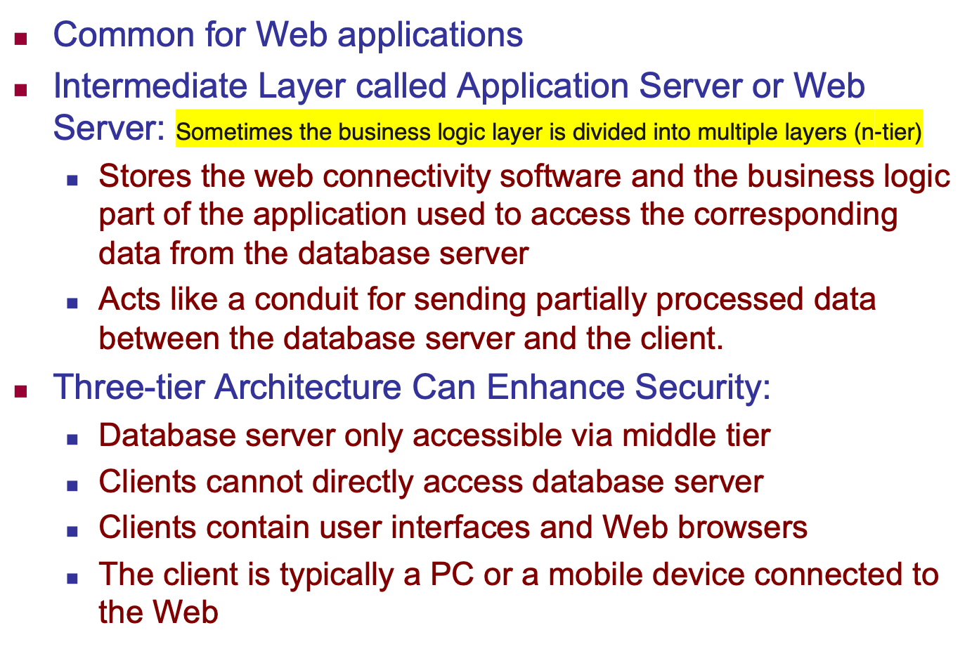
Three Tier Client-Server Architecture
Slide 2- <number>

Slide 48

Three-tier client-server architecture
Slide 2- <number>

Slide 49
Classification of DBMSs
Based on the data model used
  Legacy: Network, Hierarchical.
  Currently Used: Relational, Object-oriented, Object-relational
  Recent Technologies: Key-value storage systems, NOSQL systems: document based, column-based, graph-based and key-value based. Native XML DBMSs.
Other classifications
  Single-user (typically used with personal computers)
  vs. multi-user (most DBMSs).
  Centralized (uses a single computer with one database) vs. distributed (multiple computers, multiple DBs)
Slide 2- <number>

Slide 50
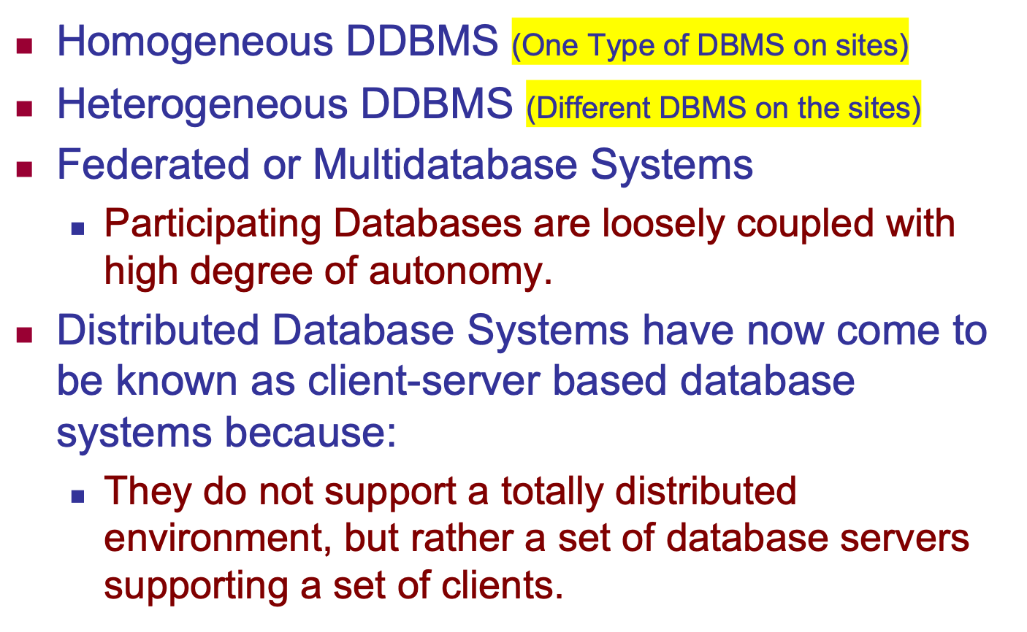
Variations of Distributed DBMSs (DDBMSs)
Slide 2- <number>

Slide 51
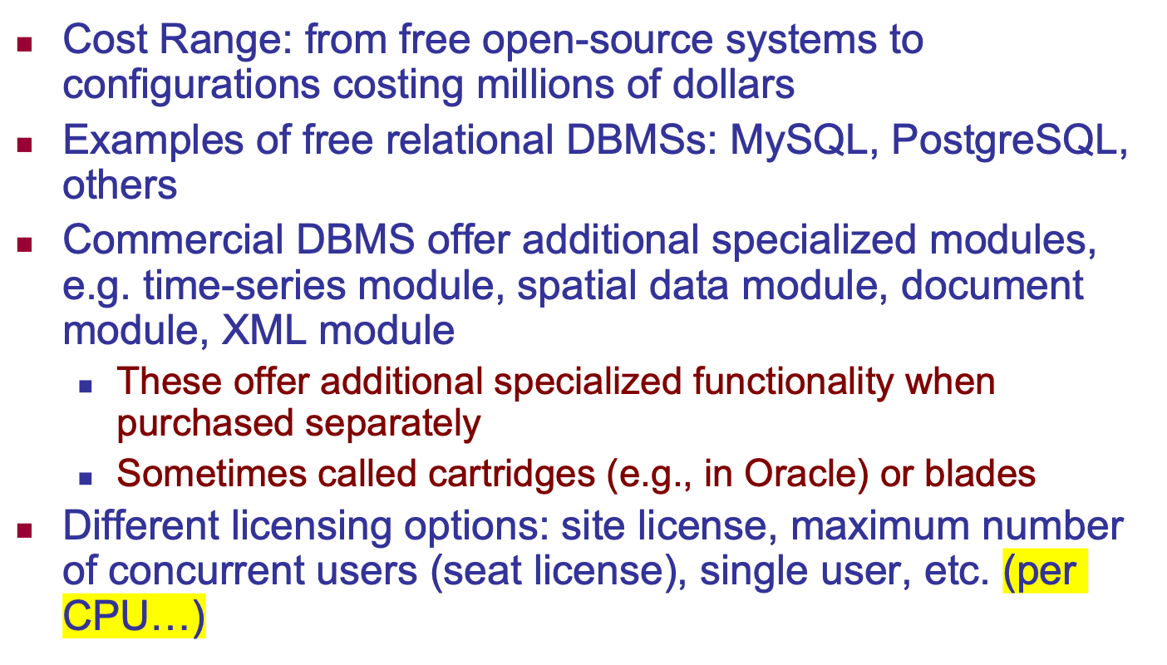
Cost considerations for DBMSs
Slide 2- <number>

Slide 52
Other Considerations
Type of access paths within database system
  E.g.- inverted indexing based (ADABAS is one such system). Fully indexed databases provide access by any keyword (used in search engines)
General Purpose vs. Special Purpose
  E.g.- Airline Reservation systems or many others-reservation systems for hotel/car etc. Are special purpose OLTP (Online Transaction Processing Systems)
Slide 2- <number>

Slide 53
Inverted indexing-based database
Is a type of database that relies on an inverted index structure to enable fast search and retrieval of data
Unlike traditional relational databases, which store records in a row-column format, inverted index databases are optimized for full-text search by mapping words or tokens to the records (or documents) in which they appear.
Slide 2- <number>

Slide 54
What is an Inverted Index?
An inverted index (also known as a reverse index) is a data structure used for searching text-based information efficiently.
Instead of mapping records to their content, it maps words or terms to the locations (documents or database entries) where they appear.
Words points out documents
Slide 2- <number>

Slide 55
How Does It Work?
1. Data Processing: The system analyzes the input data and breaks it down into tokens (words or phrases).
2. Index Creation: Each token is mapped to the records where it appears.
3. Query Execution: When a user searches for a keyword, the system looks it up in the index and retrieves relevant records instantly.
Slide 2- <number>

Slide 56
Example
Doc ID | Content
1 | “Database indexing is important”
2 | “Inverted index speeds up search”
3 | “Database search uses index”
Word | Doc IDs
database | 1, 3
index | 2, 3
important | 1
inverted | 2
is | 1
search | 2, 3
speeds | 2
up | 2
uses | 3
Now, if we search for “database”, the system instantly retrieves documents [1,3] instead of scanning everything.
Slide 2- <number>

Slide 57
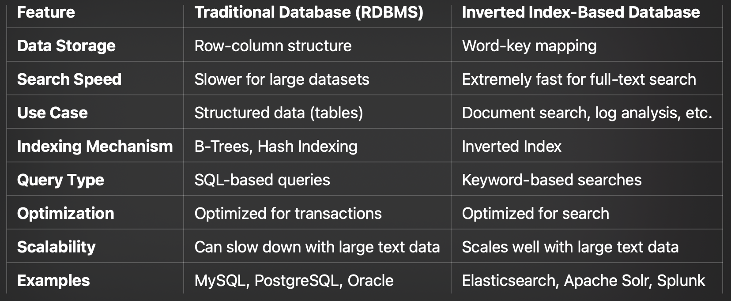
Comparison with the Traditional DBMSs
Slide 2- <number>

Slide 58
History of Data Models (Additional Material)
Network Model
Hierarchical Model
Relational Model
Object-oriented Data Models
Object-Relational Models
Slide 2- <number>

Slide 59
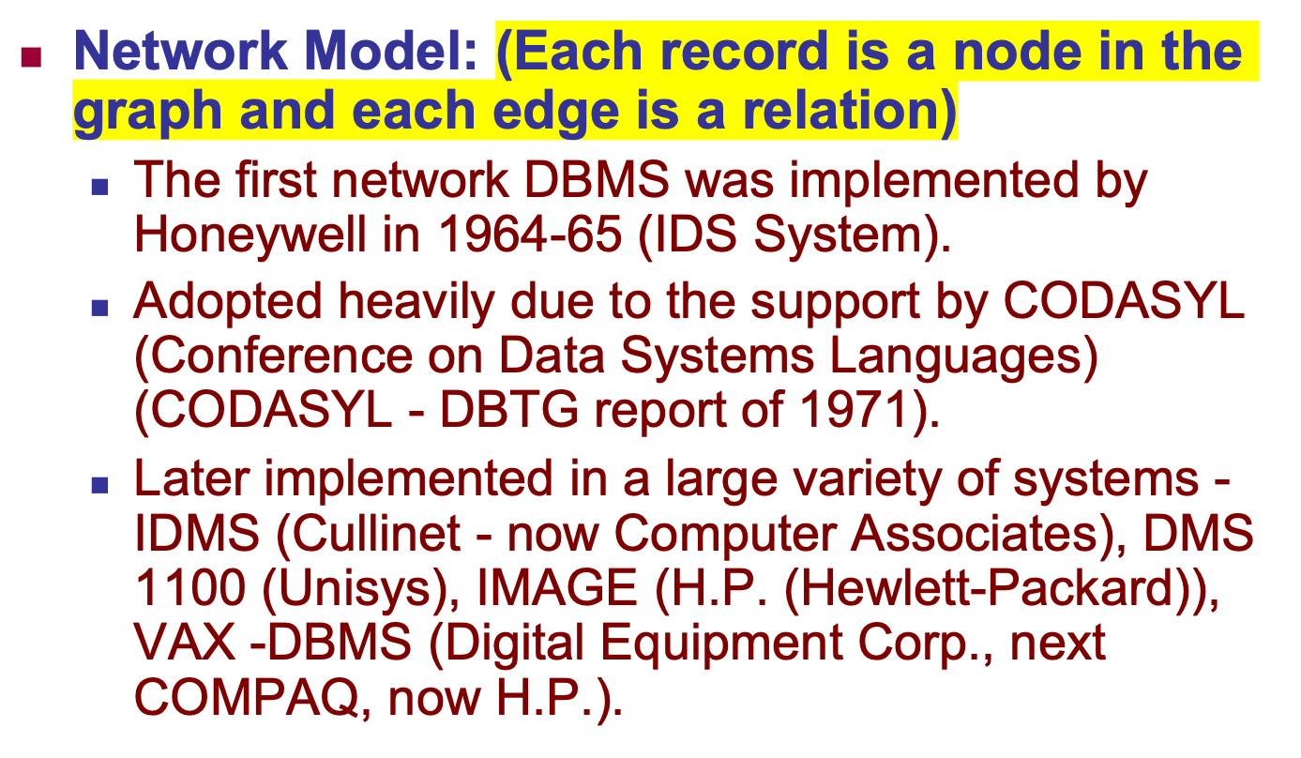
History of Data Models
Slide 2- <number>

Slide 60
Network Model
Advantages:
  Network Model is able to model complex relationships and represents semantics of add/delete on the relationships.
  Can handle most situations for modeling using record types and relationship types.
  Language is navigational; uses constructs like FIND, FIND member, FIND owner, FIND NEXT within set, GET, etc.
    Programmers can do optimal navigation through the database.
Slide 2- <number>

Slide 61
Network Model
Disadvantages:
  Navigational and procedural nature of processing
  Database contains a complex array of pointers that thread through a set of records.
    Little scope for automated “query optimization”
Slide 2- <number>

Slide 62
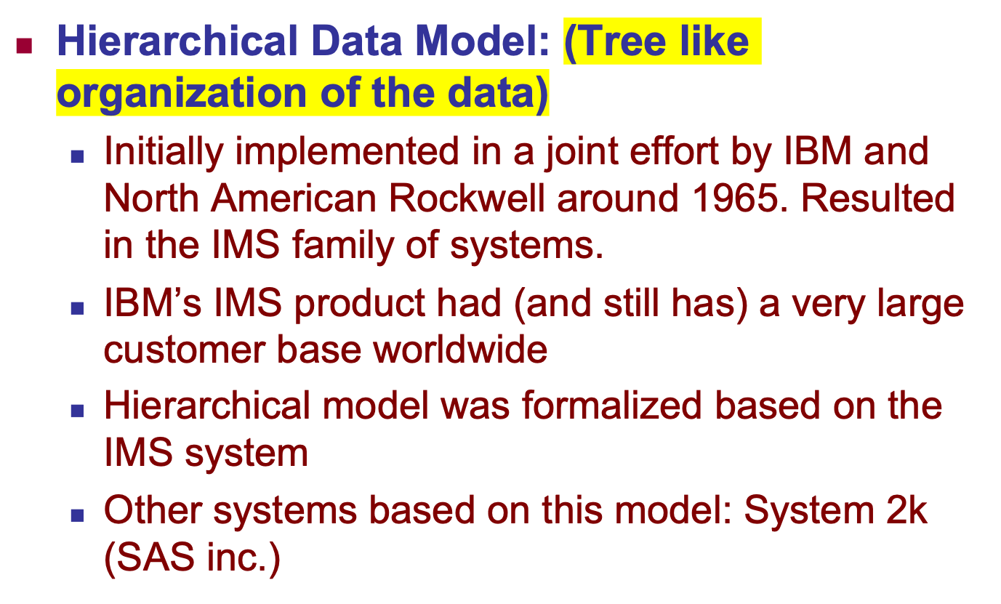
History of Data Models
Slide 2- <number>

Slide 63
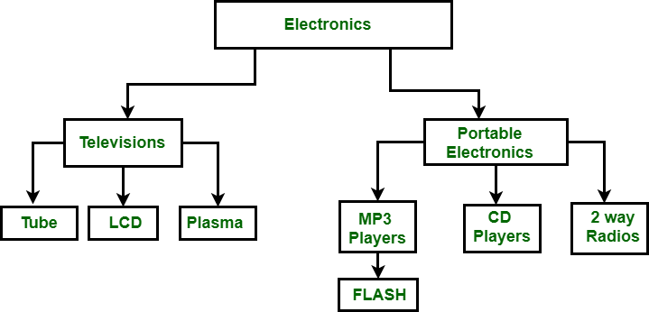
Hierarchical Model
Advantages:
  Fast Data Retrieval – Efficient for hierarchical queries.
  Data Integrity – Maintains strong parent-child relationships.
  Security – Access is controlled based on hierarchy.
  Simplicity – Easy to understand and implement for structured data.
Disadvantages:
  Limited Flexibility – Changes in hierarchy require schema modification.
  Redundant Data – Requires data duplication across branches.
  Difficult Querying – Complex queries require navigating multiple levels.
  One-to-One & One-to-Many Only – Does not support many-to-many relationships.
Slide 2- <number>

Slide 64
History of Data Models
Relational Model:
  Proposed in 1970 by E.F. Codd (IBM), first commercial system in 1981-82.
  Now in several commercial products (e.g. DB2, ORACLE, MS SQL Server, SYBASE, INFORMIX).
  Several free open source implementations, e.g. MySQL, PostgreSQL
  Currently most dominant for developing database applications.
  SQL relational standards: SQL-89 (SQL1), SQL-92 (SQL2), SQL-99, SQL3, …
  Chapters 5 through 11 describe this model in detail
Slide 2- <number>

Slide 65
History of Data Models
Object-oriented Data Models:
  Several models have been proposed for implementing in a database system.
  One set comprises models of persistent O-O Programming Languages such as C++ (e.g., in OBJECTSTORE or VERSANT), and Smalltalk (e.g., in GEMSTONE).
  Additionally, systems like O2, ORION (at MCC - then ITASCA), IRIS (at H.P.- used in Open OODB).
  Object Database Standard: ODMG-93, ODMG-version 2.0, ODMG-version 3.0.
  Chapter 12 describes this model.
Slide 2- <number>

Slide 66
Object-Oriented Database (OODB)
An Object-Oriented Database (OODB) is a database that stores data in the form of objects
Similar to how data is represented in object-oriented programming (OOP) languages such as Java, C++, Python, and C#.
Instead of using tables (like relational databases), OODBs store objects that include both data (attributes) and methods (functions) that operate on the data.
Slide 2- <number>

Slide 67
Key Features of Object-Oriented Databases
1. Object Storage Model
  Stores real-world entities as objects, similar to OOP.
  Objects contain attributes (data) and methods (functions).
2. Encapsulation
  Objects bundle data and behavior together.
  Example: A “Car” object contains brand, model, speed (attributes) and accelerate(), brake() (methods).
Slide 2- <number>

Slide 68
Key Features of Object-Oriented Databases (cont.)
3. Inheritance
  Objects can inherit properties and behaviors from other objects.
  Example: A Truck object can inherit from a Vehicle object.
4. Polymorphism
  Different objects can process the same method differently.
  Example: A draw() function behaves differently for Circle, Square, and Triangle objects.
Slide 2- <number>

Slide 69
Key Features of Object-Oriented Databases (cont.)
5. Complex Data Handling
  Supports multimedia, CAD, geospatial, and scientific data, which is difficult in relational databases.
6. Persistent Objects
  Objects are saved permanently in the database and retrieved when needed.
Slide 2- <number>

Slide 70
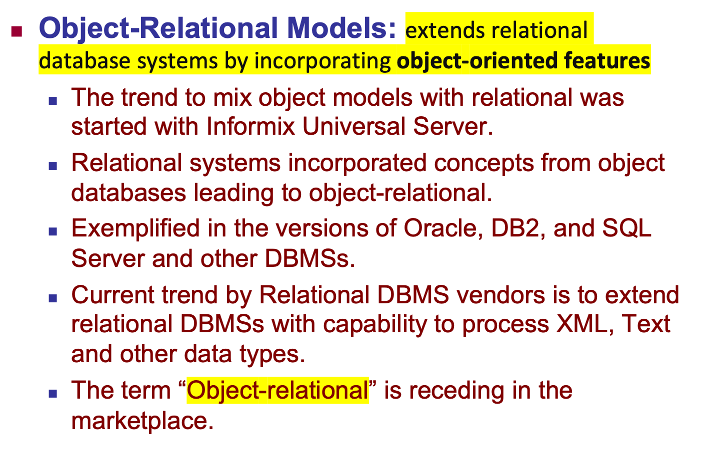
History of Data Models
Slide 2- <number>

Slide 71
Chapter Summary
Data Models and Their Categories
Schemas, Instances, and States
Three-Schema Architecture
Data Independence
DBMS Languages and Interfaces
Database System Utilities and Tools
Database System Environment
Centralized and Client-Server Architectures
Classification of DBMSs
History of Data Models
Slide 2- <number>

