Slide 1
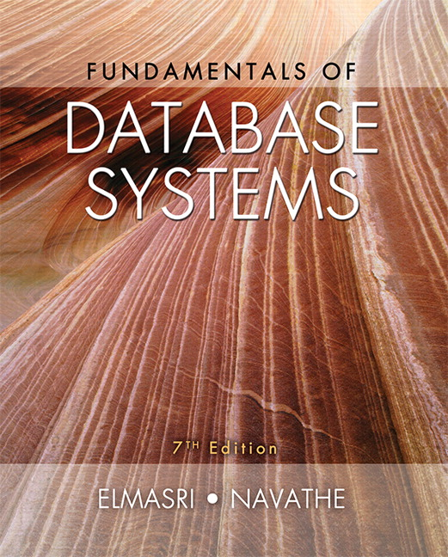

Slide 2
CHAPTER 4
Enhanced Entity-Relationship (EER) Modeling

Slide 3
Chapter Outline
EER stands for Enhanced ER or Extended ER
EER Model Concepts
Includes all modeling concepts of basic ER
Additional concepts:
subclasses/superclasses
specialization/generalization
categories (UNION types)
attribute and relationship inheritance
Constraints on Specialization/Generalization
The additional EER concepts are used to model applications more completely and more accurately
EER includes some object-oriented concepts, such as inheritance
Knowledge Representation and Ontology Concepts

Slide 4
Need for Additional Semantic Data Modeling Concepts
Designers of database applications have tried to design more accurate database schemas that reflect the data properties and constraints more precisely.
This was particularly important for newer applications of database technology, such as databases for engineering design and manufacturing (CAD/CAM), telecommunications, complex software systems, and geographic information systems (GISs), among many other applications.

Slide 5
Enhansed ER (EER)
In this chapter, we describe features that have been proposed for semantic data models
How the ER model can be enhanced to include additional more complex concepts, which leads to the enhanced ER (EER) model.
class/subclass relationships
type inheritance
specialization and generalization.
category or union

Slide 6
Subclasses and Superclasses (1)
An entity type may have additional meaningful subgroupings of its entities
Example: EMPLOYEE may be further grouped into:
SECRETARY, ENGINEER, TECHNICIAN, …
Based on the EMPLOYEE’s Job
MANAGER
EMPLOYEEs who are managers (the role they play)
SALARIED_EMPLOYEE, HOURLY_EMPLOYEE
Based on the EMPLOYEE’s method of pay
EER diagrams extend ER diagrams to represent these additional subgroupings, called subclasses or subtypes

Slide 7
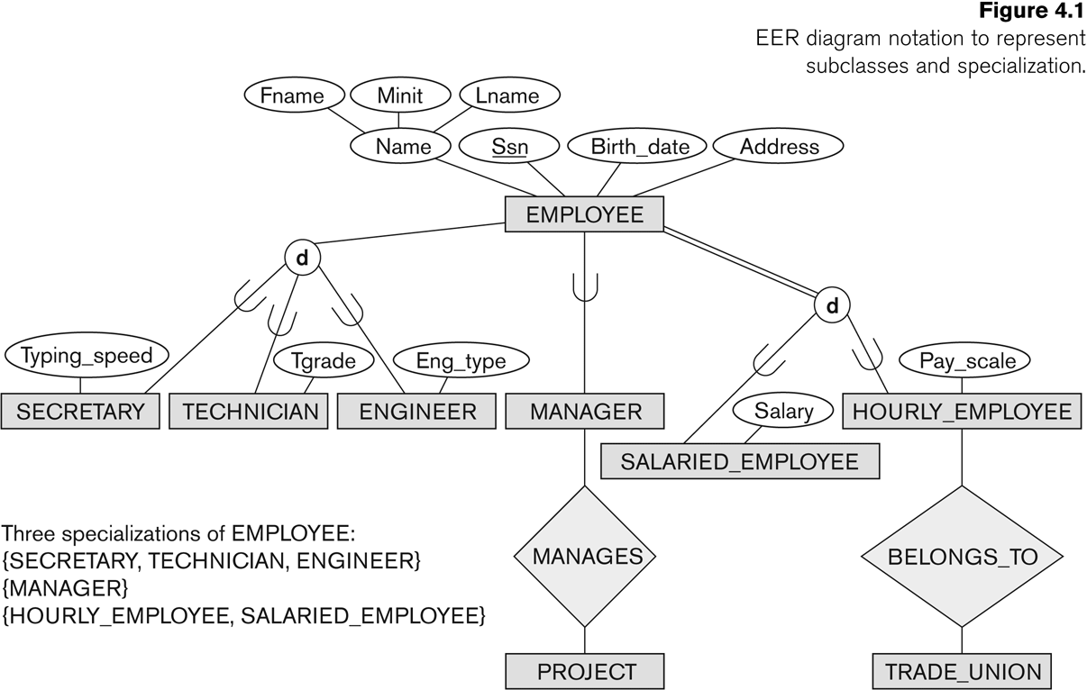

Subclasses and Superclasses
We do not need a circle if there is only one subclass

Slide 8
Subclasses and Superclasses (2)
Each of these subgroupings is a subset of EMPLOYEE entities
Each is called a subclass of EMPLOYEE
EMPLOYEE is the superclass for each of these subclasses
These are called superclass/subclass relationships:
EMPLOYEE/SECRETARY
EMPLOYEE/TECHNICIAN
EMPLOYEE/MANAGER
…
Subclass inherits all the attributes of the entity as a member of the superclass.

Slide 9
Subclasses and Superclasses (3)
These are also called IS-A relationships
SECRETARY IS-A EMPLOYEE, TECHNICIAN IS-A EMPLOYEE, ….
Note: An entity that is member of a subclass represents the same real-world entity as some member of the superclass:
The subclass member is the same entity in a distinct specific role
An entity cannot exist in the database merely by being a member of a subclass; it must also be a member of the superclass
A member of the superclass can be optionally included as a member of any number of its subclasses

Slide 10
Subclasses and Superclasses (4)
Examples:
A salaried employee who is also an engineer belongs to the two subclasses:
ENGINEER, and
SALARIED_EMPLOYEE
A salaried employee who is also an engineering manager belongs to the three subclasses:
MANAGER,
ENGINEER, and
SALARIED_EMPLOYEE
It is not necessary that every entity in a superclass be a member of some subclass

Slide 11
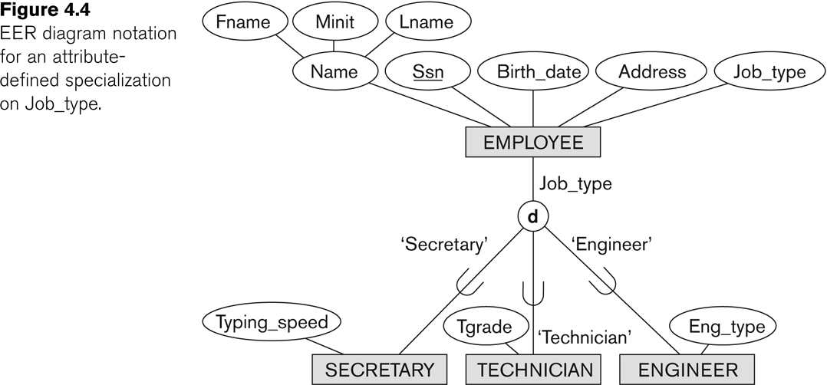
Representing Specialization in EER Diagrams
Specilization based on

Slide 12
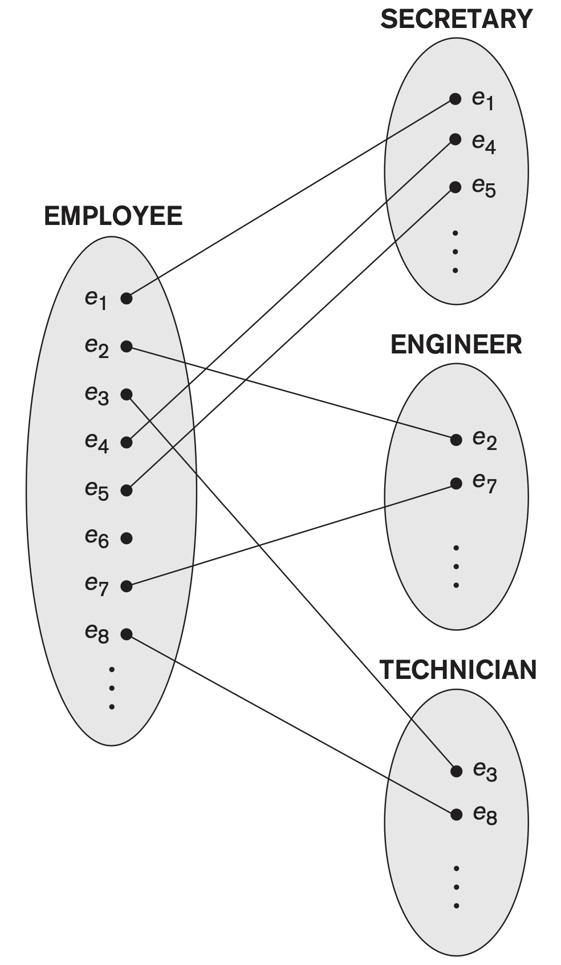
Instances of a Specilization

Slide 13
Attribute Inheritance in Superclass / Subclass Relationships
An entity that is member of a subclass inherits
All attributes of the entity as a member of the superclass
All relationships of the entity as a member of the superclass
Example:
In the previous slide, SECRETARY (as well as TECHNICIAN and ENGINEER) inherit the attributes Name, SSN, …, from EMPLOYEE
Every SECRETARY entity will have values for the inherited attributes

Slide 14
Specialization (1)
Specialization is the process of defining a set of subclasses of a superclass
The set of subclasses is based upon some distinguishing characteristics of the entities in the superclass
Example: {SECRETARY, ENGINEER, TECHNICIAN} is a specialization of EMPLOYEE based upon job type.
Example: MANAGER is a specialization of EMPLOYEE based on the role the employee plays
May have several specializations of the same superclass

Slide 15
Specialization (2)
Example: Another specialization of EMPLOYEE based on method of pay is {SALARIED_EMPLOYEE, HOURLY_EMPLOYEE}.
Superclass/subclass relationships and specialization can be diagrammatically represented in EER diagrams
Attributes of a subclass are called specific or local attributes.
For example, the attribute TypingSpeed of SECRETARY
The subclass can also participate in specific relationship types.
For example, a relationship BELONGS_TO of HOURLY_EMPLOYEE (Next Slide)

Slide 16
Specialization (3)
Note: The entity also inherits all the relationships in which the superclass participates.
A subtype can have a relationship with another entity.

Slide 17
Generalization
Generalization is the reverse of the specialization process
Several classes with common features are generalized into a superclass;
original classes become its subclasses
Example: CAR, TRUCK generalized into VEHICLE;
both CAR, TRUCK become subclasses of the superclass VEHICLE.
We can view {CAR, TRUCK} as a specialization of VEHICLE
Alternatively, we can view VEHICLE as a generalization of CAR and TRUCK

Slide 18
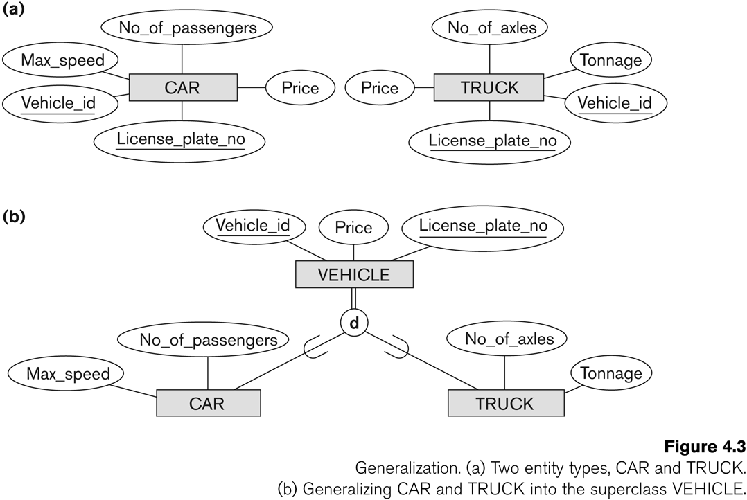
Generalization (2)

Slide 19
Generalization and Specialization (1)
Diagrammatic notations are sometimes used to distinguish between generalization and specialization
Arrow pointing to the generalized superclass represents a generalization
Arrows pointing to the specialized subclasses represent a specialization
We do not use this notation because it is often subjective as to which process is more appropriate for a particular situation
We advocate not drawing any arrows

Slide 20
Generalization and Specialization (2)
Data Modeling with Specialization and Generalization
A superclass or subclass represents a collection (or set or grouping) of entities
It also represents a particular type of entity
Shown in rectangles in EER diagrams (as are entity types)
We can call all entity types (and their corresponding collections) classes, whether they are entity types, superclasses, or subclasses

Slide 21
Types of Specialization
Predicate-defined (or condition-defined) : based on some predicate. E.g., based on value of an attribute, say, Job-type, or Age.
Attribute-defined: shows the name of the attribute next to the line drawn from the superclass toward the subclasses (see Fig. 4.1)
User-defined: membership is defined by the user on an entity by entity basis

Slide 22
Constraints on Specialization and Generalization (1)
If we can determine exactly those entities that will become members of each subclass by a condition, the subclasses are called predicate-defined (or condition-defined) subclasses
Condition is a constraint that determines subclass members
Display a predicate-defined subclass by writing the predicate condition next to the line attaching the subclass to its superclass

Slide 23
Constraints on Specialization and Generalization (2)
If all subclasses in a specialization have membership condition on same attribute of the superclass, specialization is called an attribute-defined specialization
Attribute is called the defining attribute of the specialization
Example: JobType is the defining attribute of the specialization {SECRETARY, TECHNICIAN, ENGINEER} of EMPLOYEE
If no condition determines membership, the subclass is called user-defined
Membership in a subclass is determined by the database users by applying an operation to add an entity to the subclass
Membership in the subclass is specified individually for each entity in the superclass by the user
Not by any condition that may be evaluated automatically.

Slide 24
Displaying an attribute-defined specialization in EER diagrams
If all subclasses in a specialization have their membership condition on the same attribute of the superclass, the specialization itself is called an attribute-defined

Slide 25
Constraints on Specialization and Generalization (3)
Two basic constraints can apply to a specialization/generalization:
Disjointness Constraint:
Completeness Constraint:

Slide 26
Constraints on Specialization and Generalization (4)
Disjointness Constraint:
Specifies that the subclasses of the specialization must be disjoint:
an entity can be a member of at most one of the subclasses of the specialization
Specified by d in EER diagram
If not disjoint, specialization is overlapping:
that is the same entity may be a member of more than one subclass of the specialization
Specified by o in EER diagram

Slide 27
Constraints on Specialization and Generalization (5)
Completeness (Exhaustiveness) Constraint:
Total specifies that every entity in the superclass must be a member of some subclass in the specialization/generalization
Shown in EER diagrams by a double line
Partial allows an entity not to belong to any of the subclasses
Shown in EER diagrams by a single line

Slide 28
Constraints on Specialization and Generalization (6)
Hence, we have four types of specialization/generalization:
Disjoint, total
Disjoint, partial
Overlapping, total
Overlapping, partial
Note: Generalization usually is total because the superclass is derived from the subclasses.

Slide 29
Example of disjoint partial Specialization

Slide 30
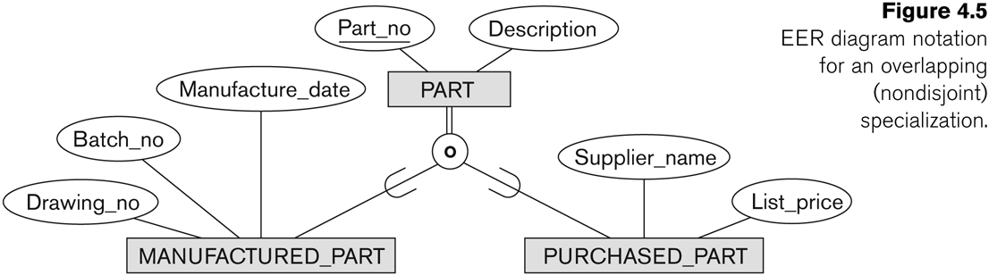
Example of overlapping total Specialization

Slide 31
Certain Insertion and Deletion Rules
Deleting an entity from a superclass implies that it is automatically deleted from all the subclasses to which it belongs.
Inserting an entity in a superclass implies that the entity is mandatorily inserted in all predicate-defined (or attribute-defined) subclasses for which the entity satisfies the defining predicate.
Inserting an entity in a superclass of a total specialization implies that the entity is mandatorily inserted in at least one of the subclasses of the specialization.

Slide 32
Specialization/Generalization Hierarchies, Lattices & Shared Subclasses (1)
A subclass may itself have further subclasses specified on it
forms a hierarchy or a lattice
Hierarchy has a constraint that every subclass has only one superclass (called single inheritance); this is basically a tree structure
In a lattice, a subclass can be subclass of more than one superclass (called multiple inheritance)

Slide 33
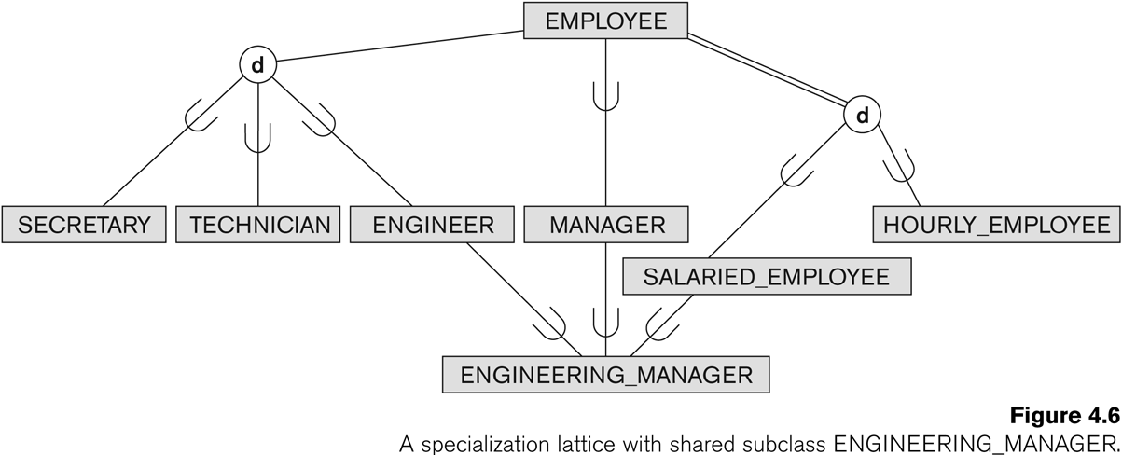
Shared Subclass “Engineering_Manager”

Slide 34
Specialization/Generalization Hierarchies, Lattices & Shared Subclasses (2)
In a lattice or hierarchy, a subclass inherits attributes not only of its direct superclass, but also of all its predecessor superclasses
A subclass with more than one superclass is called a shared subclass (multiple inheritance)
Can have:
specialization hierarchies or lattices, or
generalization hierarchies or lattices,
depending on how they were derived
We just use specialization (to stand for the end result of either specialization or generalization)

Slide 35
Specialization/Generalization Hierarchies, Lattices & Shared Subclasses (3)
In specialization, start with an entity type and then define subclasses of the entity type by successive specialization
called a top down conceptual refinement process
In generalization, start with many entity types and generalize those that have common properties
Called a bottom up conceptual synthesis process
In practice, a combination of both processes is usually employed

Slide 36
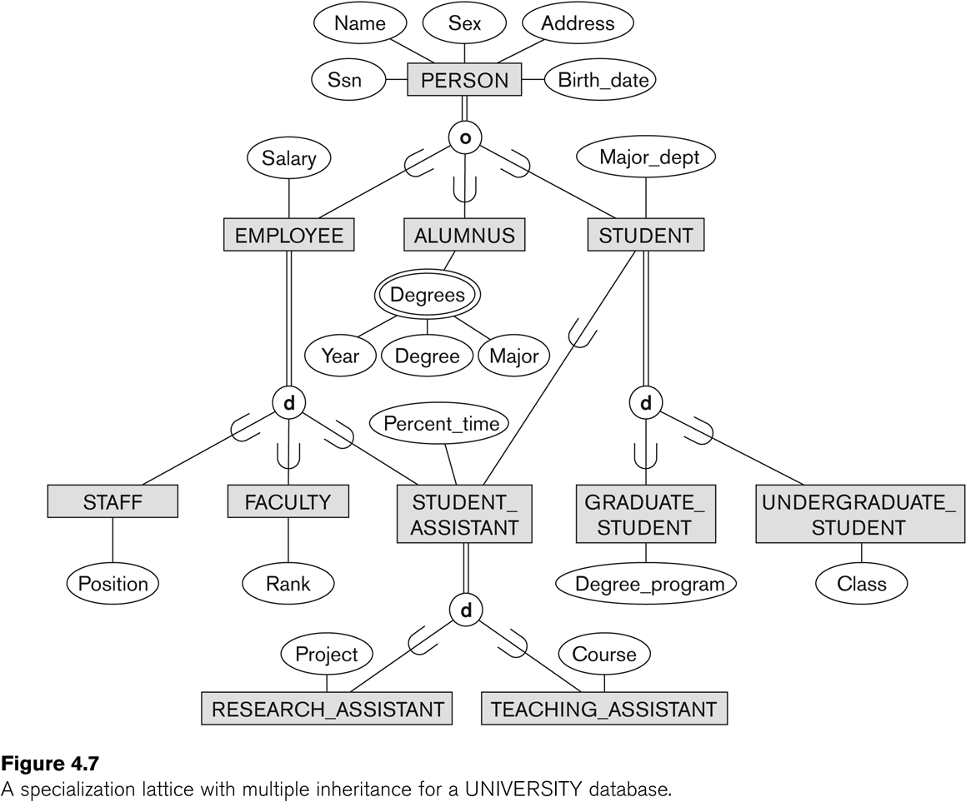
Specialization / Generalization Lattice Example (UNIVERSITY)

Slide 37
The Requirements for the Part of the UNIVERSITY Database
The database keeps track of three types of persons: employees, alumni, and students. A person can belong to one, two, or all three of these types. Each person has a name, SSN, sex, address, and birth date.
Every employee has a salary, and there are three types of employees: faculty, staff, and student assistants. Each employee belongs to exactly one of these types. For each alumnus, a record of the degree or degrees that he or she earned at the university is kept, including the name of the degree, the year granted, and the major department. Each student has a major department.

Slide 38
The Requirements for the Part of the UNIVERSITY Database
Each faculty has a rank, whereas each staff member has a staff position. Student assistants are classified further as either research assistants or teaching assistants, and the percent of time that they work is recorded in the database. Research assistants have their research project stored, whereas teaching assistants have the current course they work on.
Students are further classified as either graduate or undergraduate, with the specific attributes degree program (M.S., Ph.D., M.B.A., and so on) for graduate students and class (freshman, sophomore, and so on) for undergraduates.

Slide 39
Generalization or Specilization
Top-down conceptual refinement
Start from Person all the ways to the research assistant
Bottom-up conceptual synthesis
Subclasses are discovered first, then generalize them
You can als.o use both combinations

Slide 40
Categories (UNION TYPES)
It is sometimes necessary to represent a collection of entities from different entity types
In this case, a subclass will represent a collection of entities that is a subset of the UNION of entities from distinct entity types
we call such a subclass a union type or a category.

Slide 41
Categories (UNION TYPES)
It is different from the shared subclass which is the member of all its subclasses
ex:ENGINEERING_MANAGER, an engineering manager must be an ENGINEER, a MANAGER, and a SALARIED_EMPLOYEE;
However, in union a subclass must exist only one of its superclasses.
You can think of union as interface in OOP

Slide 42
Categories (UNION TYPES)
Example: In a database for vehicle registration, a vehicle owner can be a PERSON, a BANK (holding a lien on a vehicle) or a COMPANY.
A category (UNION type) called OWNER is created to represent a subset of the union of the three superclasses COMPANY, BANK, and PERSON
A category member must exist in at least one (typically just one) of its superclasses
Difference from shared subclass, which is a:
subset of the intersection of its superclasses
shared subclass member must exist in all of its superclasses

Slide 43
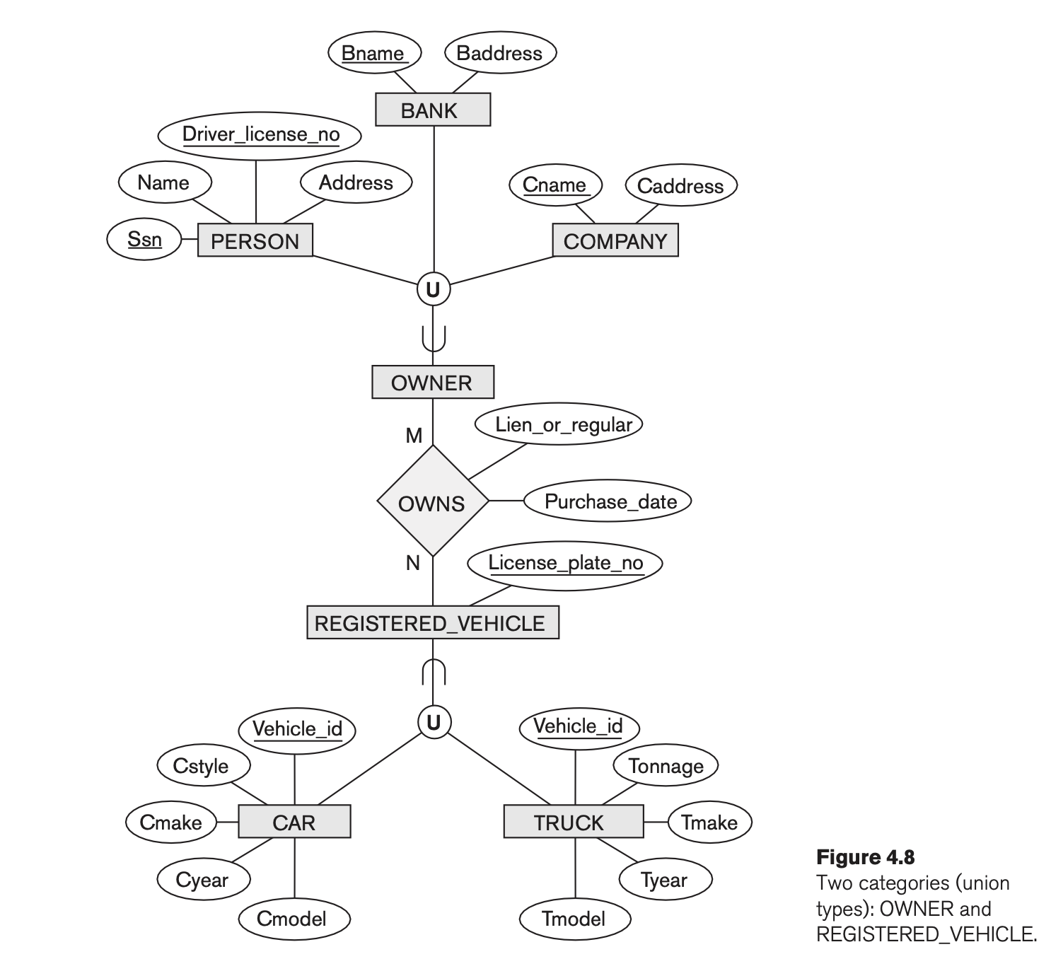
Two categories (UNION types): OWNER, REGISTERED_VEHICLE

Slide 44
Categories (UNION TYPES) Attribute Inheritance
Attribute inheritance works more selectively in the case of categories.
OWNER entity inherits the attributes of a COMPANY, a PERSON, or a BANK, depending on the superclass to which the entity belongs.
On the other hand, in specialization subclass gets all the attributes (ex. ENGINEERING_MANAGER inherits all the attributes of its superclasses SALARIED_EMPLOYEE, ENGINEER, and MANAGER)

Slide 45
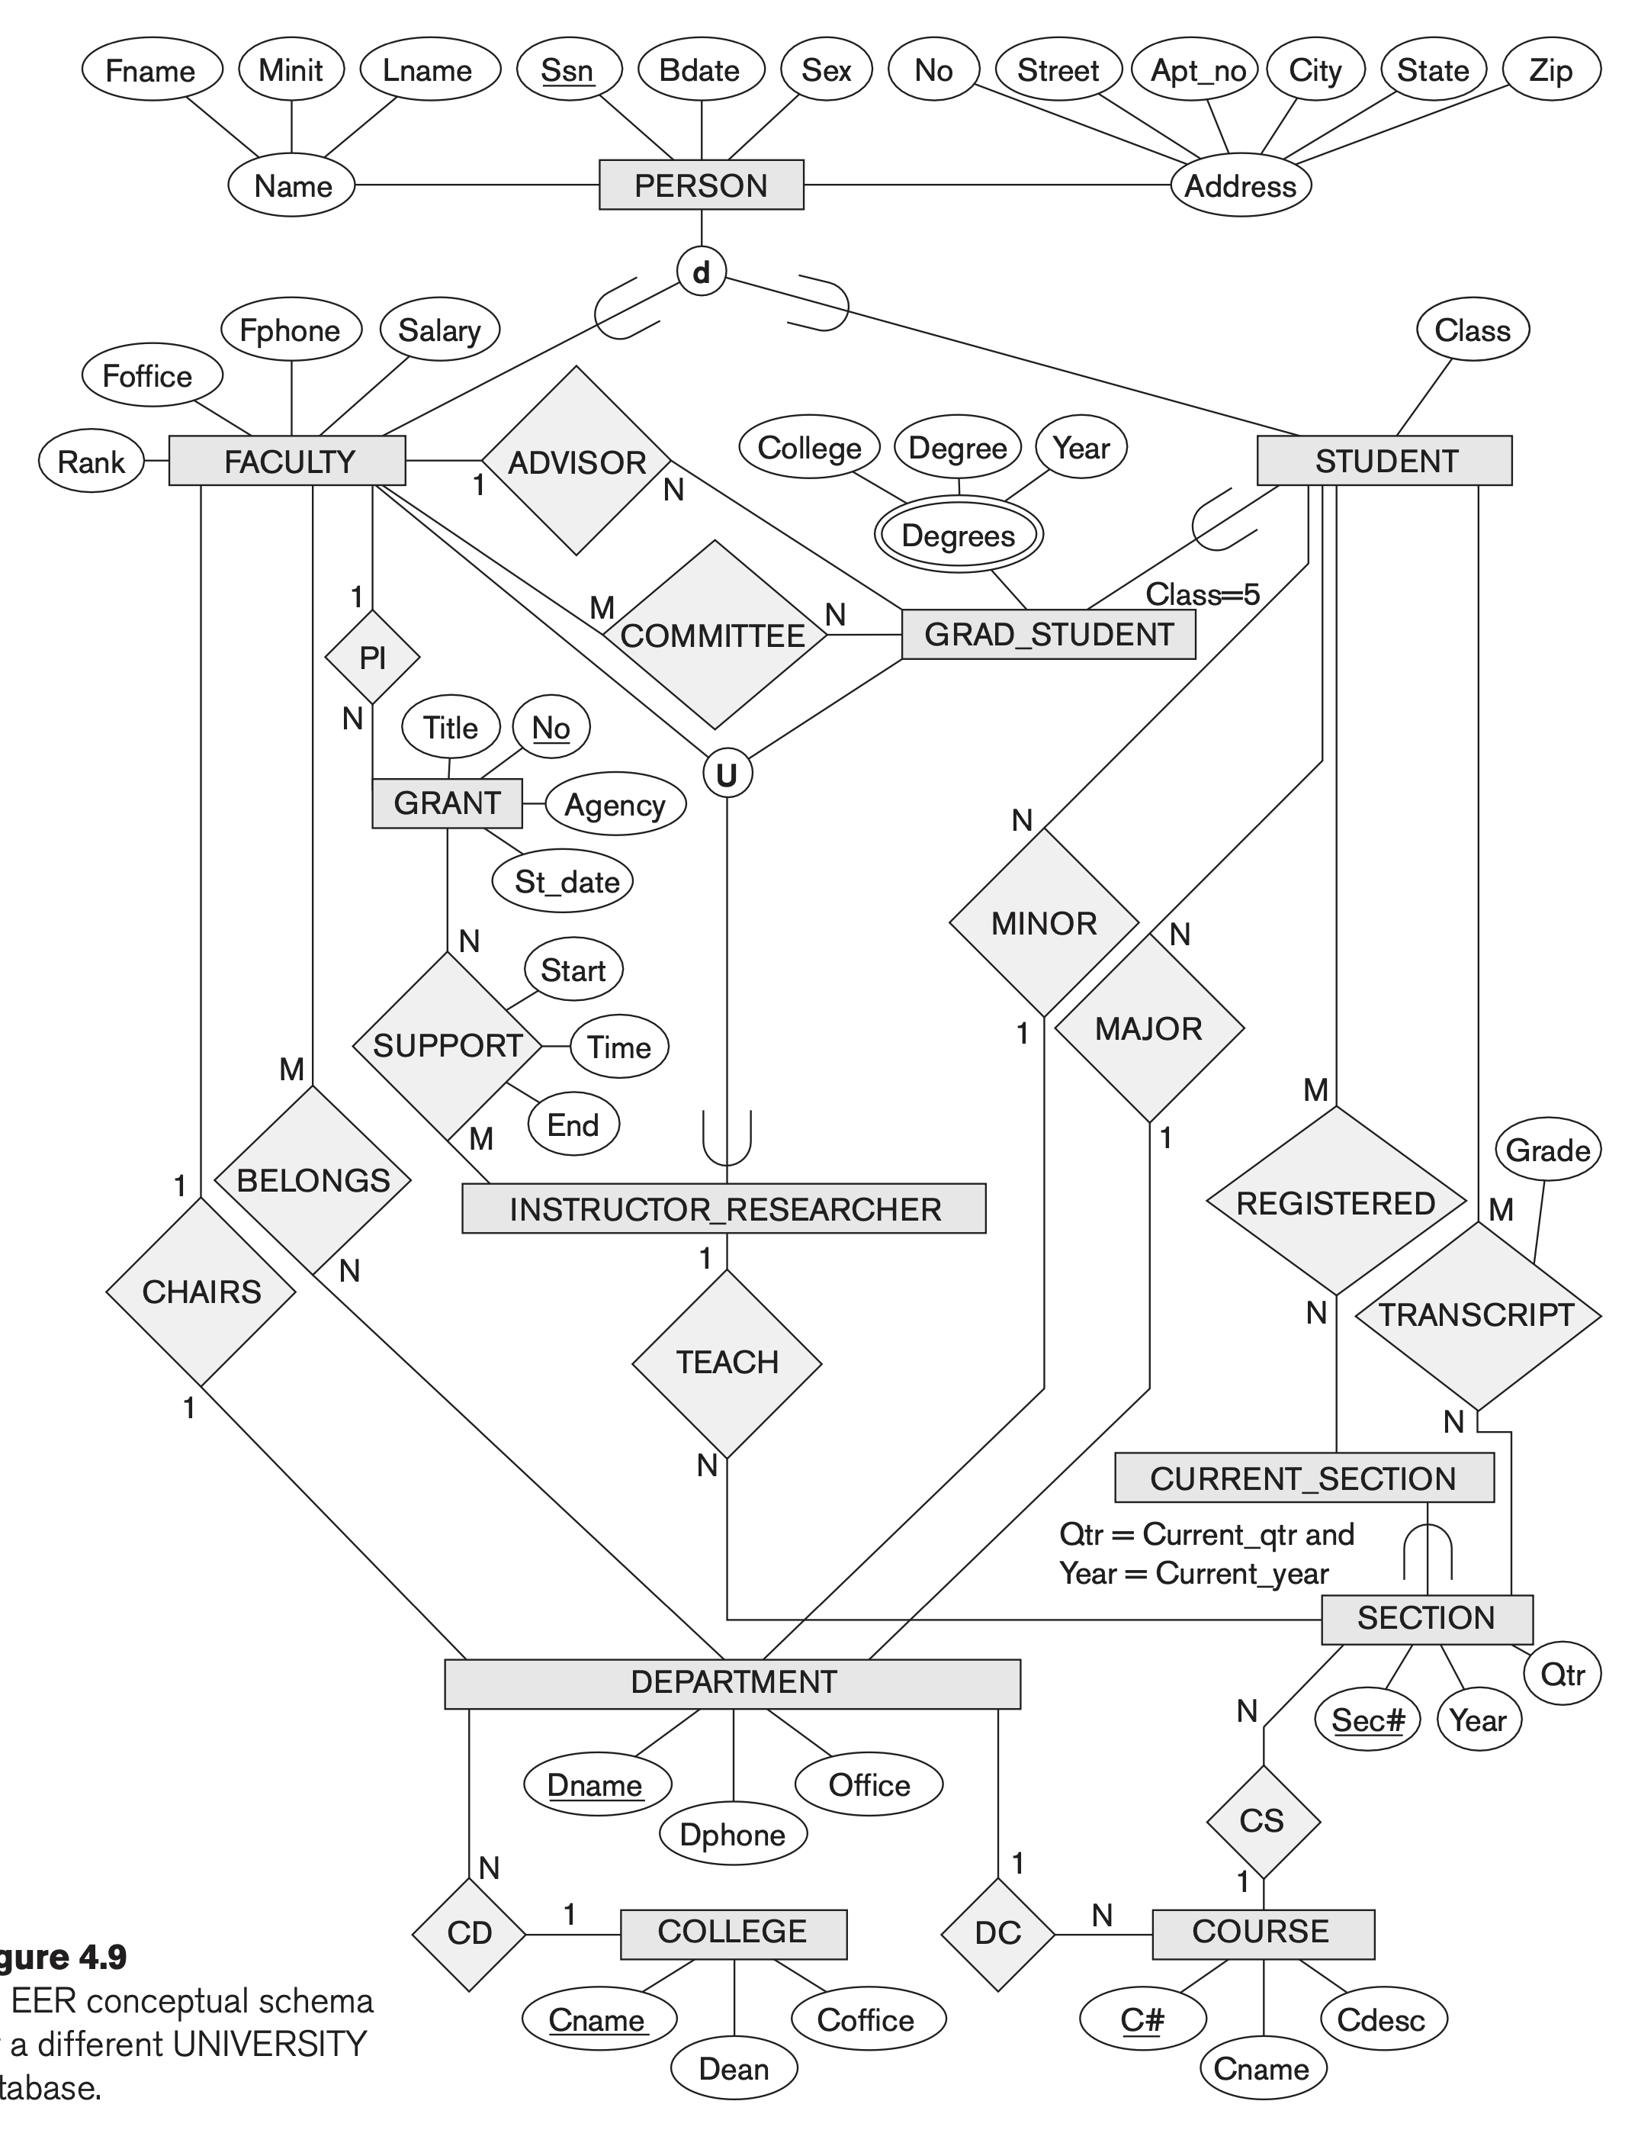

Slide 46
For each person, the database maintains information on the person’s Name [Name], Social Security number [Ssn], address [Address], sex [Sex], and birth date [Bdate]. Two subclasses of the PERSON entity type are identified: FACULTY and STUDENT. Specific attributes of FACULTY are rank [Rank] (assistant, associate, adjunct, research, visiting, and so on), office [Foffice], office phone [Fphone], and salary [Salary]. All faculty members are related to the academic department(s) with which they are affiliated [BELONGS] (a faculty member can be associated with several departments, so the relationship is M:N). A specific attribute of STUDENT is [Class] (freshman = 1, sophomore = 2, … , MS student = 5, PhD student = 6). Each STUDENT is also related to his or her major and minor departments (if known) [MAJOR] and [MINOR], to the course sections he or she is currently attending [REGISTERED], and to the courses completed [TRANSCRIPT]. Each TRANSCRIPT instance includes the grade the student received [Grade] in a section of a course.
GRAD_STUDENT is a subclass of STUDENT, with the defining predicate (Class = 5 OR Class = 6). For each graduate student, we keep a list of previous degrees in a composite, multivalued attribute [Degrees]. We also relate the graduate student to a faculty advisor [ADVISOR] and to a thesis committee [COMMITTEE], if one exists.

Slide 47
An academic department has the attributes name [Dname], telephone [Dphone], and office number [Office] and is related to the faculty member who is its chairperson [CHAIRS] and to the college to which it belongs [CD]. Each college has attributes college name [Cname], office number [Coffice], and the name of its dean [Dean].
A course has attributes course number [C#], course name [Cname], and course description [Cdesc]. Several sections of each course are offered, with each section having the attributes section number [Sec#] and the year and quarter in which the section was offered ([Year] and [Qtr]).10 Section numbers uniquely identify each section. The sections being offered during the current quarter are in a subclass CURRENT_SECTION of SECTION, with the defining predicate Qtr = Current_qtr and Year = Current_year. Each section is related to the instructor who taught or is teaching it ([TEACH]), if that instructor is in the database.

Slide 48
The category INSTRUCTOR_RESEARCHER is a subset of the union of FACULTY and GRAD_STUDENT and includes all faculty, as well as graduate students who are supported by teaching or research. Finally, the entity type GRANT keeps track of research grants and contracts awarded to the university. Each grant has attributes grant title [Title], grant number [No], the awarding agency [Agency], and the starting date [St_date]. A grant is related to one principal investigator [PI] and to all researchers it supports [SUPPORT]. Each instance of support has as attributes the starting date of support [Start], the ending date of the support (if known) [End], and the percentage of time being spent on the project [Time] by the researcher being supported.

Slide 49
Formal Definitions of EER Model (1)
Class C:
A type of entity with a corresponding set of entities:
could be entity type, subclass, superclass, or category
Note: The definition of relationship type in ER/EER should have 'entity type' replaced with 'class‘ to allow relationships among classes in general
Subclass S is a class whose:
Type inherits all the attributes and relationship of a class C
Set of entities must always be a subset of the set of entities of the other class C
S ⊆ C
C is called the superclass of S
A superclass/subclass relationship exists between S and C

Slide 50
Formal Definitions of EER Model (2)
Specialization Z: Z = {S1, S2,…, Sn} is a set of subclasses with same superclass G; hence, G/Si is a superclass relationship for i = 1, …., n.
G is called a generalization of the subclasses {S1, S2,…, Sn}
Z is total if we always have:
S1 ∪ S2 ∪ … ∪ Sn = G; subclasses cover entire superclass
Otherwise, Z is partial. Some elements are not in sublasses
Z is disjoint if we always have:
Si ∩ Sj empty-set for i ≠ j;
Otherwise, Z is overlapping.

Slide 51
Formal Definitions of EER Model (3)
Subclass S of C is predicate defined if predicate (condition) p on attributes of C is used to specify membership in S;
that is, S = C[p], where C[p] is the set of entities in C that satisfy condition p
A subclass not defined by a predicate is called user-defined
Attribute-defined specialization: if a predicate A = ci (where A is an attribute of G and ci is a constant value from the domain of A) is used to specify membership in each subclass Si in Z
Note: If ci ≠ cj for i ≠ j, and A is single-valued, then the attribute-defined specialization will be disjoint.

Slide 52
Formal Definitions of EER Model (4)
Category or UNION type T
A class that is a subset of the union of n defining superclasses D1, D2,…Dn, n>1:
T ⊆ (D1 ∪ D2 ∪ … ∪ Dn)
Can have a predicate pi on the attributes of Di to specify entities of Di that are members of T.
If a predicate is specified on every Di: T = (D1[p1] ∪ D2[p2] ∪…∪ Dn[pn])

Slide 53
Alternative diagrammatic notations
ER/EER diagrams are a specific notation for displaying the concepts of the model diagrammatically
DB design tools use many alternative notations for the same or similar concepts
One popular alternative notation uses UML class diagrams
see next slides for UML class diagrams and other alternative notations

Slide 54
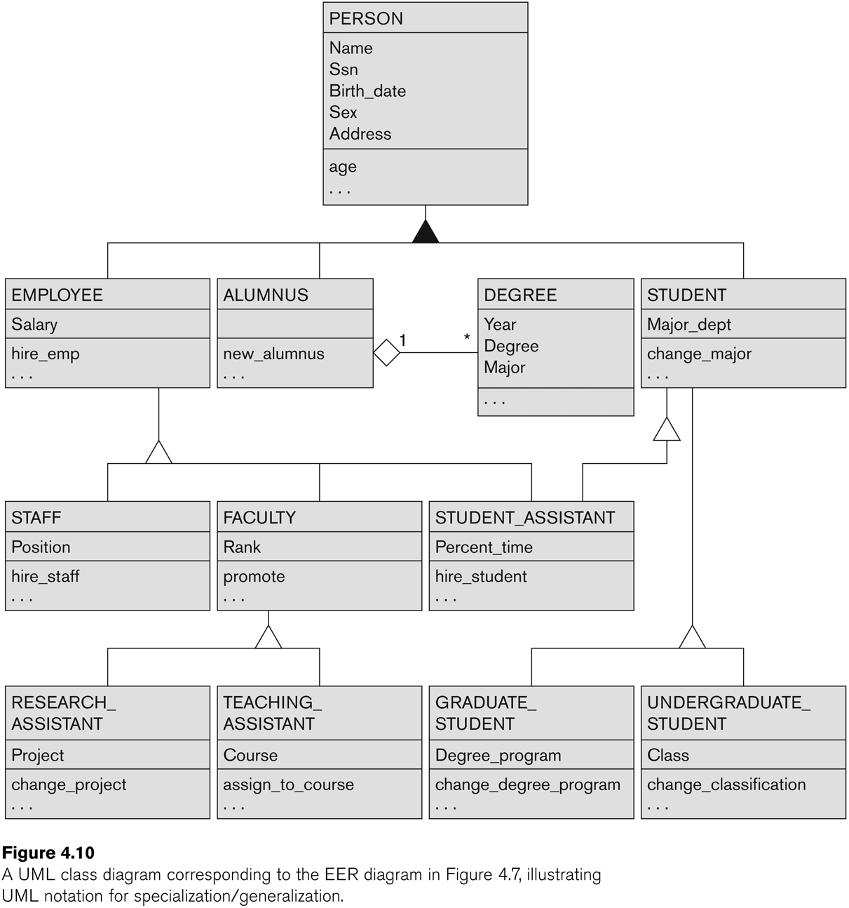
UML Example for Displaying Specialization / Generalization
overlapping
disjoint

Slide 55
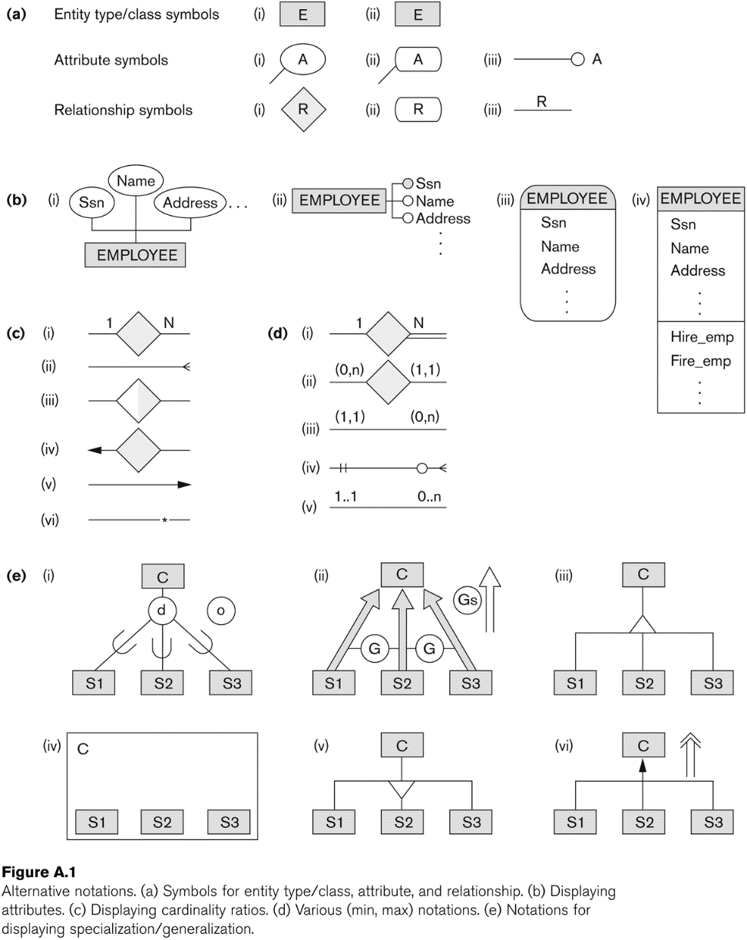
Alternative Diagrammatic Notations

Slide 56
Aggregation in EER
Stores information about interviews by job applicants to various companies.
The relationship attributes Contact_name and Contact_phone represent the name and phone number of the person in the company who is responsible for the interview
Suppose that some interviews result in job offers, whereas others do not.

Slide 57
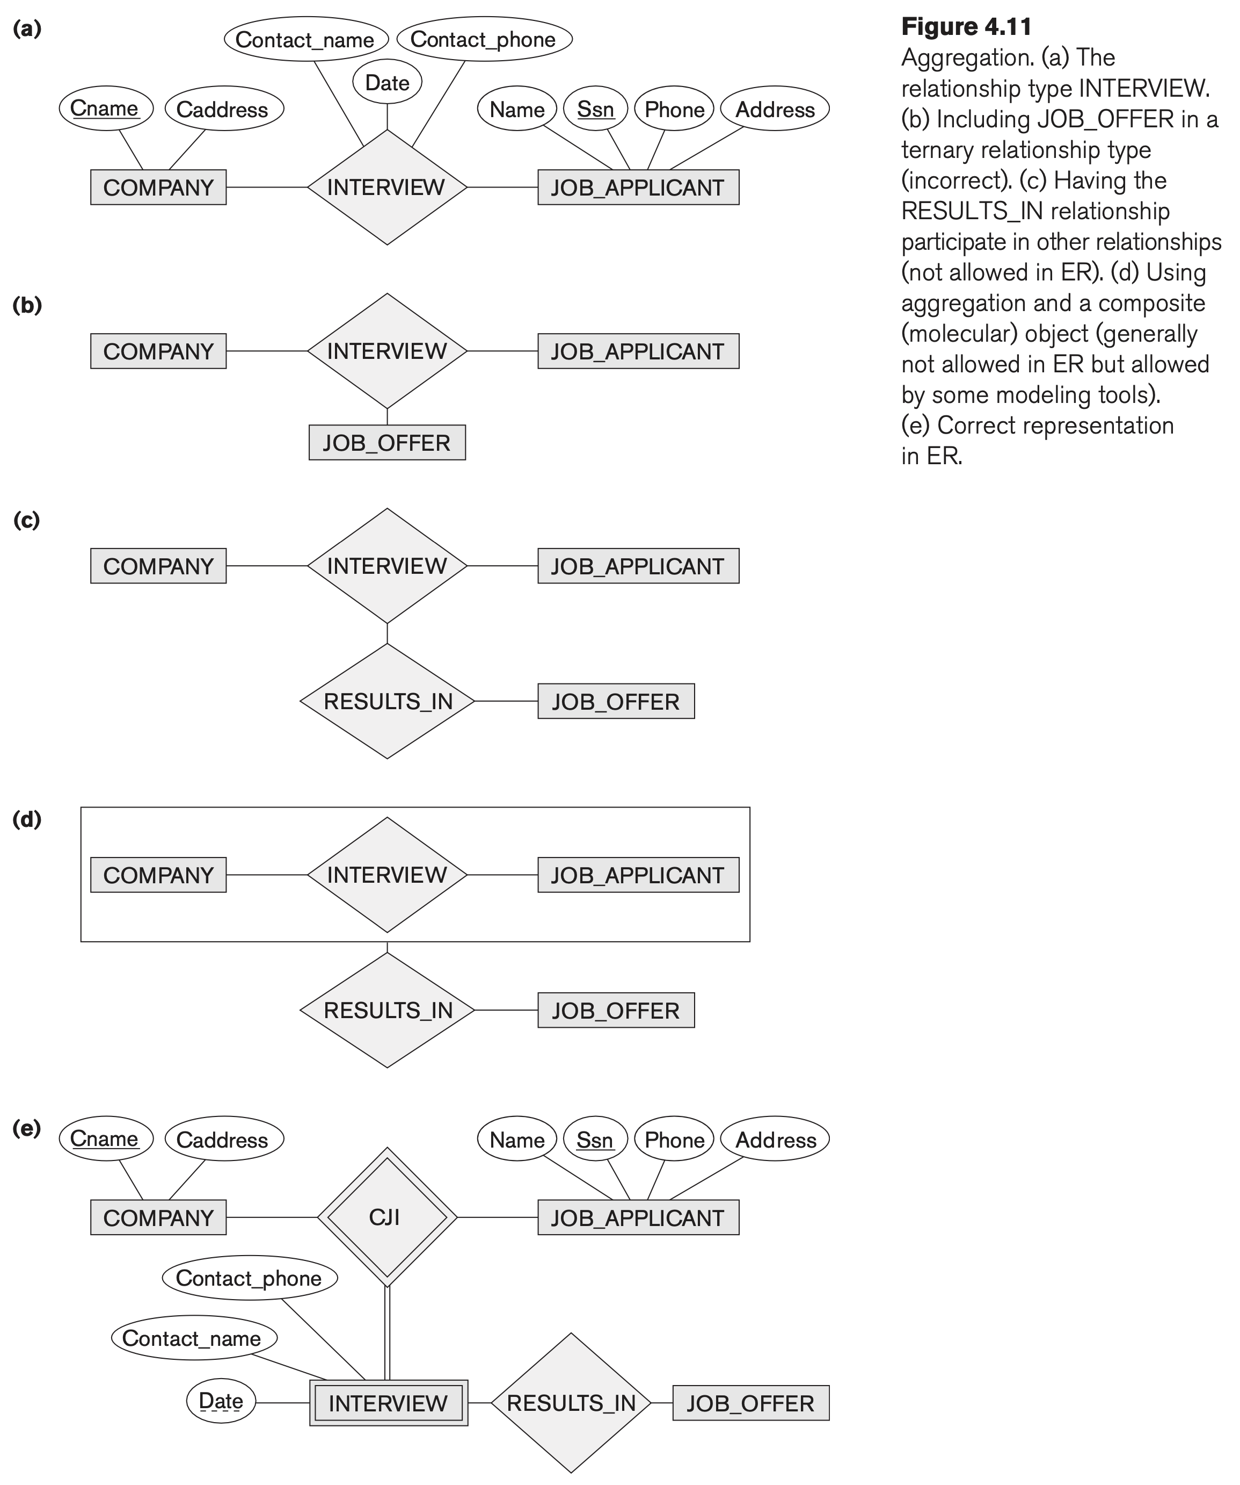
Composite single object but not allowed by many tools

Slide 58
Summary
Introduced the EER model concepts
Class/subclass relationships
Specialization and generalization
Inheritance
Constraints on EER schemas
These augment the basic ER model concepts introduced in Chapter 3
EER diagrams and alternative notations were presented
Knowledge Representation and Ontologies were introduced and compared with Data Modeling

